Slide 1
What’s Transfer Got to Do With It? Curriculum Development for Transfer
Notes:
Erik

Slide 2
Are you thinking of developing a new course? Let’s discuss the nexus of transfer agreements and articulation in the development of curriculum to support transfer. How can we work together and use transfer tools to maximize and streamline support for transfer? Come hear how to add value to your courses for transfer appeal.
Notes:
Poll: (click all that apply)
AOs
Faculty/Instructional
Faculty/Counseling
Administrators
Classified Support
Student
Trustees/Governing Board

Slide 3
What Will
Be Covered
Curriculum Development for Transfer
Fact From Fiction
Effective Practices
Q&A
Notes:
Michelle
By the end of today, you will hopefully understand the myths, get some grounding of the definitions and tools, and effective practices in developing curriculum that supports student transfer.

Slide 4
Michelle Velasquez Bean
ASCCC Treasurer, Professor of English, Rio Hondo College

Slide 5
Julie Clark
Articulation Officer, Professor of Mathematics, Merced College

Slide 6
Mark Edward Osea
Articulation Officer and Transfer Counselor, Mendocino College

Slide 7
Bob Quinn
Educational Services and Support Specialist, CCCCO

Slide 8
Framing Our Why
Curriculum Development for Transfer
Notes:
Michelle

Slide 9
Curriculum is the Foundational Building Block to Achieve
Quality, Quantity, and Scope of Learning
Equitable Learning Opportunities
Skills and Competencies Development for Employment
Leadership Development
Notes:
Michelle
TRANSFER--changes family trees! Can set a student on a new trajectory.
Curriculum and transfer practices have the opportunity to empower through representation.
MIRRORS not windows!
Opportunity--not barriers!
Ask ourselves: Are our foundations based on equity? Do our processes in developing courses and curriculum empower and support academic agency?

Slide 10
Agency, Personal Empowerment, and Connection to Histories
Programmatic, Departmental, and Institutional Identity and Direction
Transfer to Four-year Universities
Notes:
Michelle
TRANSFER--changes family trees! Can set a student on a new trajectory.
Curriculum and transfer practices have the opportunity to empower through representation.
MIRRORS not windows!
Opportunity--not barriers!
Ask ourselves: Are our foundations based on equity? Do our processes in developing courses and curriculum empower and support academic agency?

Slide 11
TRUE OR FALSE My student completed the ADT. They are guaranteed to be admitted to CPSLO.
Notes:
Mark and Julie

Slide 12
TRUE OR FALSE My student completed the ADT. They are guaranteed to be admitted to CPSLO.
Notes:
Mark and Julie

Slide 13
ADTs
Guarantees Admission to the CSU System
Notes:
Mark and Julie

Slide 14
Benefits of ADTs
Guaranteed Admission to 1 of 23 CSUs
Guaranteed Completion of Baccalaureate in 60 Semester Units
0.2 GPA Advantage at Program Impacted CSUs
0.1 GPA Advantage at Fully Impacted CSUs
ADT Must Be “Similar”
Notes:
Mark and Julie
ADT Must Be Deemed Similar

Slide 15
TRUE OR FALSE The IGETC is the UC GE Pattern.
Notes:
Mark and Julie

Slide 16
TRUE OR FALSE The IGETC is the UC GE Pattern.
Notes:
Mark and Julie

Slide 17
IGETC
The IGETC has a CSU and a UC version
Notes:
Mark

Slide 18
IGETC for UC
Requires Group 6 Language Other Than English
Does Not Require Group 1C Oral Communication
Notes:
Mark

Slide 19
IGETC for CSU
Does Not Require Group 6 Language Other Than English
Requires Group 1C Oral Communication
Notes:
Mark
Connect with your counselor or transfer counselor early and often.

Slide 20
TRUE OR FALSE I can add my new course as a required course in the ADT.
Notes:
Mark and Julie

Slide 21
MAYBE I can add my new course as a required course in the ADT.
Notes:
Mark and Julie

Slide 22
ADTs and TMCs
It all depends on the nature of the course.
Notes:
Mark and Julie

Slide 23
ADTs
Courses Can Only Be Added By One of the Following:
C-ID
AAM
GECC
BCT
Notes:
Mark and Julie

Slide 24
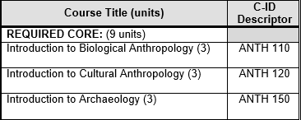
TMC
C-ID
Notes:
Mark and Julie

Slide 25
AAM
Articulation Agreement
by Major
Notes:
Mark and Julie

Slide 26
GECC
General Education Certification Course
Notes:
Mark and Julie

Slide 27
BCT
Baccalaureate Course
Notes:
Mark and Julie

Slide 28
TRUE OR FALSE Students need to complete all the courses for their major on ASSIST prior to transfer.
Notes:
Mark and Julie

Slide 29
MAYBE Students need to complete all the courses for their major on ASSIST prior to transfer.
Notes:
Mark and Julie

Slide 30
ASSIST
It all depends on the fine print of the agreement.

Slide 31
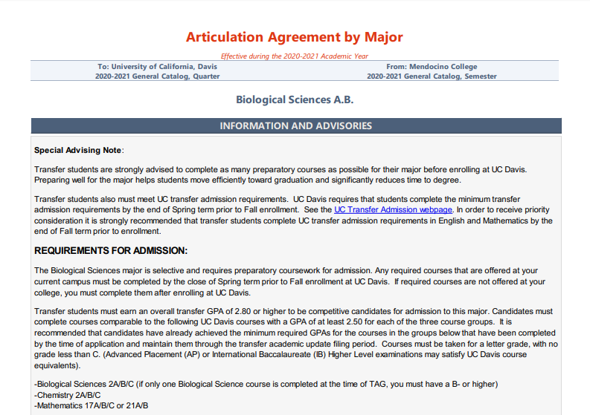

Slide 32
Scenario Calculus-Based Statistics
Notes:
Erik

Slide 33
The Role of the AO
The Consultant
Notes:
Mark

Slide 34
The Role of
the AO
Maintain ASSIST
Propose and Obtain Articulation
Represent the College
as a Liaison
Inform Stakeholders about Curriculum

Slide 35
Consult with Faculty About Curriculum
Develop or Revise Curriculum with Faculty
Understand Emerging Policies, Initiatives and Legislation Impacting Transfer
Notes:
CS

Slide 36
The Role of Instructional
Curriculum Developers
Notes:
Mark

Slide 37
The Role of Instructional
Use C-ID Descriptors and ASSIST to Guide Course Development
Use TMC to Guide ADT Development
Work With AO
Consult with Administration
Notes:
Estela

Slide 38
The Role of the Analyst
Ensures Compliance
Notes:
Bob

Slide 39
The Role of the Analyst
Tech Resource for Faculty/Admin
Ensure compliance to State & Rule
Curriculum Database & Catalog
Notes:
Bob

Slide 40
Questions
Thoughts or Concerns?
Notes:
Michelle

Slide 41
Resources ASCCC Paper on Transfer Guiding Notes for General Education Course Review Templates for TMCs C-ID ASSIST
Notes:
Michelle

Slide 42
THANK YOU! info@asccc.org
Notes:
Michelle

