Slide 1
Career and Noncredit Education Institute
Welcome!
John Stanskas,Vice President
Ginni May, Noncredit Committee Chair, Area A Representative
Cheryl Aschenbach, CTE Leadership Committee Chair, North Area Representative

Slide 2
Acknowledgements…
CTE Leadership Committee
Brandi Asmus, Woodland Community College
Marie Boyd, Chaffey College
Marne Foster, San Diego Continuing Education
Don Hopkins, Folsom Lake College
Jorge Ochoa, Long Beach City College
Noncredit Committee
Randy Beach, ASCCC South Representative
Donna Necke, Mt. San Antonio College
Bernie Rodriguez, San Diego Continuing Education
Jan Young, ACCE, Glendale College

Slide 3
Acknowledgements…
ASCCC Staff
Krystinne Mica, Chief Operating Officer
Tonya Davis, Administrative Director
Kiana Traylor, Administrative Associate
Erika Prasad, Communication and Development Director
Rita Sabler, Creative Director
Kyoko Hatano, Administrative Assistant
ASCCC Executive Committee
Julie Bruno, ASCCC President
Dolores Davison, ASCCC Secretary
Craig Rutan, ASCCC Area D Representative
Colleagues from
ACCE – Association of Community and Continuing Education
3CSN – California Community College Success Network

Slide 4
Information and Highlights
Addendum to Program, Wifi in lobby
Breakouts organized by strands – some are overlapping:
A = CTE,
B = Noncredit,
C = Counseling & Student Services,
D = Adult Ed/AEBG,
E = Improving Instructional Practices
Poster Session and Social this evening – 5:30-7:00 Mesa Verde
Fireside Chat with John Stanskas tomorrow evening – 7:00-8:00 Mesa Verde
Saturday:
Begins with a General Session
Closes with Breakout Sessions that end at 11:30

Slide 5
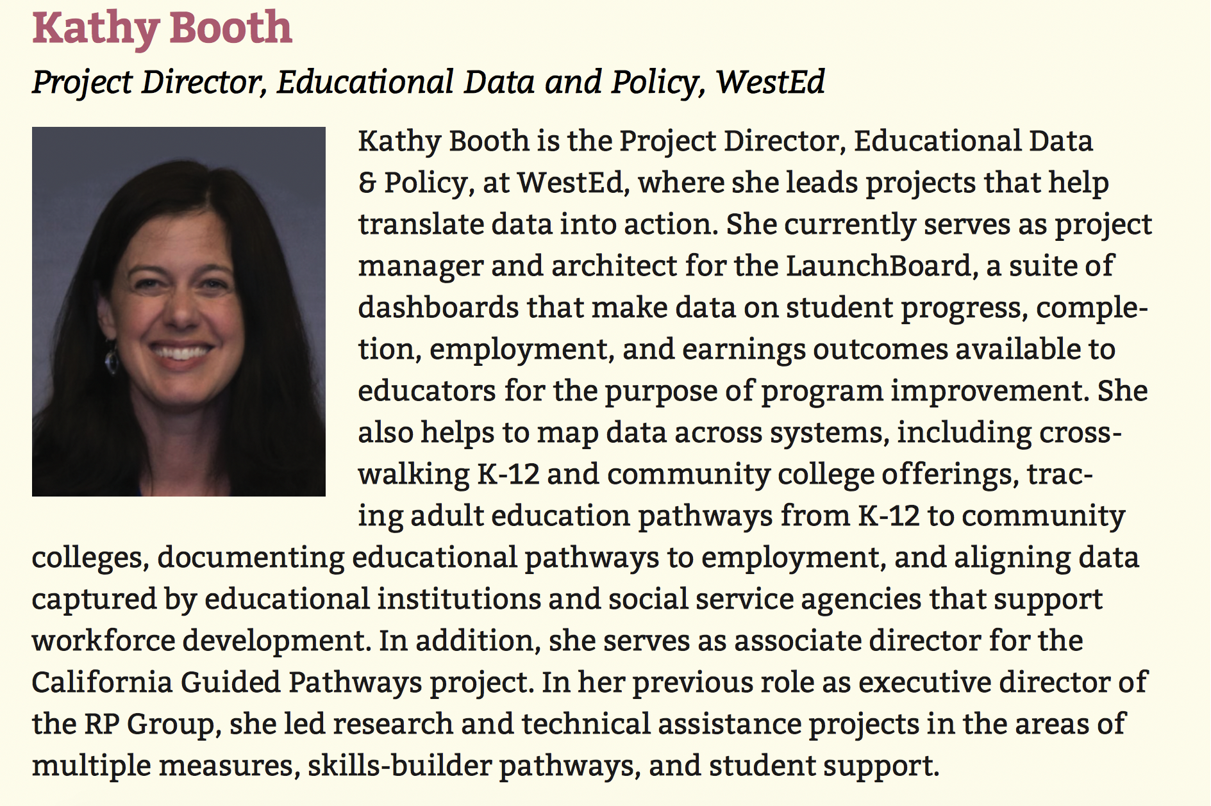

Slide 6
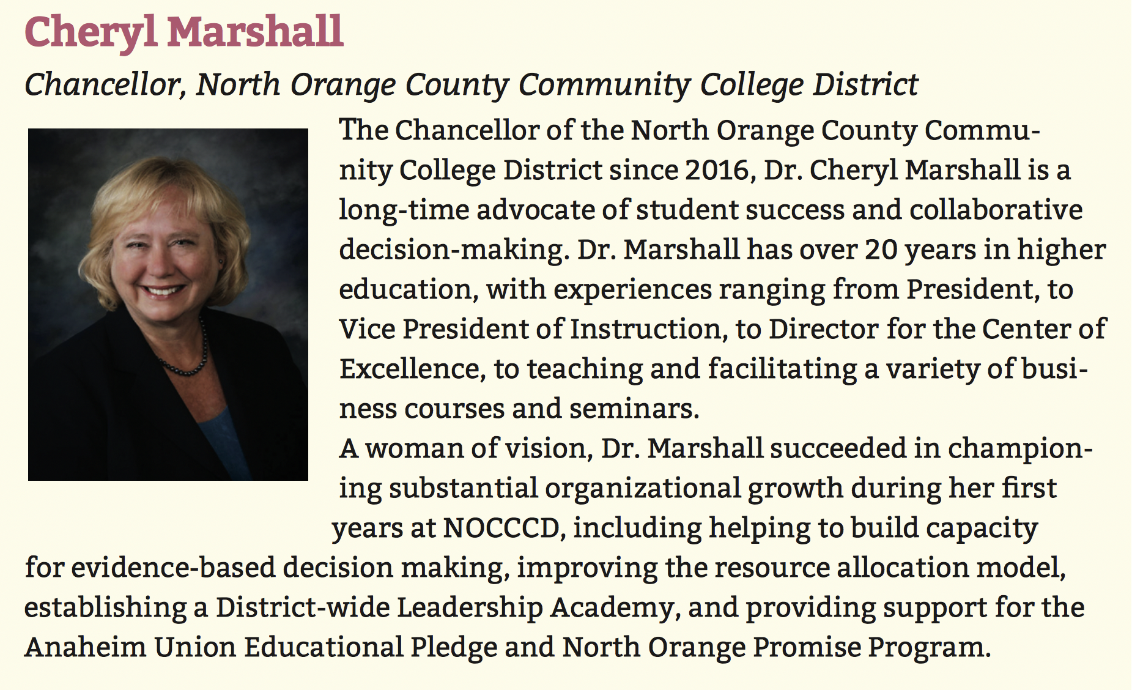

Slide 7
About this Event…

