Slide 1
Modeling Equity-Infused Teaching w/ Equity-Infused Professional Learning w/
MOST
Katie Palacios
Instructional Designer
San Diego Mesa College

Slide 2
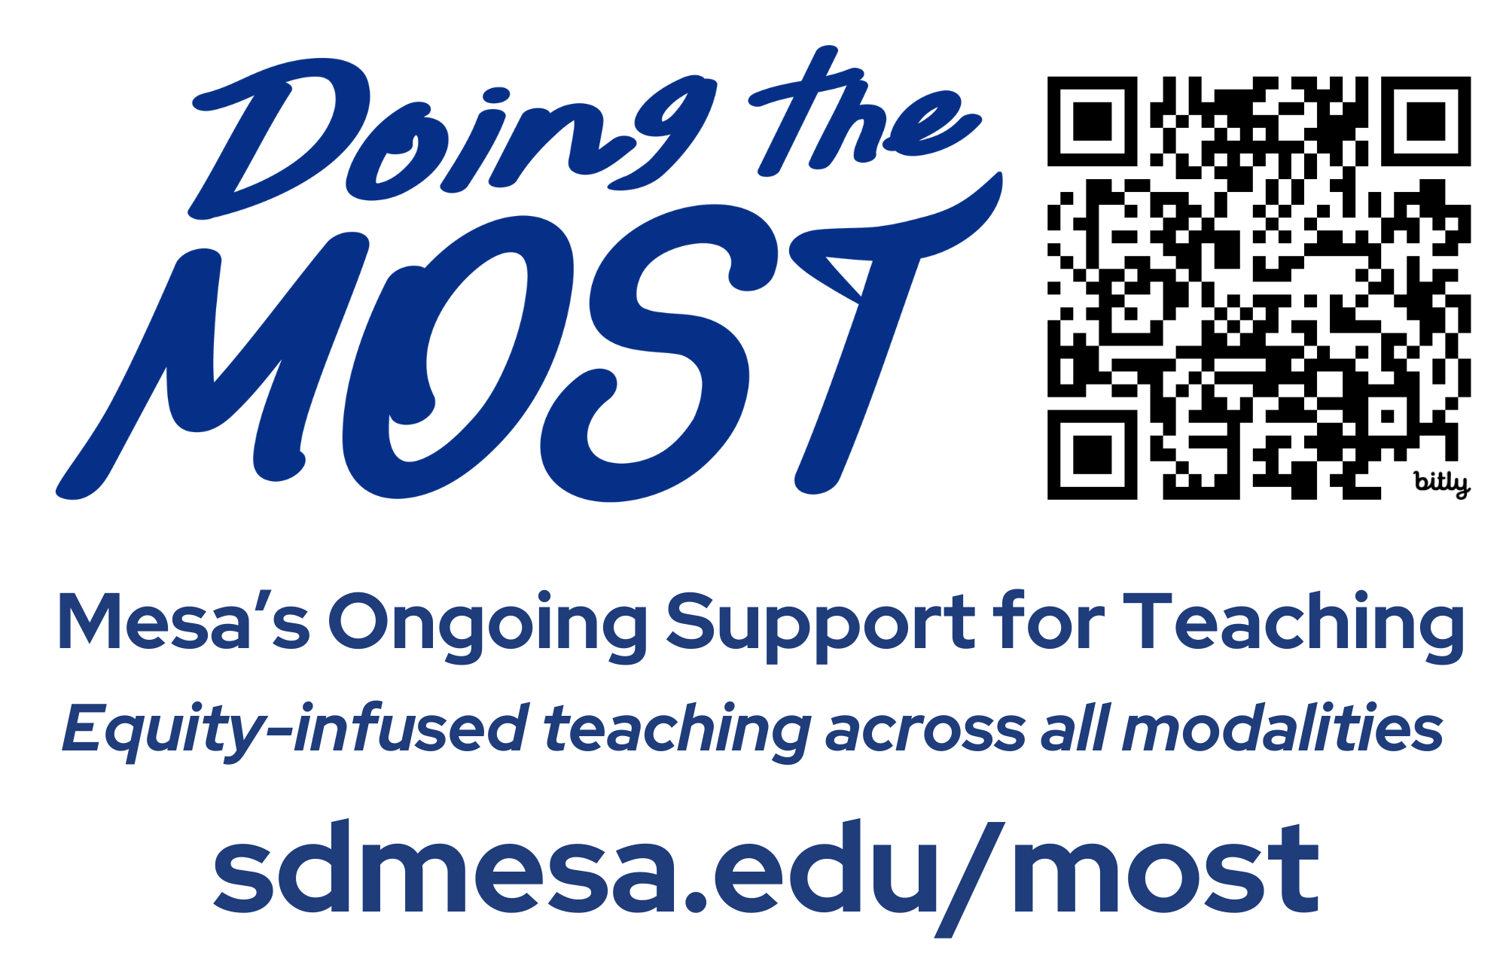
Doing the MOST

Slide 3
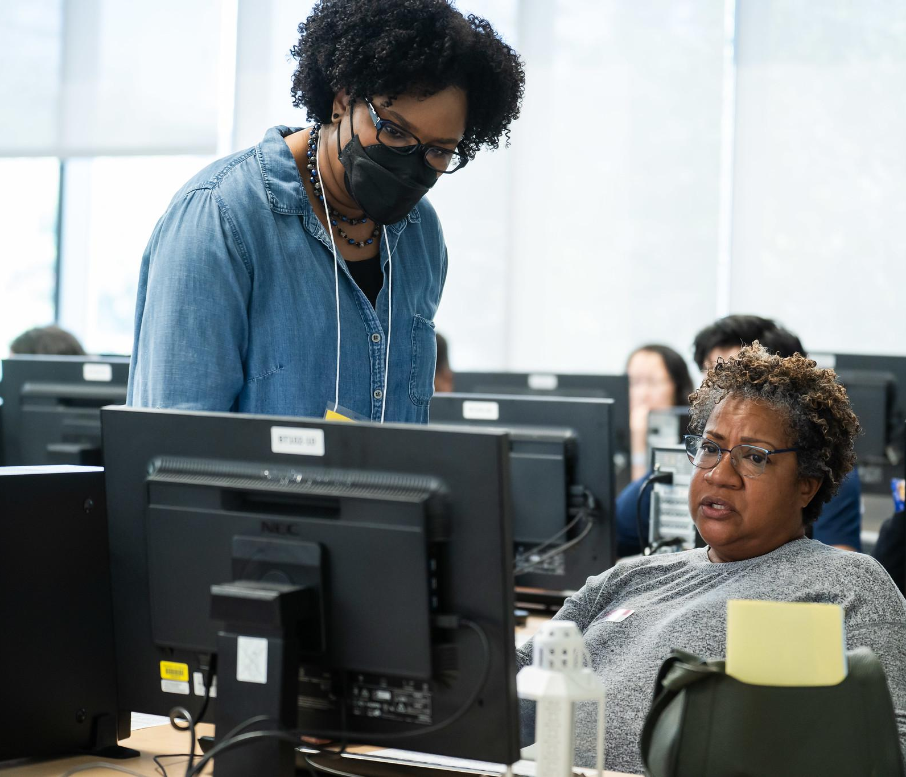
Principles
Access
Community
Intentionality
Investment in People
Teaching as a Praxis

Slide 4
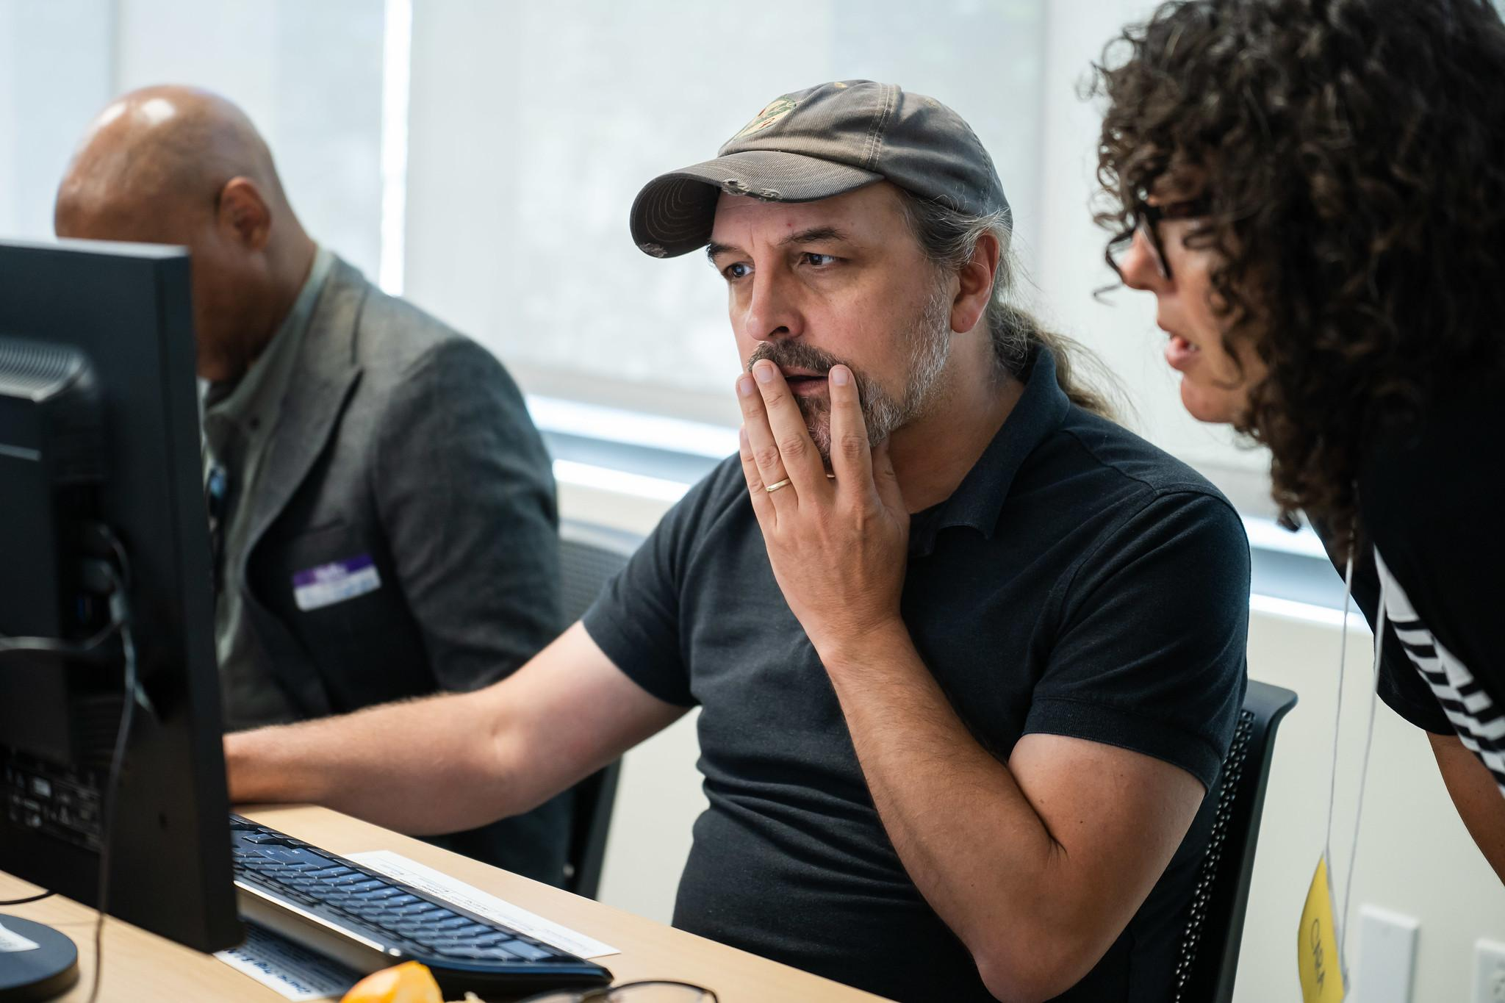
Who is on the team?
A network of 9 faculty from across the college, including one instructional designer

Slide 5
MOST Projects
OnRamp to Online Preparing Mesa students for online learning success.
Course Design Cohorts Facilitated asynchronous courses that put Mesa faculty in the shoes of online students.
Coaching Friendly one-on-one support from Mesa online faculty. ⭐bit.ly/mostcoaching
Workshops & Webinars Synchronous opportunities for MOST coaches to connect in already well-established professional learning offerings at Mesa
Toolkit Templates & support to design your online courses aligned to the CVC & Peralta rubrics.⭐ bit.ly/mosttoolkit

Slide 6
Today’s Focus
OnRamp to Online Preparing Mesa students for online learning success.
Course Design Cohorts Facilitated asynchronous courses that put Mesa faculty in the shoes of online students.
Coaching Friendly one-on-one support from Mesa online faculty. ⭐bit.ly/mostcoaching
Workshops & Webinars Synchronous opportunities for MOST coaches to connect in already well-established professional learning offerings at Mesa
Toolkit Templates & support to design your online courses aligned to the CVC & Peralta rubrics.⭐ bit.ly/mosttoolkit

Slide 7
Online Course Design Cohorts
 |  | CVC-OEI & Peralta Equity Rubric Sections | Spr ‘22 | Fall ‘22 | Spr ‘23 | Su ‘23 | Fall ‘23 | Spr ‘24 | Su ‘24
Refresh | Creating inclusive learning spaces that use backwards design & culturally responsive teaching. | Section A, B, C, D, E
Include | Creating accessible, inclusive, and approachable course content & structures. | Section A, D, E
Assess | Exploring, discussing, & experiencing equitable assessment practices. | Section C, E
Humanize | Creating the human connections online that foster learner interaction and success. | Section A, B, E
CEER | Course Equity & Excellence Redesign | On Campus classes

Slide 8
Cohort Details
Facilitated asynchronous courses that put Mesa faculty in the shoes of online students.
any faculty member can participate in a cohort
4-week, asynchronous, ~2 hours/week
typically weeks 4 - 8 of semester
2 faculty facilitators
participants choose between 🎓 credits for salary advancement or 💵 for finishing cohort

Slide 9
Our Philosophy
model good design, humanized facilitation & non-traditional grading
feedback over grades
content is equity-infused
create spaces for faculty to be experts & learners
project-based assessments
folks get compensated for their time

Slide 10
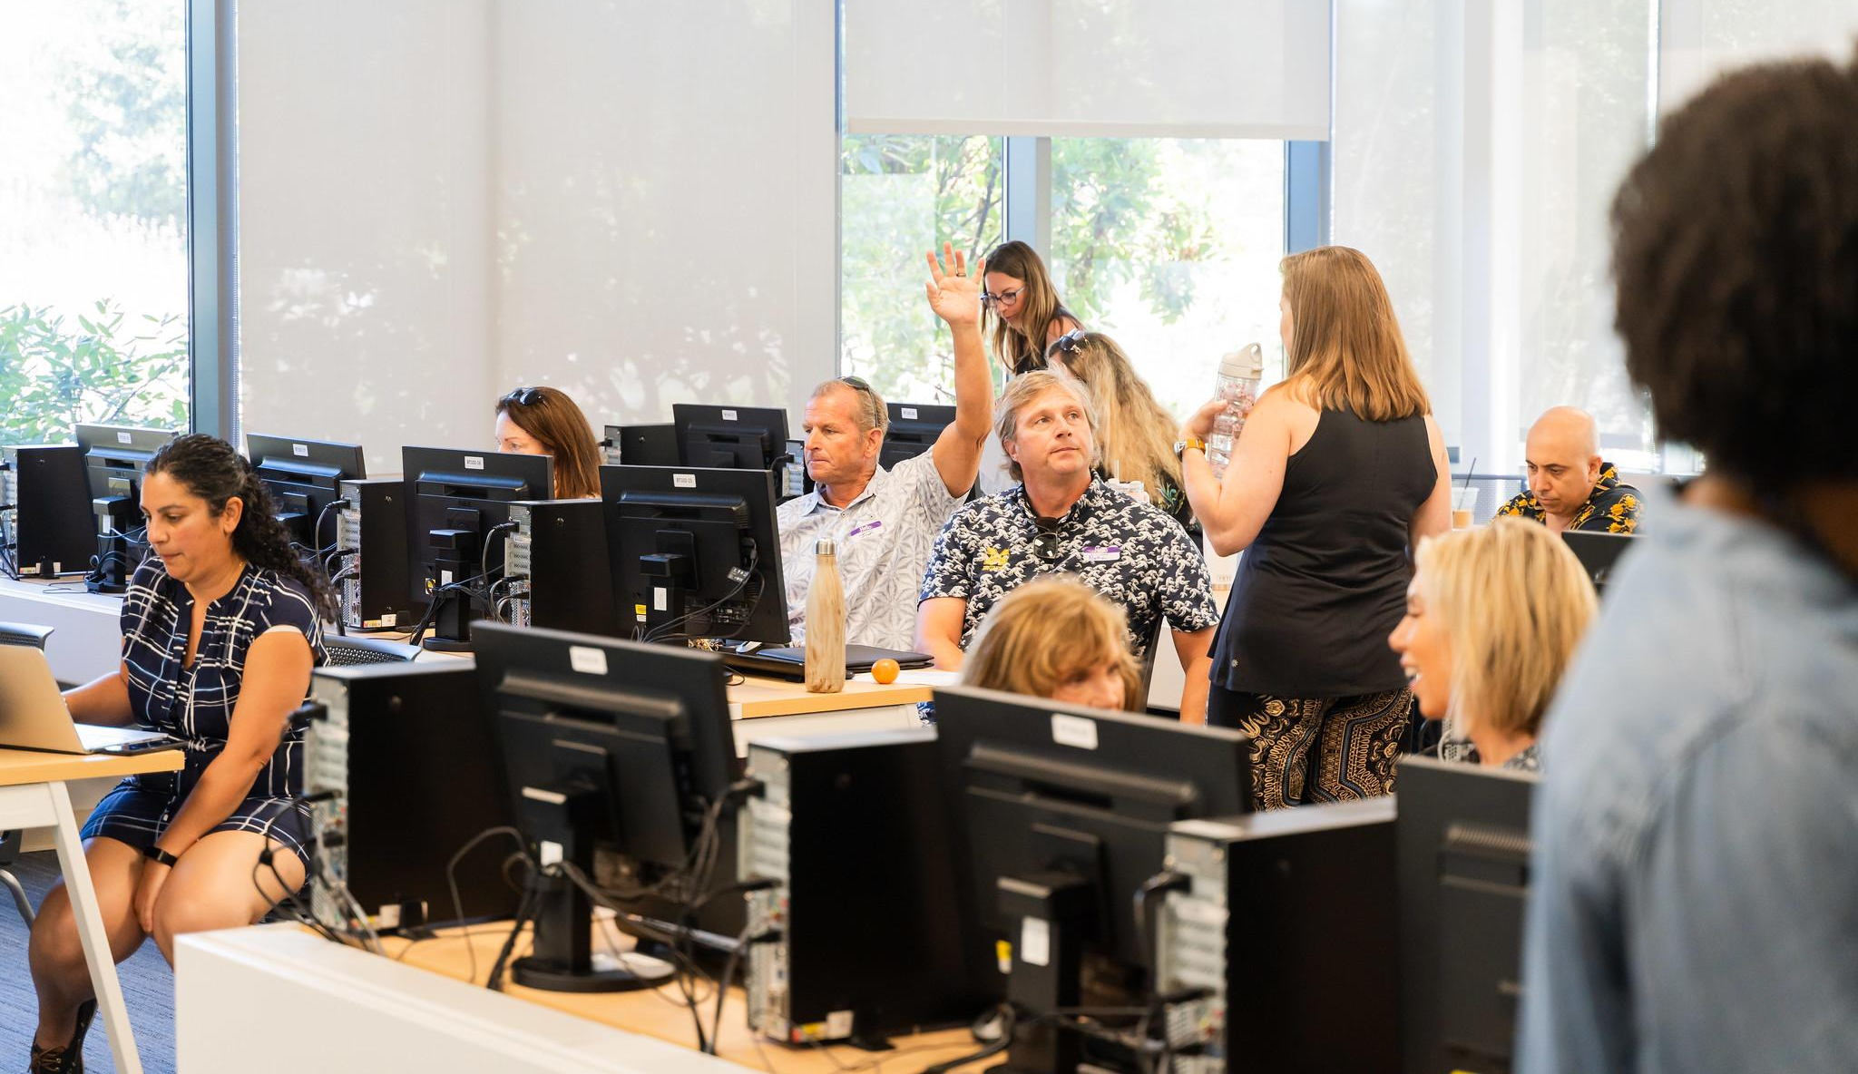
Grading Philosophy
We are here to try new things and learn together. You will be given clear instructions and a rubric for each of the assignments in this course. The rubric and submission comments will be used to provide feedback to you. You can generally expect feedback within 2-3 business days from when you turn in work.

Slide 11
Due Dates
Due dates for each week’s assignments have been set in Canvas.
If you submit an assignment late, there won’t be any penalty. Kudos to you for catching up.
If a week goes by without submitting anything, it will be difficult to catch up and complete on time. Reach out to a course facilitator to see what options are available to you.

Slide 12
Cohort Numbers
Facilitated asynchronous courses that put Mesa faculty in the shoes of online students.
24
Refresh22 completions
19
Include completions
17
Assess completions
16
Foothill’s Humanizing Online STEM Academy
21
Humanize completions
47
Refresh23 completions

Slide 13
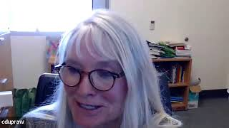
Cohort Share Outs - Prof. Christy Dupraw

Slide 14
Cohort Feedback

Slide 15
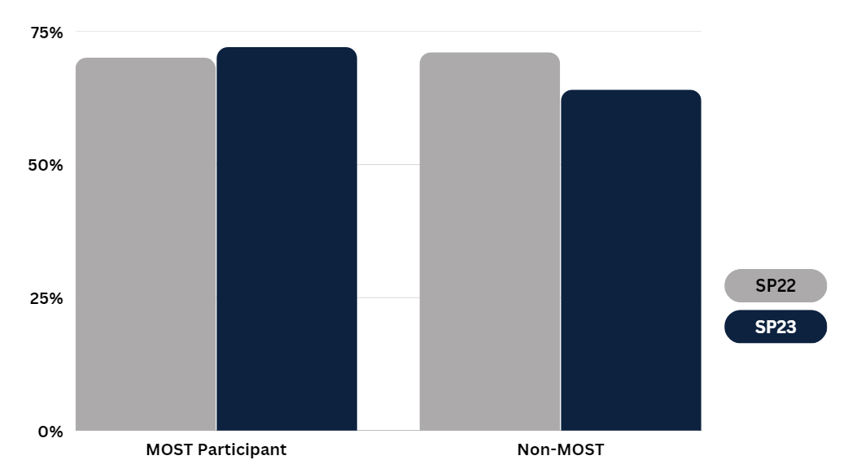
MOST Cohort Impact on Success
Course Success Rates - Pre and Post PL Cohort in Fall 2022

