Slide 1
The California Online Community College: 115 Problems but an Academic Senate Ain’t One
Geoffrey Dyer, Online Education Committee Chair Julie Oliver, Online Education Committee Craig Rutan, ASCCC Secretary

Slide 2
Session Objectives
Provide update on status and objectives of California Online Community College (COCC)
Present purpose and objectives of budgeted, competitive, one-time CVC-OEI grants to support COCC
Discuss system-wide implications of above
Review proposed resolution 1.01 F18
Notes:
Julie

Slide 3
California Online Community College
Directed by budget to have at least three programs developed by July 1, 2019, and begin enrolling students by the end of 2019.
Will use competency-based education (CBE).
Board of Trustees for COCC is Board of Governors.
$35 million in current budget for one-time, competitive CVC-OEI grants for existing districts, related to COCC.
COCC expected to work to hire CEO soon.
Where’s the academic senate?
Notes:
Julie

Slide 4
COCC—History
Spring of 2017—Gov. Brown asks Chancellor Oakley for options for an online college
Flexible Learning Options for Workers (FLOW) Workgroup assembled
ASCCC Resolution 9.02 F17 “Expand System-wide Online Educational Opportunities” adopted
Nov. 2017—National Center for Higher Education Management Systems (NCHEMS), with assistance from FLOW, produces Report on Options for an Online, Statewide Community College
ASCCC Resolution 6.02 S18 “Opposition to the Proposed California Online Community College District” adopted by acclamation
Jun. 2018—Budget signed, creating COCC
Notes:
Julie

Slide 5
Revised & New Ed Code (COCC)
Higher Education Trailer Bill (AB 1809, Committee on Budget) amended the following sections of Ed Code relevant to the COCC:
§ 70900 delegates responsibilities to COCC
§ 70901 (f)(1) BoG shall administer COCC
It also added part 46.5—the California Online Community College Act (§ § 75000-75012)

Slide 6
Purpose of COCC
Ed Code § 75001(a)(3) ”The California Online Community College shall fulfill the purposes of this part, which includes the creation of an organized system of accessible, flexible, and high-quality online content, courses, and programs focused on providing industry-valued credentials compatible with the vocational and educational needs of Californians who are not currently accessing higher education. These courses and programs shall lead to a pathway offered at a traditional community college”

Slide 7
Guiding Principles of COCC
Ed Code § 75001(b)(1-8):
(1) Offering working adults additional access to affordable, quality higher education opportunities with labor market value, especially industry-valued credentials based on competencies leading to employment, earnings gain, or upward mobility in the workplace, and not just courses leading to degrees and certificates.
(2) Providing working adults with the necessary conditions for success with flexible course scheduling, start and stop-off times, technology-enabled support communities to deepen engagement and foster social belonging, and short-term credentials as demonstrations of academic progress.

Slide 8
Guiding Principles of COCC
Ed Code § 75001(b)(1-8):
(3) Supporting student success by developing and implementing innovative teaching and student support methodologies and technologies, including leveraging student data to improve teaching and learning and to support individual student progression, providing quality onboarding of students to support their career exploration, goal-setting, educational planning, and support needs, and leveraging relevant technology resources where possible.
(4) Enhancing systemwide student success efforts by using the college’s innovative teaching and student support methodologies and technologies to inform professional development opportunities available to the rest of the community college system.

Slide 9
Guiding Principles of COCC
Ed Code § 75001(b)(1-8):
(5) Ensuring faculty roles are based on the skills needs of the college, such as online instructors, course developers, assessment developers, student mentors, reviewers, and 24-hour virtual classroom support, and ensuring flexible hiring processes that emphasize use of part-time and full-time faculty with field expertise to support emerging programs and shifts in labor market demand.
(6) Addressing barriers faced by working adult students to access higher education, including, but not necessarily limited to, financial aid support, dealing with working learners’ prior educational debts that may impede release of transcripts and credits, pathway navigational help, contextualized academic preparation, navigation of family needs and other supports, and coaching and mentoring.

Slide 10
Guiding Principles of COCC
Ed Code § 75001(b)(1-8):
(7) Aligning the college’s efforts with the broader goals outlined in the California Community Colleges system’s Vision for Success, or other strategic visions outlined by the board of governors, and holding the college accountable for its students’ outcomes and ensuring improved data collection on employment outcomes.
(8) Offering working adults additional access to affordable, high-quality higher education opportunities with labor market value that lead to additional educational opportunities provided by either the California Online Community College or by another California community college.

Slide 11
COCC—CBE
§ 75001(d)(2)(A) ”Establish competency-based educational opportunities that recognize students’ prior learning and help students advance toward a credential. Competencies shall be established with the advice of appropriate faculty and employers, and shall be focused on knowledge and skills a student must demonstrate to pass a course and to earn a credential. Examples of prior learning include prior military service, registered apprenticeship training, industry-recognized certifications, or experience from other careers. Assessments shall be developed to enable students to demonstrate mastery and shall be mapped to the competencies.”
Notes:
Julie

Slide 12
Noncredit, CDCP, and CBE
§ 75012. (a) The chancellor’s office shall conduct a review of the process used to calculate noncredit and career development college preparation rates, and make recommendations to the board of governors on or before January 1, 2019, on how that process may be modified to encourage the use and development of competency-based courses and programs.
(b) The chancellor’s office shall conduct a review of the statewide approval process to offer online courses under a flexible calendar, and make recommendations to the board of governors on or before January 1, 2019.
Notes:
Julie

Slide 13
COCC—Academic Programs
Budget Summary lists information technology and medical coding as two of the three programs to be developed by July 1
Chancellor’s Office FAQ states “The Chancellor’s Office is exploring potential programs in several areas, including advanced manufacturing, healthcare, the service sector, in-home support services, and child development.”
What roles do academic senates typically play in program development?
Notes:
Julie

Slide 14
COCC—Governance
COCC is its own district
The COCC Board of Trustees is the CCC BoG
Executive Committee of eight members created
Efforts to launch search for CEO
Notes:
Julie

Slide 15
The BoG Shall . . .
§ 75003(b)(7) ”Establish procedures that are consistent with minimum standards otherwise established by the board of governors to . . . ensure the right of the college’s academic senate to make recommendations in the areas of curriculum and academic standards. The California Online Community College may establish procedures enabling the use of a digital format, or formats.”
Before, or after the development of programs and CBE?
Notes:
Julie

Slide 16
Relationship to CVC-OEI (the COCC shall . . .)
§ 75001 (d)(3)(B) ”Utilize the Online Education Initiative’s existing social and technological infrastructure for students, instructors, and administrators, including all of the following:
(i) Contribute to the Initiative’s common course management platform for online content and classes.
(ii) Utilize and develop comprehensive, specialized student supports that are technology-enabled for scale and focused on the student experience, including, but not limited to, pathway navigation, online tutoring, online mentoring, and online help desk support. These supports, as well as the instructional delivery, shall be made available during nontraditional working hours to promote student success for the focus population.

Slide 17
Relationship to CVC-OEI (the COCC shall . . .)
§ 75001 (d)(3)(B) ”Utilize the Online Education Initiative’s existing social and technological infrastructure for students, instructors, and administrators, including all of the following: . . .
(iii) Leverage free or low-cost, high-quality online educational materials for students through Open Educational Resources and the Zero-Textbook-Cost Degree Grant. The college shall ensure any open educational resources that are developed are available for use by any California community college through the system’s common learning management platform.
(iv) Enhance systemwide student success efforts by using the College’s innovative teaching and student support methodologies and technologies to inform professional development opportunities available to the rest of the system through the Online Education Initiative and the Institutional Effectiveness Partnership Initiative.”

Slide 18
Relationship to CVC-OEI
§ 75001(f)(2)(G) ”Upon the establishment of an Academic Senate for the California Online Community College, the faculty shall review the Online Education Initiative Protocols for online content and adopt as appropriate.”

Slide 19
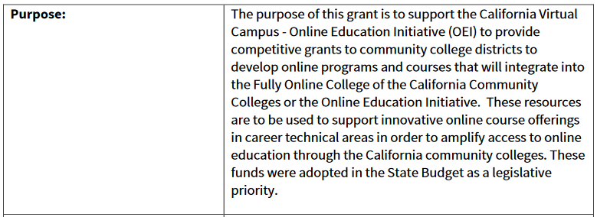
$35M in Grant Funding for Existing Colleges
In Enacted California Budget
Reviewed and approved by BoG in Sep:

Slide 20
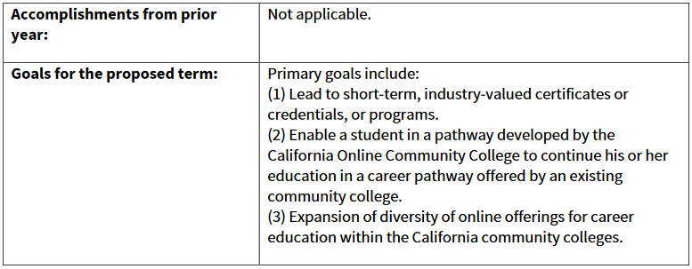
$35M in Grant Funding for Existing Colleges
Reviewed and approved by BoG in Sep:

Slide 21
System-wide Implications
What conclusions can we draw from the new Education Code sections and the new grants?
Why would an academic senate be important in the governance of the newly established college?
Is time of the essence?
Notes:
Craig

Slide 22
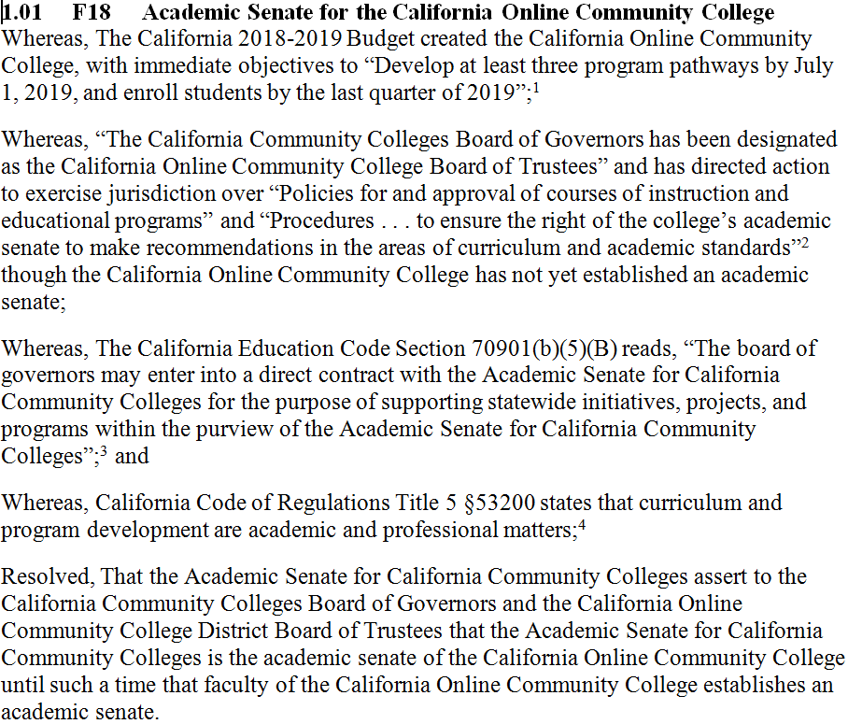
Notes:
Julie

Slide 23
Resources
California Community Colleges. Online College. Frequently Asked Questions.
California Community Colleges. Online Community College
California Community Colleges. California Online Community College District
The California Online Community College Act

