Slide 1
Guided Pathways
Marie Boyd, Chaffey College
Ginni May, Area A Representative, Guided Pathways Task Force
Career and Noncredit Education Institute
May 3, 2018, Westin South Coast Plaza

Slide 2
Today’s Hot Topics
Guided Pathways – A Little Background
Overview of Guided Pathways Award Program
Recap of Chancellor’s Office activities
Role of the Academic Senate
Challenges and Opportunities

Slide 3
REMEMBER…
…this all about the student success!

Slide 4
Guided Pathways – A Little Background
Obama clip

Slide 5
Guided Pathways – A Little Background
2009 Obama’s American Graduation Initiative press conference – 5 million more community college graduates and certificates by 2020
2010 President Obama and Dr. Jill Biden speak to the first-ever Community College Summit about the role community colleges play in developing America's workforce and furthering education
Completion By Design
Aspen Prize for Community College Excellence
Joyce Foundation
Lumina Foundation
Bank of America
JP Morgan chase
Notes:
PUBLIC PRIVATE PARTNERSHIPS STRENGTHENING COMMUNITY COLLEGES
In response to the President’s leadership and in recognition of the central role community
colleges will play in preparing the American workforce to compete in the 21st century economy,
foundations and educational organizations are increasingly investing in research and programs to
strengthen these critical institutions. The Obama Administration is pleased to highlight three
new such commitments at the White House Summit on Community Colleges. https://obamawhitehouse.archives.gov/sites/default/files/uploads/White-House-Summit-on-Community-Colleges-Fact-Sheet-100510.pdf

Slide 6
Guided Pathways – A Little Background
American Association of Community Colleges :
“Building a Nation of Learners by Advancing America’s Community Colleges”
Summer 2011 AACC launched the 21st Century Initiative:
21st Century Center Blog
Advanced Technological Education
Diversity, Inclusion, and Equity
International Programs
AACC Pathways Project
Voluntary Framework of Accountability
Workforce and Economic Development
Notes:
AACC: Primary advocacy organization for the nation’s community colleges. Founded in 1920 (linked IN)
Grounded in the enduring commitment of community colleges to improving the lives of students through opportunity and excellence,
Overall goal of the 21st Century Initiative was to educate an additional 5 million students with degrees, certificates, or other credentials by 2020.
1,300 stakeholders in 10 regions of the country--students, college faculty and staff, administrators, trustees, state policymakers, and college presidents and chancellors.
Reclaiming the American Dream had 5 parts: The Imperiled Dream; Education and National Progress; Redesigning the Community College; Essential Elements in Institutional Transformation; recommendations for reimagining the Community College – The Three Rs (Redesign, reinvent and reset)

Slide 7
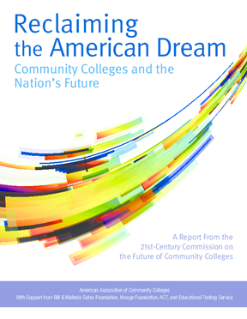
Guided Pathways – A Little Background
The 21st Century Initiative was guided by the work of the 21st Century Commission on the Future of Community Colleges
2012 Commission published Reclaiming the American Dream: Community Colleges and the Nation’s Future
AACC created Pathways Project – 30 colleges nationwide committed to redesigning their programs and support services at scale
AACC National Project includes three California colleges: Bakersfield College, Irvine Valley College, Mt. SAC and Santa Monica College joined later
Notes:
Early CCC adopters of the Guided Pathways Project included Bakersfield College, Irvine Valley College, and Mt. San Antonio College

Slide 8
National Model

Slide 9
AACC Guided Pathways – Bakersfield College Model
Notes:
ACC promotes increased access and success for the diverse community college population by securing federal and private support to colleges and providing opportunities, resources, and information related to persistence, retention, program completion, and transfer. AACC is committed to diversity in its policies, programs, and relationships, as well as in its efforts to build, maintain, and promote a culture of equity and inclusion.
Download the AACC/ACCT Joint Statement of Commitment to Equity, Diversity, and Excellence in Student Success and Leadership Development.

Slide 10
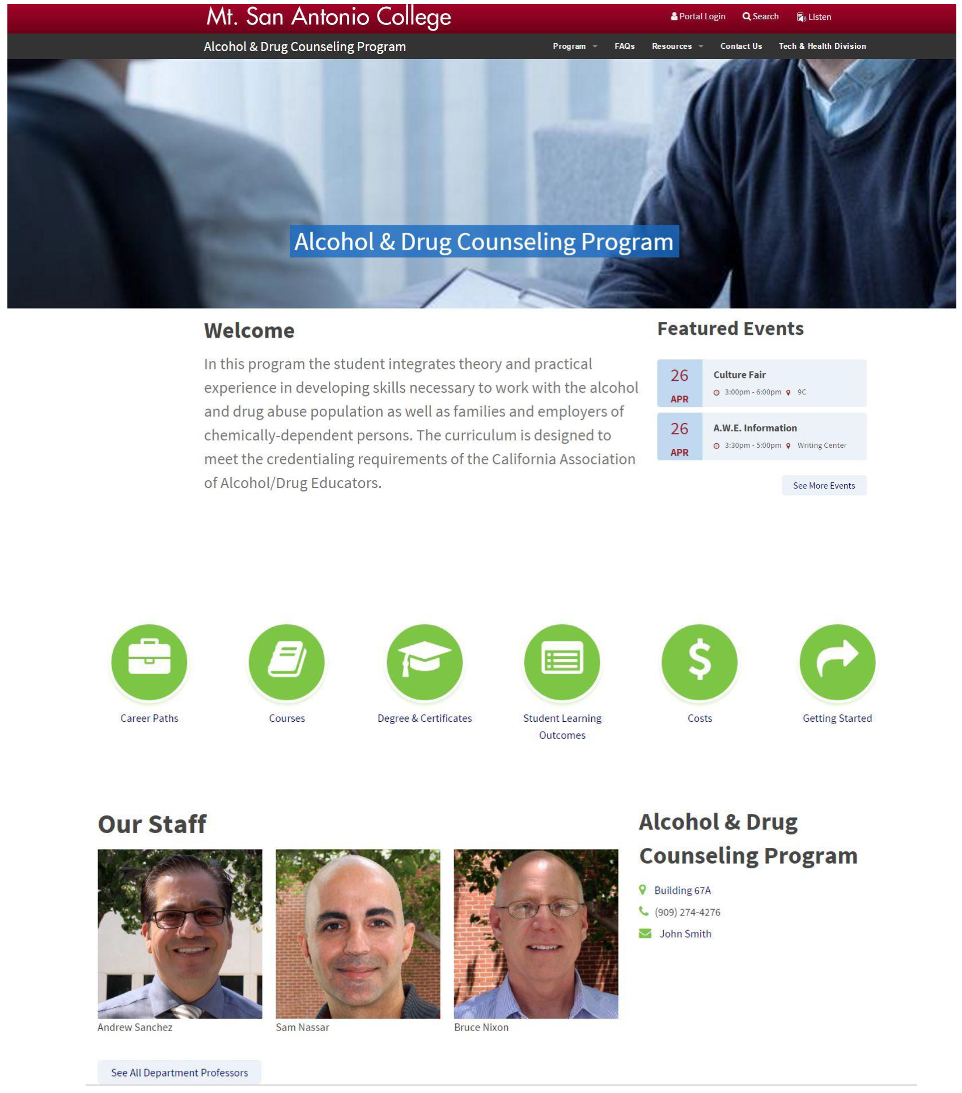
Example of Mt. SAC’s revised (find a CTE program) Website
AACC Guided Pathways Model – Mt. San Antonio College

Slide 11
Guided Pathways in California
AACC Pathways Project (3 + 1 colleges)
California Guided Pathways Project (20 colleges – pay to play)
California Guided Pathways Award Program (All 114 colleges - $150m)
Homegrown (2 colleges)

Slide 12
California Guided Pathways Project (20 colleges)
Facilitates 20 California community colleges implement an integrated, institution-wide approach to student success by creating structured educational experiences that support each student from point of entry to attainment of high-quality postsecondary credentials and careers
Built on an organizational learning model of six institutes, plus coaching
Under the fiscal agency of the Foundation for California Community Colleges, with support from College Futures Foundation, the Bill & Melinda Gates Foundation, and the Teagle Foundation
Guided by a broad-based advisory committee 2016-2017
Draws on the expertise of national partners, including the American Association of Community Colleges (AACC), Center for Community College Student Engagement (CCCSE), Community College Research Center (CCRC), National Center for Inquiry & Improvement (NCII), and WestEd
Participating colleges were announced April 17, 2017
Notes:
Geared to colleges that are ready to implement the guided pathways approach at scale within three years
Colleges needed to submit an application by February 28, 2017. Finalist colleges will participate in interviews during March 2017 and college selection will be announced on April 17, 2017.
Participants will send teams to six multi-day institutes between 2017-2019 and receive coaching to support the redesign process from state and national experts.

Slide 13
California Guided Pathways Award Program (114 colleges)
The $150 million are one-time funds allocated to colleges over 4 years to integrate recent state investments and redesign academic pathways
Chancellor’s Office and the Board of Governors will be responsible for statewide implementation of the $150 million allocation to all 114 California community colleges
Full details on the $150 million grant program should be known in late June when the state budget has been finalized

Slide 14
California Guided Pathways Award Program
Pre-existing Models:
CTE Programs
Sierra College
Skyline College

Slide 15
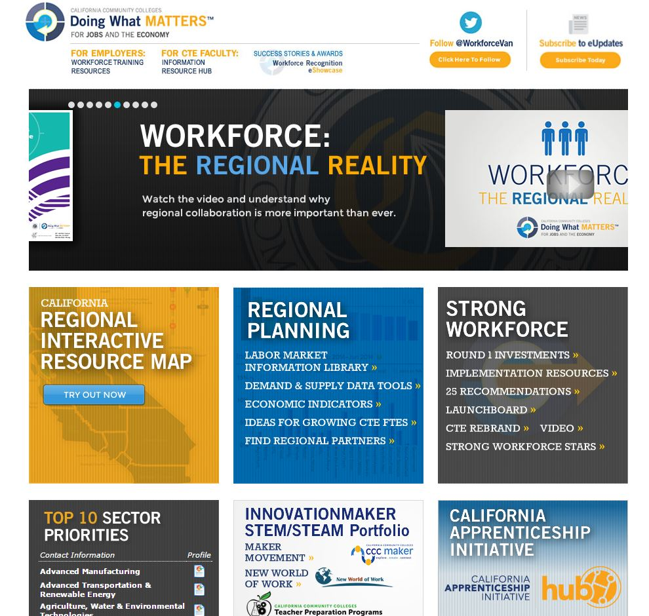
Guided Pathways and Strong Workforce
California Community Colleges Doing What Matters for Jobs And the Economy
Some comments…

Slide 16
Guided Pathways and Strong Workforce
Career Pathways Toolkit
Some comments…

Slide 17
Guided Pathways and Strong Workforce
Career Pathways Toolkit: An Enhanced Guide and Workbook for System Development
Element One: Build Cross-Agency Partnerships
Element Two: Identify Industry Sector and Engage Employers
Element Three: Design Education and Training Programs
Element Four: Identify Funding Needs and Sources
Element Five: Align Policies and Programs
Element Six: Measure System Change and Performance

Slide 18
Build Cross-Agency Partnerships
Engage cross-agency partners and employers.
Establish a shared vision, mission, and set of goals.
Define the roles and responsibilities of all partners.
Develop a work plan and/or Memorandum of Understanding for the partnership.
1) Build Cross-Agency Partnerships

Slide 19
Identify Industry Sector and Engage Employers
Conduct labor market analysis to target high demand and growing industries.
Survey and engage key industry leaders from targeted industries and sector partnerships.
Clarify the role of employers in the development and operation of programs.
Identify existing training systems within industry as well as the natural progression and/or mobility (career ladders/lattices).
Identify the skill competencies and associated training needs.
Sustain and expand business partnerships.
2) Identify Sector or Industry and Engage Employers

Slide 20
Design Education and Training Programs
Identify and engage education and training partners.
Identify target populations, entry points, and recruitment strategies.
Review, develop, or modify competency models with employers develop and validate career ladders/lattices.
Develop or modify programs to ensure they meet industry recognized and/or postsecondary credentials.
Analyze the State’s and region’s education and training resource and response capability.
Research and promote work-based learning opportunities within business and industry.
Develop integrated, accelerated, contextualized learning strategies.
Provide flexible delivery methods.
Provide career services, case management, and comprehensive supportive services.
Provide employment assistance and retention services.
3) Design Education and Training Programs
Notes:
Program alignment is important because it influences both the curriculum that students are exposed to while in the program and students’ academic and career opportunities upon graduation.

Slide 21
Identify Funding Needs and Sources
Identify the costs associated with system and program development and operations.
• Identify sources of funding available from partner agencies and related public and private resources and secure funding.
• Develop long-term sustainability plan with state or local partners.
4) Identify Funding Needs and Sources

Slide 22
Align Policies and Programs
Identify state and local policies necessary to implement career pathways systems.
Identify and pursue needed reforms in state and local policy.
Implement statutory and administrative procedures to facilitate cross-agency collaboration.
5) Align Policies and Programs

Slide 23
Measure System Change and Performance
Define desired system, program, and participant outcomes.
Identify the data needed to measure system, program, and participant outcomes.
Implement a process to collect, store, track, share, and analyze data.
Design and implement a plan for reporting system and program outcomes.
6) Measure System Change and Performance

Slide 24
Don’t Forget LaunchBoard as a Resource
Remember:
Found under CalPass – you will need to register and enter a password
Data is a bit dated

Slide 25
Chancellor’s Office Activities
Fall 2017
Self Assessment
Workshops
Spring 2018
Work Plan
Workshops
Reading Circle
In partnership with:
Career Ladders Project
RP Group
ASCCC
IEPI

Slide 26
Guided Pathways and ASCCC
Governance – The “10+1” Title 5 §53200:
curriculum, including establishing prerequisites and placing courses within disciplines;
degree and certificate requirements;
grading policies;
educational program development;
standards or policies regarding student preparation and success;
district and college governance structures, as related to faculty roles;
faculty roles and involvement in accreditation processes, including self-study and annual reports;
policies for faculty professional development activities;
processes for program review;
processes for institutional planning and budget development; and
other academic and professional matters as are mutually agreed upon between the governing board and the academic senate.

Slide 27
The 10+1 and Guided Pathways
Clear pathways and programs
Curriculum
Guided Exploration and Progress
Curriculum
Academic and Student Support
Curriculum
Teaching and Learning
Educational Programs
Degree and Certificate Requirements
Student Preparation and Success
Student Preparation and Success
Educational Programs
Student Preparation and Success
Educational Programs
Student Preparation and Success
Curriculum
Grading Policies

Slide 28
ASCCC and Guided Pathways
Guided Pathways Task Force
Guided Pathways College Visits
Guided Pathways Regional Meetings: May 11(Pasadena City College)/May 12 (Evergreen Valley College)
Academic Academy: September 14-15, 2018 (Embassy Suites South San Francisco Airports)
Guided Pathways Liaisons
In partnership with RP Group, CLP, IEPI, CCCCO…
Faculty Tool Development Lead
Faculty Capacity Building Lead
Faculty Applied Solution Kit Lead
College Visits
Information:
ASCCC Website: https://asccc.org
Email: guidedpathways@asccc.org

Slide 29
ASCCC and Guided Pathways
How else can ASCCC help you, your faculty, or your college?

Slide 30
Challenges
What challenges does this present?
To you?
To students?
To your program?
To your college?

Slide 32
RESOURCES
ASCCC Guided Pathways
IEPI Guided Pathways
AACC Pathways Project
California Guided Pathways Project
CCC Guided Pathways Grant Program Trailer Bill Language

