Slide 1
General Education Basics
ASCCC Curriculum Institute July 2016
Bernie Day, Foothill College
Dave Degroot, Allan Hancock College
Tiffany Tran, Irvine Valley College
Notes:
Dave

Slide 2
What is a Degree?
Major course requirements
Major courses define the program of study.
General Education course requirements.
General Education provides broad exposure to multiple disciplines and forms the basis for developing important intellectual and civic capacities.
Elective courses (as needed)
Students choose electives that fit their individual interests.
Notes:
Dave

Slide 3
What is General Education?
Title 5 -55061
General Education is designed to introduce students to the variety of means through which people comprehend the modern world. It reflects the conviction of colleges that those who receive their degrees must possess in common certain basic principles, concepts and methodologies both unique to and shared by the various disciplines.
College educated persons must be able to use this knowledge when evaluating and appreciating the physical environment, the culture, and the society in which they live.
Most importantly, General Education should lead to better self-understanding.
Notes:
Dave

Slide 4
Session Overview
Types of GE Patterns and Processes
Awarding Credit
Resources
Challenges/Issues
Notes:
Dave

Slide 5
Types of GE Patterns: CCC GE
All associate degrees must include GE requirements.
True or False
CCC GE requirements are a local decision.
True or False
A minimum number of CCC GE units are required for an associate degree.
True or False
Notes:
Bernie

Slide 6
Types of GE Patterns
Local General Education for AA and AS
Title 5 General Education Requirements
Minimum Units - 18 semester units or 27 quarter units
Specific Subject Areas –
Natural Sciences
Social and Behavioral Sciences
Humanities
Language and Rationality
English Composition
Communication and Analytical Thinking
Notes:
Bernie

Slide 7
Types of GE Patterns
Local General Education for AA and AS
Title 5 General Education Requirements
Minimum Units - 18 semester units or 27 quarter units
Specific Subject Areas –
Natural Sciences
Social and Behavioral Sciences
Humanities
Language and Rationality
English Composition
Communication and Analytical Thinking
Notes:
Bernie

Slide 8
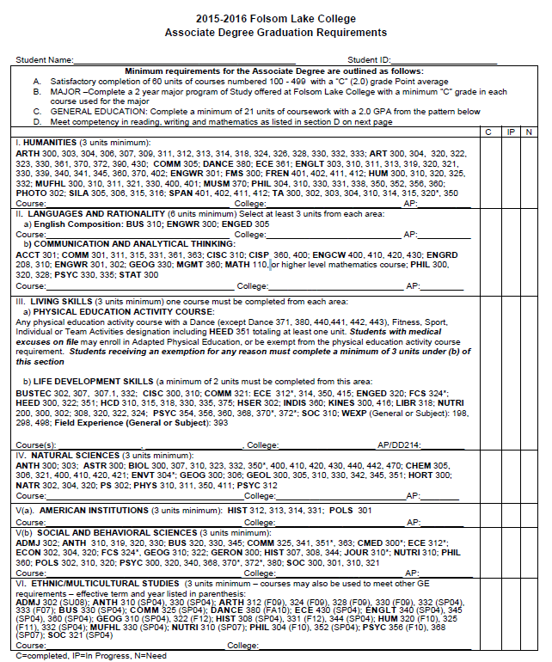
Associate Degree Example
Notes:
Bernie

Slide 9
Transfer General Education Patterns
CSU GE (California State University General Education/Breadth)
IGETC (Intersegmental General Education Transfer Curriculum)
Individual CCC courses are reviewed and approved by CSU and UC for systemwide GE Area patterns.
Notes:
Bernie

Slide 10
Transfer General Education Patterns
OTHER
Local CSU or UC GE Patterns
Private or Out-of-State Public Institutions GE Pattern
Individual CCC courses approved by four-year
institution to match up with local four-year institution’s GE Area patterns.
Notes:
Bernie

Slide 11
Types of GE Patterns
CSU GE
Title 5 GE Requirements and CSU EO 1065
Minimum Units - 39 semester units or 58 quarter units
Specific GE Subject Areas –
Area A: English Language Communication and Critical Thinking
Area B: Scientific Inquiry and Quantitative Reasoning
Area C: Arts and Humanities
Area D: Social Sciences
Area E: Lifelong Learning and Self-Development
Notes:
Bernie

Slide 12
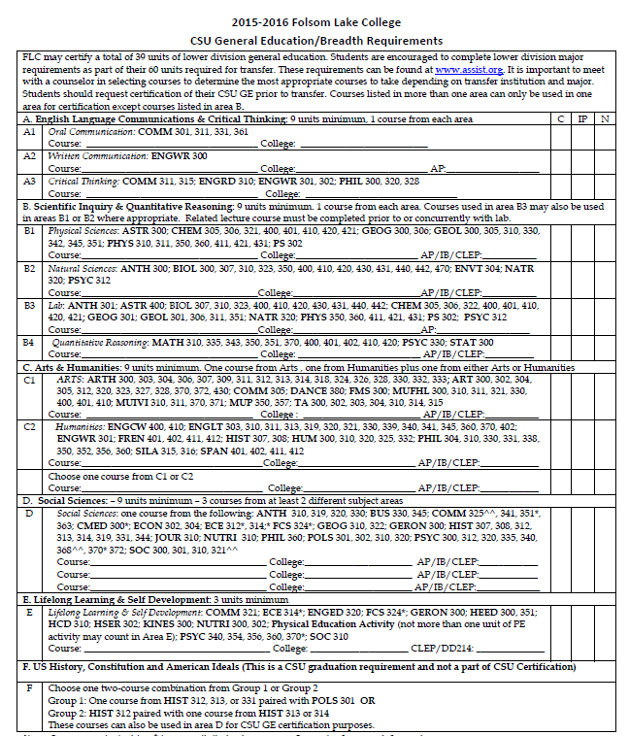
CSU GE Example
Notes:
Bernie

Slide 13
Types of GE Patterns
IGETC
CSU and UC Academic Senate
Minimum Units - 37 semester units or 54 quarter units
Specific GE Subject Areas –
Area 1: English Composition (If CSU – 1C Speech)
Area 2: Mathematical Concepts
Area 3: Arts and Humanities
Area 4: Social and Behavioral Sciences
Area 5: Physical and Biological Sciences
Area 6: Language Other Than English (UC only)
Notes:
Bernie

Slide 14
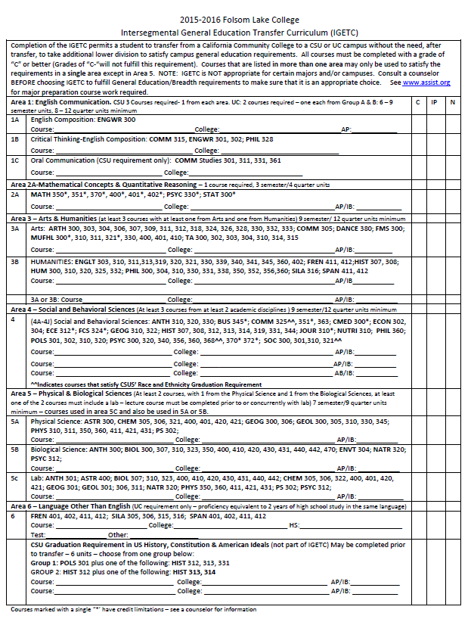
IGETC EXAMPLE
Notes:
Bernie

Slide 15
Types of GE Patterns
Associate Degrees for Transfer (ADT)
ADT are CCC Associate Degrees but are intended for students who plan to transfer to the CSU campuses.Students have four general education options to use:
CSU GE
IGETC
CSU GE for STEM (Biology & Chemistry AS-T only)
IGETC for STEM (Biology & Chemistry AS-T only)
Notes:
Tiffany

Slide 16
Types of GE Patterns
Associate Degrees for Transfer (ADT)
Colleges “can not” include additional graduation requirements
SB 440 language:
“ . . . A community college district shall not impose any requirements in addition to the requirements of this section, including any local college or district requirements, for a student to be eligible for the associate degree for transfer .”
Notes:
Tiffany

Slide 17
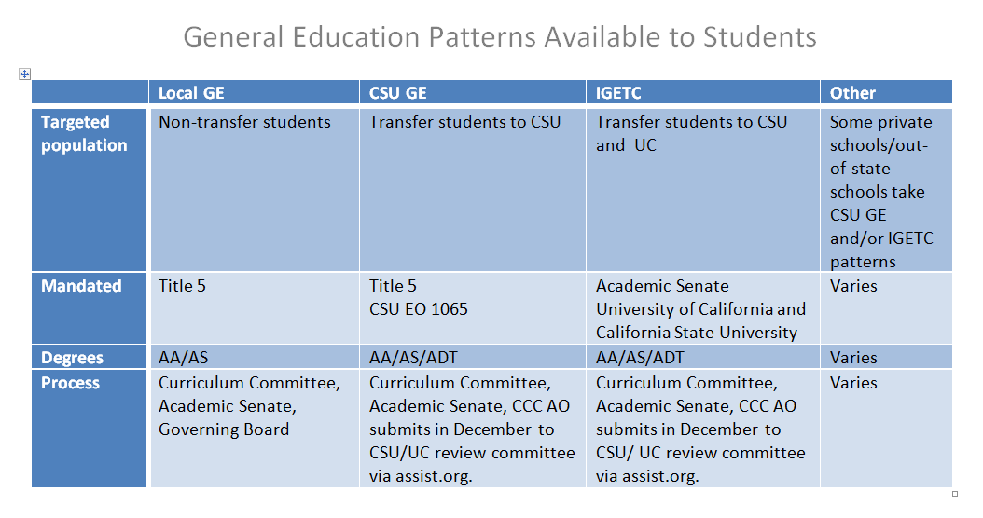
Notes:
Tiffany

Slide 18
Notes:
Tiffany

Slide 19
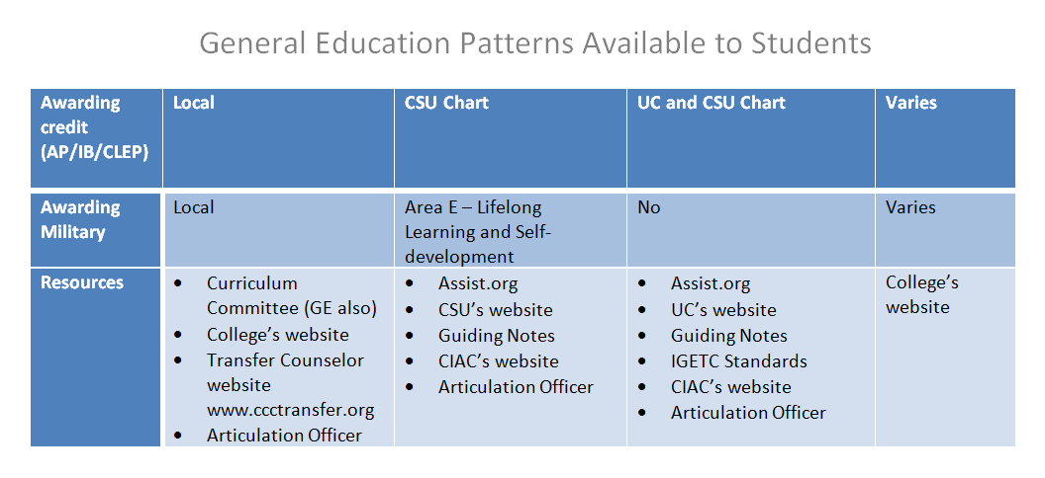
Notes:
Tiffany

Slide 20
Awarding Credit
External Examinations
Advance Placement (AP)
College Level Examination Program (CLEP)
International Baccalaureate (IB)
Military Credit
Pass Along
Double-counting
Area of Intent
GE Reciprocity
Notes:
Dave

Slide 21
External Examinations
CCC GE
Equivalencies for AP, CLEP and IB
Local decision – ASCCC: CCC GE AP, CLEP and IB Lists
CSU GE
Area Equivalencies for AP, CLEP and IB
Systemwide: CSU GE AP, CLEP and IB Lists
IGETC
Area Equivalencies for AP and IB
Systemwide: IGETC AP and IB Lists
Notes:
Dave - Quick reference – do not go over in detail as your articulation officer can assist you.

Slide 22
Military Credit
The CSU will accept military credit for basic training as equivalent to one unit of physical-activity courses in Area E, when completion of Area E is certified by a community college.
Notes:
Dave

Slide 23
GE Pass Along
A ”GE Pass Along”: substituting a course a student took at another institution for fulfillment of a GE area requirement in the local or transfer GE pattern.
From CSU or CCC CSU GE: use in same CSU GE Area as sending CSU or CCC.
From UC: local decision
From CCC IGETC: use in same IGETC GE Area as sending CCC.
From another CCC: local decision (unless reciprocity agreement)
Notes:
Bernie

Slide 24
Double-counting
A course can meet general education and also major requirement.
Example: Introduction to Psychology (PSYCH 101) from University of Washington would satisfy the Social Science requirement for Local GE, IGETC and CSU GE and also for students majoring in Psychology.
Notes:
Bernie - Local CCC vary as to allowing double counting for local GE pattern. Unlimited double counting for ADT degrees with CSU GE and IGETC.

Slide 25
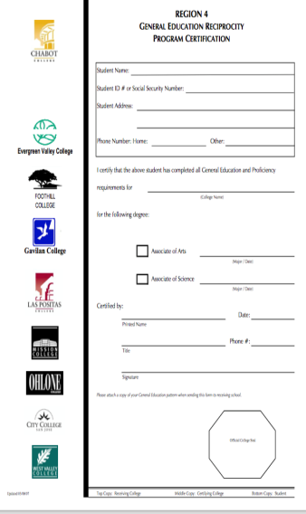
Regional Reciprocity
Notes:
Bernie

Slide 26
Resources
Local
Articulation Officer
Counselors
University Transfer Center Coordinator
GE Sub-committee of Curriculum Committee
External
ASSIST www.assist.org
CCC Transfer Counselor www.ccctransfer.org
Notes:
Tiffany

Slide 27
Resources
External (continued)
CSU Guiding Notes http://www.calstate.edu/app/documents/2015-March-GE-Reviewers-Guiding-Notes.pdf
IGETC Standards http://ccctransfer.org/sites/default/files/documents/IGTEC/2015-16/IGETC-Standards-version-1-7.pdf
Notes:
Tiffany

Slide 28
Challenges and Issues
CCC Baccalaureate Degree – Upper-division GE
GE Learning Outcomes
College Specific Graduation Requirements
Competency Requirements (math/English)
Notes:
Bernie and Dave

Slide 29
Q&A
Bernie Day – daybernie@fhda.edu
Dave DeGroot – ddegroot@hancockcollege.edu
Tiffany Tran – ttran76@ivc.edu
Notes:
Bernie and Dave

