Slide 1
Chancellor’s Office Curriculum Inventory Project Update 2017 Fall Curriculum Regional Meeting Rachel Stamm, COCI Product Manager
Last updated November 17, 2017

Slide 2
Today’s Topics
COCI Timeline and Current Status
1.6 Release
1.7 Contents
2018 Themes
COCI Oversight
College Support
Welcoming Feedback
Notes:
rachel

Slide 3
COCI Development and Rollout Timeline
Proof of Concept | DEC 2015
Database Design | JAN 2016
MVP Development | FEB 2016 – DEC 2017
Pilot Testing/Phase 1 Conversion | MAY 2017
Feature/Bug Fix Release | JUN 2017
Feature/Bug Fix Release | JUN 2017
Legacy System Retired | JUN 2017
COCI Launched/System Conversion | JUL 2017
Feature/Bug Fix Release | AUG 2017
Feature/Bug Fix Release | SEP 2017
Feature/Bug Fix Release | NOV 2017
Target: System Stability | DEC 2017
Notes:
rachel

Slide 4
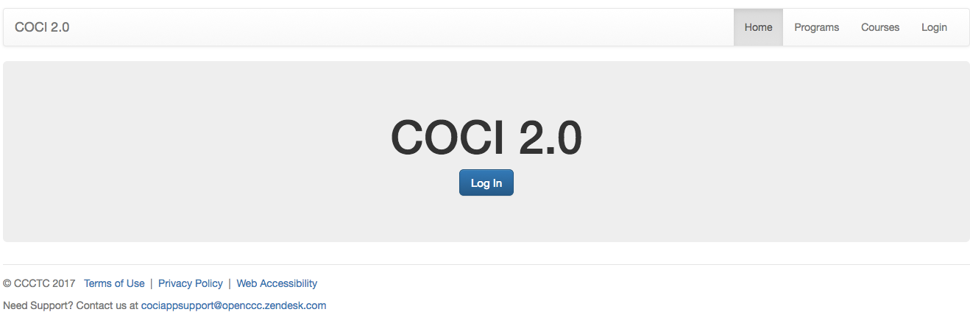
COCI Status
WE DID IT!
DID IT!
Colleges were migrated to the new COCI and the legacy system was retired.
Amazing!
BUT…We’ve had a few issues.
Notes:
rachel

Slide 5
COCI Status
We’ve worked a lot of issues since May…
Missing Attachments
Course Validation
Site Logins
Sub Change Justification
Proposal History
Legacy Data Correction
Duplicate Proposal Listings
Role Based Permissions
Program Control Numbers
Program Course Association
New Proposal Statuses
Broken Attachments
Approval Letters
Course Control Numbers
Units and Hours
…some we expected and many that we didn’t.
Notes:
rachel

Slide 6
1.6 Release Process
Added rigor to QA, end user testing and final signoff.
Release to Test
Complete Test Cases
Go/No Go Decision
Build to specs
Review Results w CCCCO
Triggers were put in place to involve development and product staff during testing process to triage any failed test cases.
Success criteria were established with the CCCCO, allowing for data driven approval to deploy.
Release notes published with issue description and better documentation of known issues.
Notes:
rachel

Slide 7
1.6 Release Contents
MIS Sync
Sub Change Flags
Program Control Number Assignment
Statuses and Actions
CB and Validation Corrections
Program/Course Association
Approval Letters for Credit C/P
TOP Code Display
Main page and history display
Main Page and Search Navigation
Justification Field
Course Control Number Assignment
Notes:
rachel

Slide 8
1.6.1
1 Critical Issue identified immediately after release
1 1.6 bug fix that was removed because it needed more work
CB22 Correction
Approval Letter Fixes
Notes:
rachel

Slide 9
1.7 Contents
Reviewer Site Navigation
NC Units and Hours Behavior
NC Approval Letters
Timing of MIS Sync
Backlog of Bug Fixes
Notes:
rachel

Slide 10
3 Key Product Themes for 2018
Parity to Legacy
Complete Existing Features
Support New Work Streams
Notes:
rachel

Slide 11
COCI Workgroup Formed Out of 5C
Workgroup formed to provide:
Oversight and support for COCI application and future release schedules
Representative prioritization of new features, system improvements
Greater ease in adopting policy changes or updates
Meeting twice monthly through December via zoom, 2018 cadence to be determined based on application status and feedback from the field.
Workgroup Members
Craig Rutan | Virginia Guleff | Jackie Escajeda | Marilyn Perry
Erik Shearer | Raul Arambula | Nili Kirschner | Cheryl Aschenbach
Chantee Guiney |  | Kirsten Corbin
Notes:
rachel

Slide 12
Getting Support
The lines are long with an extended hold time….
We want to get COCI to a place where you never need application support, but when you do, we need to do a good job providing it.
DEcember Support Objectives:
Clear backlog in support queue – there’s a catch to this one – to shorten response time to new issues
Improve your visibility of known issues and items in next release
Connect support tickets to dev tickets
Additional ticket tags on admin side
Notes:
rachel

Slide 13
Measuring Progress
You wont know if you don’t ask….
COCI year end status survey to establish the baseline level of user satisfaction.
Responses are anonymous unless you select otherwise.
The same status survey will be sent in the spring of 2018 to measure progress against identified pain points and priorities.
Notes:
rachel

