Slide 1
COR 101
Melynie Schiel: Copper Mountain College
Eric Wada: Folsom Lake College
ASCCC Curriculum Institute July 11-14, 2018 Riverside Convention Center

Slide 2
Introductions
What is your role/interest in curriculum?
Why are you here, or what do you expect to learn?
Any questions before we begin?
ASCCC Curriculum Institute July 11-14, 2018 Riverside Convention Center

Slide 3
Presentation Overview
Importance of the Course Outline of Record (COR)
Regulations/Resources
Audience
Credit vs. Noncredit CORs
CB Codes
PCAH categories
COR structure
Credit
Noncredit
COR Components and Addenda
The COR and Academic Freedom
ASCCC Curriculum Institute July 11-14, 2018 Riverside Convention Center

Slide 4
Importance of the COR:
From ASCCC's 2017 paper, The Course Outline of Record: A Curriculum Reference Guide Revisited:
"The course outline of record (COR) is a document with defined legal standing that plays a critical role in the curriculum of the California community colleges."
The COR "has both internal and external influences that impact all aspects of its content, from outcomes to teaching methodology, which, by extension, impact program development and program evaluation."
ASCCC Curriculum Institute July 11-14, 2018 Riverside Convention Center

Slide 5
Regulations and Resources
Title 5 55002
Program and Course Approval Handbook (PCAH) 6th edition
ACCJC Standards
C-ID
Transfer institutions
CSU GE Articulation
UC Articulation
ASCCC Curriculum Institute July 11-14, 2018 Riverside Convention Center

Slide 6
Intended Audience
Discipline faculty
Curriculum committee and local Board
College administration (program review and scheduling/assignment)
Faculty and articulation officers from other institutions
Employers, regional consortia, advisory boards
ACCJC visiting teams
CCCCO
Students and the public
ASCCC Curriculum Institute July 11-14, 2018 Riverside Convention Center

Slide 7
Types of Courses: Credit vs. Noncredit
Credit | Noncredit
Degree applicable and non-degree applicable (basic skills) | Some Career Development and College Preparation courses (CDCP) may lead to Certificate of Competency
Students pay fees | No student fees
Generates apportionment | Generates apportionment on two schedules
Awards units | No units
Not repeatable except in limited cases | Repeatable
Approved by Curriculum Committee, then Board, then CCCCO chapters | Approved by Curriculum Committee, then board, then CCCCO approves.
ASCCC Curriculum Institute July 11-14, 2018 Riverside Convention Center

Slide 8
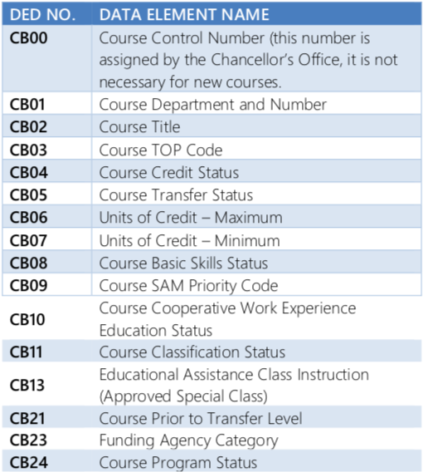
COCI Course Basic (CB) Codes for Credit Courses (COCICBCCC)
ASCCC Curriculum Institute July 11-14, 2018 Riverside Convention Center

Slide 9
PCAH Categories of Credit Courses
Program Applicable = Requirement or elective of a degree or Certificate of Achievement OR part of a GE pattern
Degree Applicable = Any course applicable to an Associate degree
Nondegree Applicable = Basic skills below Algebra or more than one level below college-level; support courses; entry-level CTE courses.
Stand-Alone = All the rest - including Experimental Offerings and Special Topics courses.
ASCCC Curriculum Institute July 11-14, 2018 Riverside Convention Center

Slide 10
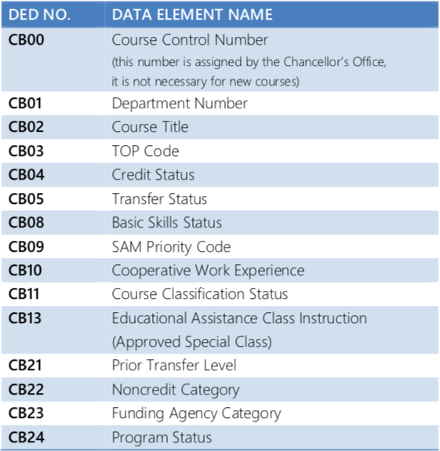
COCI Course Basic (CB) Codes for Noncredit Courses
ASCCC Curriculum Institute July 11-14, 2018 Riverside Convention Center

Slide 11
PCAH Categories of Noncredit Courses
ESL
Immigrant
Basic Skills
Health and Safety
Substantial Disabilities
Parenting
Home Economics
Courses for Older Adults
Short-term Vocational Programs
Workforce Preparation
Also Tutoring and Supplemental Education
ASCCC Curriculum Institute July 11-14, 2018 Riverside Convention Center

Slide 12
Credit COR Structure as Required by Title 5 §55002
Unit value (credit courses)
Total contact hours for course (more on this later...)
Outside of class hours
Total student learning hours
Conditions of enrollment: requisites, advisories, and other conditions
Catalog description
Objectives
(more on SLOs later...)
Content (typically in outline form)
Reading and Writing Assignments or others as appropriate
Other outside-of-class assignments
Methods of instruction
(more on DE later...)
Methods of evaluation / grading policy
ASCCC Curriculum Institute July 11-14, 2018 Riverside Convention Center

Slide 13
Noncredit COR Structure as Required by Title 5 §55002
Total contact hours for course
Catalog description
Objectives (more on SLOs later...)
Content (typically in outline form)
Assignments and activities
Methods of instruction (more on DE later...)
Methods of evaluation / grading policy
ASCCC Curriculum Institute July 11-14, 2018 Riverside Convention Center

Slide 14
Stylistic Concerns
Because of the potentially wide audience, style matters:
Content should be specific enough that the COR:
Shows appropriate level and rigor
Ensures consistency among faculty
Details aid in articulation and transferability
Distinguishes sequential courses
Demonstrates that it meets all regulatory requirements
Components should be integrated
"an obvious relationship should exist" between content, description, title, objectives, outcomes, assignments, methods of instruction and evaluation, etc. (ASCCC 2017 COR paper)
ASCCC Curriculum Institute July 11-14, 2018 Riverside Convention Center

Slide 15
COR Components: Hours and Units
Must be consistent with Board Policy and also Title 5 and the PCAH
In general, 3 hours of student work per week for one unit of credit.
Instructional modalities: Lecture, lab with homework, lab
Minimum and maximum total hours
Transfer institutions (and C-ID) may want a breakdown of instructional time
Noncredit requires only minimum and maximum total hours.
ASCCC Curriculum Institute July 11-14, 2018 Riverside Convention Center

Slide 16
COR Components: Requisites
These must be clear to a broad audience
Separate approval required for establishment. What does this look like at your college?
Side note on AB705: Do not make changes to prerequisites yet.
Noncredit courses cannot be prerequisites to credit courses (students cannot be required to take noncredit courses under current interpretation of Title 5)
ASCCC Curriculum Institute July 11-14, 2018 Riverside Convention Center

Slide 17
COR Components: Content / Objectives
Balance between flexibility and specificity
Evidence of college-level rigor and critical thinking
Consider breaking down by hours
Lab course specificity
Integrate content with description, SLOs, assessments, and assignments.
ASCCC Curriculum Institute July 11-14, 2018 Riverside Convention Center

Slide 18
COR Components: SLOs
Required by the ACCJC
Can be an addendum to the COR
The number of SLOs is a local decision.
Should differ from the Objectives/Content
Objectives/content describe what students learn during the course
SLOs describe what students can do after completing the course
Most should be at higher levels of Bloom’s Taxonomy (Analysis, Synthesis, Evaluation)
ASCCC Curriculum Institute July 11-14, 2018 Riverside Convention Center

Slide 19
COR Components: Assignments
Related to objectives and SLOs
Specific enough to show rigor
These justify the total student work and the unit value
How does your college include assignments in the COR?
ASCCC Curriculum Institute July 11-14, 2018 Riverside Convention Center

Slide 20
COR Components: Methods of Instruction
How is the content delivered, how is student learning facilitated during scheduled class time?
Examples: Lecture, discussion, lab, studio, performance, student presentations, field trips, intercollegiate athletics competition, etc….
Distance Education (DE) Modality
Requires a separate approval (Title 5 §55206).
Does the COR need to specify how DE modality and in-person differ?
How is DE approval documented at your college?
ASCCC Curriculum Institute July 11-14, 2018 Riverside Convention Center

Slide 21
COR Components: Evaluation / Assessment
Assessments should be related to objectives and SLOs.
Should show rigor
How can academic freedom be maintained?
Do departments want to require cumulative finals?
ASCCC Curriculum Institute July 11-14, 2018 Riverside Convention Center

Slide 22
Other COR Components to Consider:
Textbooks
Faculty discipline(s)
Materials or field trip fees
Repeatability
Transferability and C-ID applicability
Degree/Certificate applicability
Links to other courses (cross-listing, prereq to.., etc…)
Effective term
ASCCC Curriculum Institute July 11-14, 2018 Riverside Convention Center

Slide 23
COR and Academic Freedom
Title 5 §55002 requires that a qualified instructor teaches the course in accordance with the objectives and other details in the COR.
Flexibility in:
Instructional methods
Assessments/Evaluation
Assignments
Textbooks
ASCCC Curriculum Institute July 11-14, 2018 Riverside Convention Center

Slide 24
Thank You for Attending
Speaker contact information:
Melynie Schiel: mschiel@cmccd.edu
Eric Wada: eric.wada@flc.losrios.edu
ASCCC Curriculum Institute July 11-14, 2018 Riverside Convention Center

