Slide 1
Can a Single COR Work for Every Instructor?
Randy Beach, Southwestern College Eric Wada, ASCCC Curriculum Committee, Folsom Lake College

Slide 2
Description
The course outline is the basis for establishing articulation/transfer agreements, C-ID approval, creating degrees and certificates, and establishing and reviewing prerequisites. However, no two instructors will ever teach the same course exactly the same way – thank goodness! How can local curriculum committees assist faculty in creating course outlines that allow for flexibility and academic freedom while ensuring the integrity of the instruction across course sections? Please join us for this discussion about creating a balance between academic freedom and required elements for all course outlines of record.
ASCCC Curriculum Institute July 11-14, 2018 Riverside Convention Center

Slide 3
What brings you to this breakout? What do you hope to learn?
ASCCC Curriculum Institute July 11-14, 2018 Riverside Convention Center

Slide 4
Things to Consider
Required and Recommended Components of a COR
Academic Freedom vs Regulatory Compliance
Course Outline of Record vs Course Syllabus
Flexibility in Instructional Methods, Methods of Evaluation, and Assignments
What do you do when faculty ignore the COR?
What local practices are proving to be effective for you?
ASCCC Curriculum Institute July 11-14, 2018 Riverside Convention Center

Slide 5
Required COR Components: Where To Look
CCR, Title 5 (esp. Section 55002)
CCCCO Program and Course Approval Handbook (PCAH) 6th Edition
ACCJC accreditation standards
C-ID and transfer institutions
ASCCC 2017 paper: The Course Outline of Record: A Curriculum Reference Guide Revisited
ASCCC Curriculum Institute July 11-14, 2018 Riverside Convention Center

Slide 6
Required Components: Title 5 §55002 Credit
Unit value (credit courses)
Total contact hours for course (more on this later...)
Conditions of enrollment: requisites, advisories, other conditions
Catalog description
Objectives
Content (typically in outline form)
Reading and Writing Assignments
Other outside-of-class assignments
Methods of instruction
Methods of evaluation/grading policy
ASCCC Curriculum Institute July 11-14, 2018 Riverside Convention Center

Slide 7
Recommend Components
DE Modality as a method of instruction
Effective Term
Teaching disciplines/Minimum
qualifications
Cross-Listed courses (can be in course description)
Course repeatability or courses related in content
Required texts and other instructional materials (lab manuals, software, etc.)
GE and Transferability/C-ID
Others?
ASCCC Curriculum Institute July 11-14, 2018 Riverside Convention Center

Slide 8
COR and Regulatory Compliance: Title 5 & ACCJC
§55002(a)(4)Conduct of course. All sections of the course are to be taught by a qualified instructor in accordance with a set of objectives and with other specifications defined in the course outline of record.
I.C.7 In order to assure institutional and academic integrity, the institution uses and publishes governing board policies on academic freedom and responsibility. These policies make clear the institution’s commitment to the free pursuit and dissemination of knowledge, and its support for an atmosphere in which intellectual freedom exists for all constituencies, including faculty and students. (ER 13)
ASCCC Curriculum Institute July 11-14, 2018 Riverside Convention Center

Slide 9
Academic Freedom: What is it?
From AAUP’s Statement on Professional Ethics*:
“Professors, guided by a deep conviction of the worth and dignity of the advancement of knowledge, recognize the special responsibilities placed upon them. Their primary responsibility to their subject is to seek and to state the truth as they see it. As teachers, professors encourage the free pursuit of learning in their students. They hold before them the best scholarly and ethical standards of their discipline. …professors seek above all to be effective teachers and scholars
*https://www.aaup.org/report/statement-professional-ethics
ASCCC Curriculum Institute July 11-14, 2018 Riverside Convention Center

Slide 10
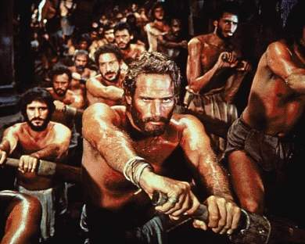
Academic Freedom vs Regulatory Compliance
ASCCC Curriculum Institute July 11-14, 2018 Riverside Convention Center

Slide 11
Academic Freedom vs Regulatory Compliance
Academic freedom is the freedom of teachers, students, and academic institutions to pursue knowledge wherever it may lead, without undue or unreasonable interference.
Does this freedom allow for faculty to deviate significantly from the COR?
Academic Freedom more about implementation of the COR, but the COR is the standard
ASCCC Curriculum Institute July 11-14, 2018 Riverside Convention Center

Slide 12
Academic Freedom vs Regulatory Compliance
Districts policies ensuring academic freedom; faculty must meet professional standards
The Board of Governors (thru title 5
regs) ensures that every student
receives the education they have
been promised
The COR is a legal document, establishes what to include every time a course is offered
Academic freedom can exist within regulatory compliance
ASCCC Curriculum Institute July 11-14, 2018 Riverside Convention Center

Slide 13
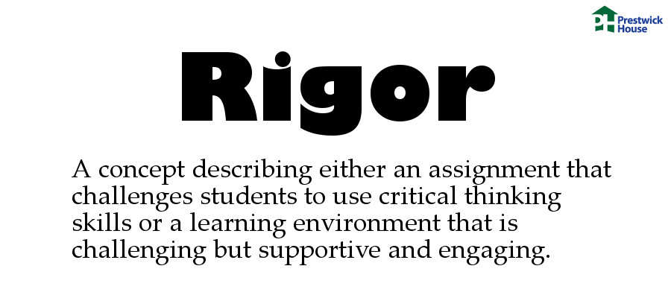
Academic Rigor
Determination of rigor embedded in the Standards for Approval (§55002)
Grading Policy
Units
Intensity
Prerequisites and Corequisites
Basic Skills Requirements
Difficulty
Level
If following the intent of the COR, rigor is maintained
ASCCC Curriculum Institute July 11-14, 2018 Riverside Convention Center
Notes:
Grading Policy - demonstrated proficiency in the subject matter (not attendance)
Units – a minimum of 3 hours of student work per week per unit (prorated)
Intensity – critical thinking, independent study outside of class time
Prerequisites and Corequisites – student will be highly unlikely to receive a satisfactory grade without knowledge/skills not taught in the requisite course
Basic Skills Requirements – if target course requires competence in communication or computational skills, eligibility for enrollment in associate degree credit courses in English and/or mathematics as prereq or coreq.
Difficulty – critical thinking and application of concepts at college level
Level – learning skills and vocabulary appropriate for college level

Slide 14
Course Outline of Record vs Course Syllabus
Legally required by title 5
Basis for determination of rigor, objectives, content
Basis of articulation agreements with other colleges
Establishes prerequisites, corequisites, advisories (§55003)
Changed by committee action
Serves as a legal contract
Communicates through assignments/methods/standards the rigor, objectives, content
Evidence to support articulation agreements/ transfer
Created with department/school guidance/expectations
ASCCC Curriculum Institute July 11-14, 2018 Riverside Convention Center

Slide 15
Academic “Flexibility:” Instructional Methods
Appropriate for/ align with content/objectives/SLOs
Title 5 requires examples, not a list
Choose methods to best suit different teaching and learning styles (DE?)
Discipline faculty collaborate to determine if any particular method is absolutely essential
If a specific method isn’t absolutely imperative, consider using “may” rather than “will” on COR

Slide 16
Academic “Flexibility:” Methods of Evaluation
Similar to Instructional methods
Discipline faculty may choose to be as specific/ comprehensive, depending on local requirements
Be cautious with wording addressing grading criteria – a statement like “Instructors will assign points based on the assignments given“ can allow flexibility
ASCCC Curriculum Institute July 11-14, 2018 Riverside Convention Center

Slide 17
Academic “Flexibility:” Methods of Evaluation Cont.
Methods of Evaluation can affect articulation and
transferability
If an assignment is actually required for all sections
then it should be listed that way on the COR
Not listing enough information can lead to requests
for syllabi or even loss of articulation
Establishing prerequisites and corequisites using
content review often involves listing the skills that
students must use during the course so should be
indicated in Methods of Evaluation section
ASCCC Curriculum Institute July 11-14, 2018 Riverside Convention Center

Slide 18
Academic “Flexibility:” Assignments
Last, but not least: “Assignments and/or Other Activities”
COR must specify types or examples of assignments
Must require critical thinking
Be appropriate and clearly connected to course content and objectives
Should substantiate unit value (minimum of three hours per unit per week in class and on outside assignments)
May influence requisite implementation so wording is again key (WILL vs. MAY)
ASCCC Curriculum Institute July 11-14, 2018 Riverside Convention Center

Slide 19
What do you do when faculty ignore the COR?
How can you be certain instructors follow the COR?
Whose responsibility is it to monitor? (Curriculum Committee, department chairs, deans, other?)
Is anyone looking at individual syllabi to see if they match the COR?
ASCCC Curriculum Institute July 11-14, 2018 Riverside Convention Center

Slide 20
What do you do when faculty ignore the COR?
What about the instructor that has taught the same class for the last 10 years and doesn’t care that the COR has changed?
Is teaching to the COR part of the evaluation process?
What about student evaluations or complaints to the chair/dean?
ASCCC Curriculum Institute July 11-14, 2018 Riverside Convention Center

Slide 21
What do you do when faculty ignore the COR?
Assume the best of your colleagues… perhaps they simply don’t know about the COR and/or its significance?
Department chair or dean distribute COR to faculty every semester
A strong academic freedom statement with emphasis on adhering to COR
Emphasize importance of COR to establish prerequisites
Dean can not assign course if not adhering
ASCCC Curriculum Institute July 11-14, 2018 Riverside Convention Center

Slide 22
Flexibility in the COR
COR Flexibility begins when the COR is written
There must be collaboration between all program faculty (include PT) when creating or changing the COR
Reflection time to determine good vs. essential pedagogical practices for discipline
Cycle of learning outcomes assessment/reflection can inform and strengthen teaching and learning and COR flexibility
AAUP: “Professors do not discriminate against or harass colleagues. They respect and defend the free inquiry of associates, even when it leads to findings and conclusions that differ from their own.”
ASCCC Curriculum Institute July 11-14, 2018 Riverside Convention Center

Slide 23
Flexibility in the COR
COR applies to ALL sections taught
Wording is key (e.g. “may” vs. “will”)
Designation of required and optional
elements in the COR willhelp faculty
determine what they MUST do
versus things that MIGHT do!
Designating certain items as optional
could impact C-ID approval or
articulation agreements. Make sure you check with your articulation
officer about these possibilities.
ASCCC Curriculum Institute July 11-14, 2018 Riverside Convention Center

Slide 24
What about your college?
What local practices prove to be effective for you?
ASCCC Curriculum Institute July 11-14, 2018 Riverside Convention Center

Slide 25
Questions?
Do you have any additional questions for us? Randy Beach, Southwestern College, rbeach@swccd.edu
Eric Wada, ASCCC Curriculum Committee, Folsom Lake College, Eric.Wada@flc.losrios.edu
ASCCC Curriculum Institute July 11-14, 2018 Riverside Convention Center

