Slide 1
CURRICULUM AND PUBLIC DOCUMENTS
Randy Beach, Southwestern College
Michelle Grimes-Hillman, Long Beach City College
Eric Wada, Folsom Lake College
2018 ASCCC Curriculum Institute, Riverside

Slide 2
Description
Balancing the need for accessible and user-friendly curriculum publications while satisfying accreditation standards and education code is a challenge. Fortunately, there is a wealth of information on best practices available to help meet this challenge. This session will examine the relationship between curriculum and the college catalog, the class schedule, and other campus publications, on maintaining accuracy and consistency between them, and on serving the needs of those who use them.
ASCCC Curriculum Institute July 11-14, 2018 Riverside Convention Center

Slide 3
Introductions
What is your role in curriculum?
What do you hope to learn?
ASCCC Curriculum Institute July 11-14, 2018 Riverside Convention Center

Slide 4
Scenarios
Courses without SLO assessments are deleted from the college catalog to report a high rate of assessment.
The college has just received approval for new courses, can they be offered immediately?
One of the departments on your campus has modified the online schedule of classes to describe content in a history course that is not found in the course outline.
Students have brought to the department chair a syllabus that shows a different course description than is found in the official course outline. The faculty claims academic freedom of the syllabus.
ASCCC Curriculum Institute July 11-14, 2018 Riverside Convention Center

Slide 5
Types of Publications
College catalog
Catalog addendum
Schedule of classes
Class syllabus
Other:
College and departmental websites
Marketing materials
ASCCC Curriculum Institute July 11-14, 2018 Riverside Convention Center

Slide 6
ACCJC Standard I.C
The institution assures the clarity, accuracy, and integrity of information provided to students related to its mission statement, learning outcomes, educational programs, and student support services - I.C.1 (ER 20)
The institution provides a print or online catalog for students and prospective students with precise, accurate, and current information - I.C.2 (ER 20)
ASCCC Curriculum Institute July 11-14, 2018 Riverside Convention Center

Slide 7
ACCJC Policy on Institutional Advertising
Policy on Institutional Advertising
Educational programs and services offered shall be the primary emphasis of all advertisements, publications, promotional literature and recruitment activities, including those presented in electronic formats…
ASCCC Curriculum Institute July 11-14, 2018 Riverside Convention Center

Slide 8
ACCJC Publication Requirements
Admissions, Fees and Programs
Major Policies and Procedures Affecting Students
Locations or Publications Where Other Policies may be Found
ASCCC Curriculum Institute July 11-14, 2018 Riverside Convention Center

Slide 9
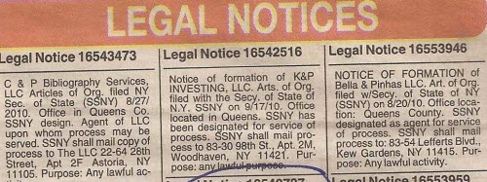
Title 5 Course Publication Requirements
§58104: Courses must be published in the official catalog and/or addenda and listed in the schedule of classes.
§58102: Course Descriptions must be clear and understandable
§55003: Requisites must be published in college publications available to students and in the COR.
§55041(b): Repeatable courses must be identified as such
ASCCC Curriculum Institute July 11-14, 2018 Riverside Convention Center
Notes:
§58104: Courses must be published in the official catalog and/or addenda and listed in the schedule of classes. §58102: Course Descriptions Must be clear and understandable May be designated as meeting specialized needs but must affirm that they are open to all qualified students §55003: Requisites Must be published in college publications available to students and in the COR. §55041(b): Repeatable courses must be identified as such

Slide 10
Title 5 Course Publication Requirements
§55005: The following information must be published prior to student enrollment:
Course Type
Transferability
Eligibility to meet a major/area of emphasis or general education requirement
§55022(a)(1)(2): when a course is offered as Pass/No-pass, must specify whether that is the only option or whether the student may choose a Letter Grade option.
ASCCC Curriculum Institute July 11-14, 2018 Riverside Convention Center
Notes:
§55005: The following information must be published prior to student enrollment: Course Type: degree-applicable credit course, non-degree applicable credit course, noncredit course, community services course Transferability to baccalaureate institutions Eligibility to meet a major/area of emphasis or general education requirement §55022(a)(1)(2): when a course is offered as Pass/No-pass, must specify whether that is the only option or whether the student may choose a Letter Grade option. §55041(b): Repeatable courses must be identified as such
http://extranet.cccco.edu/Portals/1/Legal/Ops/09-04.pdf

Slide 11
Other Course Elements/Publications
Lecture/lab hours
To Be Announced (TBA)
Distance education
C-ID equivalency
Honors distinction
Special fees
Flow charts
Road maps
Cross-listings
ASCCC Curriculum Institute July 11-14, 2018 Riverside Convention Center
Notes:
http://extranet.cccco.edu/Portals/1/Legal/Advisories/A08-02.pdf

Slide 12
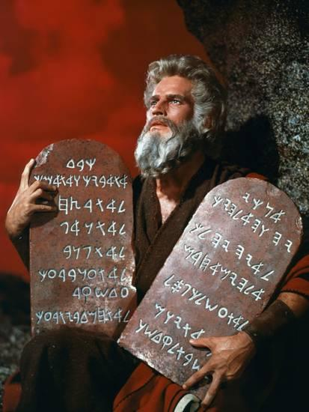
Title 5 Program Publication Requirements
§55070(e), §55130: credit certificates and degrees
§55150, §55155(e): non-credit certificates of competency and completion

Slide 13
Title 5 Program Publication Requirements
The following must appear exactly as approved by the Chancellor’s Office:
Program Title
Program Type: AA, AA-T, AS, AS-T, Certificate of Achievement, Competency, Completion, Adult High School Diploma
Catalog Description (including SB 1440 language for ADTs)
Courses: required, electives, general education (for degrees)
Credit programs only: units for each category, plus the total units
ASCCC Curriculum Institute July 11-14, 2018 Riverside Convention Center

Slide 14
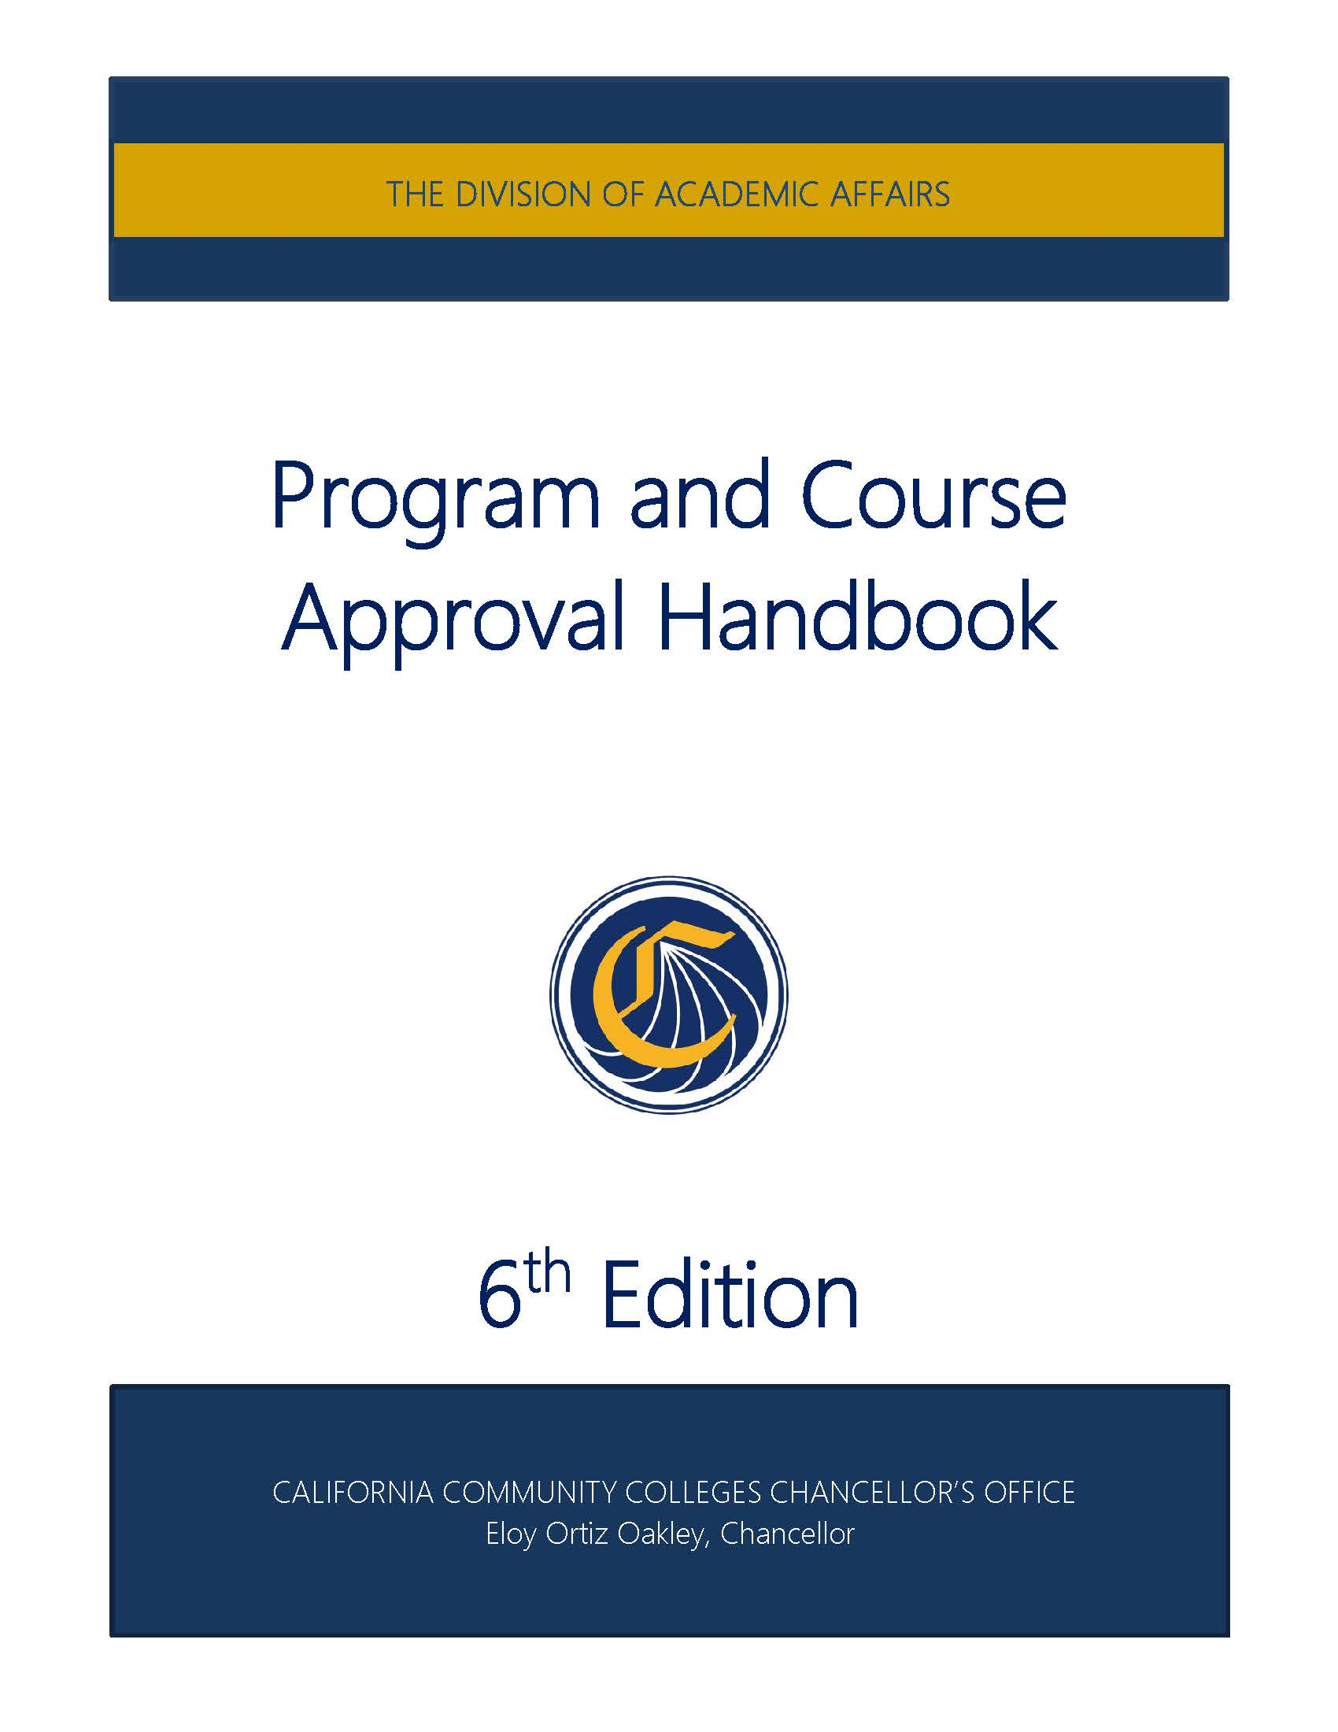
PCAH Program Publication Requirements
Title 5, §55000.5
The Chancellor shall prepare, distribute, and maintain a detailed handbook for use by community college districts. The handbook shall contain course approval criteria and procedures for securing course and program approvals.
Program and Course Approval Handbook, 6th Edition
ASCCC Curriculum Institute July 11-14, 2018 Riverside Convention Center

Slide 15
Additional Program Information
Non-transcripted Certificates (not “Certificate of Achievement”)
Guided Pathways and Recommended Course Sequences
Sequences showing blended major coursework with GE options
Other public facing program information..?
Notes:
Non-transcripted Certificates (not “Certificate of Achievement”)
Title, Description, Courses: required, elective, general education (for degrees), Units (if applicable)

Slide 16
Program Review: Accreditation
ACCJC Standard I.B.5
The institution assesses accomplishment of its mission through program review and evaluation of goals and objectives, student learning outcomes, and student achievement...
ACCJC Standard II.A.16. The institution regularly evaluates and improves the quality and currency of all instructional programs offered in the name of the institution, including collegiate, pre-collegiate,
career-technical, and continuing and community education courses and programs, regardless of delivery mode or location...

Slide 17
Program and/or Periodic Review
Title 5, §51022: All courses and programs must be reviewed periodically
Title 5, §55003: course and program pre/corequisites must be affirmed via "content review" at least once every six years or every two years for CTE courses/programs.
Ed Code 78016: colleges must review the effectiveness of CTE programs every two years.
C-ID descriptors and TMCs are evaluated every five years.
The UC requires textbooks to be published within seven years. Advisory committees meet, licensing agencies change their standards, program review takes place every…
ASCCC Curriculum Institute July 11-14, 2018 Riverside Convention Center

Slide 18
Reviewing Publication Policies
ACCJC Standard I.B.7: The institution regularly evaluates its policies and practices across all areas of the institution, including instructional programs, student and learning support services, resource management, and governance processes to assure their effectiveness in supporting academic quality and accomplishment of mission.
How frequently should such reviews occur?
Who participates in this process?

Slide 19
The Catalog
Know your audience
Students
Counselors/advisors
Financial Aid personnel
Degree auditors
Advisory committee members
Transfer institution counselors
Etc.
ACCJC Standard I.C.2 (ER 20):
The catalog is “…for students and prospective students…”
Are they experts or novices?

Slide 20
ACCJC: The Catalog
The following list of information must be included in the College Catalog.
Official Name, Address(es), Telephone Number(s), and Website Address of the Institution
Educational Mission
Representation of accredited status with ACCJC and with programmatic accreditors, if any
Course, Program, and Degree offerings
Student Learning Outcomes for Programs and Degrees
*Accreditation Standards (2014), Catalog Requirements (pg. 18)
ASCCC Curriculum Institute July 11-14, 2018 Riverside Convention Center

Slide 21
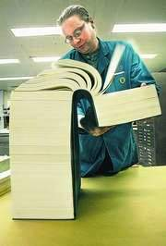
ACCJC: The Catalog
The following list of information must be included in the College Catalog.
Academic Calendar and Program Length
Academic Freedom Statement
Available Student Financial Aid
Available Learning Resources
Names and Degrees of Administrators and Faculty
Names of Governing Board Members
*Accreditation Standards (2014), Catalog Requirements (pg. 18)
ASCCC Curriculum Institute July 11-14, 2018 Riverside Convention Center

Slide 22
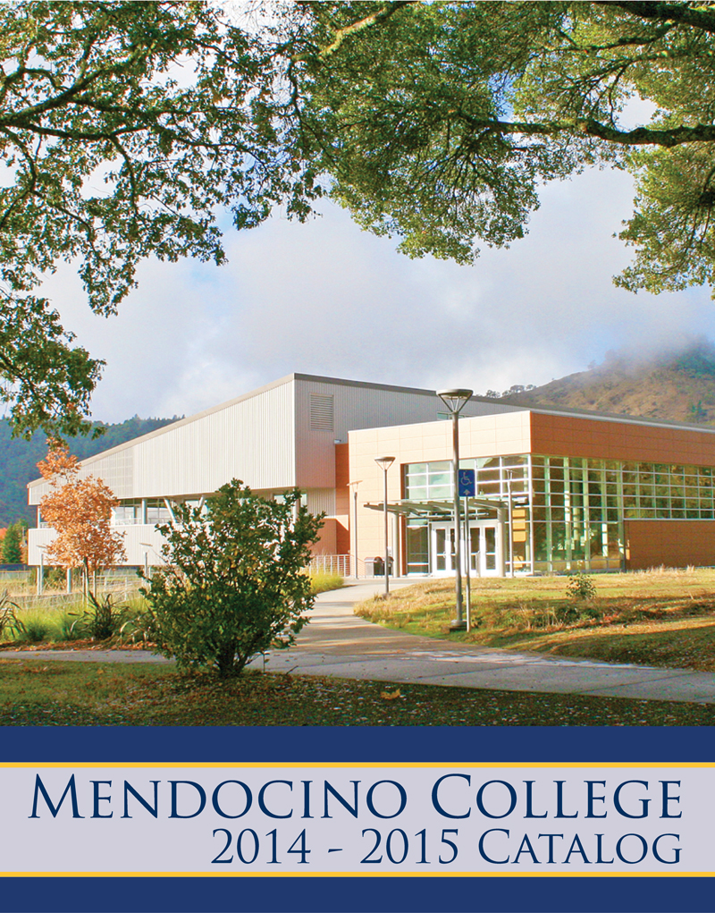
The Catalog
Print vs. online
PDF vs. searchable database
Single vs. multiple files:
Policies
Program listings
Course listings
Addenda
Title 5, §58104: Courses approved after publication of the current catalog or schedule of classes must be well publicized.
How often do you release an addendum?
ASCCC Curriculum Institute July 11-14, 2018 Riverside Convention Center

Slide 23
Where Does Catalog Info Come From?
Data sources and Integrity
Local curriculum management system
Chancellor’s Office Curriculum Inventory (COCI)
Catalog and schedule
Other publications (by different offices, with different timelines)
What is the official source?
How do we ensure its accuracy?
How do we align all other sources to it?

Slide 24
Online Resources
Ed Code Title 3, Div 7, Part 48, Ch 1, Art 1, Sec 78015-78016.5
http://leginfo.legislature.ca.gov/faces/codes_displayText.xhtml?lawCode=EDC&division=7.&title=3.&part=48.&chapter=1.&article=1.
Title 5, 55000
http://www.gamutonline.net/district/swhit/PolicyCategoryList/1126/8
PCAH, 6th Ed.: http://extranet.cccco.edu/Portals/1/AA/Credit/2017/PCAH6thEditionJuly_FINAL.pdf
COCI Data Element Dictionary
Courses (CB): http://extranet.cccco.edu/Divisions/TechResearchInfoSys/MIS/DED/Course.aspx
Programs (SP): http://extranet.cccco.edu/Divisions/TechResearchInfoSys/MIS/DED/StudentProgramAward.aspx
ACCJC: https://accjc.org/eligibility-requirements-standards-policies/#accreditation-standards

Slide 25
Questions?
Randy Beach, rbeach@swccd.edu
Michelle Grimes-Hillman, mhillman@lbcc.edu
Eric Wada, eric.wada@flc.losrios.edu

