Slide 1
IMPORTANCE OF CODING IN THE CURRICULUM REVIEW PROCESS
Shireen Awad- Curriculum Specialist, Chaffey College
Marie Boyd- Curriculum Chair, Chaffey College
Eric Wada- ASCCC Curriculum Committee, Folsom Lake College
Notes:
Eric

Slide 2
GOALS
Streamline local curriculum approval processes
More informed decision-making regarding course and program codes
Review TOP, CIP, SAM, and SOC Codes
Enhance the efficiency between the Curriculum Specialist and the Curriculum Chair
Notes:
Eric

Slide 3
CODES CODES CODES…AND MORE CODES

Slide 4
CODES – MIS MANAGEMENT INFORMATION SYSTEM
USES:
CB03 Course-Top-Code
CB04 Course-Credit-Status
CB05 Course-Transfer-Status
CB08 Course-Basic-Skills-Status
CB09 Course-SAM-Priority-Code
CB10 Course-Coop-Work-Exp-Ed-Status
CB11 Course-Classification-Code
CB21 Course-Prior-to-College-Level
CB22 Course-Noncredit-Category
CB24 Course-Program-Status
MIS Course Codes
Notes:
Marie

Slide 5
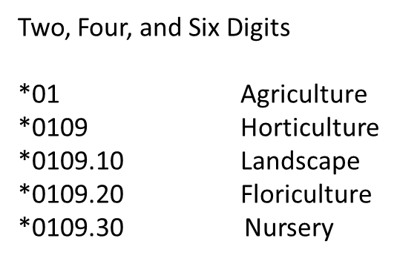
CODES – TOP TAXONOMY OF PROGRAMS
USES:
Course Identification
Program Identification
Apportionment and grant funding (Perkins)
SalarySurfer
Student Success Scorecard
LaunchBoard
Data Mart (Program Awards)
Report to IPEDS/ Gainful Employment
Report to the state legislature (ARCC )
Facilities, Budgets, Faculty, Outcome Reports
TOP Directory – Most recent revision: 2012
CCCCO TOP/CIP Crosswalk
Notes:
Marie

Slide 6
CODES– CIP CLASSIFICATION OF
INSTRUCTIONAL PROGRAMS
USES:
The federal standard for postsecondary instructional program classification
Tied to federal financial aid
Used for Gainful Employment which is reported on your program’s website
Used for tracking Baccalaureate Degrees
Used for Veterans’ financial aid
Used for Accreditation
Used in the COCI yet?
CIP Code Directory
O*NET Crosswalk CIP/SOC
2 – digit 14 Engineering
4 – digit 14.08 Civil Engineering
6 – digit 14.0804 Transportation & Highway Engineering

Slide 7
CODES– SAM STUDENT ACCOUNTABILITY MODEL
USES:
CB 09
Accreditation reports
DataMart reports
Student Success Scorecard
Educational Master Plan Goals – Progress on Measurable Objectives
Gainful Employment Program Disclosures
Perkins Core Indicator Reports (VTEA)
President's Load Study reports - used for Hiring Priorities
Help identify pathways within CTE programs, such as which courses are introductory and which are the capstone courses
SAM codes affect calculations about students who took intro courses and skills-builders
A – Apprenticeship (offered to apprentices only)
The course is designed for an apprentice and must have the approval of the State of California, Department of Industrial Relations, Division of Apprenticeship Standards.
B – A “B” course is offered in one specific occupational area only and clearly labels its taker as a major in this area. The course may be a “capstone course” that is taken as the last requirement for a career technical education program. Priority letter “B” should be assigned sparingly; in most cases no more than two courses in any one program should be labeled “B”. Each “B” level course must have a “C” level prerequisite in the same program area.
C – Courses will generally be taken by students in the middle stages of their Programs and should be of difficulty level sufficient to detract “drop-ins”. A “C” level course may be offered in several occupational programs within a broad area such as business or agriculture. The “C” priority, however, should also be used for courses within a specific program area when the criteria for “B” classification are not met. A “C” level course should provide the student with entry-level job skills.
D - “D” courses are those taken by students in the beginning stages of their occupational programs. The “D” priority can also be used for service (or survey) courses for other occupational Programs.

Slide 8
CODES – SOC STANDARD OCCUPATIONAL CLASSIFICATION
USES:
Managed by the U.S. Dept. Labor, Bureau of Labor Statistics
Used by federal agencies to classify workers into occupational categories for the purpose of collecting, calculating, or disseminating data.
Used when calculating supply and demand and developing labor market projections for job openings.
Tracks program completers to make sure they end up in a federally recognized occupation (SOC Code)
TOP Code Alignment Project
Gainful Employment
Financial Aid
Baccalaureate Degrees
Veterans
WIOA
Salary Surfer
2018 Standard Occupational Classification

Slide 9
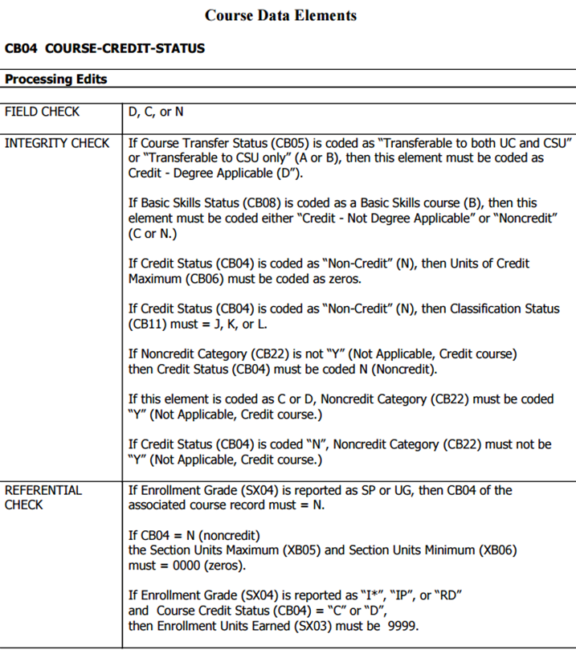
COURSE CODING IN COCI
Courses are coded using the California Community Colleges Management Information System Data Element Dictionary also known as the “CB Data Element Dictionary”.
Curriculum Specialists are to know these codes so that they may directly input them into COCI and the Student Information System.
This provides an exact mapping of codes with field checks and integrity checks. Integrity checks are “If…then” statements that guide the specialist on inputting the proper codes.
Example (p. CB-10)
Notes:
Some of these codes are not chosen during the curriculum review process which is why it is important for the specialist to understand the data element dictionary as they will input the appropriate codes based upon the proposal.

Slide 10
COURSE CODING IN COCI
Once the codes have been reviewed and approved locally, they are inputted into COCI and the college’s Student Information System by the Curriculum Specialist.

Slide 11
COURSE CODING IN COCI
During the development of a new course, the Curriculum Specialist will input the codes locally approved.

Slide 12
CODING CONT.

Slide 13
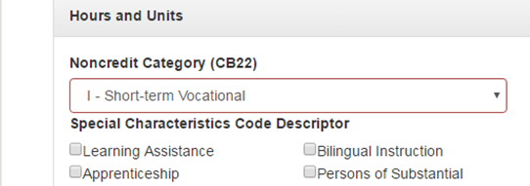
COURSE DATA VALIDATION IN COCI
In the event that the codes do not align as described in the CCC Management Information System Data Element Dictionary, COCI will produce a validation error after submission attempt.
COCI will also highlight the CB areas that need to be corrected during this validation.

Slide 14
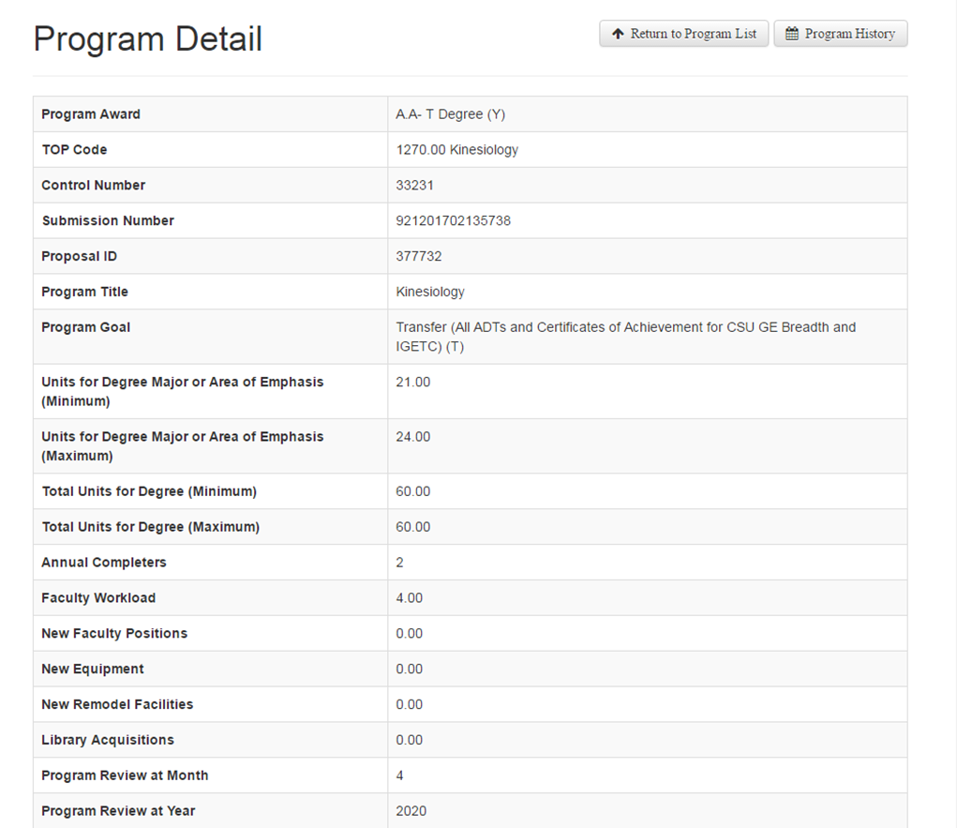
PROGRAM CODING IN COCI
SP Program Codes
SP01 Student-Program-Identifier
Indicates, by TOP code, the subject area of the student’s degree
SP02 Student-Program-Award
Designates the award type and whether it is credit or noncredit
SP03 Student-Program-Award-Earned
Indicates whether a student has completed a program
SP04 Student-Program-Control-Number
Maps student completion back to program control number issued when an educational program has been approved using the Curriculum Inventory

Slide 15
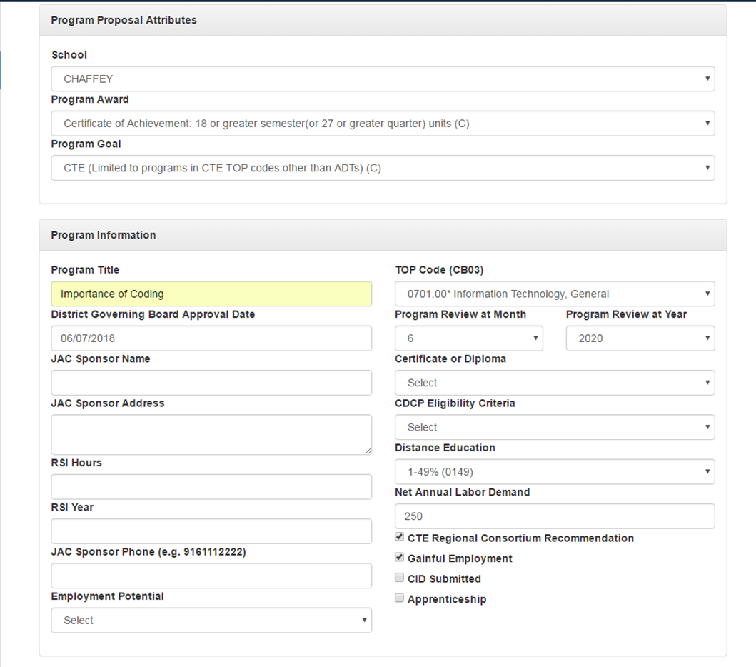
PROGRAM CODING IN COCI

Slide 16
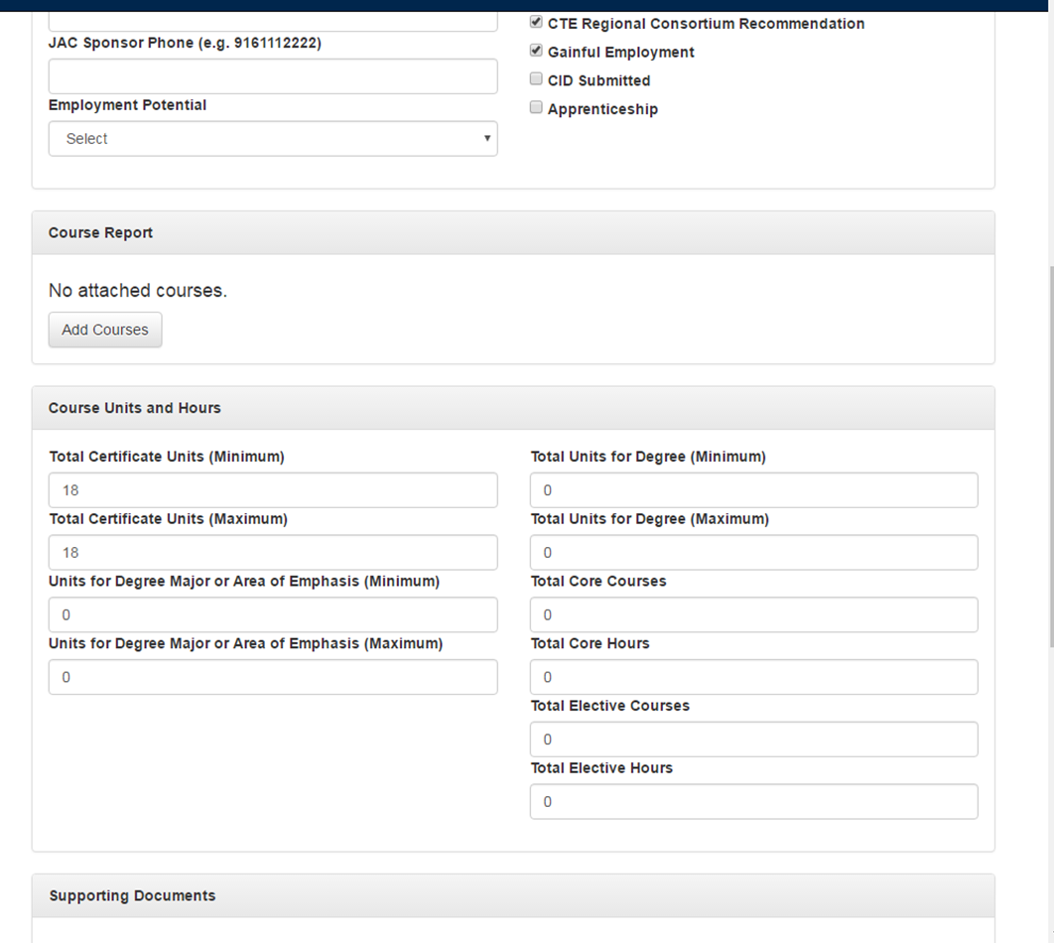
PROGRAM CODING IN COCI

Slide 17
“PROGRAM DATA VALIDATION” IN COCI
COCI currently does not have program validation; however, each program is reviewed by the Chancellor’s Office.
Some helpful notes:
Program Goals:
CTE: Limited to certificates and programs in a CTE TOP Code other than ADTs
Transfer: ADT, CSUGE, or IGETC only. ADT can have a CTE TOP Code.
Local: Other AA/AS degrees and certificates in a non CTE TOP Code.
Course Units and Hours (see previous slide as reference):
Certificates: only need to fill “certificate units minimum and maximum”. All other fields will have a 0 in them.
AS/AA/ADTs: only need to fill “units for degree or area of emphasis (minimum and maximum)” and “total units for degree (minimum and maximum)”. Certificate section, total core courses, total core hours, total elective courses, and total elective hours are marked as 0.
Noncredit: All fields will be 0 except “Total Core Courses and Total Core Hours” and “Total Elective Courses and Total Elective Hours” (if applicable).
Notes:
Spoke with David Garcia in regards to accuracy of slide, especially first bullet.

Slide 18
WHO ASSIGNS TOP, SAM, CIP, AND SOC CODES AT YOUR COLLEGE?
TOP Codes and SAM Codes should be chosen by Faculty during the curriculum process in consultation with the Curriculum Office.
TOP Codes and SAM Codes must align:
If a TOP Code is CTE (indicated by an asterisk), the SAM Code can only be the occupational TOP Codes B, C, or D.
If a TOP Code is non-CTE, the SAM Code must be E) Non Occupational.
SAM Code, A) Apprenticeship, is only offered to apprentices only.

Slide 19
ASSIGNING TOP CODES AND SAM CODES DURING THE CURRICULUM PROCESS

Slide 20
WHO ASSIGNS TOP, SAM, CIP, AND SOC CODES? CONT.
CIP Codes directly align with the TOP Code which is listed in the CROSSWALK: 6th Edition Taxonomy of Programs [TOP] to 2010 Classification of Instructional Programs [CIP]

Slide 21
WHO ASSIGNS TOP, SAM, CIP, AND SOC CODES? CONT.
SOC Codes are assigned by…

Slide 22
WHO REVIEWS TOP, SAM, CIP, AND SOC CODES?
Review of TOP Codes and SAM Codes are often completed by the Technical Review Committee of the Curriculum Committee. The Curriculum Committee may review these codes as well.
The Curriculum Specialist/Catalog Producer may also review TOP Codes and SAM Codes as these are data elements coded in the Curriculum Inventory and the college’s Student Information System.
Any changes made to TOP/SAM Codes during the review process must be in consultation with the faculty originator.

Slide 23
EXAMPLE OF CURRICULUM REVIEW OF TOP/SAM CODE

Slide 24
ASSIGNING AND REVIEWING TOP CODES AND SAM CODES DURING THE CURRICULUM PROCESS
Some disciplines are not clearly CTE or transfer, how are TOP Codes assigned?
What are the advantages and disadvantages of each (CTE vs. non-CTE)?
What should curriculum committees be telling faculty during the code selection process?

Slide 25
WHO REVIEWS TOP, SAM, CIP, AND SOC CODES? CONT.
CIP Codes are primarily used by the Financial Aid Office.
The TOP Code/CIP Crosswalk is used by Financial Aid to report the CIP Code on the Program Participation Agreement (PPA).
Prospects in COCI
CIP may become a data element in COCI. At this point, the Curriculum Specialist will be responsible for providing this code using the Crosswalk.
The Financial Aid office would also be able to review which CIP code is assigned via COCI.

Slide 26
WHO REVIEWS TOP, SAM, CIP, AND SOC CODES? CONT.
SOC Codes are reviewed by…

Slide 27
PUBLIC DISPLAY OF CODES
Although not mandated, some colleges include some codes in their Catalog.
Chancellor’s Office Control Number
Top Code
CIP
Page 89 of Chaffey College's Programs of Study 2017-2018
Local Code from Institutional Research

Slide 28
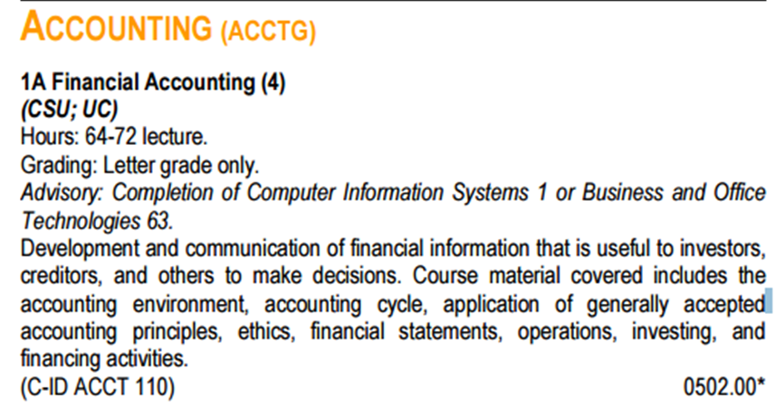
PUBLIC DISPLAY OF CODES
Although not mandated, some colleges include some codes in their Catalog.
TOP CODE

Slide 29
PUBLIC DISPLAY OF CODES
COCI is also accessible to the public. One can perform searches by TOP or SAM Code.
Appendix (questions from the session):
- Regarding apprenticeships:
http://extranet.cccco.edu/Divisions/WorkforceandEconDev/PolicyAlignmentandOutreach/ApprenticeshipCalifornia.aspx
Regarding where SOC Codes are kept: Locally, it varies who maintains them.

Slide 30
THANK YOU!
Any questions?
Shireen Awad- sharon.awad@chaffey.edu
Marie Boyd- marie.boyd@chaffey.edu
Eric Wada- Eric.Wada@flc.losrios.edu

