Slide 1
David Garcia, COCI Admin, Chancellor’s Office Rachel Stamm, Curriculum Systems Consultant, CCC Technology Center
Working with the Chancellor’s Office Curriculum Inventory (COCI)
Breakout Session
Curriculum Institute, Summer 2018

Slide 2
Session Description
The Chancellor’s Office Curriculum Inventory (COCI) maintains all program and course elements that require Chancellor’s Office approval. Although the guidelines for its use are documented in the Program and Course Approval Handbook (PCAH), veteran users are familiar with its quirks and perks, short-cuts and work-arounds, and know how to calm it down when it throws a tantrum. If you are one of these brave and often not-fully appreciated souls, or you would like to learn from them, this session is for you.

Slide 3
Today’s Topics
This quirky little system…
Proposal Owner
CCCCO Reviewer
Search and Filter Options
Actual Membership Benefits…
Credit Course Approvals
Sub Changes for Programs
Program Modifications
Short cuts and work-arounds eventually become paved roads…
Bulk Upload
Adding courses to programs
Legacy Documents

Slide 4
This Quirky Little System…
Proposal Owner
CCCCO Reviewer
Search and Filter Options

Slide 5
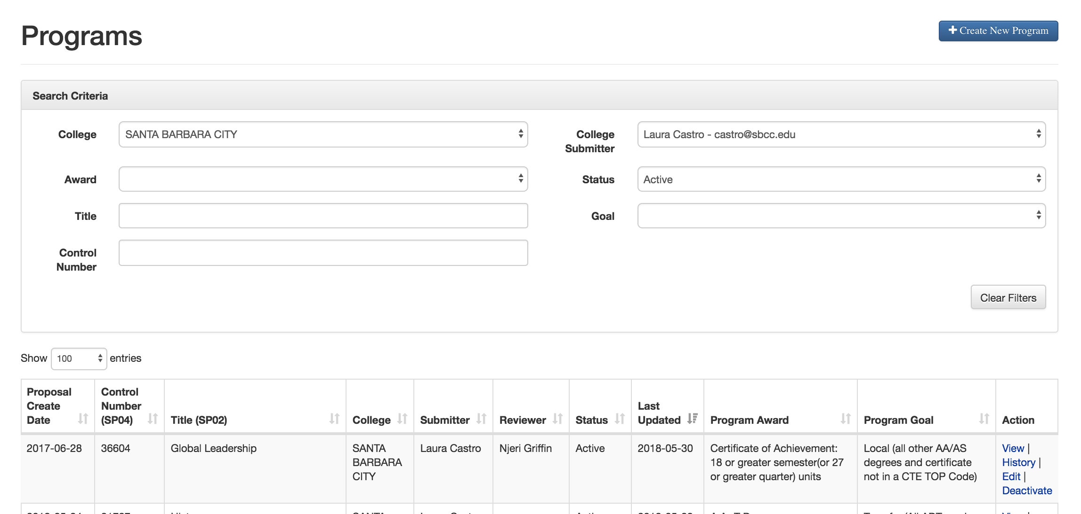
Changing Proposal Owner
Locate the Course or Program needed and select “Edit”

Slide 6
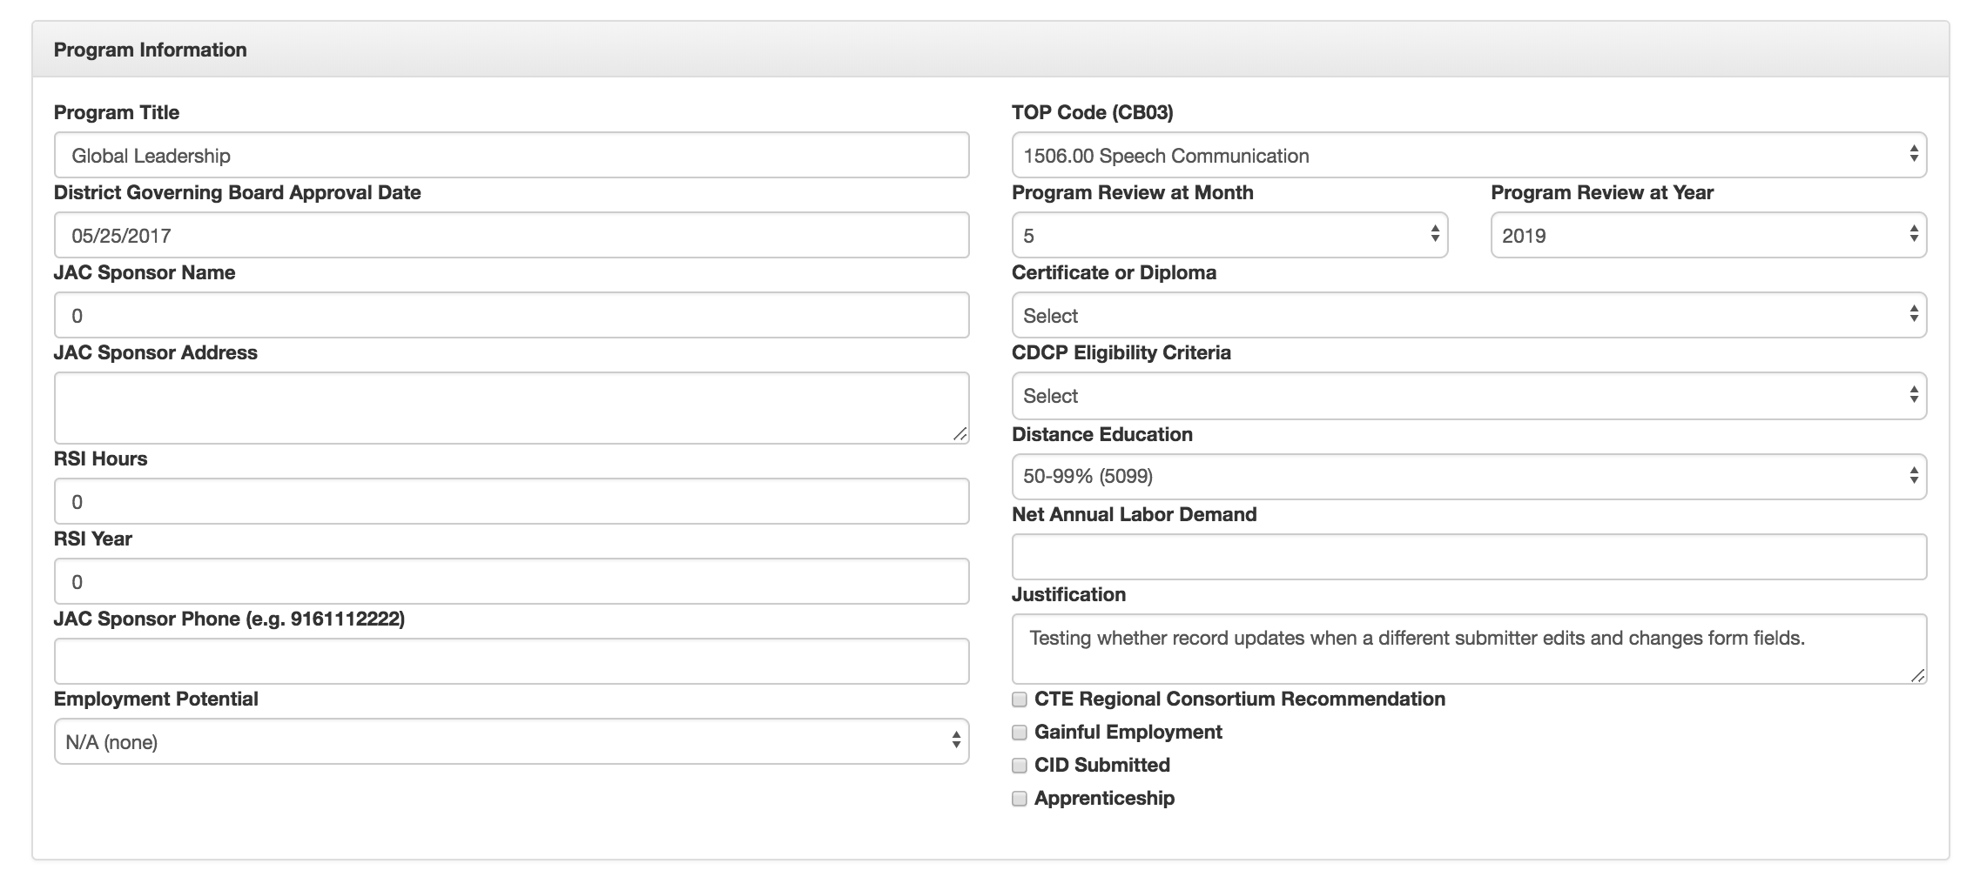
Changing Proposal Owner
Note the change made to the record in the ”Justification” field

Slide 7
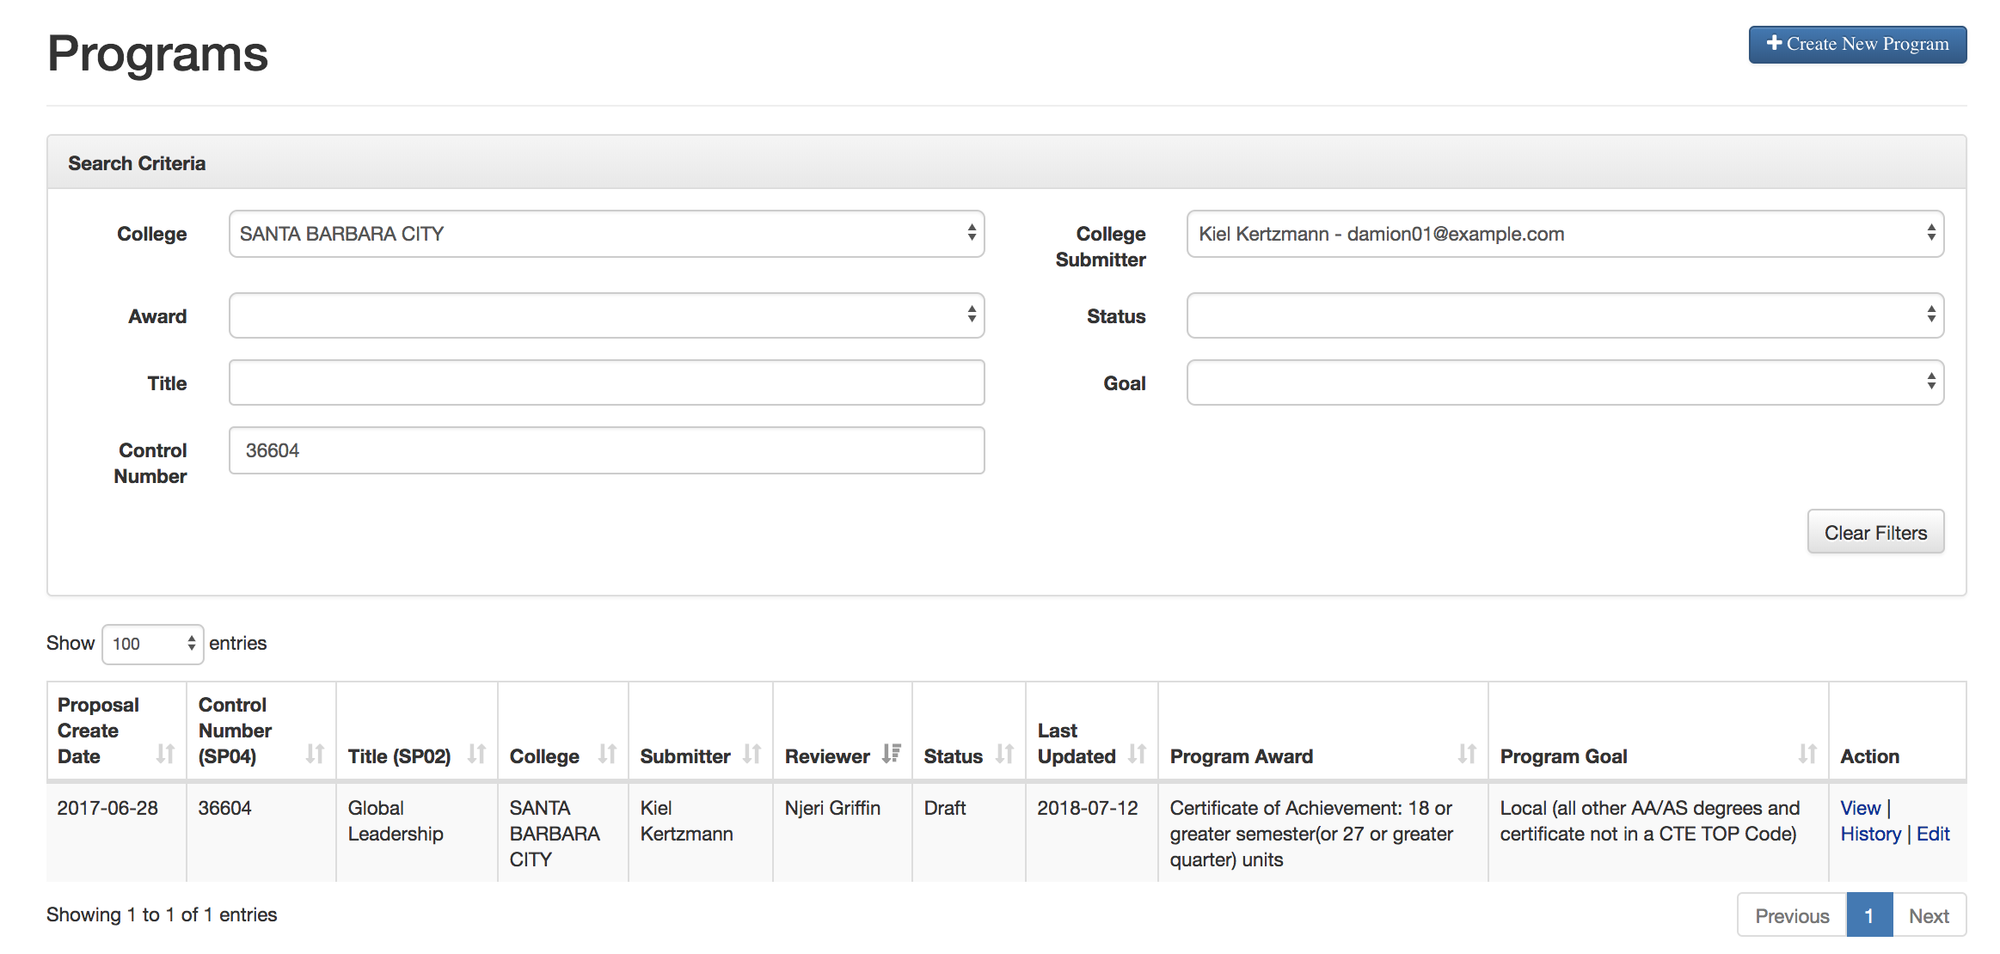
Changing Proposal Owner
Submitter Name Updated

Slide 8
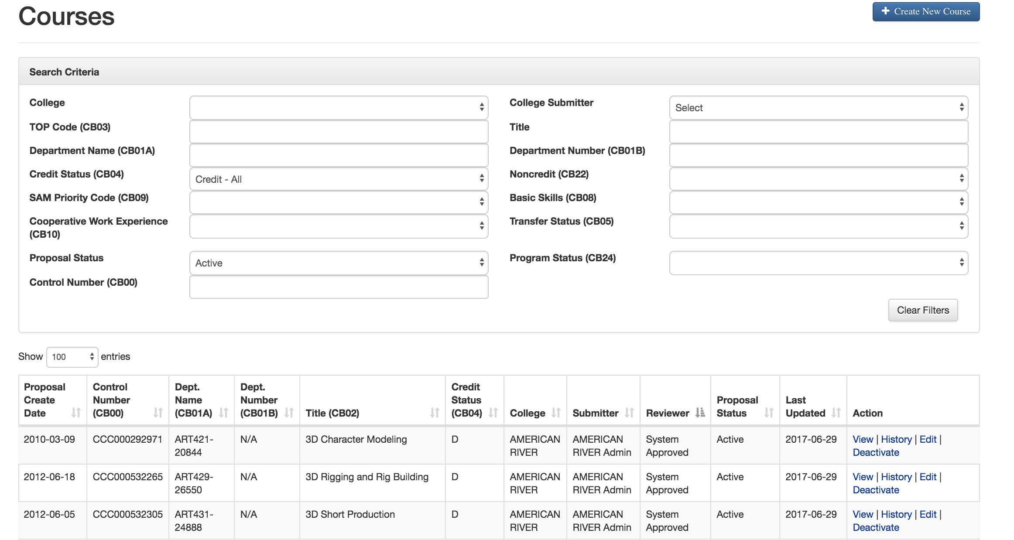
CCCCO Reviewer Name
Credit Courses Now reflect System Approved in Reviewer Column

Slide 9
To Recap
College Submitter name updates when a different submitter (or College Admin) edits an existing record and then selects “Save” or “Submit”.
Updates were made to how the assigned reviewer displays on courses and programs main pages.
These changes were required to as part of the layout updates under development right now.
We’re working to have these changes part of our Fall Release.

Slide 10
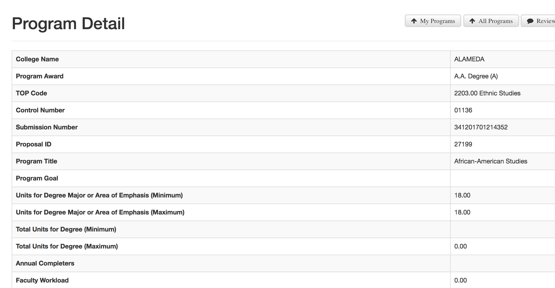
Current Program Detail Page

Slide 11
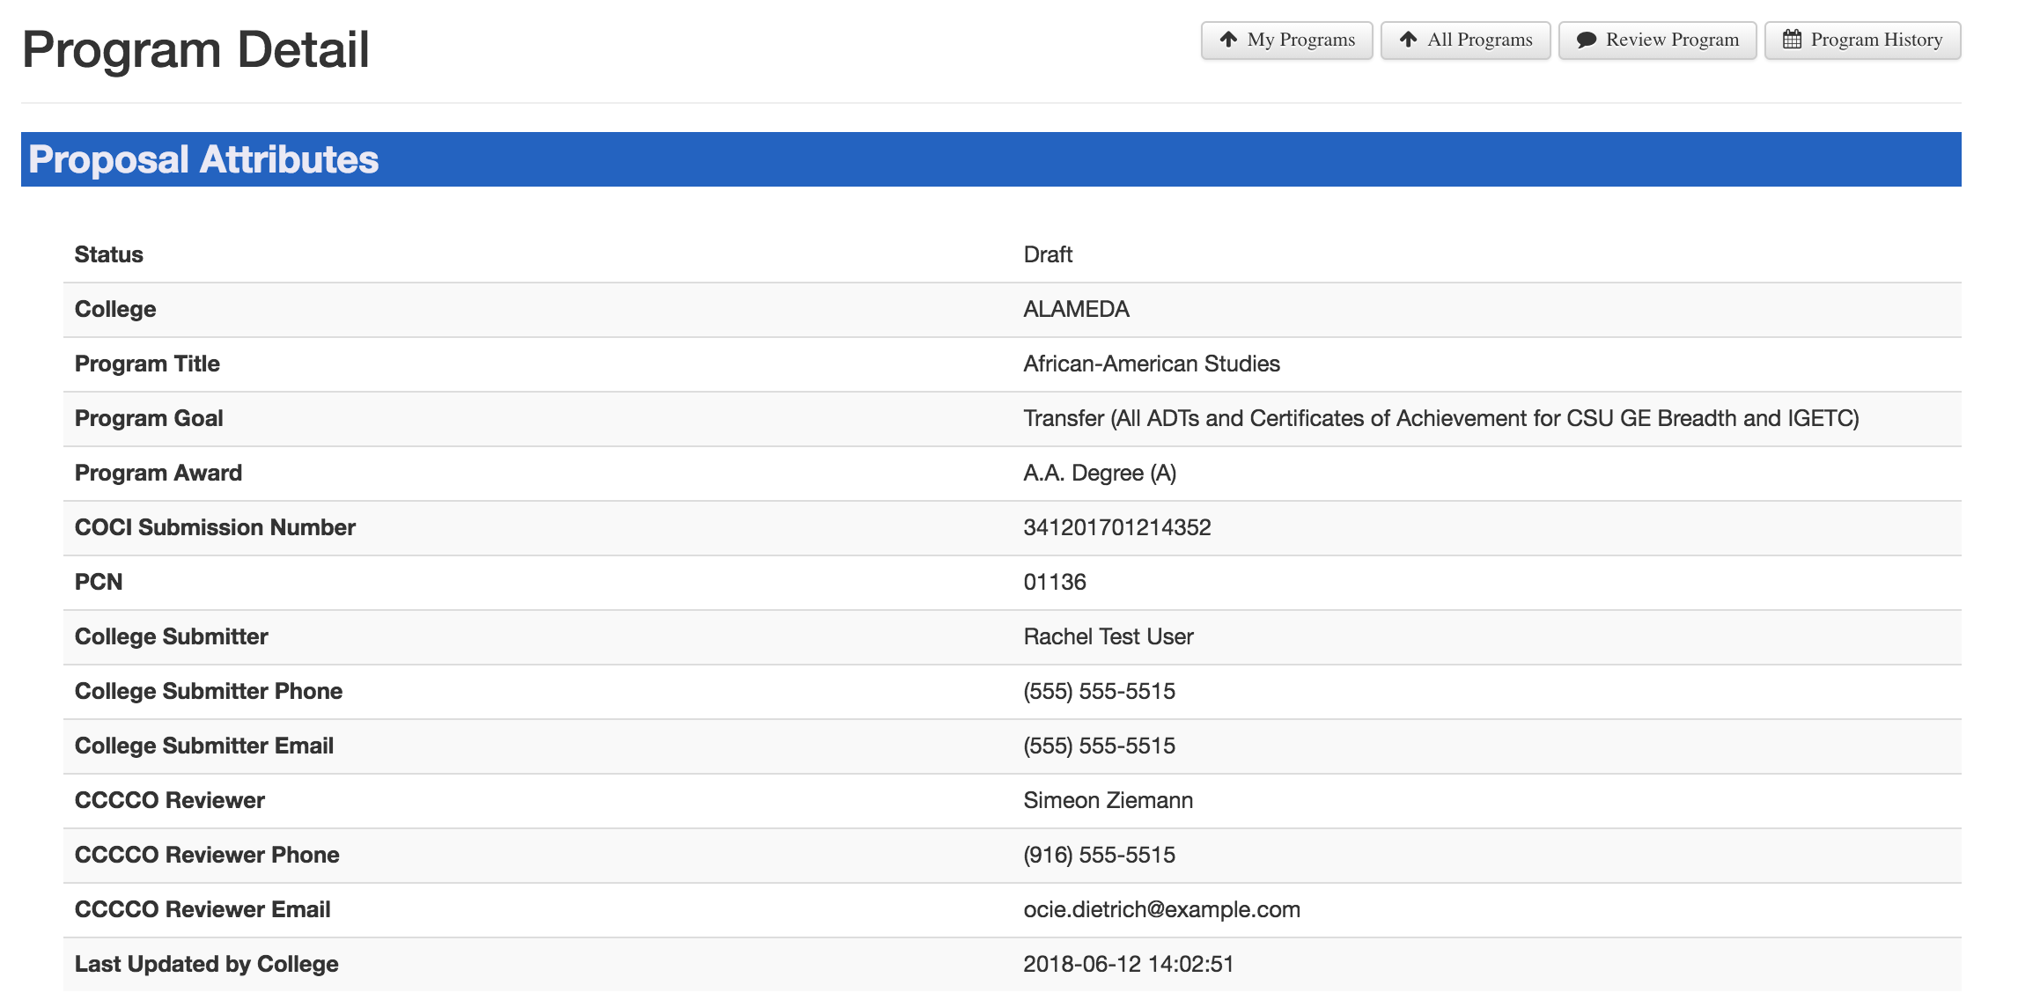
New Program Detail Page

Slide 12
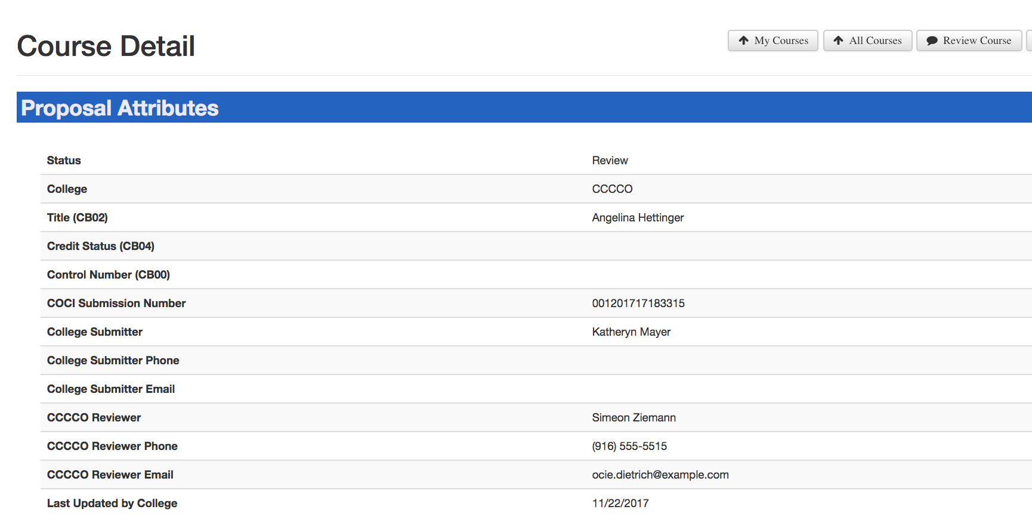
New Course Detail Page

Slide 13
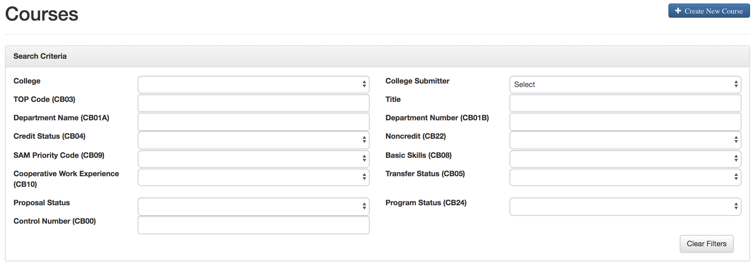
One More Change…
Can’t Search by “Review”

Slide 14
Review Made It
“Review” finally made it to the list!

Slide 15
Membership Benefits…
Credit Course Approvals
Sub Changes for Programs
Program Modifications

Slide 16
Who Owns Curriculum
The College.
The content of Courses and Programs in COCI belongs to the College and the College is responsible for its completeness and alignment with the standards in the PCAH.
The College is responsible ensuring the Control Number assigned matches the correct version of the Course or Program.
The College is responsible for maintaining data parity between with curricula approved locally and curricula in the inventory.

Slide 17
Who Owns Curriculum
The College.
The content of Courses and Programs in COCI belongs to the College and the College is responsible for its completeness and alignment with the standards in the PCAH.
The College is responsible ensuring the Control Number assigned matches the correct version of the Course or Program.
The College is responsible for maintaining data parity between with curricula approved locally and curricula in the inventory.

Slide 18
The Role of the CCCCO
The Chancellor’s Office reviews the content of Courses and Programs (using both human and automated processes) to validate its completeness and alignment with the standards in the PCAH.
The Chancellor’s Office is responsible for assignment of a unique Control Number for all Courses and Programs that successfully validate.
The Chancellor’s Office is responsible for maintaining an inventory of all validated curricula across California Community Colleges.

Slide 19
The Role of MIS
MIS consumes Course and Program data from COCI and is responsible for generating a unique CCN for Courses after a final set of validations are completed.
MIS is the owner of the Data Element Dictionary and is responsible for the field integrity checks on CB data elements to be in alignment with the PCAH and CCCCCO Curriculum policies.

Slide 20
COCI Benefits
Credit Course Auto-Approval
Insight into CCN Assignment Errors
Sub-Change flags removed entirely from Programs
Course documents added and updated to program proposal automatically
Sub-Change flag removed for changes to last 2 digits of TOP Code for Courses (Fall Release)
Public Reports reflect same data elements as DataMart (Fall Release)
Auto-Approval for select Program modifications (Fall Release)

Slide 21
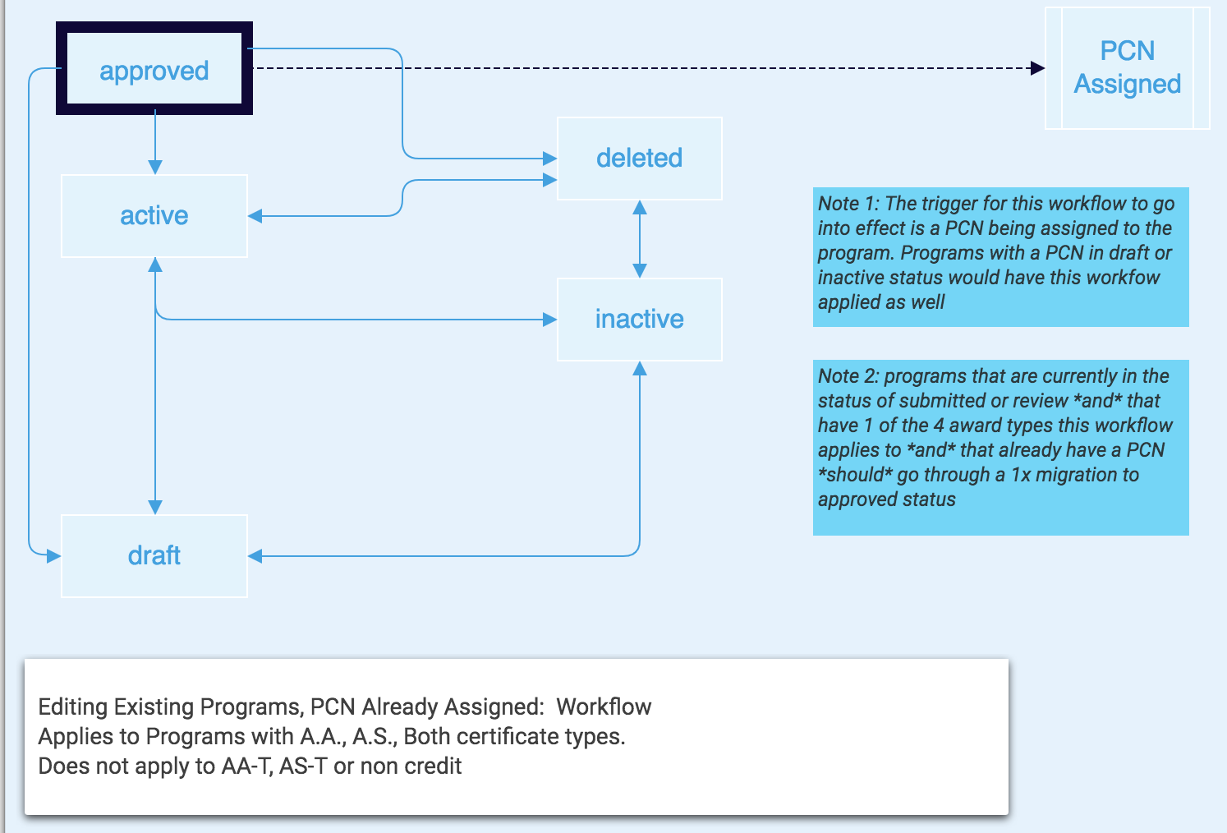
Program Modifications

Slide 22
To Recap
Workflow changes apply to the following program award types: A.A., A.S., Certificate 12-18, Certificate 18+.
Once released a Program will go from Active to Edit and back to Active on submit.
These 4 Program awards will essentially be on auto-approval for modifications.
Users will be able to modify Programs iteratively and the ”Submit” button becomes Submit these changes to the database rather than Submit to the CCCCO for review.

Slide 23
Short cuts and work-arounds eventually become paved roads…
Bulk Upload
Adding courses to programs
Legacy Documents

Slide 24
Bulk Upload
It’s not ready for prime time.
Challenges have included:
Inbound file format
Criteria for accepting or rejecting a file
Rules for changes to Sub=Change fields
Reflecting changes in field history

Slide 25
Adding Courses to Programs
Expanded course statuses loading in table to make updates and edits to Programs more efficient.
Changes made to results display:
Courses with statuses: active, approved, revision, review or submitted now display in the search results
Courses with statuses of active, revision, review, or submitted must have control numbers
Courses in approved status appear independent of CCN assignment
YYYYYYYYY is an acceptable search parameter in he control number field.

Slide 26
Legacy Documents
Legacy documents have been one of the most challenging and stressful parts of this new system.
Documents have been corrupted, disassociated from the record or hidden beneath the parent record.
We’ve updated the onscreen messaging when it appears a record is corrupted or cannot be found.
We’ve added tools to regenerate official Approval Letters from within the screens.
We’ve identified a solution for documents hidden under the parent record.
An example…

Slide 27
Regenerated Documents
Today in production, Program Architectural Drafting from Saddleback is in Approved Status, but isn’t showing any associated documents

Slide 28
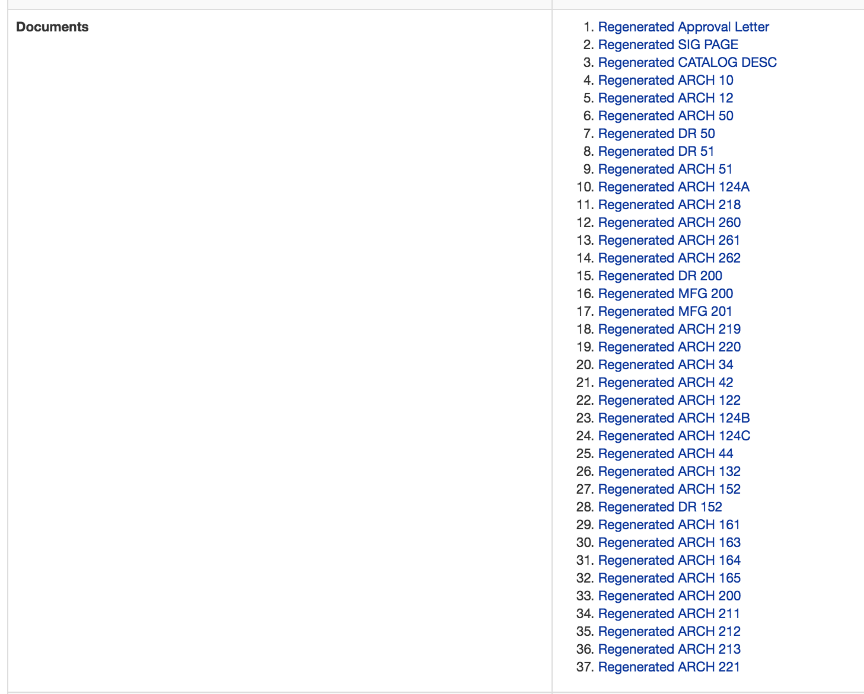
Regenerated Documents
Today in pilot, the Program Architectural Drafting from Saddleback is in Approved Status, and is now showing most of the original documents.
Documents restored as part of this fix will be flagged with “Regenerated” in the document link

