Slide 1
Intrusive and Embedded Counseling:
Collaborative Instructor-Counselor Work to Support Student Success
Brandi Asmus, Woodland Community College
Dolores Davison, ASCCC Secretary

Slide 2

Why Did You Choose This Session?
Role at the college
Interest in effective practices
Other?

Slide 3
What is Embedded/Intrusive Counseling?
Intrusive counseling is based on the philosophy that the counselor and the student share responsibility for student academic success or failure. (Connell, 2003)
Embedded counseling includes counseling during scheduled course meetings or other structure to ensure that students are able to engage with counselors in a timely manner.

Slide 4
Why Should You Be Interested in Intrusive/Embedded Counseling?
Simplifies intake/advising process and makes students better informed
Provides support for both students and faculty
Early anecdotal evidence demonstrates some improvement in success/completion rates

Slide 5
Effective Practices:
Facilitated Counselor-Instructor Collaboration At Santa Barbara City
College
Initial Steps:
Confronting Preconceptions About the Role of Counseling
Communicating Regularly and Effectively Between Counselors and Faculty
    One-on-one conversations
    Monthly group meetings

Slide 6
Benefits of the SBCC Model
Provides a safety net for students and faculty
Helps maintain high standards for personal responsibility
Gives students more personal attention, and this makes them more likely to succeed

Slide 7
Benefits of the Model
Makes faculty more knowledgeable about requirements for degrees and transfer, course availability, etc.
Helps students build relationships with counselors and the campus
Shows students that faculty and counselors are a single support network, working together for their success

Slide 8
Making The SBCC Model Work
Advising Students
  Registration Advising Sessions
  Aligned Message around Student Responsibilities
Classroom Presentations
Building Community
  Learning from each other
  Sharing a common purpose: The success of our students

Slide 9
Evidence from SBCC: Exit Survey Results, Fall 2016
82% of all students surveyed found the counselors helpful to them over the course of the semester.
  84% of these respondents indicated that their chosen Learning Community was a good fit for them
  85% answered that their expectations had been met
  88% were confident that they were prepared for the courses that follow.
  The face to face connection of the faculty, counseling staff and students remains the program's greatest asset.

Slide 10
Extend the Classroom (ETC) at Bakersfield College
Vision: The vision of Extend the Classroom is to compel students to actively seek support services in order to be successful in their academic, personal, and career goals.
Mission: The mission of Extend the Classroom is to identify and motivate at-risk students in order to foster their academic, personal, and career success.

Slide 11
Why Faculty at Bakersfield Support ETC
Student Friendly
Shared Curriculum
Professional Support
SLO Assessment Data
Adjunct Friendly
Extends Office Hours
Improved Student Success Overall

Slide 12
Intrusive Counseling at Bakersfield College
Early alerts from faculty
Phone calls and emails
Blunt conversations
Conversations beyond academics
Walking students to support services
Following up
Two Major Lessons:
Students will not seek out services that they do not realize they need.
Many if not most academic failures do not have anything to do with academics

Slide 13
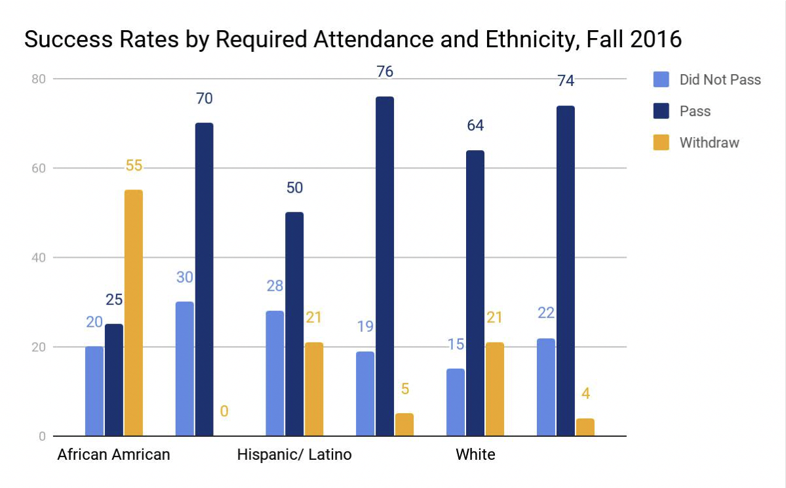
Phase 1 – 12 Sections
Left Column is Without ETC; Right Column is With ETC

Slide 14
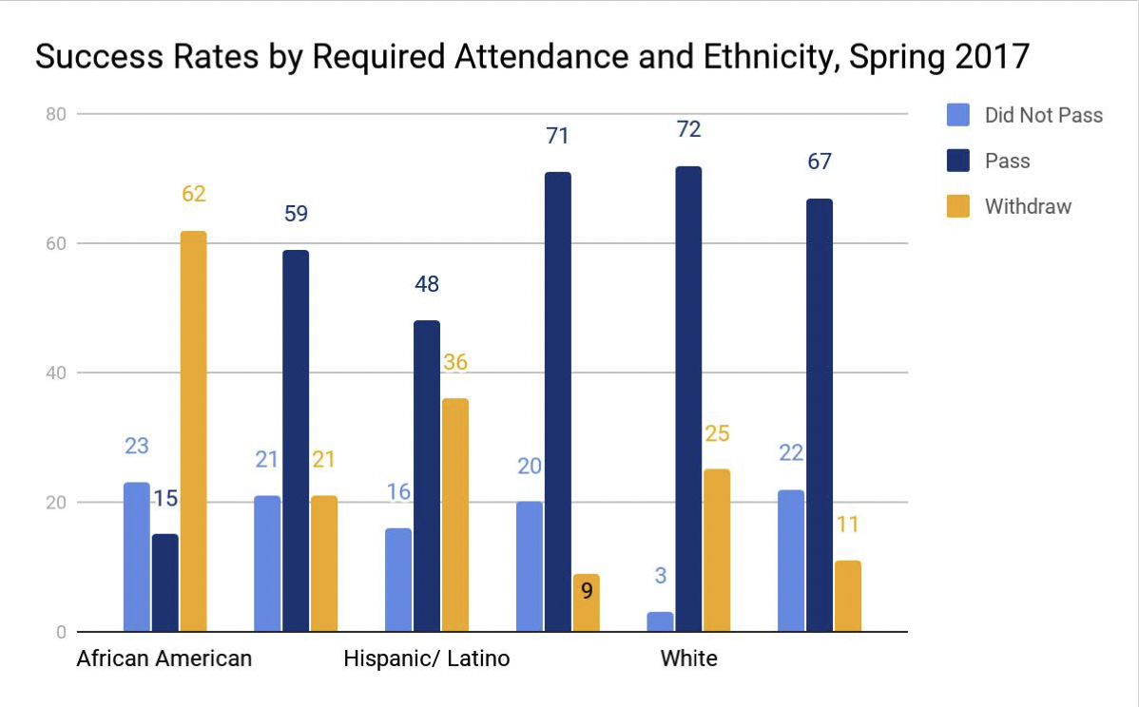
Phase 2 – 24 Sections

Slide 15
Suggestions and Challenges from Bakersfield
Tips:
Culture of mentoring and sharing
Hiring Process for Faculty and Staff
Recruiting process for Peer Mentors
Shared curriculum and textbook
Shared CMS shell (Canvas)
Challenges:
“Full” buy-in
Hiring/training/funding peer mentors
Attendance at the ETC and ensuring participation
Faculty time/pay or compensation

Slide 16
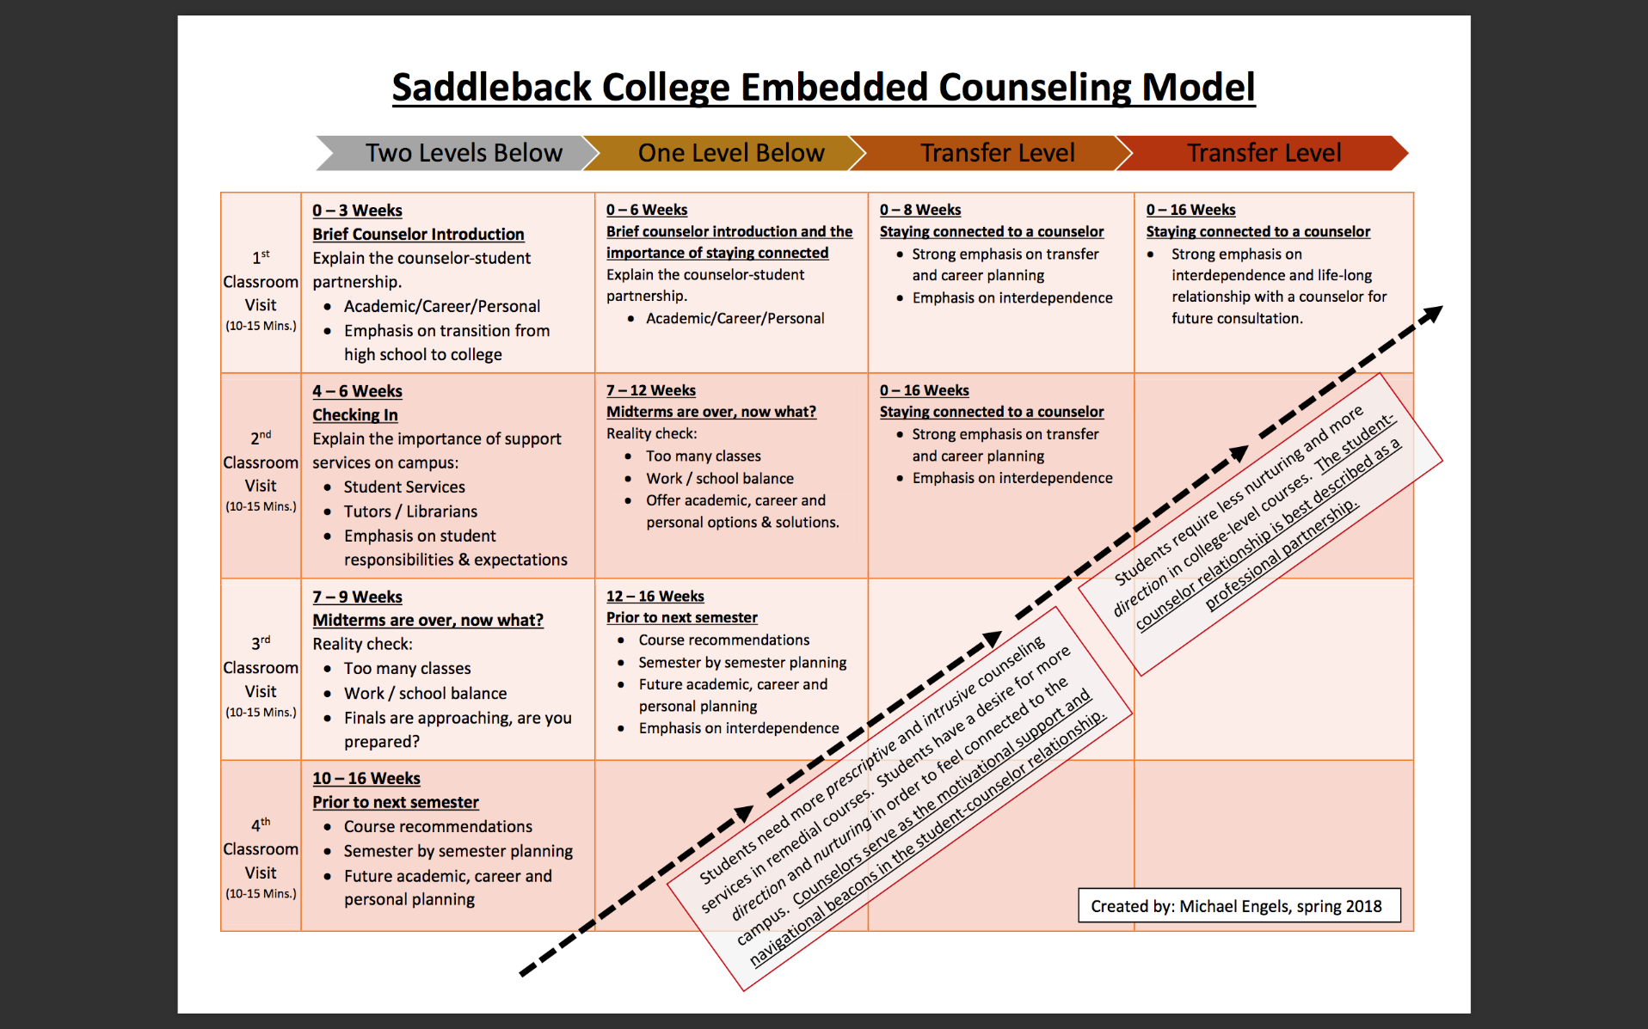
Saddleback’s Embedded Counseling Model

Slide 17
Questions?
Thank you!
Brandi Asmus (basmus@yccd.edu)
Dolores Davison (davisondolores@foothill.edu)

