Slide 1
Entrepreneurship Curriculum Development with Makerspace Concepts!
Curriculum Alignment Project – Inland Empire Regional Consortium
Lisa Kiplinger-Kennedy – Deputy Sector Navigator, Business & Entrepreneurship
Frank Almeida – Moreno Valley College
Marie Boyd – Chaffey College, Curriculum Chair
Pamela Stegeman – College
Ajene Wilcoxson – Riverside City College
Patty Worsham – Norco College
2019 Career and Noncredit Institute
ASCCC

Slide 2
:
Notes:
“a place in which people with shared interests, especially in computing or technology, can gather to work on projects while sharing ideas, equipment, and knowledge.”

Slide 3
Inland Empire/Desert Regional Consortium Curriculum Alignment Program
What this project was:
Small Business Curriculum Alignment and Development: A collaborative effort of Business Entrepreneurship faculty, a deputy sector navigator in Business and Entrepreneurship, and a curriculum chair to create mutually agreed upon and T5 compliant Course Outlines of Record (CORs), stackable certificates and a “local” AS degree in Entrepreneurship.
An attempt at creating curriculum which, once reviewed by the Regional Consortium and Chancellor’s Office, could be submitted and rapidly approved by all colleges in the consortium.
What this project was not:
An “official” C-ID effort or an ADT degree
A conjoint program
Notes:
LISA

Slide 4
C-ID Basics Refresher
Began in 2007 as a pilot project to replace CAN (California Articulation Number) and provide a response to the call for a “common course numbering system”
Faculty-based system of common course identifiers and descriptors
Provides a mechanism for identifying required courses in Associate Degrees for Transfer (ADTs)
Descriptors: sets expectations for course content, rigor, and student learning outcomes or objectives.
Receipt of a C-ID designation confirms a course meets the published standards of course content, rigor, and student learning outcomes or objectives.
Notes:
MARIE

Slide 5
C-ID: Intersegmental vs Intrasegmental
Initial Goal of C-ID: Facilitate transfer process for California students by increasing articulation between postsecondary education segments and institutions
Intrasegmental Articulation
Between CCCs
Intersegmental Articulation
CSU – TMCs > ADTs
UC Transfer Pathways
System transfer agreements with HBCUs, CA Independent Colleges & Universities
Articulation & transfer agreements with local colleges & universities – any entity can articulate with all CCCs by agreeing to articulate a C-ID descriptor
Notes:
MARIE

Slide 6
Model Curriculum (MC) Refresher
MC = Model Curriculum. MC may be developed for CTE or non-transferable programs or transfer programs that are not aligned with TMC criteria. CTE MCs are developed collaboratively between CCC faculty, Doing What Matters key talent, and industry.
DIG = Discipline Input Group. A meeting of faculty formed to initiate the discussion of C-ID course descriptors and MCs or TMCs. All faculty are welcome to attend and provide feedback at the DIG for their discipline.
It should be noted that model curriculum (MC) falls outside of SB 1440/440 and is not subject to the limits and mandates associated with such legislation. As a result, MCs will not obligate colleges to develop MC-aligned degrees or certificates. Each college may determine if the model curriculum is appropriate for their program and students.
For more information regarding model curriculum please see the model curriculum FAQ on the C-ID Model Curriculum page
Notes:
MARIE
First two bullets from Cheryl’s plenary 2019 PP
Last three bullets from the C-ID Model Curriculum Page: https://www.c-id.net/model-curriculum

Slide 7
Notes:
MARIE

Slide 8
Streamlined Approval Refresher
Conversations regarding the streamlining of curriculum approval began in the Fall, 2016 under Vice Chancellor Pam Walker.
Beginning Fall, 2017, The Chancellor’s Office required all Colleges to certify that local training occurred to support the curriculum streamlining process of all credit course proposals, modified credit programs, and local credit programs, with the exception of Associate Degrees for Transfer (ADTs) and new Career Technical Education credit programs. Periodic reviews of the locally approved and certified curriculum will be conducted by the Chancellor’s Office to monitor compliance and data integrity.
Presently, the California Community College Curriculum Committee (5C) is discussing streamlined curriculum approval for MC aligned CTE curriculum.
Notes:
MARIE

Slide 9
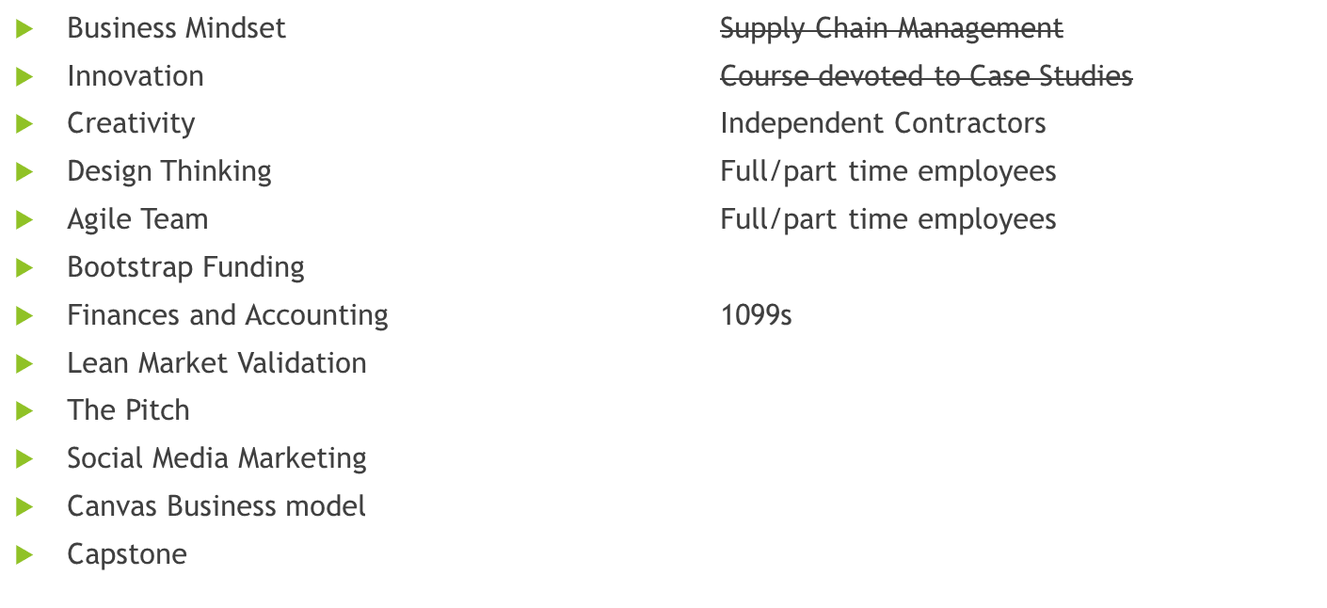
Beginning Points – Curriculum Design Course Content
Shout Out to Santa Ana college curriculum
MOOCS!
Santa Barbara City College curriculum
Course Content
Notes:
FACULTY PRESENTERS: PATTY, FRANK, PAM & AJENE
Talk about how the team surveyed the subject areas and discussed:
Which were most important broad topics for each course
How to prevent overlap
Checked and double-checked to make sure all relevant content was covered somewhere
Negotiating in times of differences in opinion!
How we might get a set of objectives established for one course, but then realize something was left out and had to go back to revisit a course we had thought was completed

Slide 10
Finished Products
ENTRE 100 Introduction to Entrepreneurship
ENTRE 104 Entrepreneurship Basics
ENTRE 105 Starting a Business with Limited Resources
ENTRE 107 Money, Finance and Accounting for Entrepreneurs
ENTRE 108 Business Model Canvas and Presentations
ENTRE 110 Entrepreneurial Simulation
ENTRE 112 Building an Entrepreneurial Team
ENTRE 114 Solopreneur
Notes:
PATTY, FRANK, PAM & AJENE

Slide 11
Curriculum Topics – In the Weeds with a Curriculum Geek!
T5 required elements in a Course Outline of Record (COR) versus local process
T5 required elements in a Course Outline of Record (COR) versus accreditation requirements
What’s an “integrated” Course Outline of Record?
What’s the difference between Content and Objectives??
Unit Values PCAH
Where do SLOs belong?
Notes:
MARIE & PAM

Slide 12
Curriculum Design – Title 5 and Beyond!
Stackable Certificates – what does T5 say? NOTHING!
Funding Formula!
Financial Aid!
Notes:
MARIE & PAM

Slide 13
Professional Development Topics
How different colleges in our consortium handle Minimum Qualifications
External Accreditors and Their Benefits
i.e., Accreditation Council for Business Schools and Programs
Title 5 requirements of a Course Outline of Record versus academic freedom
Load issues – credit versus noncredit
Notes:
MARIE & PAM

Slide 14
Articulation Topics
Transfer curriculum versus non-transfer – how do colleges establish “transfer” level curriculum?
Why do we need to include out of class assignments on our Course Outlines of Record
Why do we need to include textbooks on our Course Outlines of Record?
Open Education Resources in place of traditional texts:
Open Textbook Library
Notes:
MARIE
Center for Open Education | 330 Wulling Hall | 86 Pleasant St SE | Minneapolis, MN 55455 USA | open@umn.edu
College of Education and Human Development | University of Minnesota

Slide 15
Regional Consortium Topics
Streamlined recommendations
Streamlined approval at the Chancellor’s Office
Entrepreneurship Curriculum available to CCCs throughout the State
Notes:
MARIE

Slide 16
Next Steps
MAJOR OUTCOMES:
A cohesive regional Small Business curriculum. DONE
Region-wide Entrepreneur certificate pathway. ALMOST DONE
• Strong regional partnerships between CC, K12, and industry sectors.
Portable Small Business and Entrepreneur Curriculum. DONE
• A skilled and trained workforce within the areas of Gig economy, nonprofits, and small businesses.
Notes:
LISA

Slide 17
Individual Impressions Overall…..

Slide 18
Individual Impressions Overall…..

Slide 19
Questions? Thank you!
Contacts:
Lisa Kiplinger-Kennedy –lisak.kennedy@vvc.edu
Frank Almeida – Frank.Almeida@rccd.edu
Marie Boyd – marie.boyd@chaffey.edu
Paul Hiller - philler@msjc.edu
Dave Hollomon – David.Hollomon@vvc.edu
Tara Johnson – tara.Johnson@chaffey.edu
Denise Pasley – dpasley@barstow.edu
Pamela Stegeman – pstegeman@collegeofthedesert.edu
Ajene Wilcoxson – Don.Wilcoxson@rcc.edu
Patty Worsham – Patty.Worsham@norcocollege.edu

