Slide 1
Effective Practices for Working with CTE Advisory Committees and Regional Consortia
Dianna Chiabotti, Napa Valley College
Senior Dean- Career Education and Academic Pathways
Carrie Roberson, ASCCC North Representative
Kim Schenk, Diablo Valley College
Senior Dean- Curriculum & Instruction
2019 Curriculum Institute: Decoding Your Curriculum
Thursday, July 11
3:45 pm – 5:00 pm

Slide 2
REALITIES!
Paradigm shift, NOW…and forever?
Students and the student experience
System driven by legislation and law
CCCCO, CCC system, local college, department/program, course, other?
Student needs!
114 ways of doing,
114 ways of being

Slide 3
Here we are…
CTE program approval processes require input from local Advisory committees and review by the Regional Consortium to validate the proposed program’s responsiveness to labor market demand and employer needs. This breakout will focus on the process for Consortium review, the roles and responsibilities of Deputy Sector Navigators and the Regional Consortia in CTE program development, as well as tips and tricks to ensure the effectiveness of advisory committees.

Slide 5
WHY?
Legislative and Regulatory Guidance
California Education Code, Section 66010.4
“A primary mission of the California Community Colleges is to advance California's economic growth and global competitiveness through education, training and services that contribute to continuous workforce development.“
California Government Code, Section 15370.24
"The California Community Colleges shall work with businesses and employers to identify, on a region-by-region basis, work force education and training needs, including the needs of small business and create networks of service providers that meet identified needs in the most cost-effective and timely manner."

Slide 6
And…
Chapter Four:
California State Plan for Vocational and Technical Education outlines the role of the Community College system in workforce preparation and mandates the efforts to improve linkages, cooperation and collaboration among a variety of partners to "produce responsive solutions to workforce development needs.“ (pg.16)
Plan advocates the development/strengthening of linkages between:
· Secondary education
· Post-secondary education
· Business
· Industry
· Labor
· State and local government
· Community representatives
· Students

Slide 7
OTHER?
Perkins IV: PART B, SEC. 121. STATE ADMINISTRATION
(8) describes how the eligible agency will annually evaluate the effectiveness of such career and technical education programs, and describe, to the extent practicable, how the eligible agency is coordinating such programs to ensure non-duplication with other Federal programs;
California State Plan: Requirements of Local Educational Agency CTE Programs Assisted with Section 131 and 132 Funds (Page 223)
Have extensive business and industry involvement, as evidenced by not less than one annual business and industry advisory committee meeting and planned business and industry involvement in program activities as described in the Guidelines for the 2008–2012 Local Plan for Career Technical Education and instructions for the annual application for funds.
California Education Code Section 78016 (a) Every vocational or occupational training program offered by a community college district shall be reviewed every two years by the governing board of the district to ensure that each program, as demonstrated by the California Occupational Information System, including the State-Local Cooperative Labor Market Information Program established in Section 10533 of the Unemployment Insurance Code, or if this program is not available in the labor market area, other available sources of labor market information, does all of the following:
(1) Meets a documented labor market demand.
(2) Does not represent unnecessary duplication of other manpower training programs in the area.
(3) Is of demonstrated effectiveness as measured by the employment and completion success of its students.
Program and Course Approval Handbook, Sixth Edition, July 2017, pp. 75,76,77, 85 Page 75, 76
B. Criteria for Approval – Career Technical Education Degrees: AA and AS

Slide 8
ACCJC Accreditation Standards
Standard II: Student Learning Programs and Services
Instructional Programs
14. Graduates completing career-technical certificates and degrees demonstrate technical and professional competencies that meet employment standards and other applicable standards and preparation for external licensure and certification.
16. The institution regularly evaluates and improves the quality and currency of all instructional programs offered in the name of the institution, including collegiate, pre-collegiate, career-technical, and continuing and community education courses and programs, regardless of delivery mode or location. The institution systematically strives to improve programs and courses to enhance learning outcomes and achievement for students.

Slide 9
Title 5, Section 55601: Appointment of Vocational Education Advisory Committee
The governing board of each community college district participating in a vocational education program shall appoint a vocational education advisory committee to develop recommendations on the program and to provide liaison between the district and potential employers. The committee shall consist of one or more representatives of the general public knowledgeable about the educational needs of disadvantaged populations, students, teachers, business, industry, the college administration, and the field office of the Employment Development Department.

Slide 10
Advisory Committee Role
Title 5 §55601 The governing board of each community college district participating in a vocational education program shall appoint a vocational education advisory committee to develop recommendations on the program and to provide liaison between the district and potential employers.

Slide 11
CTE Program Approvals
Approved Program
Recommendation of Regional Consortia
Local Curriculum Process Approval
Recommendation of the Program Advisory Committee

Slide 12
Do you know your Regional Consortium?

Slide 13
Regional Consortia Role
Recommend programs for approval to the Chancellor’s Office
*Consider: Undue impact on other colleges, Labor Market Data (LMI)
Title 5 §55130(b)(8)(E):
(8) The need for the proposed program ascertained with regard to at least the following factors:
(A) Other community colleges in the area currently offering the program;
(B) Other programs closely related to the proposed program offered by the college;
(C) Relation of the proposed program to job market analysis, where applicable;
(D) Enrollment projection for the proposed program;
(E) Recommendations of career technical education regional consortia, when applicable; and
(F) The classification of the courses in the program in accordance with section 5500l.

Slide 14
Deputy Sector Navigator (DSN):
Deputy Sector Navigators
Work with region’s colleges and employers to create alignment around workforce training and career pathways.
Connect faculty & colleges with:
Other faculty & colleges with similar programs
K-12, adult schools, and workforce agencies to support program enrollments
Local business, industry, unions to identify/validate skills gaps
Regional advisory committees (where they exist) to validate curriculum

Slide 15
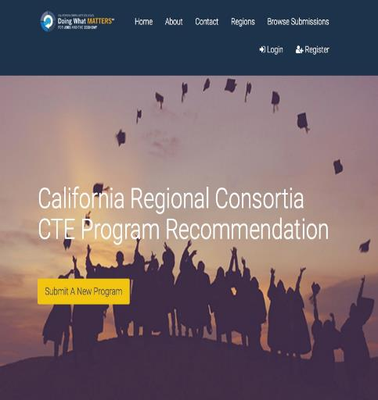
www.regionalcte.org

Slide 16
YOUR TURN! ~ACTIVITY~
How can a college
leverage dynamic and expertise
from advisory committees?

Slide 17
Effective Practices
PROGRAM REVIEW:
Program effectiveness, SLO/PLO success, other?
STUDENT LEARNING EXPERIENCES:
Internships, jobs, work experience, guest speakers, contextualized learning, other?
COMMUNICATION:
Ongoing, multi-way, other?
PARTNERSHIPS:
Connections to DSN, Guided Pathways, K-12, Transfer institutions, other?
IDENTIFY the HOW:
CCCCO/SWP funding, functions/roles change, support for time required, evaluation, other?

Slide 18
QUESTIONS…& THANK YOU!
Dianna Chiabotti
dchiabotti@napavalley.edu
Kim Schenk
kschenk@dvc.edu
Carrie Roberson
RobersonCa@butte.edu

