Slide 1

Equity, Guided Pathways and Accreditation: A Partnership for Student Success
Sonya Christian, President, Bakersfield College
Stephanie Curry, ASCCC North Representative, Accreditation Committee Chair
Stephanie Droker, ACCJC President

Slide 2
General Session Description
Accreditation and Guided Pathways are both focused on the assessment and improvement of institutional systems. As each of our colleges reviews systems, processes and policies through the guided pathways framework we focus on how we can improve our institutions and make them student centered. In this opening session, learn about the ACCJC recent changes to streamline processes and focus on innovation and excellence rather than compliance. Learn how the important work being done in California Community Colleges in Guided Pathways and Equity provides evidence of meeting ACCJC Accreditation standards.

Slide 3
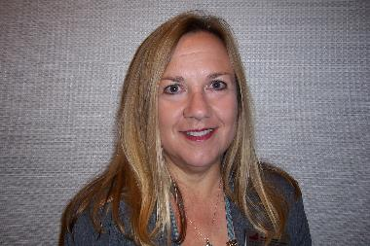
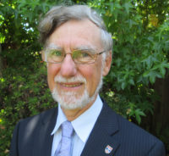
WELCOME!
Virginia “Ginni” May, ASCCC Treasurer
Ian Walton, ACCJC Commission Chair

Slide 4
Institute Theme
Equity, Guided Pathways and Accreditation: A Partnership for Student Success

Slide 5

Institute Goals
1. Show the alignment of Guided Pathways, Equity and Diversity with Accreditation
2. Identify how Faculty can take a lead role as drivers of continuous quality improvement
3. Promote cross-functional collaboration for holistic responses to the Accreditation Standards focusing on systemic support for student success

Slide 6

Breakout Types
1) Informative-Workshops focus on the presentation of information to attendees. These breakouts will be lecture style with the use of presentation technology such as PowerPoint
2) Collaborative- Workshops focus on the sharing of ideas and information between presenters and attendees and among attendees
3) Interactive- Workshops combine the lecture style of informative worships but might also have interactive collaborative activities such as small group work or think/pair/shares

Slide 7

2020 Accreditation Institute APP
Instructions in your Program

Slide 8
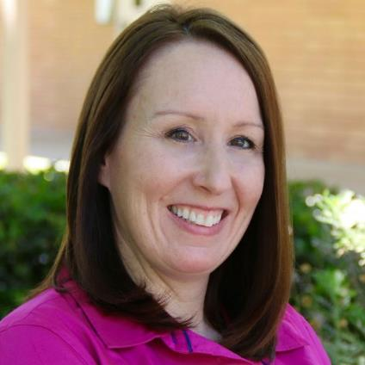
ACCJC President
Dr. Stephanie Droker

Slide 9
ACCJC’s Commitment to our Members
The Accrediting Commission for Community and Junior Colleges supports its member institutions to advance educational quality and student learning and achievement. This collaboration fosters institutional excellence and continuous improvement through innovation, self-analysis, peer review, and application of standards.
Ensuring Accreditation is Value-Added to Institutions
  Balance the importance of compliance with improvement and innovation
  Protect and honor peer review
  Review colleges in the context of their unique missions

Slide 10
ACCJC’s Strategic Plan 2020 - 2025
  Goals
    Foster innovation
    Lead advocacy efforts on accreditation
    Collaborate and communicate to improve educational quality
  Meeting our Goals
    Restructure the comp review process (Fall 2022)
    Develop a new standards framework (launch 2021)
    Build internal capacity of our agency
    Nurture ongoing collaborations and partnerships
    Increase two-way communication opportunities

Slide 11

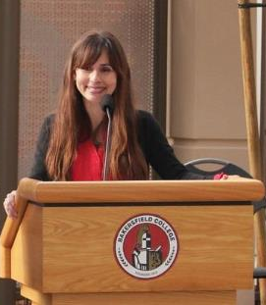




Equity, Guided Pathways and Accreditation:
A Partnership for Student Success
February 21, 2020 | ASCCC Accreditation Institute
@CalCommColleges
#BeingClear #BeingBold
bakersfieldcollege.edu
sonyachristianblog.com
@sonyachristian
sonya.christian.96
Sonya Christian
President, Bakersfield College

Slide 12
I could talk about…
$150 million in legislated funding
AB705
AACC Guided Pathways Project
California Guided Pathways Demonstration Project
SB1440
Vision for Success
California Guided Pathways Advisory Committee
Student-Centered Funding Formula
Guided Pathways Summits

Slide 13
I could talk about
It’s All About Student Learning & Achievement
Standard I.B: Assuring Academic Quality & Institutional Effectiveness
I.B.1: Sustained dialogue
Standard IV.A: Decision-Making Roles & Processes
IV.A.1: Innovation leads to institutional excellence
IV.A.5: Decision-making aligned with expertise
I.B.9: Resources & Structure advance mission
I.B.3: ISS
I.B.5: Disaggregated data

Slide 14
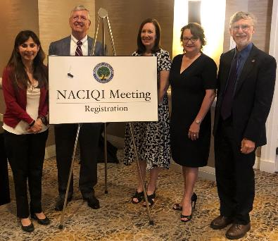
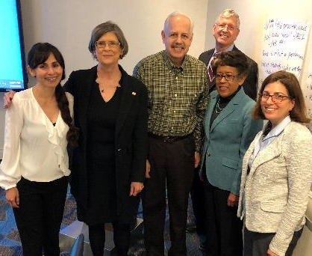

Slide 15





I could talk about…
I.A
I.B
II.A
II.A
I.C
II.A
II.B
II.C
II.A
II.B
II.C
Standards III & IV

Slide 16
Interdependence
Accreditation
State
#BeingBold
#BeingClear
College

Slide 17


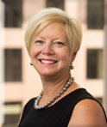
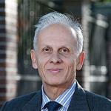
#BeingClear #BeingBold
Accreditation – Being Bold. Being Clear
ACCJC
CHEA 2020
CIQG 2020
Foster Innovation
Improve Quality
Recognize Learning
Innovation
Building peace in the minds of men and women
Beyond Academic Excellence
Societal Impact, Equity and the Pursuit of Truth

Slide 18
#BeingClear #BeingBold
One minute paper:
What are one or two things that excited
you about this presentation?
#BeingClear #BeingBold
#ASCCC2020 #CACCsLearn

Slide 19

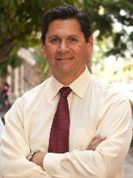




#BeingClear #BeingBold
The State (CA) – Being Bold. Being Clear.
Vision for Success
CACCs

Slide 20

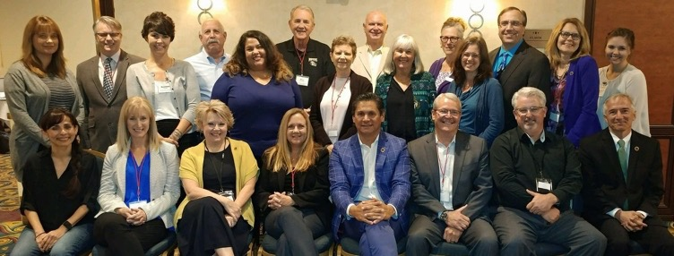
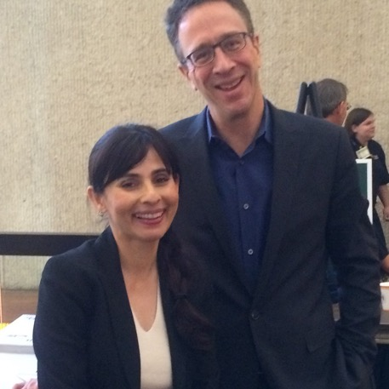
#BeingClear #BeingBold
CACCs – Being Bold. Being Clear.

Slide 21
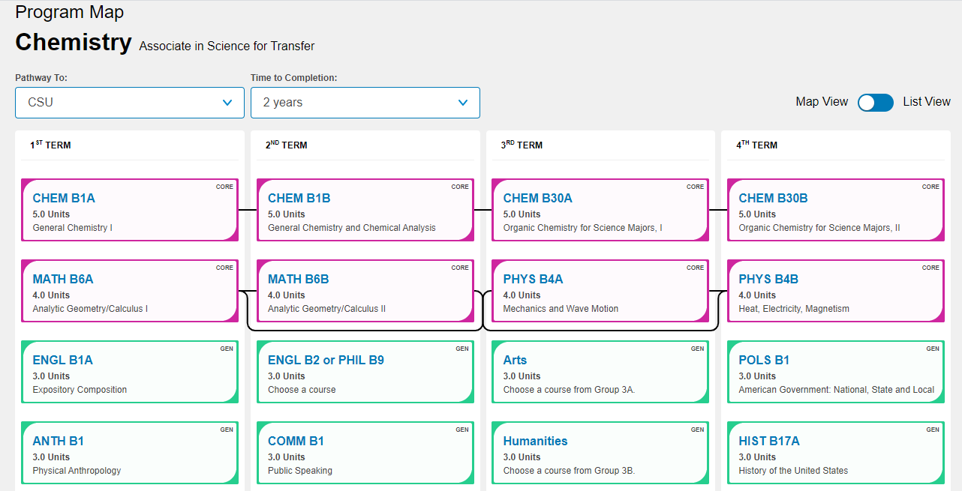
#BeingClear #BeingBold
CACCs – Being Bold. Being Clear.

Slide 22
CACCs – Being Bold. Being Clear.
=15 units
=15 units
=15 units
=15 units

Slide 23
Boldly Innovate
How would you dismantle and rebuild existing structures to advance student learning and achievement?
Issuer Information
Criteria
Tags
Alignment with Standards
Date of Issuance
Expiration Date
Notes:
Section V: Let’s take back learning
Faculty leadership in the development of microcredentials supports a continuity from the curriculum, to classroom practice, to assessment, and connects it with the student’s future.
The development of microcredentials around our SLOs gives the SLOs relevance and connection to the students and to the outside world. The “what we know” and the “how we know it” is embedded in each badge, which means assessment is part of the DNA.
This continuity and connection helps us move from “assessment and instruction” to “assessment-driven instruction”, where the subject matter, the teaching methods, and the assessment of learning are coordinated to ensure that students have mastery of key concepts and skills.

Slide 24




SLO 1: The student will upload to a server…
SLO 2: The student will …
SLO 3: The student will …
SLO 4: The student will …

Slide 25


Slide 26
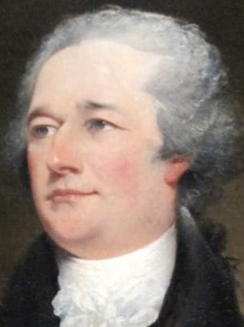
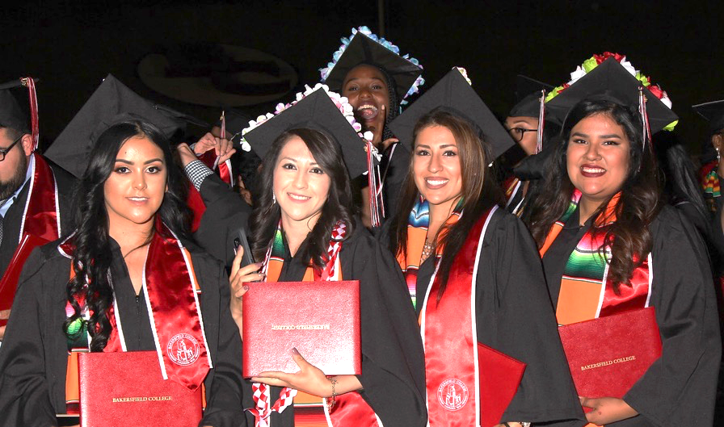
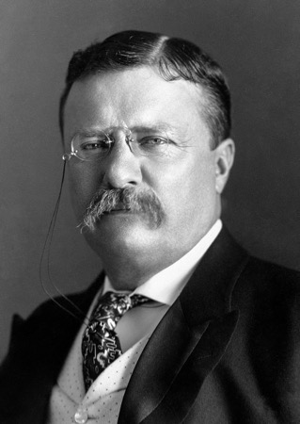
Who do we serve?
Alexander Hamilton
1755-1804
Theodore Roosevelt
1858-1919
Bakersfield College Graduates 2019

Slide 27
New Student Enrollment Growth Since 14-15

Slide 28
Boldness Leads to Excellence in Outcomes
Increased Number of Latinx Students Transferring to CSU
Notes:
Pretty flat numbers for African American and Asian students, declining numbers for white students and large increases for Hispanic students.

Slide 29
Boldness Leads to Excellence in Outcomes
Increased Number of Latinx Students Transferring to UC
Notes:
Pretty flat numbers for African American and Asian students, declining numbers for white students and large increases for Hispanic students.

Slide 30
Percent Enrollment Growth by Race

Slide 31
Proportionality Index getting closer to One for Most Groups
Notes:
A PI value of 1.0 indicates an absence of disproportionate impact. These results show that Hispanic and White populations have low levels of disproportionate impact (generally PI must be 0.80 or less to be considered substantive). There is strong PI for Black students, although the situation appears to be improving somewhat in the latest data from Fall 2019.
Proportion of Ethnicity in CCC Four Years Prior Relative to Proportion of Ethnicity among CSU Transfers

Slide 32
Boldness Leads to Excellence in Outcomes
Are we moving the only dial that matters?
#EquityMatters
61.6%%
Notes:
In 2017-18, 67.8% of all ADT awardees were Latinx which exactly mirrors our enrollment
No gap!
Grew from 61% to 67.8%

Slide 33
Boldly Partnering Beyond Our College
Have we engaged our partners in advancing our mission?
Early College
Guided Pathways
Dual Enrollment

Slide 34
Boldness Leads to Excellence in Outcomes
Are we moving the only dial that matters?
67% avg.
52% avg.

Slide 35
#BeingClear #BeingBold
One minute paper:
What are one or two things that excited
you about this presentation?
#BeingClear #BeingBold
#ASCCC2020 #CACCsLearn

Slide 36
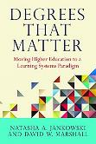
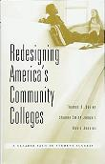
#OccupyLearning
Guided Pathways Pillar 4 Ensure Learning. Accreditation Student Learning.
1. Learning is Socially Constructed
Degrees that Matter: Consensus
2. Coherent learning pathways
Degrees that Matter: Aligned
3. Take Teaching to the Learner
Degrees that Matter: Learner Centered; Pillar 4: Learning Facilitation
Equity-Mindedness Prioritizes Relevance
Pillar 4: Internships, field trips, & project-based learning. AACU: HIP
4. Learning Visible
Degrees that matter: Communication. WICHE Passports. Badges
Learning Transcends Compliance
Beyond “academic excellence” to “societal engagement”
Notes:
So a statistical treatment of disaggregating data to tell the story misses the point. Rather, understanding that the “learning” is “socially agreed upon” in the years that kids as they grown up spend with their families, creates a “learning divide” if approached in a traditional manner. The academy, particularly the community colleges must “close this learning divide” by customizing the “social construction” within the classroom and outside the classroom to unleash the power of learning within each of our students. A broad brush answer to this is to make the “socialization” relevant. And the “relevancy” is done through internships, field trips, project-based learning.
When these changes are universal it will become the “universal design for disabilities.” When there are curb cuts for wheelchair users we don’t question it. It is the same with learning.

Slide 37
#BeingClear #BeingBold
One minute paper:
What are one or two things that excited
you about this presentation?
#BeingClear #BeingBold
#ASCCC2020 #CACCsLearn

Slide 38

Questions?
#BeingClear
#BeingBold
#ASCCC2020 #CACCsLearn

Slide 39
Some additional slides to show the interdependence of Equity, Accreditation, Guided Pathways

Slide 40
Standard I.B: Assuring Academic Quality & Institutional Effectiveness
At Bakersfield College, institutional effectiveness is defined by our ability to ensure student learning and achievement.
Student outcomes – not process outcomes – drive all institutional planning and we measure our success in advancing student learning and achievement using research-based momentum points.

Slide 41
Standard I.B: Assuring Academic Quality & Institutional Effectiveness
An example: Bakersfield College is engaging in continuous improvement of student learning by pursuing clarity of student learning through microcredentialing, badging, and competency-based education.

Slide 42
Understanding Student Achievement
Standard I.B.1 | GP Strategies
The institution demonstrates a sustained, substantive, and collegial dialogue about student outcomes, student equity, academic quality, institutional effectiveness, and continuous improvement of student learning and achievement | Momentum Points Program Pathways Mapper Outcomes over Process Microcredentialing Badging

Slide 43
Understanding Student Achievement
Standard I.B.3 | GP Strategies
The institution establishes institution-set standards for student achievement, appropriate to its mission, assesses how well it is achieving them in pursuit of continuous improvement, and publishes this information | Momentum Points Vision for Success Student Equity Plan Tableau/Data Dashboards Data Coaching

Slide 44
Improving Institutional Effectiveness
Standard I.B.9 | GP Strategies
The institution engages in continuous, broad based, systematic evaluation and planning. The institution integrates program review, planning, and resource allocation into a comprehensive process that leads to accomplishment of its mission and improvement of institutional effectiveness and academic quality. Institutional planning addresses short- and long-range needs for educational programs and services and for human, physical, technology, and financial resources. | Momentum points Outcomes over process Resource Braiding Program Pathways Mapper Closing the Loop

Slide 45
Standard IV.A: Decision-Making Roles & Processes
At Bakersfield College, student learning and achievement is not just the purview of faculty.
Instead, BC’s guided pathways redesign is a whole-college effort, engaging faculty, staff, administrators, and students in the work to ensure institutional excellence.

Slide 46
Standard IV.A: Decision-Making Roles & Processes
At Bakersfield College, institutional leaders (faculty, administrators, staff and students) create the conditions for innovation by leveraging our intentionally-designed formal structures and empowering all individuals and committees to innovate through a distributed leadership model.

Slide 47
Innovation to Excellence
Standard IV.A.1 | GP Strategies
Institutional leaders create and encourage innovation leading to institutional excellence. They support administrators, faculty, staff, and students, no matter what their official titles, in taking initiative for improving the practices, programs, and services in which they are involved. When ideas for improvement have policy or significant institution-wide implications, systematic participative processes are used to assure effective planning and implementation. | Intentionally-designed formal structure Distributed leadership Program Pathways Mapper Completion Coaching Communities Kern Promise Early College

Slide 48
Decision-Making Structures
Standard IV.A.5 | GP Strategies
Through its system of board and institutional governance, the institution ensures the appropriate consideration of relevant perspectives; decision-making aligned with expertise and responsibility; and timely action on institutional plans, policies, curricular change, and other key considerations. | Distributed leadership Completion Coaching Communities Faculty leadership

Slide 49

Questions

Slide 50

ENJOY THE INSTITUTE!

