Slide 1
Community College Noncredit Funding: Tracking Student Attendance in Noncredit Michelle Fischthal, D.B.A. VPI San Diego College of Continuing Education LaTonya Parker, ASCCC Area D Representative Matthew Rivaldi, MBA, Faculty San Diego College of Continuing Education Jan Young, MBA Glendale College, ACCE President

Slide 2
Welcome
Even before the pandemic, noncredit classes have been offered in fully online and hybrid formats. Many colleges have struggled to implement online noncredit courses because of unique challenges with the attendance accounting procedures, but San Diego College of Continuing Education has been navigating policy and funding for online Noncredit instruction for more than 15 years. Please join us for a discussion about funding and attendance accounting for online instruction for Noncredit students and how you might be able to use some of the same structures as San Diego College of Continuing Education to offer these exciting opportunities to students and update on the status of AB 421 (Ward).
Notes:
Matthew

Slide 3
Today
Introductions
About San Diego College of Continuing Education
Noncredit Attendance Reporting
Noncredit Course Design - Faculty Perspective
AB-421 - Link
Notes:
Matthew

Slide 4
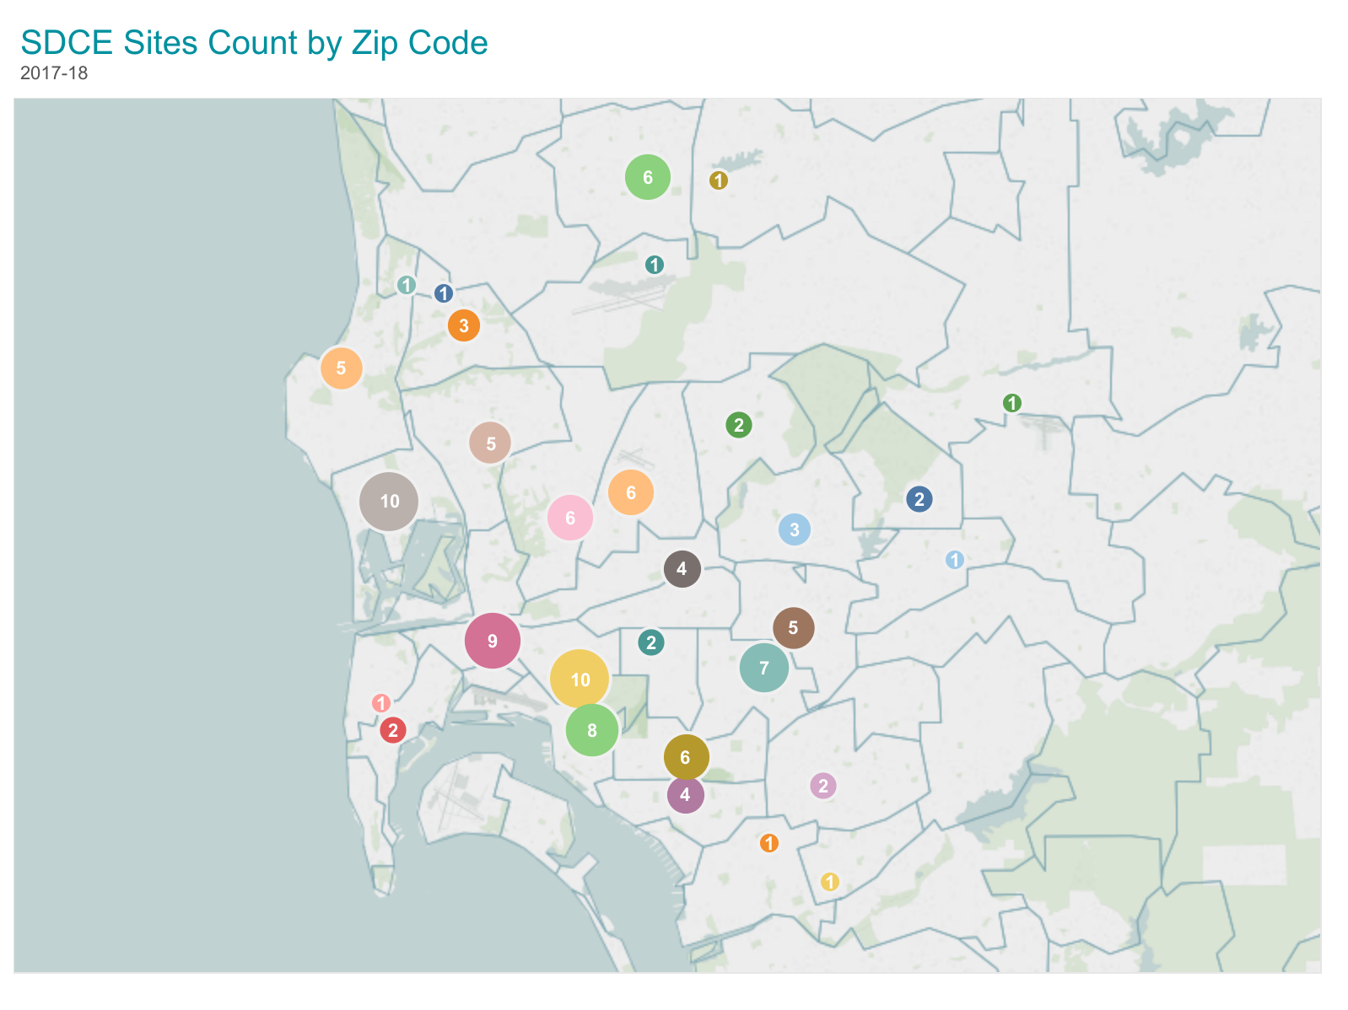
About San Diego College
of Continuing Education
104 years in service
One of four divisions of the
San Diego Community College District
One of the largest noncredit institutions in CA - Separate WASC Accreditation
Classes are FREE
Serve 40,000+ students annually
Students range in age from 18-100+
All are welcome!
7 campuses + 150 offsite locations
Notes:
Michelle

Slide 5
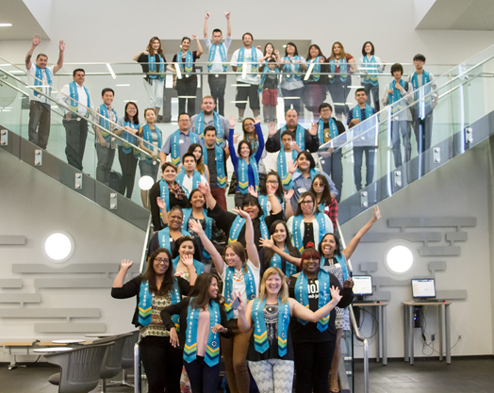
SDCCE Seven Pillars for Student Success
Employment Security
Food Security
Housing Security
Transportation Security
Financial Literacy
Textbook and course material affordability
Intellectual and Emotional Security
Notes:
Michelle

Slide 6
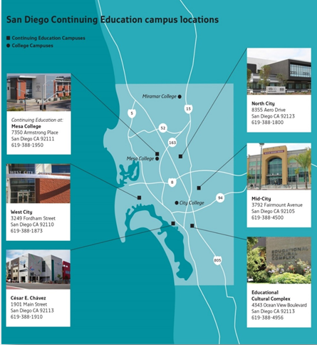
Online Courses @ San Diego College
of Continuing Education (www.sdce.edu)
Enrollments:
2013-14: 3,443 online enrollments
2017-18: 7,372 online enrollments
= 114% increase of SDCE students enrolling in noncredit online classes
FTES:
2013/14: 138.0 FTES
2017/18: 344.9 FTES
2018/19: 456.0 FTES
= FTES increased by 330%

Slide 7
SDCCE Fully Online Program Buildout
https://sdce.edu/icom
Notes:
Michelle
SDCCE applied for the CVC-OEI grant in order to start offering fully-online programs in 2020 (and then COVID hit!). Up until this time all of our programs were Hybrid - although we did have some fully online classes.
We started the build out with our Business and Technology program and have now moved onto ESL and HSEP. WE will have 22 programs fully online by fall which is about 25% of our CDCP programs.
The intent is to provide both synchronous and asynchronous instruction - in fact it must include online face-to-face instruction, low or zero textbook costs, and significant interaction from faculty to student and student to student.

Slide 8
Noncredit Attendance Reporting
An example from San Diego
College of Continuing Education
Notes:
Matthew

Slide 9
Note
This presentation does not reflect or represent the California Community College Chancellor’s Office (CCCCO) or any other institution.
Information in this presentation may not be pertinent to your institution or stakeholders. It is recommended that each institution consult with Title 5 and stakeholders before implementing a noncredit attendance procedure. Due to the complexity of the Noncredit Alternative Accounting Method, institutions may interpret the language differently.
Notes:
Matthew

Slide 10
In Class (noncredit)
Online (noncredit)
Positive Attendance
Based on actual hours of student attendance (15 minute increments)
Census Based
Total hours of instruction or programming received by the students +
plus instructor contact (defined by Title V, Section 55204) +
outside-of-class work expected as noted in the course outline of record and approved by the curriculum committee…
Summarized from: Title 5 58003.1 (f) (2)
Notes:
In Class or “Face-to-Face”
MAtthew

Slide 11
Hours Illustrated - “The Bucket”
Imagine the hours that are needed to teach a course are represented by a “bucket.”
How big the bucket is is based on the Course Outline of Record (COR). The number of hours is an agreement with the State of California to fund the course.
For example BUSN 630, Small Business Planning, has a “bucket” that contains 54 “Lecture/Laboratory Hours” based on the COR.
54 HOURS
OF
INSTRUCTION OR PROGRAMMING
LECTURE/LABORATORY HOURS 54
Notes:
matthew

Slide 12
Face-to-Face (noncredit)
Faculty “fill up the bucket” of instruction or programming with 54 hours of instructor contact by attending class at the same time as students in order to teach their courses.
SDCCE Faculty are not expected to provide office hours or contact outside of normal class time.
54 HOURS
OF
INSTRUCTION OR PROGRAMMING
LECTURE/LABORATORY HOURS 54
Notes:
Matthew

Slide 13
Face-to-Face (noncredit)
SDCCE is funded based on Full Time Equivalent Student (FTES) hours based on Positive Attendance. Students sign in and out of every class. Attendance is reported weekly.
It is important the faculty encourage regular attendance for the success of the students as well as the for the purpose for collecting FTES.
54 HOURS
OF
INSTRUCTION OR PROGRAMMING
LECTURE/LABORATORY HOURS 54
Notes:
Matthew

Slide 14
Face-to-Face (noncredit)
In addition to the hours in the course, faculty may also assign “outside of class” hours to the course, however these hours are not counted for funding purposes.
54 HOURS
OF
INSTRUCTION OR PROGRAMMING
54 HOURS OF OUTSIDE STUDENT CLASS HOURS
LECTURE/LABORATORY HOURS 54
Notes:
Matthew

Slide 15
Face-to-Face (noncredit)
SDCCE does NOT receive FTES funding for any Outside Student Class Hours. SDCCE Faculty do not provide contact for these hours.
FTES is generated from actual student hours of attendance. Title V 58006.
54 HOURS
OF
INSTRUCTION OR PROGRAMMING
54 HOURS OF OUTSIDE STUDENT CLASS HOURS
$
$
LECTURE/LABORATORY HOURS 54
Notes:
Matthew

Slide 16
Online (noncredit)
Title V 58003.1 (f)(2) defines how SDCCE calculates FTES by using three areas:
$
$
$
54 HOURS OF INSTRUCTION OR PROGRAMMING
54 HOURS OF OUTSIDE STUDENT CLASS HOURS
54 HOURS OF INSTRUCTOR CONTACT
instructor contact (defined by Title V, Section 55204) +
outside-of-class work expected as noted in the COR…
Instruction or programming received by the students +
Notes:
Matthew

Slide 17
Online (noncredit)
Whereas the hours students complete a course should be the same for face-to-face or online courses, the FTES formula has been problematic to understand both how to teach and how to track attendance.
Essential in the formula is the amount of “Instructor Contact” that students receive in order for online courses to earn similar FTES as face-to-face courses.
54 HOURS
OF
INSTRUCTION OR PROGRAMMING
54 HOURS OF INSTRUCTOR CONTACT
LECTURE/LABORATORY HOURS 54
Notes:
Matthew

Slide 18
Online (noncredit)
According to Title 5 55204, Instructor Contact is defined as contact…
“...between instructor and students, and among students, either synchronously or asynchronously, through group or individual meetings, orientation and review sessions, supplemental seminar or study sessions, field trips, library workshops, telephone contact, voice mail, e-mail, or other activities. Regular effective contact is an academic and professional matter pursuant to sections 53200 et seq.”
54 HOURS OF INSTRUCTOR CONTACT
54 HOURS
OF
INSTRUCTION OR PROGRAMMING
LECTURE/LABORATORY HOURS 54
Notes:
Matthew

Slide 19
Online (noncredit)
Just like face-to-face courses, faculty members provide opportunities for students to complete Outside Student Class Hours for online classes according to the COR.
54 HOURS
OF
INSTRUCTION OR PROGRAMMING
54 HOURS OF OUTSIDE STUDENT CLASS HOURS
54 HOURS OF INSTRUCTOR CONTACT
LECTURE/LABORATORY HOURS 54
Notes:
Matthew
SDCCE indicates Outside of Class Hours in the COR DE Addendum

Slide 20
Online (noncredit)
Title V 58003.1 (f)(2) defines how SDCCE calculates FTES by using three areas:
$
$
$
54 HOURS
OF
INSTRUCTION OR PROGRAMMING
54 HOURS OF OUTSIDE STUDENT CLASS HOURS
54 HOURS OF INSTRUCTOR CONTACT
instructor contact (defined by Title V, Section 55204) +
outside-of-class work expected as noted in the COR…
Instruction or programming received by the students +
Notes:
Michelle
So here are the three buckets in total that are used within the Alternative Accounting Method Formula. Its important to note (again) that institutions may interpret contact differently - some consider it office hours as in credit, because FTES seems very high, otherwise. It is, compared to a positive attendance class!

Slide 21
Online (noncredit)
To get similar FTES funding for an online course, SDCCE faculty thoughtfully consider all three sections - it is typical for them to add up to three times the COR.
In this example 54 x 3 = 162.
$
$
$
54 HOURS
OF
INSTRUCTION OR PROGRAMMING
54 HOURS OF OUTSIDE STUDENT CLASS HOURS
54 HOURS OF INSTRUCTOR CONTACT
instructor contact (defined by Title V, Section 55204) +
outside-of-class work expected as noted in the COR…
Instruction or programming received by the students +
Notes:
Michelle
Again, the outside hours are identified on the DE addendum attached to the COR. COntact hours are determined at the section level by the offering instructor.
MF to break in and talk about how other institutions approach it and why?

Slide 22
Online (noncredit)
From the student perspective, they ARE NOT completing 162 hours or work, they are only completing 108 hours of work to complete the course (similar to the face-to-face course).
54 HOURS OF INSTRUCTION OR PROGRAMMING
54 HOURS OF INSTRUCTOR CONTACT
54 HOURS OF OUTSIDE STUDENT CLASS HOURS
Instruction or programming received by the students +
108 HOURS
instructor contact (defined by Title V, Section 55204) +
outside-of-class work expected as noted in the COR…
Notes:
Michelle

Slide 23
Online (noncredit)
How individual faculty instructors “fill up the buckets” is entirely up to the faculty members based on the COR
DE Addendums are critical to identify online activities!
According to Title 5 55204, Instructor Contact is defined defined as contact…
“...between instructor and students, and among students, either synchronously or asynchronously, through group or individual meetings, orientation and review sessions, supplemental seminar or study sessions, field trips, library workshops, telephone contact, voice mail, e-mail, or other activities. Regular effective contact is an academic and professional matter pursuant to sections 53200 et seq.”
54 HOURS OF INSTRUCTOR CONTACT
instructor contact (defined by Title V, Section 55204) +
Notes:
Michelle
SDCCE developed DE Addendums to all the. WE identify there things like, outside of class hours, expectations of contact, the type of online course that can be offered (i.e. fully, hybrid, only in an emergency)

Slide 24
Face-to-Face (noncredit)
Online (noncredit)
Instruction Example
Instructor Contact Example
54 HOURS
OF
INSTRUCTION OR PROGRAMMING
54 HOURS OF INSTRUCTOR CONTACT
DOES NOT NEED TO BE ALL LIVE ZOOM SESSIONS!
9 hours per week
3 hours of in-class M/W/F
Lecture, quizzes, lab work, providing feedback, supervising in-class group work
9 hours per week
3 hours live synchronous via Zoom
6 hours asynchronous work - participating in discussion boards, emails, group activities
Notes:
Michelle
Title V defines noncredit online different than online credit!!!!!
Online Example: final two bullets relate to asynchronous contact

Slide 25
Online (noncredit)
How individual faculty instructors “fill up the buckets” is entirely up to the faculty members based on the COR
Outside-of-class work is not clearly defined by Title 5. We often refer to it as “homework.” SDCCE DE Committee also speaks to it as outside-of-class work without Instructor Contact.
See Instructor Contact Title 5 55204,
54 HOURS OF OUTSIDE STUDENT CLASS HOURS
outside-of-class work expected as noted in the COR…
Notes:
Michelle

Slide 26
Anything special with COVID?
Online noncredit pre COVID required in-person registration
One mandatory in-person meeting
Register for class Onsite
Orientation to LMS (Learning Management System)
Testing
Student services
Notes:
Michelle
One advantage of COVID is that we are able to enroll students without a mandatory onsite meeting

Slide 27
Noncredit Course Design
A Faculty Perspective
Notes:
Hand to Matthew

Slide 28
Recommended
Number of Hours/week of
Delivery of instruction
Examples may include but are not limited to
Discussion Boards
Voice Mail
Email (internal or external of LMS)
Chat (asynchronous & synchronous)
Texting
Accessibility development and implementation
Screencasts or other instructor’s video recording (Zoom, Camtasia)
Blogs (to initiate instructor-student & student-student contact)
Video blogs to give feedback to students’ work
Instructional Videos with close-captions or transcripts
Quizzes and exams (preparation, feedback & grading)
Social media
Instructional input/feedback/guidance to students on their work (e.g.: E-Packages/labs/textbooks)
Feedback to other students’ outside work or project
Instructional support: Respond to students' questions and troubleshoot/communicate software glitches and fixes
INSTRUCTION OR PROGRAMMING RECEIVED BY STUDENTS
Notes:
Matthew

Slide 29
Recommend
2. Number of Hours/week of
ASYNCHRONOUS, SYNCHRONOUS and/or F-2-F
Examples may include but are not limited to
Course announcements
Personalized feedback (email, video messaging, LMS messaging, podcasts, chat, texting, etc.)
Collaborative feedback (e.g.; blogs, groups discussions, wikis, podcasts, etc.)
Instructor-created Modules (e.g.: Screencasts, Recorded videos w/subtitles, etc.)
Virtual Office Hours (e.g.: Zoom, CCCConfer, Skype, etc.)
Orientation and review sessions
Telephone contact
Supplemental seminar, study sessions and/or library workshops
Video conferencing for class session, discussion, test prep/review and/or office hours (Skype, Zoom, CCCConfer)
Field trips
Supplemental seminar or study sessions on-campus
Social Media (e.g.: Twitter, Facebook, etc.)
Interactive activities among students
Other contact
INSTRUCTOR CONTACT
Find the right collaboration!
Contact defined by Title 5 55204
Notes:
Matthew

Slide 30
Recommend
3. Number of Hours/week of
OUTSIDE-OF-CLASS WORK
Examples may include but are not limited to
Videos
Rewatching recordings of live sessions
Reading book chapters or articles
Visiting websites or physical locations
Research for a project or assignment
Practicing reading, writing, speaking, presenting
Assigned Reading
Listening assignments (music, documentaries,
etc.)
Computerized exercises or practise programs (e.g.: brain fitness, simulation software, etc.)
Research
Studying
Quizzes and exams (students downloading & working offline with no instructor contact)
Other outside work or project
OUTSIDE-OF-CLASS WORK
(= not led by instructor)
Based on: Title 5 58003.1
Notes:
Mathew
Outside of class work is anything that doesn’t receive contact from the instructor

Slide 31
AB 1727 (Weber) AB 421 (Ward)
Notes:
Hand to Jan

Slide 32
AB 1727(Weber) 2020
2014 Legislature passed CDCP funding to equalize some noncredit classes and programs.
CDCP still funded based on positive attendance, not census so not truly equalized.
2020: AB1727 introduced bill co-sponsored by San Diego College and ACCE to allow “managed enrolled” CDCP classes--those that had a firm start and stop date-- to collect attendance based on census, similar to credit.
100% approval by legislature; Governor vetoes bill due to costs.

Slide 33
AB421 (Ward)
Department of Finance’s projected costs for AB1727 were twice as high as scenarios run by ACCE.
2021 Introduced AB421--same intent. Meeting with Dept of Finance to account for divergent projections.
Chancellor’s Office asked to modify bill’s provisions related to the calculation of FTES. (gives Chancellor’s Office more flexibility in case of emergencies and that no other specific accounting methods are in statue.)

Slide 34
Language of AB 421 (Ward)
(A) For CDCP courses, the units of FTES shall be computed by dividing actual student contact hours of attendance by 525, or by multiplying the weekly number of student contact hours of students in active enrollment as of Monday of the week nearest to one-fifth of the length of the term, unless another week is specified by the chancellor to incorporate past practice, by the term length multiplier, and dividing by 525.
Amend 84760.5 of the Education Code to read: The following development and college preparation courses and classes for which credit is not given, and that are offered as complement of courses, through both face-to-face and distance ed. instructional methods,

Slide 35
Thank you for your participation!
Questions and answers
Notes:
Matthew

Slide 36
Content License:
© 2021, San Diego Community College District and the respective copyright owners.
Unless otherwise noted, this work is licensed under a Creative Commons Attribution 4.0 International License.

Slide 37
End of Presentation

