Slide 1
Ensuring Learning: Accessibility & Flexibility in Equity-Driven Curriculum General Session 3: Friday July 9th 10:45pm – 12:15pm

Slide 2
THANK YOU!

Slide 3
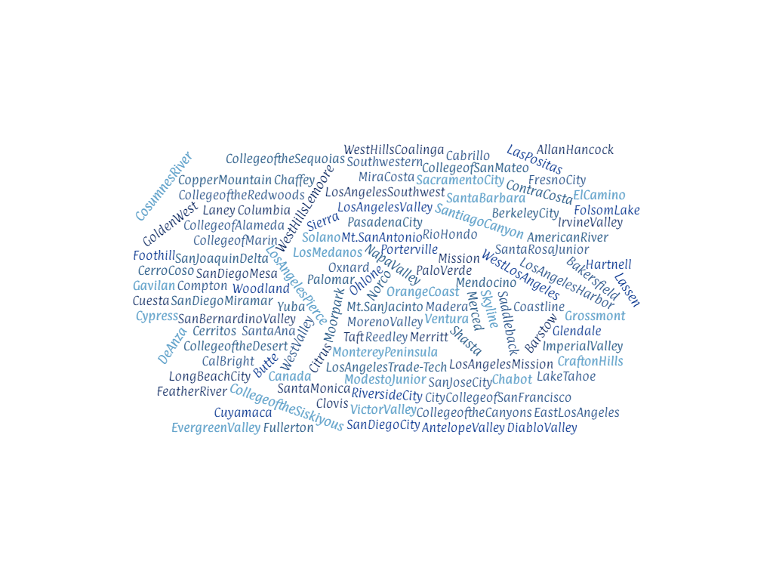
…and a special message!

Slide 4
Did you…?!
Learn
Engage
Feedback

Slide 5
CONNECT & ENGAGE!
Chancellor’s Office Curriculum Assistance Listserv:
http://listserv.cccnext.net/scripts/wa.exe?SUBED1=CURRICASSIST
“Unofficial” Curriculum Chairs listserv:
Request to join: CCCCurriculumChairs+subscribe@groups.io
“Unofficial” Curriculum Specialists listserv:
Request to join: CACurriculumStaff+subscribe@groups.io

Slide 6
RESOURCES
ASCCC.ORG
Event Presentations/Materials
Events > Past Events > Choose the Event > Presentation Materials
2021 Curriculum Institute Pathable available 365 days
Questions?
Email: info@asccc.org

Slide 7
California Community Colleges Curriculum Committee (5C)
The California Community Colleges Curriculum Committee (5C) makes recommendations and provides guidance to the Chancellor’s Office on local and regional implementation of curriculum policy and regulations throughout the California Community College system, including general education, workforce, and development education programs in credit, non-credit and not-for-credit areas.
5C is responsible for the development and revision of all title 5 regulations related to curriculum and instruction, the periodic revision of the Program and Course Approval Handbook, the Baccalaureate Degrees Handbook, and all other recommendations that require approval by the Board of Governors. In formulating its recommendations to the Board of Governors, the 5C shall consult with all appropriate constituencies, and shall rely on the advice and judgment of the Academic Senate.
Advising the Chancellor’s Office on state-level curriculum certification processes to ensure quality, integrity, compliance, collaboration, flexibility, timeliness, and transparency, while putting the needs of students first.
Working with the Chancellor’s Office to ensure that all levels of local and regional curricular design and approval is faculty-led and driven by student need.
Advising the Chancellor’s Office on training programs for colleges and districts regarding submission of curriculum to the Chancellor’s Office.

Slide 8
Representing YOU…US!
Karen Daar (Co-Chair) – Los Angeles Valley College – CIO
Aisha Lowe – CCCCO – Vice Chancellor, Educational Services
Carrie Roberson (Co-Chair) – Butte College – Faculty (ASCCC)
Lesley Agostino – Diablo Valley – California Community Colleges Classified Senate (4CS)
Raul Arambula – CCCCO – Dean, Educational Services
Michelle Bean – Rio Hondo – Faculty (ASCCC)
Mayra Cruz – DeAnza – Faculty (ASCCC)
Stephanie Curry – Reedley – Faculty (ASCCC)
Kelly Fowler – Merced – Chief Instructional Officer (CIO)
Don Miller – Rio Hondo – Chief Instructional Officer (CIO)
Estela Narrie – Santa Monica – Faculty (ASCCC) + Articulation Officer
Mark Osea – Bakersfield – Faculty (ASCCC) + Articulation Officer
Jennifer Patel – MiraCosta – California Community Colleges Association for Occupational Education (CCCAOE)
Erik Reese – Moorpark – Faculty (ASCCC)
Erik Shearer – Napa Valley – Faculty (ASCCC)
David Williams – Solano - Chief Instructional Officer (CIO)
Alketa Wojcik – MiraCosta – Chief Student Services Officers (CSSO)
Jan Young – Glendale – Association of Community & Continuing Education (ACCE)

Slide 9
See Ya!
2022 Curriculum Institute
Riverside
July 6th – 9th 2022
2021-2022 Curriculum Chair
Stephanie Curry
ASCCC Area A Representative

