Slide 1
Improving the Richness of the Decision-Making Process by Uplifting Participation by and Increasing the Diversity of Marginalized Voices and Experiences June 16, 2021 Karla Kirk, ASCCC North Representative Robert L. Stewart Jr, ASCCC Area C Representative

Slide 2
Breakout Description
Who sits at the Decision-Making tables at your college? Are Committee Meetings well attended at your college? Are the same faces and voices prominent during Committee Meetings at your college? Which voices are missing? This breakout session is an invitation to participate in a vital discussion on how colleges can identify and prune “traditional” committee meeting practices that deter participation, alienate, marginalize and silence.
Google link for all participatory activities for this breakout. Where you see the word “Participation” please open the link below or click on the link that says “Participation” on the slide and type in your input.
Google Doc for Improving the Richness of the Decision-Making Process by Uplifting Participation by and Increasing the Diversity of Marginalized Voices and Experiences

Slide 3
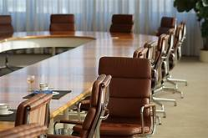
Topics to Discuss
Land Acknowledgement (Reconciliation/Decolonization Minutes)
Effects of Colonization on Decision-Making
Traditional Domination of Meetings
Time, Place, Duration as Barriers
Making Acquaintance and Introductions
Leadership Structure
Participation
Empowerment

Slide 4
Land Acknowledgements
One way that meetings can be started is to give acknowledgement to the indigenous peoples whose land the meeting is taking place on. An example would be:
“We begin today by acknowledging that we are holding our gathering on the land of the _______ who have lived and continue to live here. We recognize the __________ and their spiritual connection to this land as the first stewards and the traditional caretakers of this area we now call _______. As we begin we thank them for their strength, perseverance and resistance. We also wish to acknowledge the other Indigenous Peoples who now call _______their home, for their shared struggle to maintain their cultures, languages, worldview and identities in our diverse City”.

Slide 5
Important Things to Consider
Make the effort to research the history of the Peoples on whose land the meeting is being held in order to draft the Acknowledgement.
Important contribution to reconciliation and decolonization efforts.
Reconciliation Minutes – repetition of the land acknowledgement before each meeting, and then carving out a few minutes to provide a space for discussions on reconciliation and decolonization. This can provide an opportunity to learn and reflect for committee members, call for an end to indigenous erasure, engage with Native people in meaningful ways, and help inform more inclusive and diverse practices in the work of the committee and its members
Participation
What are some topics that you think may be important to introduce during the Reconciliation Minutes?

Slide 6
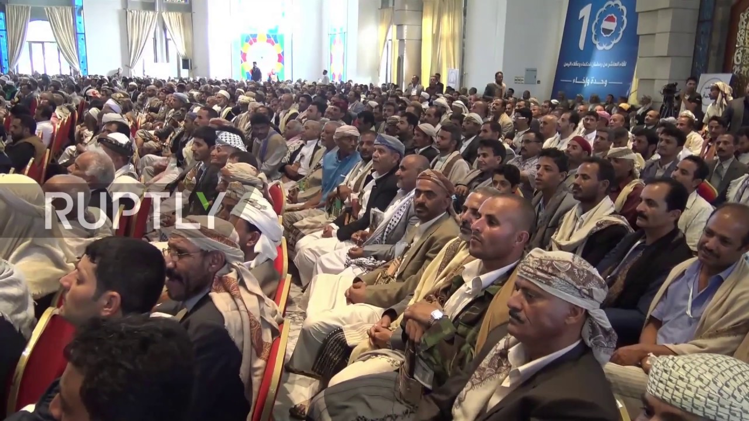
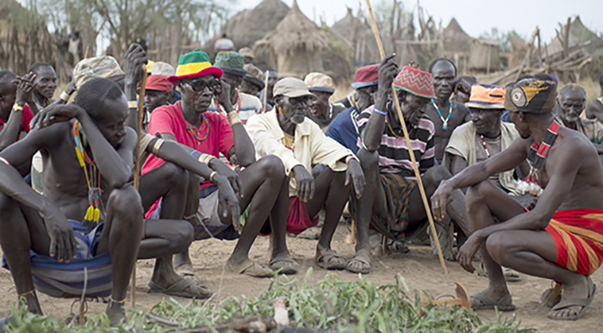
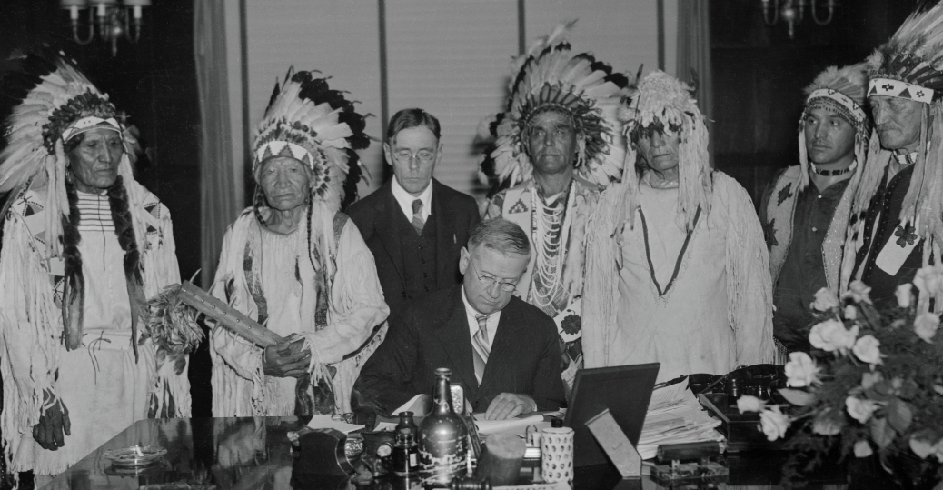
Effects of Colonization on Decision-Making
Participation
Traditionally, who sat at the decision-making table? Go as far back as you’d like.
Discussion: Once areas around the globe were colonized by Europeans, how did the decision-making model change? How did this inform how decision-making bodies are seen today?

Slide 7
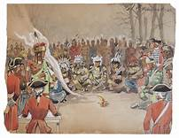
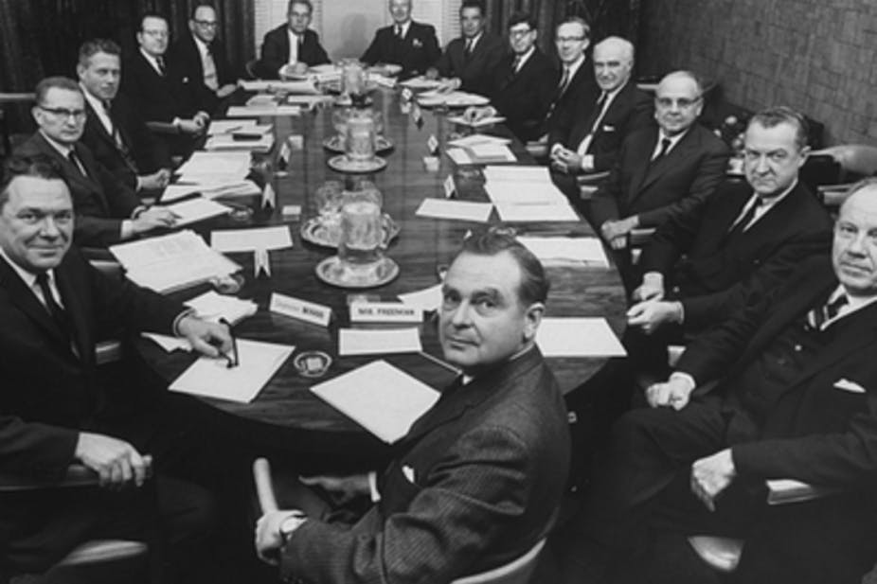
Domination of Meetings Post-Colonization
What happened?
Participation
What are some benefits of having a more diverse make-up of decision-makers at the table? Race considerations certainly affect diversity, but what are some other diversity issues recognized throughout the photo history in this presentation?

Slide 8
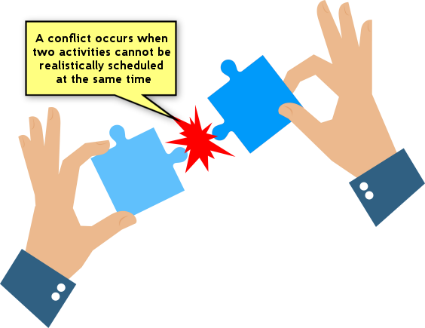
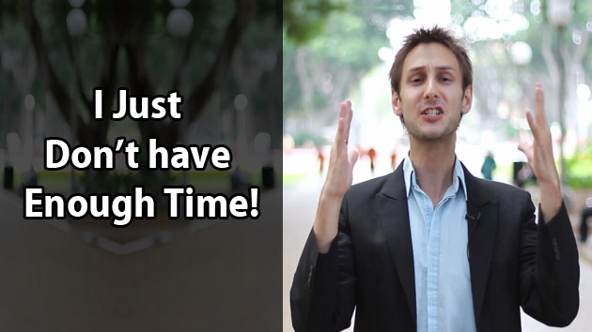
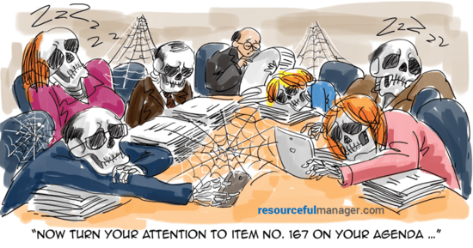
Time, Place, and Duration as Barriers?
Discussion: Does the Time, Place or Duration of a meeting matter as it relates to who can or cannot attend? How can these things affect inclusion and diversity at the decision-making table?

Slide 9
Making Acquaintance and Introductions
Committee Cohesiveness Matters
Does everyone know each other? How do they know each other?
Are introductions important?
Discussion: How does the insistence on using formal titles affect inclusion and diversity at decision-making tables? Are formal titles important for maintaining collegiality or a possible deterrent to collegiality?

Slide 10
Leadership Structure
Discussion: Does it matter who runs the committee meeting? Would who chairs a committee meeting have an effect on inclusion and diversity of a meeting? If so, in what ways? How often should the Chair of a Committee change? Does that affect inclusion and diversity of the committee?
Participation
Who typically Chairs the college committees and academic senate committees at your college?

Slide 11
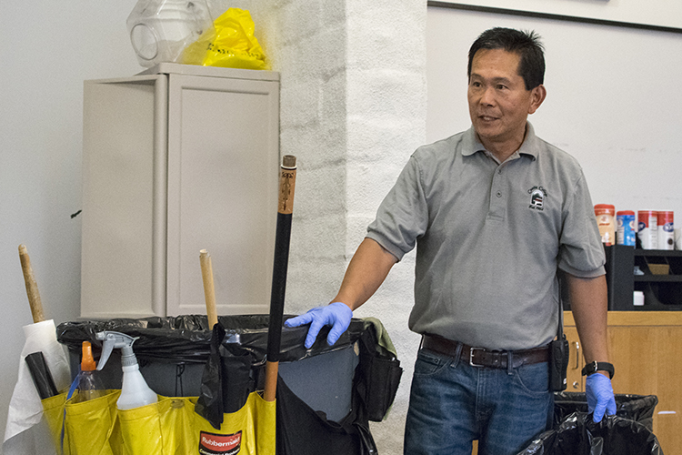
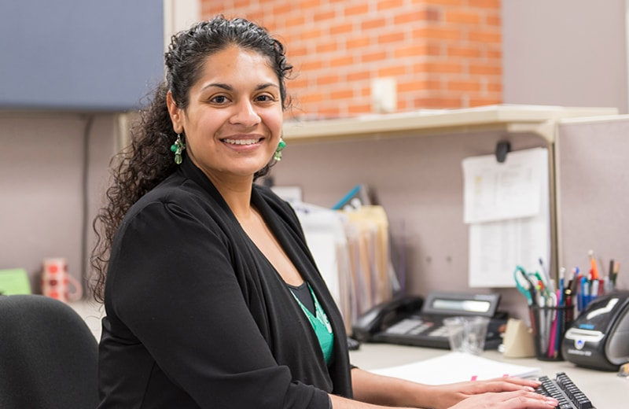
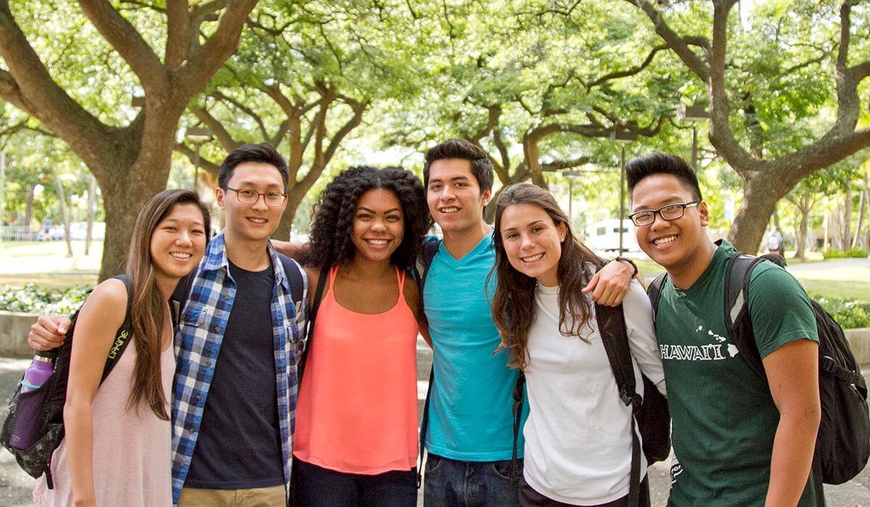
Committee Participation
Discussion: Who typically gets to participate on your college committees? Is your participatory governance handbook intentional about inclusion and diversity?
Participation
Typically, to what extent do classified staff effectively participate in decision-making at your college? How do students effectively participate in decision-making at your college?

Slide 12
Empowerment & Engagement
Discussion: How can everyone on the committee feel empowered to contribute to the agenda and the work of the committee? If only one or two people are empowered to create the agenda, does that have an affect on the inclusion and diversity of the committee? Does it affect who shows up or volunteers?
What is the relationship between Empowerment and Engagement?
Participation
Please list one or two effective practices that will empower and engage more diverse and inclusive participation on college decision-making bodies.

Slide 13
Resources
Land Acknowledgement Resolution from CSULA
https://dailybruin.com/2021/01/16/op-ed-acknowledging-indigenous-peoples-is-only-first-step-meaningful-action-required
https://www.ictinc.ca/blog/weaving-reconciliation-into-your-meetings#:~:text=Weaving%20Reconciliation%20into%20Your%20Meetings%20November%2013%2C%202019,number%20of%20websites%20and%20in%20email%20signature%20blocks.

Slide 14
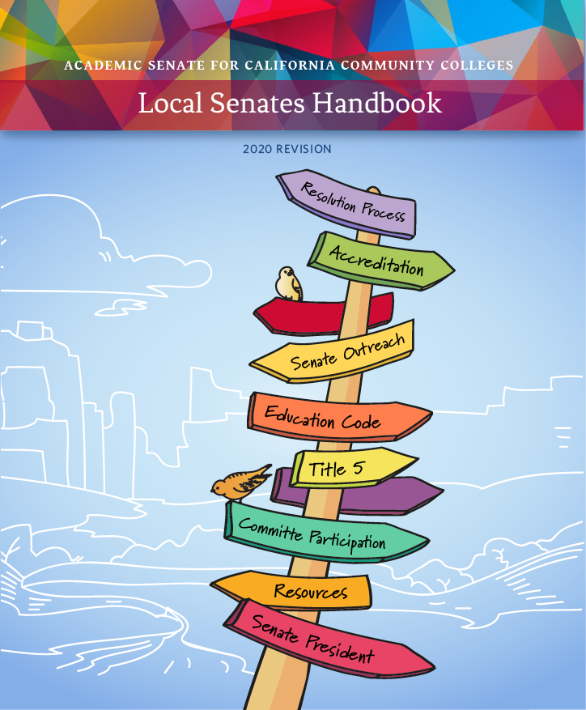
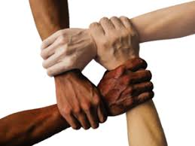
What about Leadership Resources?
Bookmark ASCCC.org
Click on the Local Senates Handbook image to the right in order to access important resources all Local Academic Senate leaders should become familiar with.
Notes:
Communities under the RESOURCES tab
Handbook under the COMMUNITIES tab
Technical Visits under SERVICES tab
Listservs under RESOURCES

Slide 15
karla.kirk@fresnocitycollege.edu
stewarrl@lasc.edu

