Slide 1
Mapping the Journey: An Update on Transfer Pathways

Slide 2
Presenters
Adrienne Brown
Articulation Officer
Los Angeles Harbor College
Mark Edward Osea
Articulation Officer & Transfer Counselor/Coordinator
Mendocino College
Eric Wada
ASCCC North Representative
Folsom Lake College

Slide 3
Description
California community colleges are charged with preparing students to transfer, and most agree there is room for improvement. Presenters will review the data regarding transfer from the California Community College system to the CSU system and the current structure of associate degrees for transfer (ADTs), University of California transfer pathways (UCTPs), and locally articulated degrees. Updates will be provided on the Transfer Alignment Project.

Slide 4
Poll
What is your role in curriculum?
Faculty
Classified
Administrator
Articulation Officer
Curriculum Chair
Curriculum Specialist
Transfer Center

Slide 5
Outline
Transfer Options
ADTs and applicability
UC Transfer
Local/Out-of-State/CCC Baccalaureate
Transfer Data
Transfer Alignment Project

Slide 6
Associate Degree for Transfer (ADT)

Slide 7
Associate Degree for Transfer “ADT”: Background
SB 1440 (Padilla, 2010) established the requirement for ADT program awards.
Guarantee of admission to a similar major at CSU.
Must be possible to complete a BA/BS degree with 60 units at a CCC and 60 units to a CSU.

Slide 8
Associate Degree for Transfer “ADT” - CSU
TMC Structure Currently:
60 units at a CCC;
At least 18 in a major;
Complete CSU-GE or IGETC (IGETC for STEM in three disciplines).
Major requirements and GE requirements may double-count.
TMCs often specify how courses must articulate (e.g. C-ID, as major prep, or GE).
Meet major and admission prep to as many CSUs (and other institutions) as possible.
Determinations of similar based on TMCs: https://c-id.net/tmc
Determinations of similar: https://www.calstate.edu/apply/transfer/Pages/associate-degree-for-transfer-major-and-campus-search.aspx

Slide 9
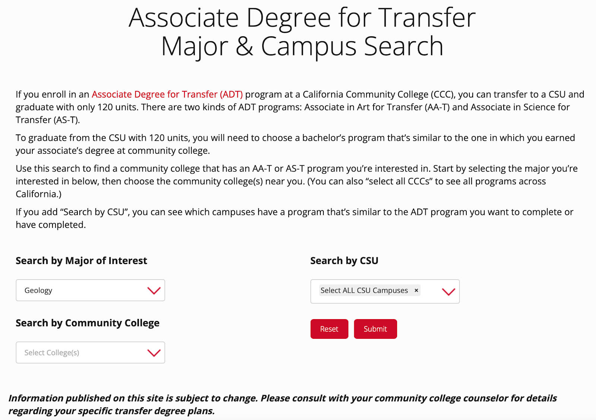
ADT: CSU

Slide 10
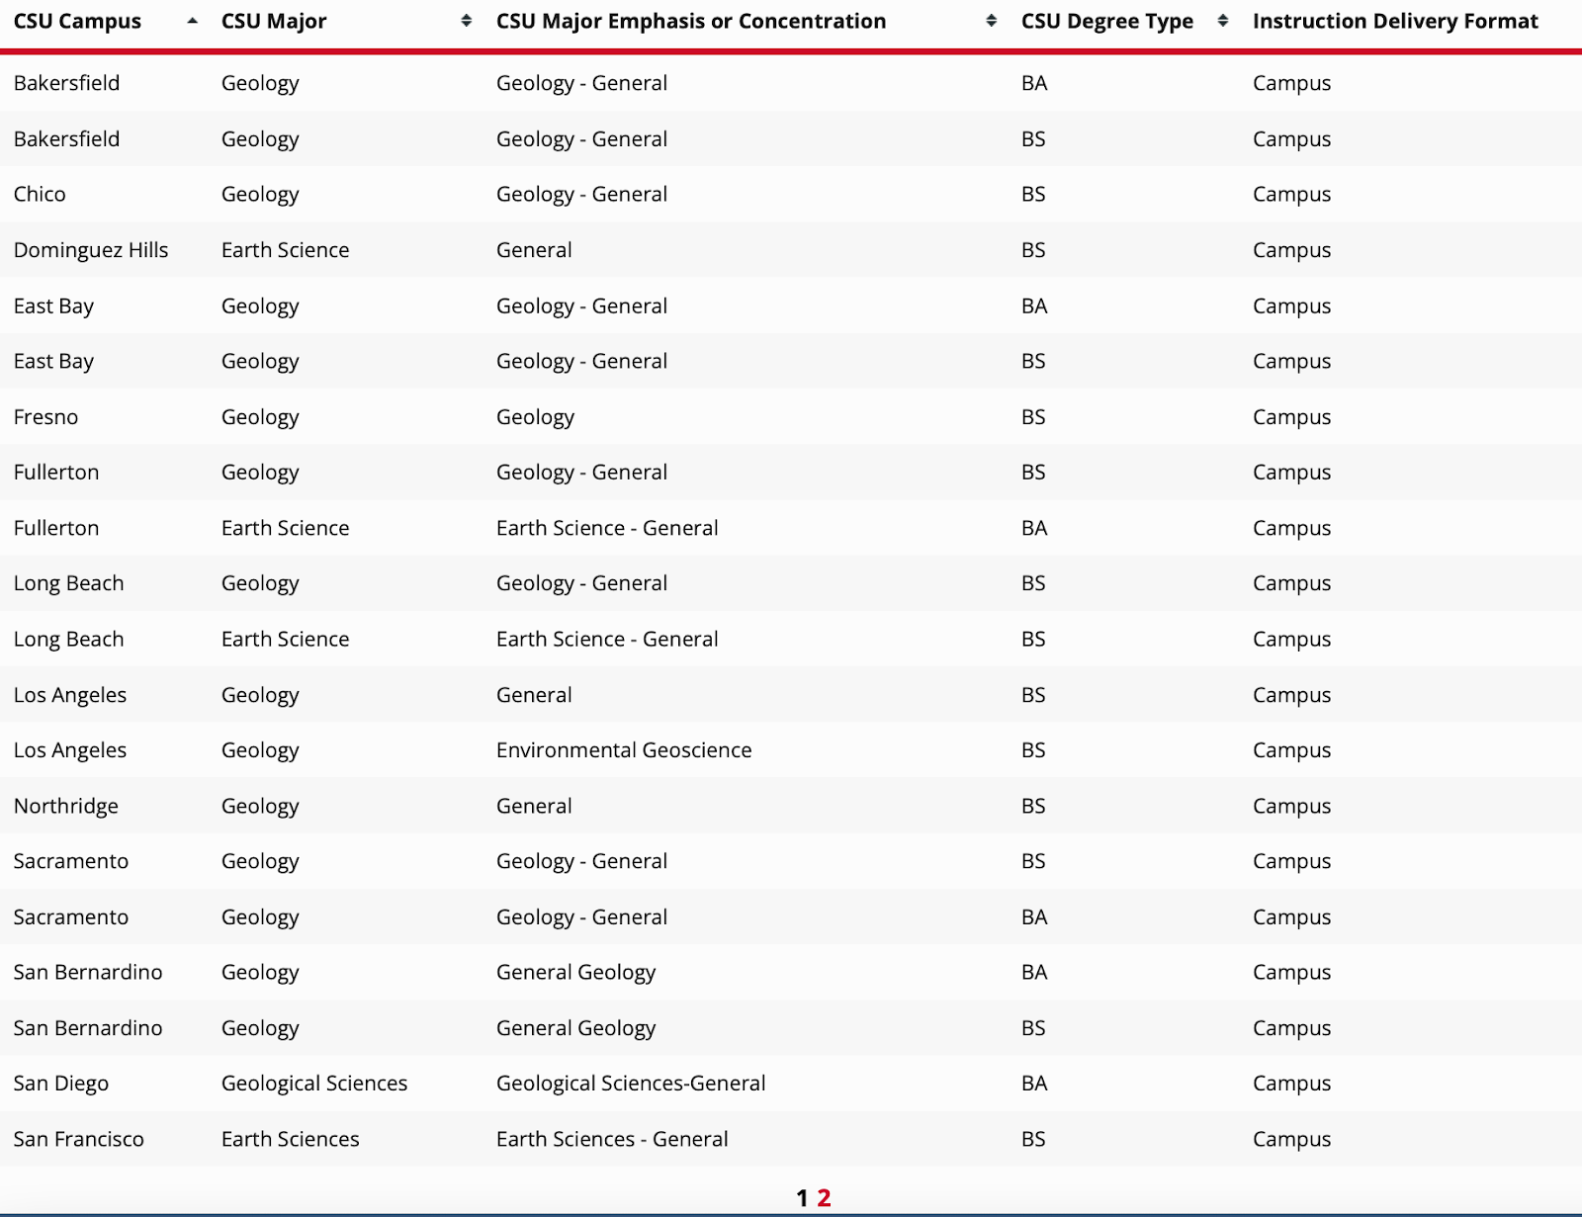
ADT: CSU

Slide 11
ADT: AICCU
Applicable to Association of Independent California Colleges and Universities (AICCU)
Private, non-profit 4-year institutions in California
ADTs accepted by individual campuses: https://aiccu.edu/page/transferstudents
AICCU/CCCCO MOU on ADTs: https://www.cccco.edu/-/media/CCCCO-Website/Files/Educational-Services-and-Support/Transfer-and-Articulation/aiccu-cccco-mou-signed-a11y.pdf?la=en&hash=E5BBEE63B263886124E454561FE499EDD0239CFD
(Independent Colleges/Universities)

Slide 12
ADT: AICCU

Slide 13
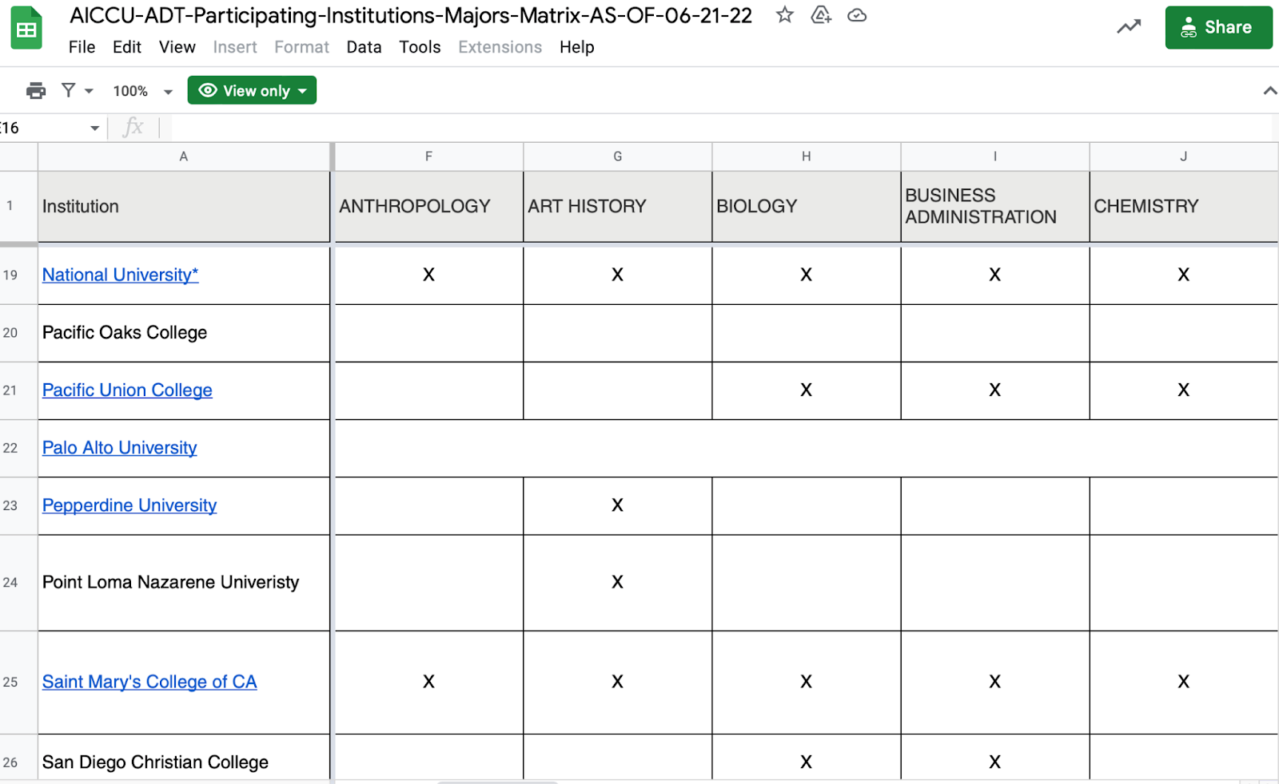
ADT: AICCU

Slide 14
ADT: HBCUs
Admission to Historically Black Colleges and Universities (HBCUs): https://www.californiacommunitycollegehbcutransfer.com/
ADTs accepted by 39 HBCUs; streamlined application and pre-transfer advising available to students. Some colleges have higher GPA requirements.
Finally, there are a few private out-of-state or fully online colleges that also accept ADT, a list is at the bottom of this page: https://www.cccco.edu/Students/Transfer/participating-ca-independent-non-profit-universities
Historically Black Colleges and Universities

Slide 15
ADT: HBCU

Slide 16
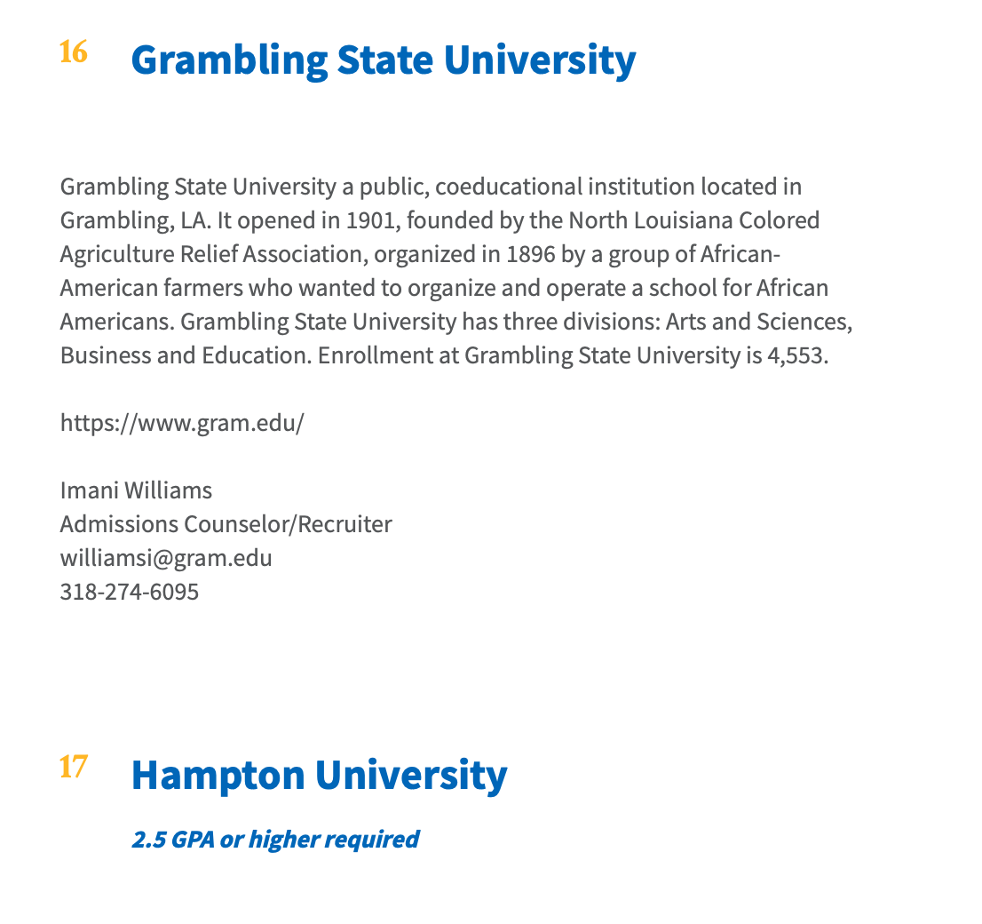
ADT: HBCU

Slide 17
UC Transfer Initiatives
Notes:
Mark

Slide 18
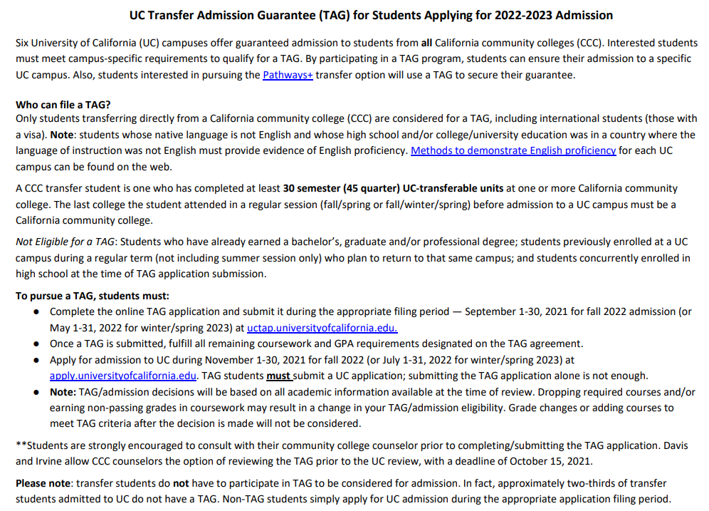
UC TAG
Transfer Admission Guarantee
Notes:
Mark
Applicable to the six participating UCs for those students who will have completed 30 UC transferable units by the summer prior to the following fall admission.
Students must meet the TAG requirements as indicated on the UC TAG matrix for the admission cycle.
GPA Requirements for TAG range from 2.7 to 3.5
Not all majors participate

Slide 19
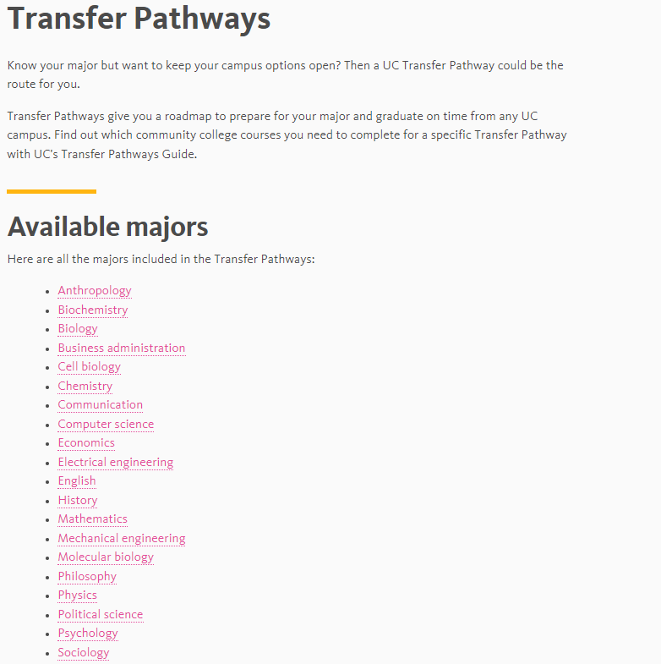
Transfer Pathways
Notes:
Mark
Available for 20 highly sought after majors.
Students who complete a transfer pathway are most competitive as they would have more than likely completed the major prerequisites expected for that major.

Slide 20
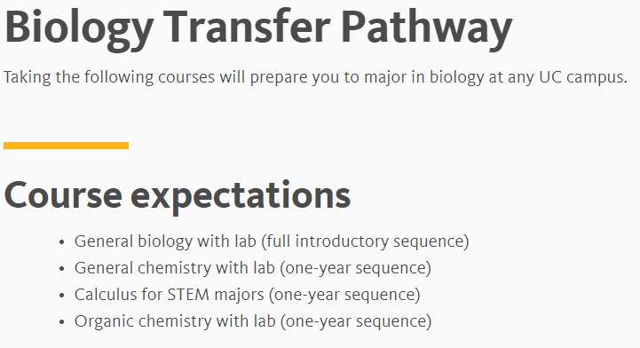
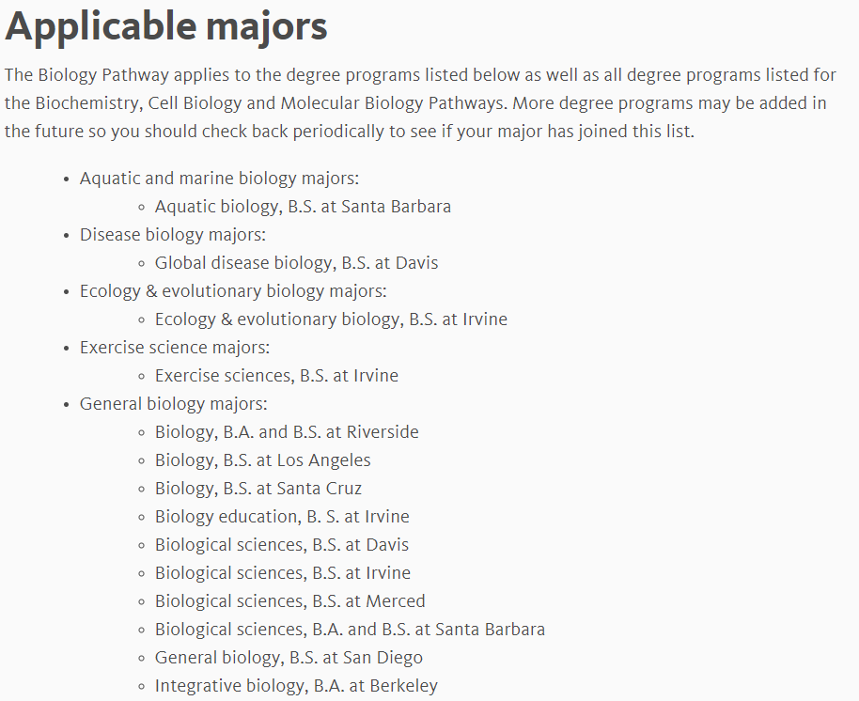
Transfer Pathways
Notes:
Mark
A sample of what the Biology Transfer Pathway. Each pathway shows what the expected courses are, and specifically which institutions the pathway will apply to. Completion of all of the courses will make the students the most competitive for all those majors. Some campuses may require less, some might require all, some will require a variation of both. For example: UCI and UCD.

Slide 21
Transfer Pathways (Example)
Notes:
Mark
A sample of what the Biology Transfer Pathway. Each pathway shows what the expected courses are, and specifically which institutions the pathway will apply to. Completion of all of the courses will make the students the most competitive for all those majors. Some campuses may require less, some might require all, some will require a variation of both. For example: UCD and UCI.

Slide 22
Pathways+
Pathways
+
TAG
Notes:
Mark
Great for students who is majoring in one of the 20 transfer pathways and wants a guaranteed admission to one of the 6 participating UC campuses.
Maintaining a competitive GPA will allow a student to be competitive for the non-TAG UCs.

Slide 23
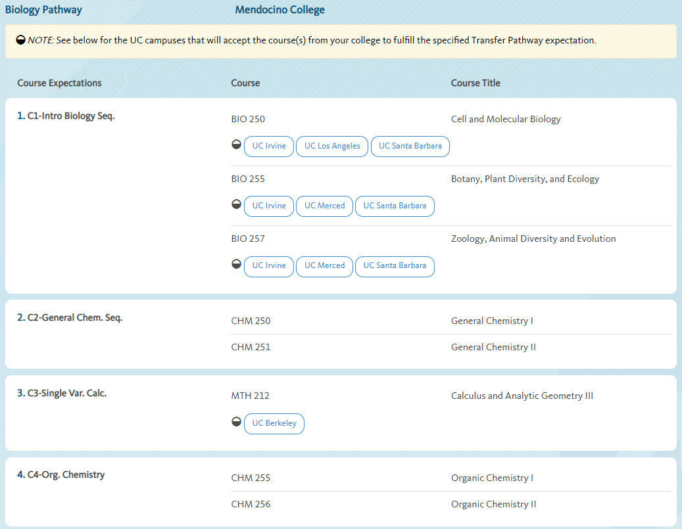
Pathways+
Transfer Pathways Guide
Notes:
Mark
The pathways guide shows the pathways expected courses with the articulated courses for a specific CCC. These agreements are pulled from ASSIST, and they may not necessarily be updated.

Slide 24
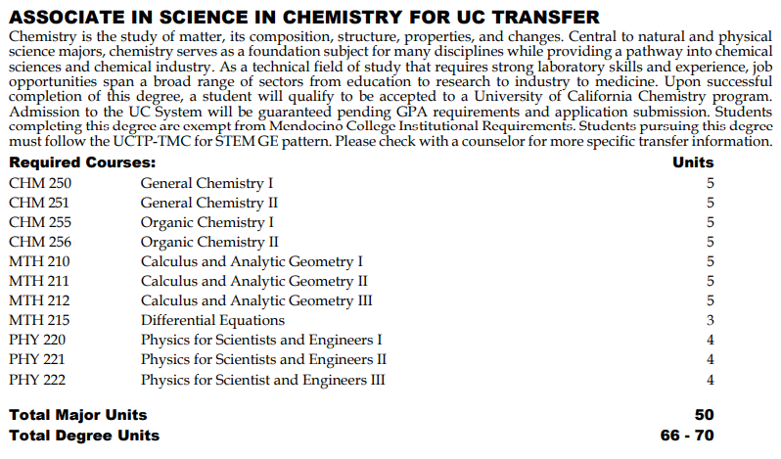
UCTP: UC Transfer Pathways
Chemistry
&
Physics
Notes:
Mark
Students defer two courses in Area 3 and two courses in Area 4.
Students are competitive for both programs because they will all the major preparation expected for the majors, and also earn an AA. By maintaining a competitive GPA, student will maximize opportunity to be admitted to the UCs.
Does not guarantee admission, so student will still need to complete the the Pathways + if they want a guaranteed admission.

Slide 25
UC/CSU Transfer Without an ADT/TAG etc…
Still a viable and necessary pathway for:
CSU majors that can’t take a TMC as similar
CSU impacted campuses and programs (updated annually): https://www.calstate.edu/attend/impaction-at-the-csu/Documents/ImpactedProgramsMatrix.pdf
CSU Redirection: https://www.calstate.edu/apply/redirection
UC campuses or majors that don’t offer TAGs
Notes:
Mark

Slide 26
CCC Baccalaureate Degrees

Slide 27
CCC Baccalaureate Degrees
AB 927 (Medina, 2021) expanded CCC baccalaureate degrees allowing up to 30 new programs to be developed every year. Not overlapping with UC/CSU remains a component of the law.
Currently 15 CCC baccalaureate degrees exist: https://www.cccco.edu/About-Us/Chancellors-Office/Divisions/Educational-Services-and-Support/What-we-do/Curriculum-and-Instruction-Unit/Curriculum/Baccalaureate-Degree-Program

Slide 28
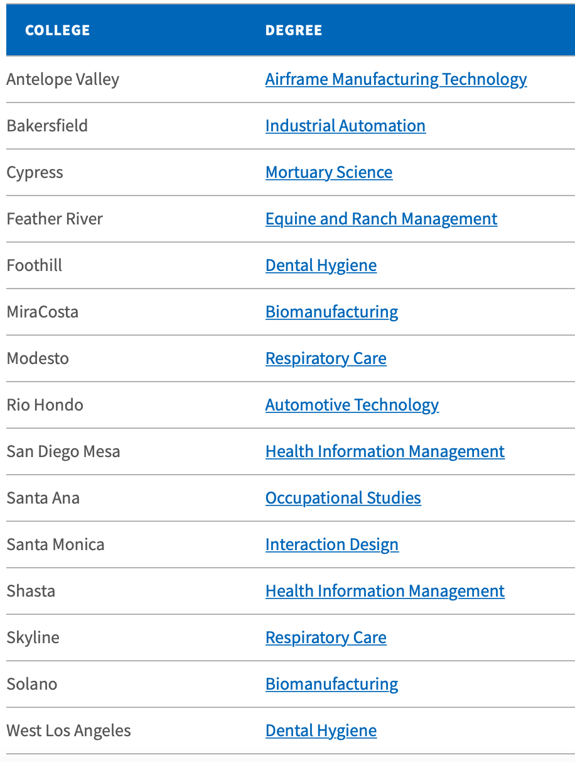
CCC Baccalaureate Degrees

Slide 29
Transfer Data

Slide 30
Transfer Data
Enrollment
Transfer admissions
Persistence
Outcomes
Salary information
Data sources:
CCC Data Mart: https://datamart.cccco.edu/DataMart.aspx
CSU Institutional Research:
https://www.calstate.edu/data-center/institutional-research-analyses/
UC Information Center:
https://www.universityofcalifornia.edu/about-us/information-center

Slide 31
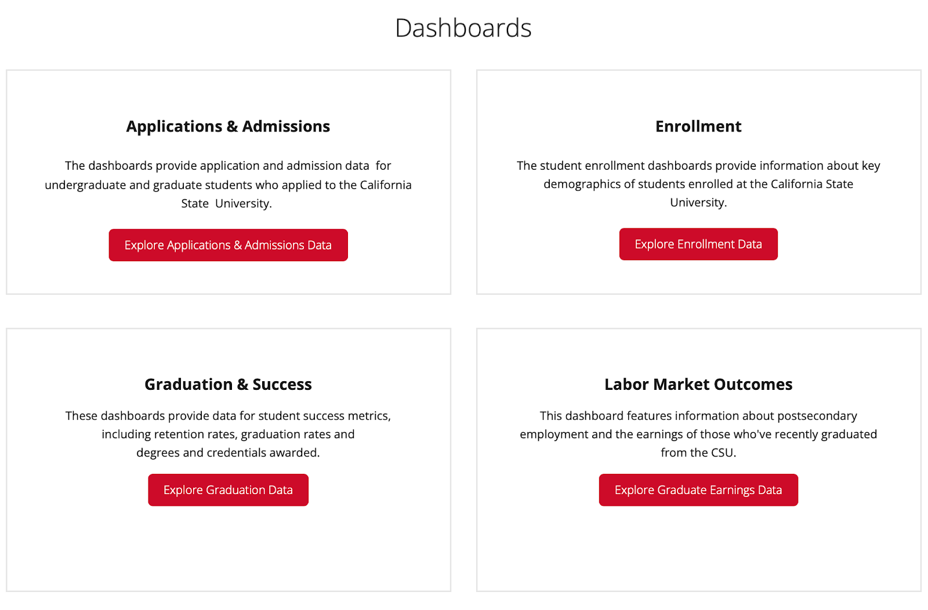
Transfer Data to CSU

Slide 32
Transfer Data to CSU

Slide 33
Transfer Data to CSU

Slide 34
Transfer Alignment Project

Slide 35
Transfer Alignment Project
Goal: Where possible, align UCTP with TMC.
If not possible, provide clear reasons why alignment is not possible.
Work with existing processes to modify existing pathways that improve student transfer and develop additional feasible transfer pathways.
Sources: https://asccc.org/transfer-alignment-projectand https://c-id.net/uc-transfer-pathways

Slide 36
Transfer Alignment Project
Progress to date:
Disciplines where alignment was found:
Political Science
Sociology
Disciplines in progress:
Anthropology
English
History
Disciplines where alignment is not currently possible:
Biology
Business Administration
Economics
Mathematics
Philosophy

Slide 37
Impacts on Curriculum Committees?
Is there time/space to look at new and existing programs/pathways to ensure broad understanding?
Guided Pathways and program maps
Program requirements structured for appropriate flexibility
Program development
Equitable access
Discussions to promote equitable outcomes
Methods of communicating transfer opportunities to the college community?

Slide 38
Thank You!
Follow-up questions:
info@asccc.org
c-idsupport@asccc.org

