Slide 1
Using Data Effectively: Importance of Data Disaggregation to Measure Equitable Student Success

Slide 2
Presenters
Stephanie Curry: ASCCC Area A Representative, Reedley College
Eric Wada: ASCCC North Representative, Folsom Lake College

Slide 3
Breakout Description
Disaggregating data by (for example) racial/ethnic, LGBTQIA, Full time/Part time, Transfer and Pre-transfer status is important to focus on inclusion, diversity, equity, accessibility, and anti-racism. This breakout session will discuss how local Academic Senates can access and use data to inform the 10+1. Participants will share local processes that use data, and if/how the data are disaggregated to ensure equitable student success outcomes. As a group, we will share strategies for how Senates can empower faculty to use data appropriately to enhance equitable student success.

Slide 4
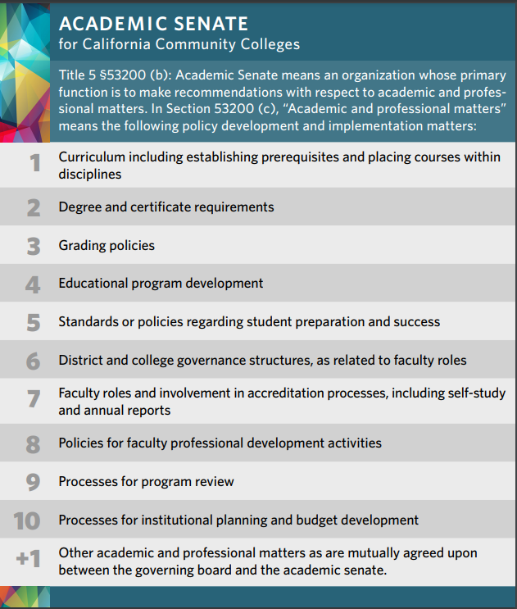
Data and the 10+1
Data is embedded in all the 10+1 areas

Slide 5
Sample Data by 10+1 Area
Curriculum- Enrollment, Success, Persistence, Retention
Educational Program Development- Labor Market Data, Advisory Committees, Transfer/Local Degree Development, Program Maps
Policies for Professional Development- Interest Surveys, Attendance Data
Program Review- Program Completion, Transfers, CTE, Attendance, SLO/ILO data
Processes for Institutional Planning and Development- Student Surveys, internal and external environmental scans

Slide 6
Additional Areas of Academic and Professional Matters that Include Data
Student Equity and Achievement Plans (SEA)
Workforce and Program Creation
Accreditation Reports
Institutional Set Standards
Student Learning and Student Support Outcomes
CCCCO Vision for Success
Student Centered Funding Formula (SCFF)
Accreditation (institutional and program)
Grants
AB 705 reports

Slide 7
Sources of Data
CCCCO:
Data Dashboard:
Transfer-level gateway completion dashboard
Datamart: Enrollments, Student Services, Outcomes
Data sources:
Local Management Information Systems (MIS)
Institutional Research (college and district)
Other Sources:
Cal-Pass- Student Success Metrics
Local institutional research pages and dashboards

Slide 8
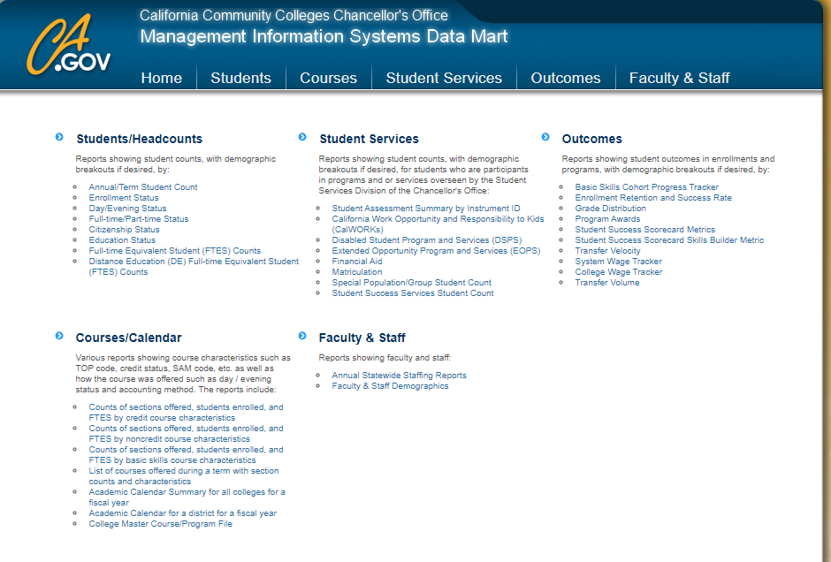

Slide 9
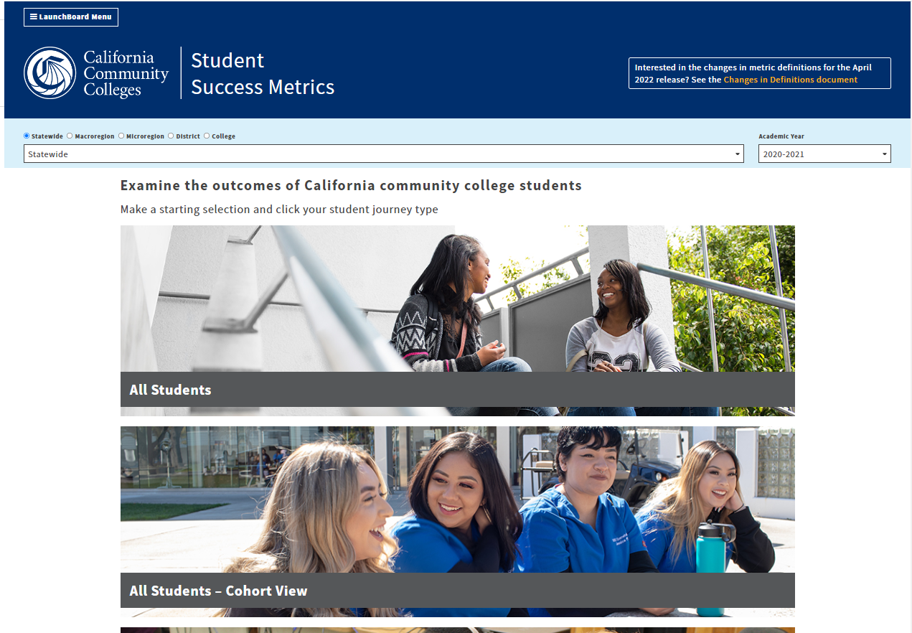

Slide 10
Student Success Metrics
Student Journey Types
All Students
Cohorted Students
Adult Ed/ESL Students
Short-Term Career Ed
Degree/Transfer Students
Undecided/Other Students

Slide 11
Student Success Metrics
Types of Data
Successful Enrollment
Skills Gain
Course Success Rate
Completed Transfer Level Math and English
Completed a Level of Education
Noncredit CTE or Workforce Preparation
Earned 9+ Career Education Units
Persistence
Unit Threshold
Transitioned to 4 year or earned an award
Became Employed
Attained a Living Wage

Slide 12
Student Centered Funding Formula- Supplemental Data
AB 540 Students
Pell Grant Recipients
Promise Grant Recipients
ADTs
Associate Degrees
Credit Certificates
Completion of Transfer Level Math and English
Transfer to a 4 year university
9 or More CTE Units
Attainment of a Living Wage

Slide 13
Disaggregated Data- Samples
Demographics
Race/Ethnicity
Gender
Age
LGBT
Financial Aid
Promise/BOG Eligible
Pell Grant Eligible
Other Disproportionate Impacts
Credit ESL
DSPS
First Generation
Foster Youth
Homeless/Housing-Insecure
Veterans
Justice-involved/Re-entry

Slide 14
Why Disaggregate Data
May identify disproportionate impacts
Prerequisite validation
Placement vs. outcomes/success
Alignment with equity goals
Conversation starters related to equity goals
Should be used in Program Review and other College Planning Documents
Required by Accreditation

Slide 15
Things to Remember with Disaggregation
Groups with fewer than ten people or missing information are summed together and displayed in the "All Masked Values" for Suppression and Complementary Suppression purposes in accordance with FERPA.--From Cal-Pass
Groupings such as Asian not disaggregated by smaller populations within the demographics
Data are only as accurate as the data in your local MIS system

Slide 16
Management Information Systems (MIS) Data- Things to Remember
MIS data comes directly from your college’s Data Systems (e.g. Colleague, Banner)
Data from DataMart is usually 1-2 years behind
Data may be in cohorts which may be from 3-6 years earlier
Always look at the matrix definitions and definitions of cohorts.

Slide 17
Disproportionate Impact- Three Approaches
The 80% Rule The 80% Rule helps answer the question, “Do any subgroup(s) achieve the desired outcome less than 80% of the time the highest achieving (reference) subgroup successfully achieves that outcome?”
The Proportionality Index (PI) The proportionality index helps answer the question, “If a subgroup of students represents 45% of the student body, does that same subgroup also represent at least 45% of the students who achieve the desired outcome?” Representation in the outcome group at a rate lower than their representation in the general student body may indicate disproportionate impact, depending on how large the observed difference is.
The Percentage Point Gap Index The percentage point gap approach reflects the difference in percentage points between a given demographic group and the observed overall average (or mean) across all demographic groups (California Community Chancellor’s Office, 2015). The larger the difference, the more likely that such a difference is reflective of disproportionate impact
https://www.cccco.edu/-/media/CCCCO-Website/About-Us/Divisions/Digital-Innovation-and-Infrastructure/Network-Operations/Accountability/Files/Disproportionate_Impact_Equity_and_Placement-201701051.ashx

Slide 18
Who Has Access to Data?
Does your college have a data management plan
Who has access to data?
Faculty researchers
Faculty data coaches
Classified researchers
Administrators
How do you access data?
What level of data can faculty access-
Department, Program, Course, Section?

Slide 19
Data Literacy
Definition- the ability to read, write and communicate data in context, including an understanding of data sources and constructs, analytical methods and techniques applied, and the ability to describe the use case, application and resulting value.
Faculty should be supported with professional development to increase data literacy.
Senates should support efforts (10+1 area)

Slide 20
Data Coaches
Data coaches can:
Be the conduit between faculty and researchers as well as research data.
Help faculty formulate questions that will provide them the data they seek
Help researchers understand the specific data needs of faculty

Slide 21
Data Analysis
Observational data
No controls for systematic differences between populations (i.e. assumes all are equal)
Comparison group(s)?
Randomized trials with control groups necessary for cause-effect relationships
Association/correlation does not imply causation

Slide 22
How Do You Use Data? How Are You Involved in Data Discussions?

Slide 23
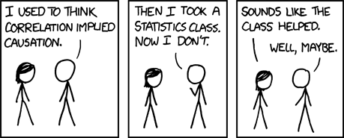
Source: https://xkcd.com/552/

Slide 24
Questions?
Thank you! info@asccc.org

