Slide 1
AB 1111 Common Course Numbering:
Draft Report Update
Webinar
December 5, 2023
2:00 pm – 3:00 pm
Notes:
CA

Slide 2

Introduction
Presenters:
Cheryl Aschenbach, ASCCC President
Ginni May, ASCCC Past President
Join ASCCC Past President Ginni May, who is co-chairing the AB 1111 Task Force, and ASCCC President Cheryl Aschenbach as they provide an overview of the late November version of the AB 1111 Draft Summary Report (linked here), updated from the earlier August and October 2023 versions. Additionally, provide input on the report for them to take to the Task Force meeting and ask your lingering questions.
For additional AB 1111 Common Course Numbering Task Force Information, including the report and December 7 meeting info, click here.
Notes:
CA

Slide 3
Overarching CCN Guiding Principles from Draft Summary Report
Implement vision for CCN with a new vision for intersegmental transfer and articulation that includes calling for a resourced infrastructure for intersegmental faculty collaboration
Ensure early and strong participation of CCC, CSU, UC, and AICCU faculty
Design solutions that balance faculty, college, and system autonomies with student needs
Commit to a strong implementation of student-facing CCN
Apply principles and guidelines of Universal Design for Learning throughout
Embrace moving to a single data management system across the CCCs
Notes:
GM/CA

Slide 4
Recommended Implementation Plan:
System Governance
California Community Colleges Chancellor’s Office – system level support and coordination; oversight of resources for implementation
Common Course Numbering Council – High level oversight of CCN implementation:
  CCCCO participatory governance group
  Broad stakeholder representation
  Minimum lifespan of 3 yrs; evaluate effectiveness and representation annually
  Intersegmental partner representation (CSU, UC, independents)
  Decision making: if consensus not reached, majority vote will prevail
Steering Committee of CCN Council – Planning and facilitation of CCN Council
  Four representatives, one appointed by each organization: CCCCO, ASCCC, CIOs, CSSOs
Two workgroups:
  CCN Development and CCN Technology and Processes
  Workgroup leads will serve as voting members on CCN Council
Notes:
GM

Slide 5
Recommended Implementation Plan:
CCN Development Workgroup
Charge
Make design recommendations for infrastructure and processes needed for curricular coordination to assign common course numbers
Coordinate, support, and guide intersegmental disciplinary teams to create, adopt, and implement CCN Descriptors
Engage stakeholders and research impact of all CCCs implementing CCN
Broad representation recommended
  Particularly CCC faculty (including AOs), academic leadership, and representatives from CSU, UC, AICCU colleges, HBCUs
Notes:
CA

Slide 6
Recommended Implementation Plan:
CCN Development Workgroup
Guiding Principles
  Aim to reduce tasks and processes; do not increase the level of difficulty or work of the colleges
  Ensure broad representation of faculty from broad subject areas
  Support aspiration of the acceptance of CCN descriptors to serve as primary pathway for system articulation of individual courses
  Student facing CCN will require a minimum set of elements in a COR. Honor academic freedom by providing faculty complete autonomy in how they engage students in delivery and assessment of course content
  Ensure CCN descriptors will be developed by faculty at the CCC level in collaboration with CSU, UC, and AICCU faculty and supported by admin and staff
  Develop a taxonomy that clearly identifies commonly numbered courses with all the information needed in a minimum number of digits
  Consider adjustments needed to align CCN work with quarter system colleges
Notes:
CA

Slide 7
Recommended Implementation Plan:
CCN Development Workgroup
CCN Descriptor Elements
CCN Descriptor Elements | Descriptor Elements Classification
Course Number | Identical
Course Title | Identical
Unit Amount (x semester/y quarter) | Adheres to an Established Minimum
Course Description | Part 1: Identical
 | Part 2: Optional; expanded college discretion
Prerequisites | Identical
Course Content | Required Topics: Identical
 | Optional Topic Expansion, college discretion (defined in CCN Descriptor Development)
Student Learning Objectives/Outcomes | Required: Identical
 | Optional Details Expanded, college discretion (defined in CCN Descriptor Development)
Notes:
CA

Slide 8
Recommended Implementation Plan:
CCN Development Workgroup
GE and Course to Course Articulation
The courses based on CCN Descriptors will be applied to the same GE areas designated by the Cal-GETC review process and articulated identically for all students who:
Complete courses at a CCC and transfer to another CCC;
Complete courses at a CCC and transfer to a CSU, UC, or AICCU institution;
Complete courses at a CSU, UC, or AICCU institution and transfer to a CCC institution.
Notes:
CA

Slide 9
Recommended Implementation Plan:
CCN Development Workgroup
Taxonomy
Currently, significant variability of course subject identification and numbering.
CB01 (Dept. Number): 12 characters max, incl. spaces and dashes
Considerations:
  Flexibility for managing local courses
  Distinguish between currently numbered courses and CCN numbered courses
  Avoid duplication of current course numbering systems
  Provide a method for conveying traditional course level (years 1-4, pre-transfer, noncredit)
  Provide a method for identifying specialized course types (honors, lab, corequisite embedded)
  Scalable to incorporate volume of current and future courses
  Accommodates local non-CCN courses with expectation CCCs adopt CCN system holistically
  Address differences in course identification for quarter system colleges and develop strategies for these colleges to align with the taxonomy and building of classes
  Determine how course repeats, corequisite courses, mirrored noncredit courses, and cross-listing of courses will be managed and will impact policy and student transcripts
Notes:
CA

Slide 10
Recommended Implementation Plan:
CCN Development Workgroup
CCN Descriptor Development
Success depends on the establishment of intersegmental collaboration that has the authority and representation to change processes and practices impacting transferability and applicability of transfer courses
Priority action items to be initial first steps of CCN Council and to occur in tandem with first proof of concept phase:
  Develop agreements accepting CCN Descriptors as basis for determining course-to-course articulations with CCC system
  Develop processes and standards for verification that a course meets the required CCN elements, as defined by CCN Descriptor developed through intersegmental collaboration
  Develop processes for creating and reviewing CCN Descriptors that engage receiving institution faculty early in the process
Phase 1: Proof of concept to vet development processes and templates, test technology-based implementation, test-drive convening practices, validate intersegmental collaboration
  Develop CCN Descriptors for an initial set of high-enrollment courses aligned with Cal-GETC in 2024 with courses being ready Fall 2025 enrollment
  ASSIST to help identify course variations that articulate the same way
  C-ID descriptors as a foundation
  Align with and be informed by Data Reconciliation and Analysis work
Notes:
CA

Slide 11
Recommended Implementation Plan:
CCN Technology and Processes Workgroup
Guiding Principles
  Strive for digital equity in any technology and implementation approach
  When implementing new technology systems, minimize additional costs and streamline existing systems
  When selecting a technology solution, strive to select a system where college/district/system processes drive the software instead of software driving the processes
Data Reconciliation and Analysis
  Clean-up of current data across COCI, ASSIST, C-ID to result in a unique identifier and consistency in four data fields housing Course Title, Course/Subject Number, Course/Subject Name, and Units
  Data reconciliation can occur in parallel with CCN work
New Technology
  Reconcile all technologies being used in related work: AB 928, Cal-GETC, AB 1111, CVC-OEI
  Combining COCI and C-ID reduces data entry burdens and eases addition of workflows for submission and approvals associated with CCN designation
Data Management and Data Warehouse
  Streamlining of processes and technological solutions is needed
  Potential to merge COCI and C-ID repositories
  Would require linking of system repository to local curriculum management software
Use of Technology to Verify Identical vs. Equivalent for Articulation
  Automated review with trigger for human review
  Common Course Outline of Record and automated certification system
Notes:
GM

Slide 12
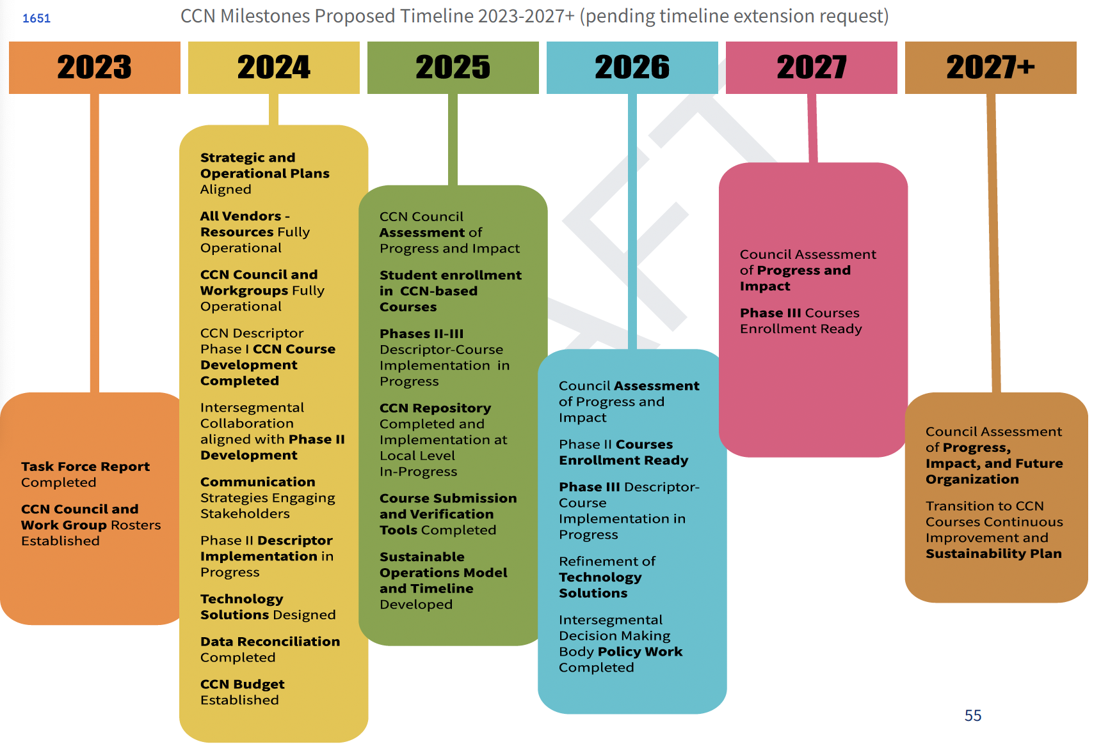
Recommended
Implementation Plan:
Timeline
Notes:
GM

Slide 13
What Can We Be Doing Now?
What can you do now?
  College/District
    Affirm college and district curriculum approval processes
    Consider an expedited yet thorough process for the batching of curriculum, conditions for expedited processes
    Curriculum Committee/Academic Senate
    Ensure curriculum approval processes are well-established, understood, and followed
    Work with administration to make sure resources (people and funding) are adequate for the volume of work expected
  Department
    Begin reviewing your curriculum from a global perspective – how do your GE/majors courses align with such courses at other colleges?
What can you do at the state level?
  Encourage faculty to participate in volunteer opportunities – complete the Volunteer for Statewide Service form
  Participate in Discipline Input Groups; encourage colleagues to participate, too
  Respond to faculty surveys for vetting of processes, descriptors, and such
Notes:
GM/CA

Slide 14
Questions?
Thank you! info@asccc.org
Notes:
CA

