Slide 1
Local Academic Senates - Planning Agendas and Running Effective Meetings
Manuel Vélez,
ASCCC Vice President
María-José Zeledón-Pérez, Ed.D
ASCCC Area D Representative

Slide 2
Breakout Description
One of the most important responsibilities of the Academic Senate leaders is to chair the Academic Senate meetings. These meetings are the space where Senate business is conducted and where faculty engages in crucial conversations and debate. To run an effective and efficient meeting it is necessary to set up an agenda prior to the meeting.
This session will focus on strategies to help Senate leadership prepare for and run effective Senate meetings that still allow for constructive debate.
Special emphasis will be placed on topics such as planning agendas, parliamentary procedures, timelines for motions and resolutions, and working with outside groups. We will also place emphasis on strategies for developing and accomplishing long-term goals.
Notes:
MJ

Slide 3
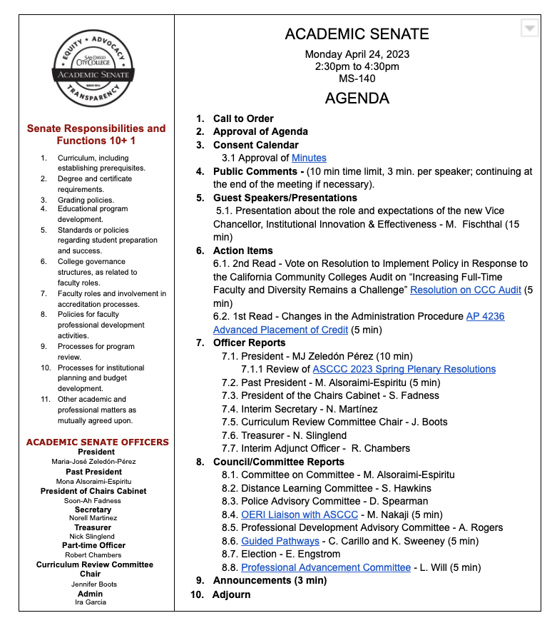
Setting the Agenda
Setting an individual meeting agenda and a yearly/semester agenda:
Look at deadlines and timelines for required documents
Plan ahead on items needing debate
Align agenda with local goals and mission of the college
Work with other groups for alignment in collegewide discussions
Work with your local executive committee members to build agendas
Work to get presenters/experts to attend to answer questions of senators
Notes:
MJ

Slide 4
Timelines & Working with other Groups
Timelines
Work backwards from the deadline to make sure senate has enough time to review and debate issue.
Be proactive and make sure administration know deadlines for when items need to be to senate for full review.
If possible, add in an extra meeting for review in cases where there might be significant debate.
Working with other groups
Work with other groups for alignment in collegewide discussions (classified professionals, students, administration).
Work with other local senate leaders if you agree, joint resolutions or recommendations are powerful in districts.
Work with local unions to identify areas of shared purview.
Notes:
MJ

Slide 5
The Brown Act
Because Academic Senate meetings are subject to the Brown Act it’s important to consider the following:
All senate meetings should be announced, and agendas should be made public at least 72 hours prior to your meetings.
Agendas must include a brief description of each item (not to exceed 20 words).
Make sure to include time and a process for public comments on your agenda.
Special meetings may be called with 24-hour notice. Only business specified for the special meeting may be addressed.
Emergency meetings may be called under specific, drastic circumstances. Emergency meetings should be publicly announced at least one hour prior to the start if possible.
If transitioning from online meetings due to the pandemic, review the traditional Brown Act rules for teleconferencing and AB 2449 for limited remote participation.
Click here for a comprehensive guide on the Brown Act from the League of California Cities
Notes:
Manuel

Slide 6
Rules of Order
Commonly known as “parliamentary procedures”, rules of order are generally accepted rules, precedents, and practices used in the process of conducting an assembly or meeting. Clearly defined rules of order help to maintain decorum, ensure for effective dialogue, and facilitate the completion of senate business.
Rules of orders should be addressed and defined in the Senate’s constitution.
“Robert’s Rules of Order” are the most popular form; however each senate should determine which rules of order work best for it.
A senate appointed Parliamentarian can ensure that rules of order are followed and that meetings are run effectively.
Notes:
Manuel

Slide 7
Rules of Order Determine
Rules of order determine how the business of the senate is conducted:
Making and accepting motions
Conducting discussions or debates
Accepting amendments to motions
Introducing resolutions
Voting on motions and resolutions
Accepting and correcting minutes and changes to the agenda
Calling meeting to order and adjournment
Allowing for public comments
Notes:
Manuel

Slide 8
Representation From Other Groups and Committees
Because Senate business often requires collaboration with college, district, and “outside” committees and groups it’s important to make sure that representatives from those groups are present at your meetings whenever necessary.
Permanent Representation: Committees formed by the senate, and which conduct the business of senate should have representatives attend and give reports at every senate meeting. Groups whose work impacts instruction should also have a representative at each meeting.
Temporary Representation: If a committee is formed on your campus to address a major initiative, policy or structural change, emergency, or social challenge which impacts instruction it’s a good idea to invite a representative of that group to senate meetings for the duration of the event
Guest Presentations: College, district, and community organizations may be invited to give a brief presentation to the Academic Senate during senate meetings.
Notes:
MJ

Slide 9
Action vs. Informational Items
Proactively work with your college and district to identify which items come to the senate for action and what comes as informational.
You can use informational items for future action items to prep the senate for the read.
You can take a “sense of the senate” if you need to see how the senate feels about an item.
Work with administration to what needs to be acted upon by “approve of the body”. Just having senate members in the room is not a formal approval of an item.
Clearly identify in your agenda action vs. informational items.
Notes:
MJ

Slide 10
Running the Meeting
Timekeeping- Make sure you keep track of the time so you can complete your agenda. Some Senates identify specific times for each item on the agenda.
Recognizing Speakers/Process for Discussions- To keep order in the meeting and discourage anyone dominating the discussion create a process for identifying how speakers are identified.
Staying in the Senate Purview- Make sure discussions remain in the purview of the senate. If it goes into other areas steer the discussion back to the 10+1 but note the issue for discussion with the appropriate group.
Voting- Make sure the voting process is clear and written down in the constitution and bylaws including a process for proxies.
Notes:
Manuel

Slide 11
Written Procedures
All processes and procedures for your senate including agendas and voting should be written and approved by the senate.
They can be placed in a Constitution and/or Bylaws or other document which should be reviewed systematically through an identified process.
Notes:
Manuel

Slide 12
A Well-Informed Senate
Conducting the business of the senate and running effective meetings requires that your senators be familiar with your constitution and bylaws as well as the specific rules of order used to conduct your meetings.
It’s also important for senators to understand the college and district governing structure and where their Senate fits within that structure.
To help ensure that your senate is well-informed:
Publish a senate handbook to be distributed to in-coming senators.
Organize senate orientations at the beginning of each academic year.
Provide every senator with access to the Senate constitution.
Host “flex” activities on parliamentary procedure, collective bargaining and governance.
Distribute copies of ASCCC’s The Rostrum to senators.
Notes:
MJ

Slide 13
Resources for Senate Leaders
Local Senates Handbook
Rostrum Archive
Directory
info@asccc.org
Local Senate Visits
Notes:
MJ

Slide 14
Questions and Answers

