Slide 1
A Sense Belonging: Inviting/Engaging Underrepresented Faculty to Participate and Contribute
Dr. Carlos R. Guerrero,
South Representative
Dr. María-José Zeledón-Pérez
Area D Representative

Slide 2
Description
Having a seat at the table provides an opportunity for faculty, especially underrepresented faculty, to use their voice in decision making for transformational change. For that to happen colleges must provide a culture of belonging.
Academic senates serve a unique role on our California community colleges to ensure that underrepresented faculty become part of the campus conversation. It is well established in educational leadership research that decision-making is at its best when diverse voices are amplified and when alternative perspectives are considered.
Join us in this important discussion on intentionally including underrepresented faculty in leadership roles on our campuses.

Slide 3
Topics to Discuss
Belonging as a key ingredient to IDEAA efforts
Strategies to promote diverse faculty to participate in leadership
Creating leadership paths for new faculty or those who have been disengaged
Assessing your own structures for barriers
Notes:
Ways to encourage diverse faculty to participate in college governance
Strategies to promote authentic participation (for yourself as a leader and making space for others to feel comfortable to do so)
Creating leadership paths for new faculty or those who have been disengaged
Orientation of new faculty to promote future faculty leaders - SM?
Assessing your own structures for barriers
Transition: One of the barriers to active (let alone authentic) participation is “meeting hate” and negative perceptions people may have of meetings.
Poll the audience: By a show of hands, how many of you LOVE going to meetings? or when you see a meeting invite pop up on your calendar you get that giddy feeling of excitement?

Slide 4
What is Belonging?
“Belonging is a close cousin to many related experiences: mattering, identification, and social connection. The unifying thread across these themes is that they all revolve around the sense of being accepted and included by those around you.”
Harvard Business Review, The Value of Belonging at Work (2019)
Sense of belonging is a phenomenon that “captures the individual’s view of whether he or she feels included in the college community” (Hurtado & Carter, 1997, p. 327) as well as the “degree to which an individual feels respected, valued, accepted, and needed by a defined group” (Strayhorn, 2012, p. 87).

Slide 5
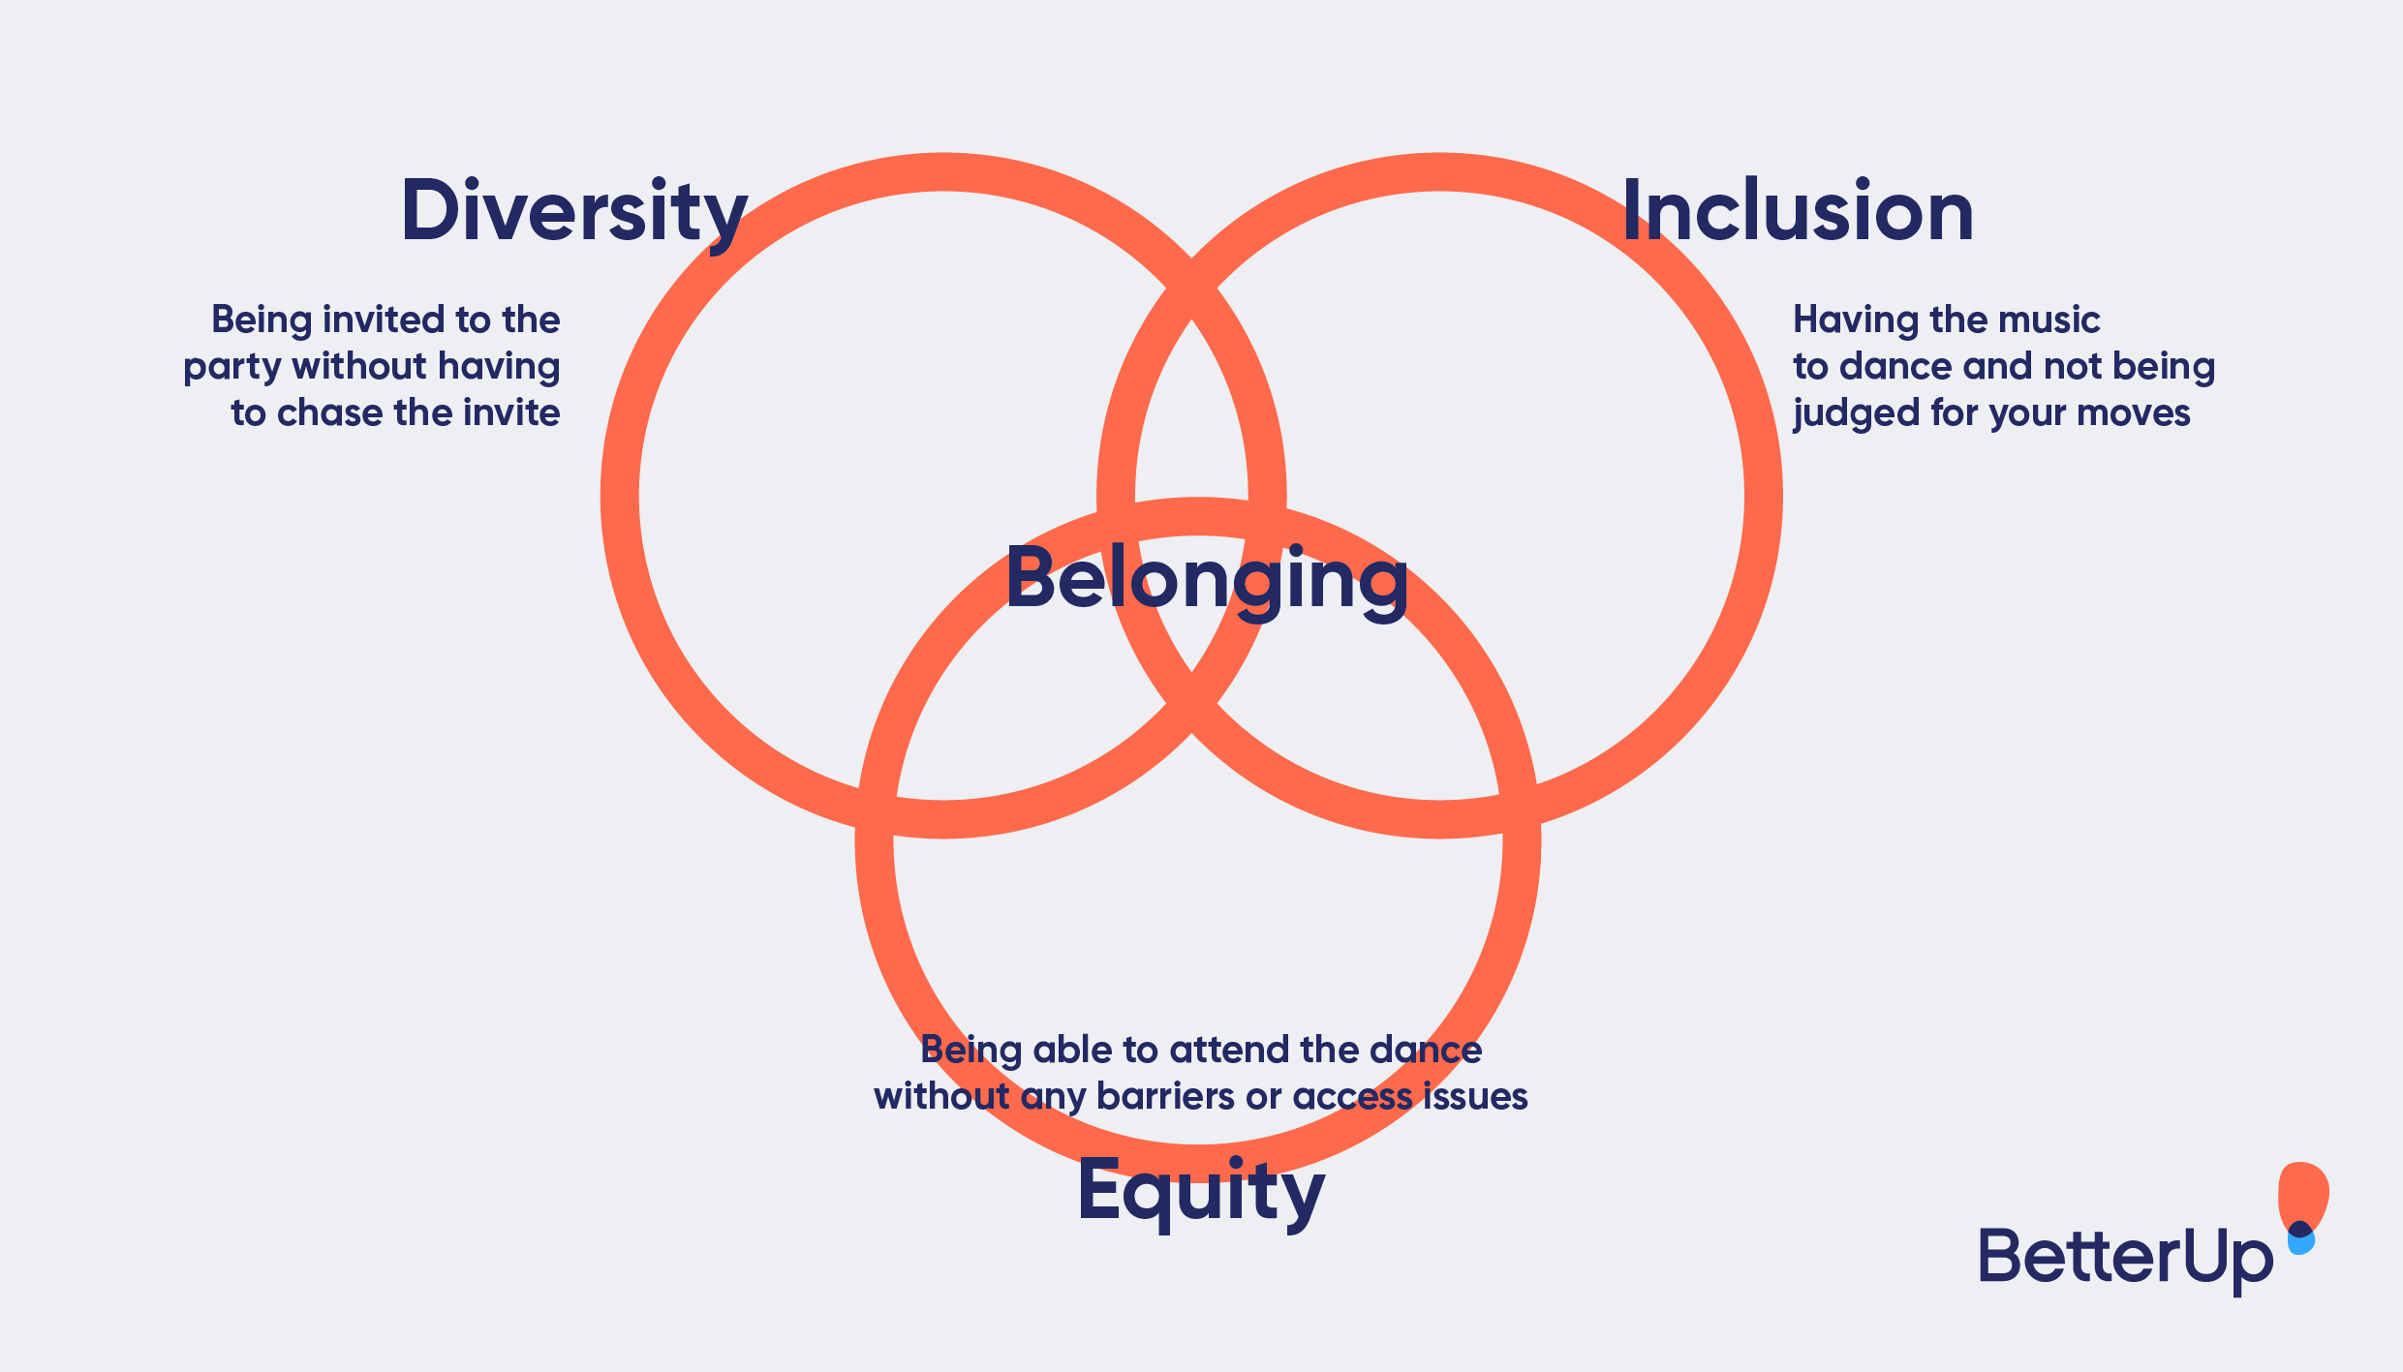
Belonging is a key ingredient to IDEAA efforts

Slide 6
Perceptions of campus culture
What are your first impression of your college meetings (committees, governance, taskforces)?
How did you feel going to your first college meeting? As an observer? As a member? As a leader?
If we asked you to describe a typical committee meeting for your college, what would it look like? Who would be represented? Who would be leading?
How would you describe the interpersonal climate? Competitive? Defensive? Collaborative? Equitable? Others?
Notes:
joining these groups can be very intimidating. Often there are linguistic barriers with acronyms, jargon, or other specialized vocabulary.
Is the perception the reality? Based on past negative meeting experiences, some marginalized voices may elect not to even participate.
Some of the complaints about meetings include:
Complaint 1: One or two people do all the talking, Complaint 2: Meetings aren’t run effectively
Complaint 3: The meeting should have been an email
Complaint 4: Everyone is on their phones
Complaint 5: The meetings are redundant
Other complaints include: competitive interrupting, not respectful of individual contributions, being spoken down to, or mansplaning, gaslighting, not trusting my expertise in my field, etc. others from the room?

Slide 7
Strategies to Promote Authentic Participation
As a group, setting explicit norms and understandings to value contributions from diverse ideas
Storytelling as a Leadership style
Authenticity and Vulnerability
Knowing your values as a leader and as a participant
Staying grounded
Leading with intention
Validating each others' experiences
Notes:
Leader authentic voice - Requires emotional openness and Builds bridges and increase trust
Your values - (communicate our values and how we advocate/connect with others because of these). Staying grounded and aware of yourself
Member authentic voice
(What is your why behind the choices you make?). Including various voices in decision making. Staying open to all perspectives and experiences. Validating another's experience even if you don't understand.

Slide 8
Embracing IDEAA with Intention
There have been many events through the years that have highlighted the need for creating a diverse and inclusive workplace. From a morale and business perspective, making sure that inclusion, diversity, equity, anti-racism and access are valued throughout the inner workings of the college is imperative. Why?
Increased innovation and creativity
Provides insight into the needs of diverse stakeholders
Improves decision-making
Ensures that all employees are able to thrive
Makes sure that colleges and services are representative of the communities they serve

Slide 9
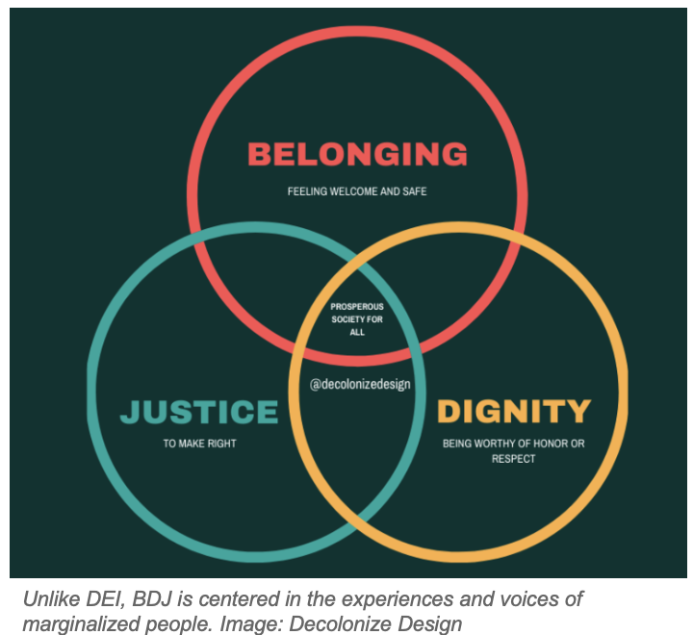
Sense of Belonging Centering Voices of Marginalized Faculty

Slide 10
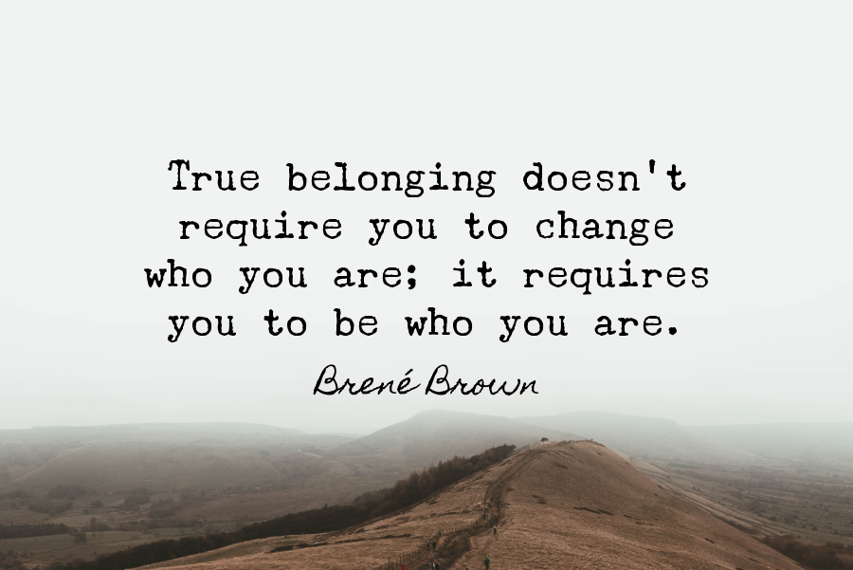
Inviting More Voices and Authentic Stories
The conversation around inclusion and diversity needs to take a human-centric approach. It’s not just about the numbers — it’s about the people.
When we bring our authentic stories with empathy to better relate and assist our colleagues and students’ we provide an opportunity for others to look through new lenses for perspective taking.
Sharing our stories and owning them are a powerful tool to help us foster a sense of belonging and build community.
Underrepresented faculty voices are crucial for transformational change in our institutions.

Slide 11
“Belonging Moments”
Perhaps most important, belonging in the real world occurs not only in “big moments” but mainly in “little moments”— i.e., as part of our daily interactions with others.
Belonging is both formal and informal arrangements;
Belonging happens within a community of faculty;
Belonging occurs within a network of professional relationships;
Belonging is reciprocal and involves the “giving and receiving of wisdom.”
Builds a “community” to help faculty to be part of the campus life and leadership, part of a whole

Slide 12
Cultivating Diverse Faculty Leadership
Commitment to diverse leadership requires intentional and organized efforts that focus on a long-term shift towards inclusive and welcoming environments. Faculty leadership can foster inclusive environments in the following ways:
Host Diversity-Themed Campus/Faculty Forums
Diversity Audits/Assessment
Professional Development
Diversity-Themed Mentorship Programs
Adopt a Cultural Humility Framework
Mentorship

Slide 13
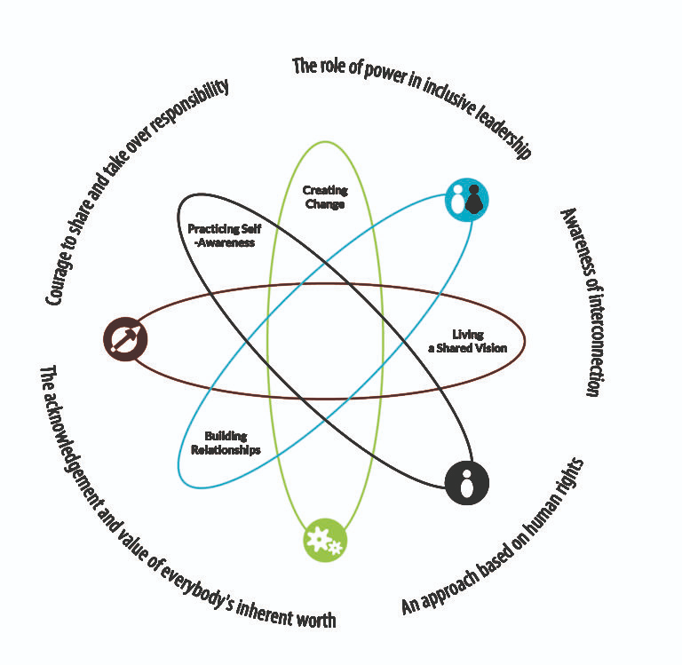
The Inclusive Leadership Framework
According to the Inclusive Leadership Handbook, an inclusive leadership approach “appreciates diversity, invites and welcomes everyone’s individual contribution, and encourages full engagement with the processes of decision-making and shaping reality. The following traits are important for creating an inclusive environment:
● Visible commitment: Leaders articulate a genuine commitment to diversity, challenge the status quo, hold others accountable, and make diversity and inclusion a personal priority.
● Humility: Leaders are modest about capabilities, admit mistakes, and create the space for others to contribute.
● Awareness of bias: Leaders show awareness of personal blind spots and flaws in the system and work hard to ensure meritocracy [value based on their own abilities].
● Curiosity about others: Leaders demonstrate an open mindset and deep curiosity about others, listen without judgment, and seek empathy to understand those around them.
● Cultural intelligence: Leaders are attentive to others’ cultures and adapt as required.
● Effective collaboration: Leaders empower others, pay attention to the diversity of thinking and psychological safety, and focus on team cohesion
Notes:
“Effective, inclusive leadership within the field of education also requires the knowledge and wisdom to examine the systems and attitudes within an education system and challenge the policies and practices to ensure they are not biased, exclusionary, or harmful to children. Such leadership can impact school culture, student outcomes, and teacher morale and effectiveness.”

Slide 14
Creating Leadership Paths
Mentorship
Role of standing committee chairs, how are they chosen?
are there formal coordinator opportunities?
committee appointed?
senate assigned?
Workgroups within committee, ad hoc, short-term leading initiatives
College-wide initiatives
Term lengths and set number of terms?
Understanding motivation:
Why do people seek the role?
Why do people elect to stay in the role?

Slide 15
Assessing Your Own Structures for Barriers
What is your faculty appointment process like?
How does your senate support succession planning?
What are ways that your senate collects input?
What voices are missing in discussions?
What resources do you make available for faculty who take on leadership opportunities in participatory governance?
Notes:
Need to break barriers and encourage faculty
Faculty Appointments: Does your process promote diverse pools of interested faculty? Have you assessed the diversity of your past faculty appointments? Does it seem that there are just a handful of key faculty that seem to be on everything? When appointing faculty is it open to the whole senate or just an individual representative of the senate to make the appointment? could there be bias? Do you ask for just a name to be submitted if interested in serving or do you request other information to make a more informed appointment? Extra consideration when appointing to search/hiring committees?
Succession Planning: What is the diversity on your senate and as terms expire or opportunities emerge how is your senate actively recruiting and encouraging diverse faculty to consider applying for the experience? Typically senate leadership emerges from senators who have experience..how do we make experience opportunities early so that there can be succession planning?
Collecting Input: As your senate seeks input from faculty on various plans, processes are you actively seeking those voices who are not at the table or offering opportunities for additional input? What about the ways you seek input from your part-time faculty (often times more diverse than your ft ranks)?
What voices are missing?
Resources: What resources does your senate make available to faculty who do step up to be involved with participatory governance? formal or informal support?

Slide 16
At the End of the Day as Inclusive Leaders:
We create, change and innovate while balancing everybody’s needs
We have the courage to take conscious steps to break down barriers for people at risk of being excluded from the table
We appreciate diversity, invite and welcome everyone’s individual contribution, and encourage full engagement with the processes of decision-making and shaping reality
We practice self-awareness
We share a vision
We build relationships

Slide 17
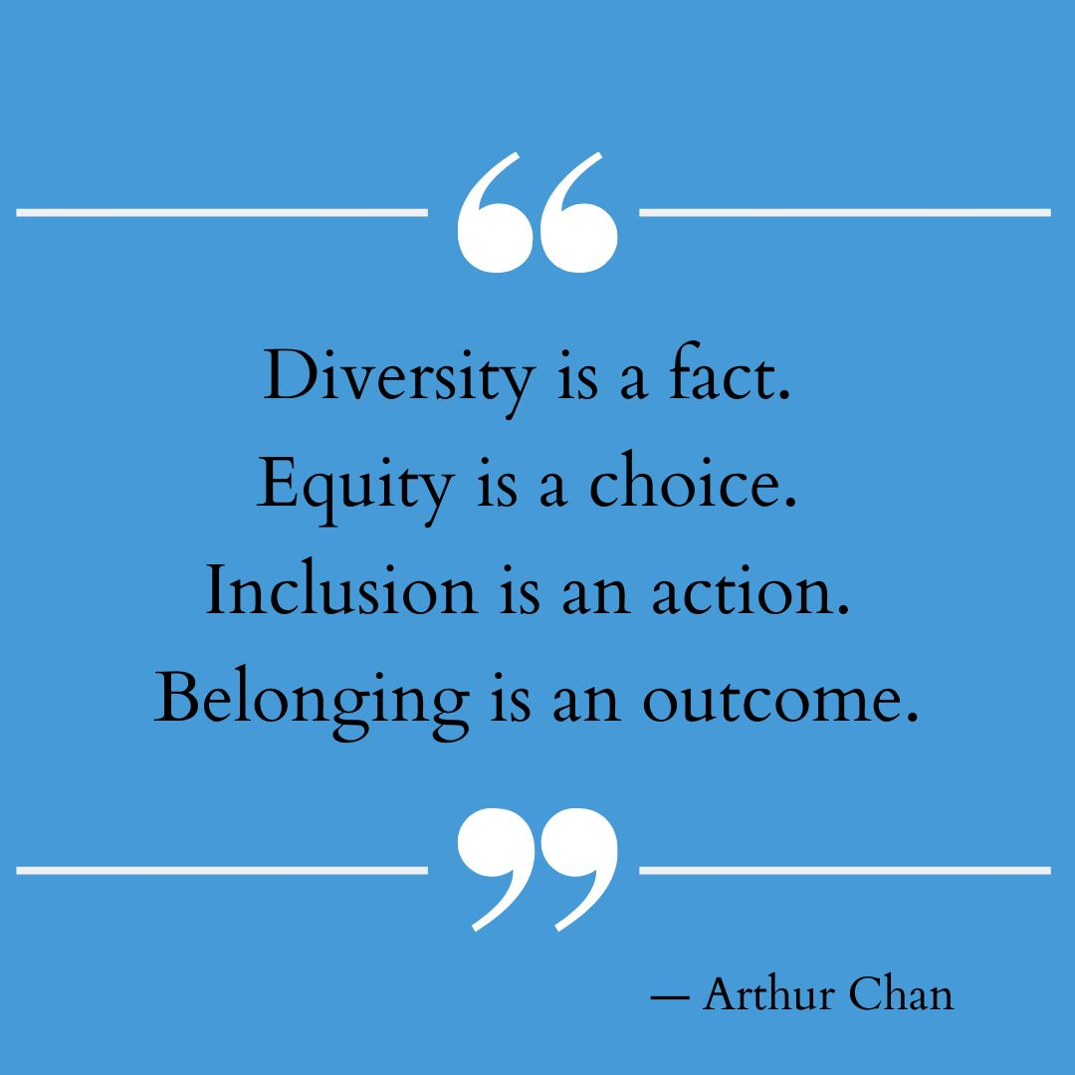
THANK YOU! GRACIAS!

Slide 18
Stay Involved. Find Additional Resources
Students’ application to sit on one of the SSCCC’s external committees
SSCCC Participatory Resources
Faculty application to serve on an ASCCC Committee
ASCCC Local Senates Handbook

