Slide 1
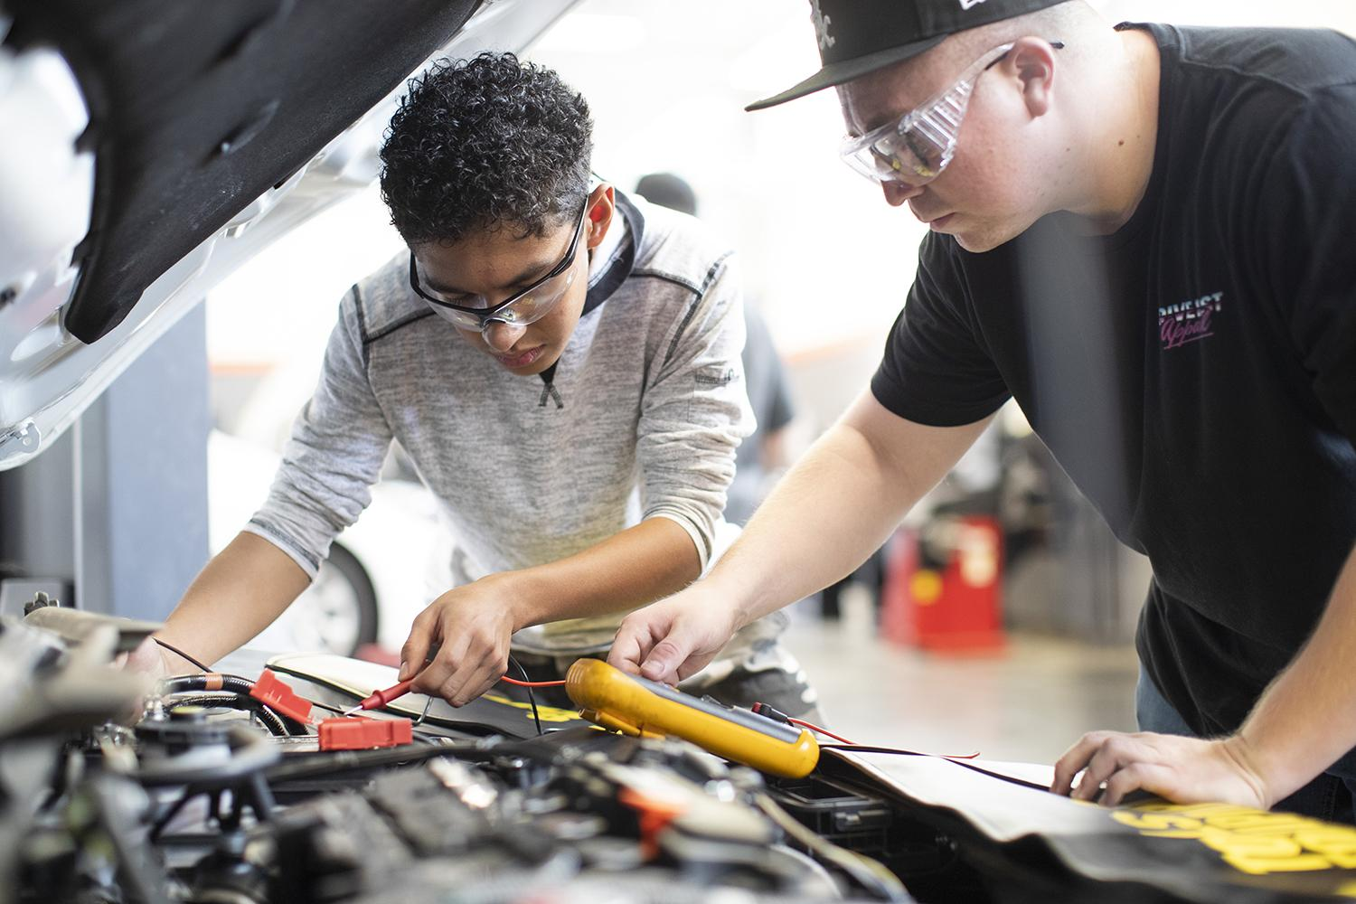
Inland Empire/Desert Regional Consortium

Slide 2
Mission & Vision
Mission & Vision
The mission of the Inland Empire/Desert Regional Consortium is to enhance its stakeholders’ workforce goals through communication, coordination, collaboration, and provision of resources.
VISION
The Inland Empire/Desert Regional Consortium is the trusted partner of regional workforce entities and contributes to the social and economic prosperity of the region and its diverse communities.

Slide 3
Inland Empire Desert Regional Consortium
A collective of workforce education and training providers led by the community colleges in Riverside and San Bernardino counties
Projects and services support the work of community college and K-12 workforce stakeholders, adult education, local workforce development boards, regional non-profit workforce entities, and others
Supported through funding provided by the California Community Colleges’ Chancellor’s Office.
Committed to working together to provide the region with workforce development programs that address real needs and contribute to economic prosperity
Notes:
Statement 01

Slide 4
Consortium Structure
9 Community College Districts
12 Community Colleges
56 K-12 Districts
Public Charter Schools
2 County Offices of Education
Adult Education Consortia
Community Based Organizations
Workforce Development Boards & organizations

Slide 5
Inland Empire/Desert Regional Consortium 2
Stephanie Murillo and Lori Sanchez
Regional Co-Chairs
K12 SWP
CC SWP & Employer Engagement
Regional Marketing
Fiscal Management
Stephanie Murillo
Director, K14 TAP
Lori Sanchez
Director of Strategic Partnerships
James Meier
Marketing Director
Sheryl Plumley
Director
K12 Pathway Coordinators
Sub-regional Employer Engagement Managers
Industry Managers
Notes:
Statement 01

Slide 6
Strong Workforce
Strong Workforce
A state education, economic, and workforce development initiative for the purpose of expanding the availability of high-quality, industry-valued career technical education and workforce development courses, programs, pathways, credentials, certificates, and degrees.
Strengthens and expands Career Technical Education programs and pathways
Prepares students to enter employment in occupations where there is documented demand and which pay a livable wage
K12 SWP supports collaboration across education systems between K12 and community colleges and intersegmental partnerships with involvement from industry
Since 2016, SWP & K12 SWP brought over $161.7 million to the Inland Empire/Desert for career education

Slide 7
IEDRC in Practice
IEDRC in Practice
Fiscal agent for SWP and other grants
Employer engagement services
Industry/sector expertise
Support for building and developing Career Education pathways in K12 and CC
Technical assistance for work based learning initiatives
Support the transition to and completion of community college career education
Support to build and expand career education in the region
Convene, communicate, collaborate – and create space to expand collaboration between stakeholders

Slide 8
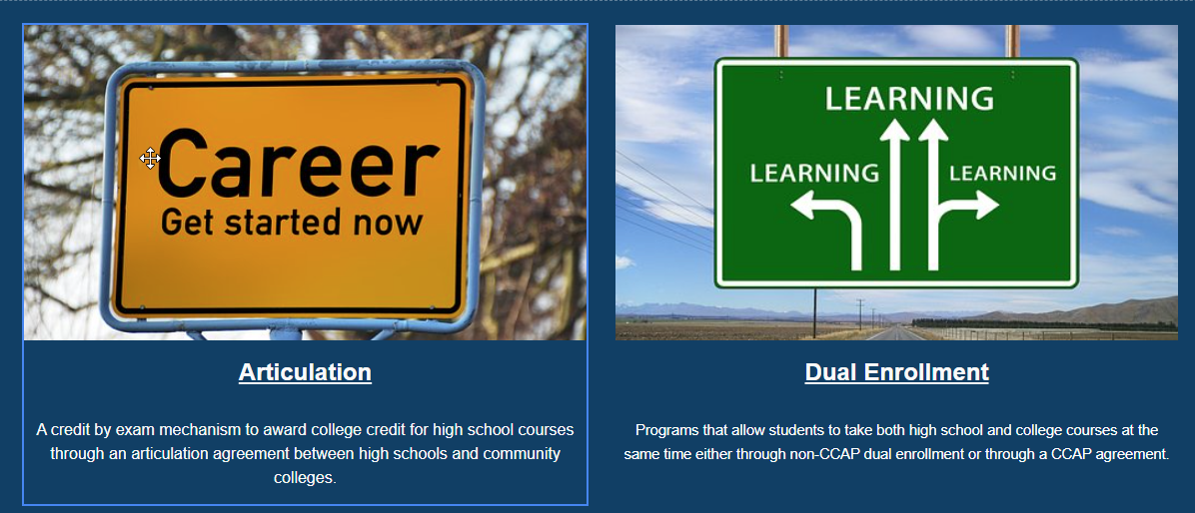
Early College Credit Initiatives
Notes:
Statement 01

Slide 9
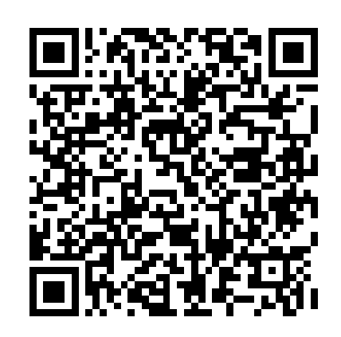
IEDRC Supporting Dual Enrollment
IEDRC Supporting Dual Enrollment
Needs assessments surveys are underway to gather feedback for:
Creation of a community of practice on Dual Enrollment
Creation of resources that support practitioners, students, faculty
We need your help! Please complete the survey
Dual Enrollment Practitioner Needs Assessment

Slide 10
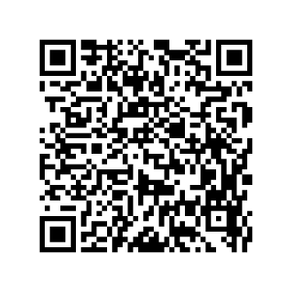
Instructor Needs Assessment
Instructor Needs Assessment

Slide 11
Early College Credit Resources
^{New WEBSITE}
^{Early College Quick Overview}
ECC Comparison Worksheet

Slide 12
Questions?
Questions?

Slide 13
Ways to Engage with Us
Get involved with SWP planning.
Utilize regional staff for industry advisory committees, professional development, and more.
Leverage regional marketing resources to promote your programs.
Access current and relevant labor market data related to your programs.
Connect to K-12 Strong Workforce projects and partners.
Notes:
Statement 01

Slide 14
Questions and Feedback
Questions and feedback
What did you learn that you didn’t already know before today?
You heard a lot of information today, what do you think will be of most use to you?
Which IEDRC and/or ASCCC resources would you like to learn more about?
What types of information or support could you use from the IEDRC and/or ASCCC?

Slide 15
Contact Us
For general information about regional projects and funding:
Lori Sanchez and Stephanie Murillo
For employer engagement and community college strong workforce projects:
Lori Sanchez, Director of Strategic Partnerships
Lori.Sanchez@rccd.edu
For K-12 strong workforce projects and resources:
Stephanie Murillo, K14 Technical Assistance Provider
Stephanie.Murillo@rccd.edu
For regional marketing resources:
James Meier, Director of Communications and Marketing
James.Meier@rccd.edu
Sign up for meeting announcements and newsletters:
info@desertcolleges.org
Notes:
Statement 01

