Slide 1
CAREER TECHNICAL EDUCATION MINIMUM QUALIFICATIONS TOOL KIT

Slide 2
Career Technical Education Faculty Minimum Qualifications Toolkit
https://www.asccc.org/sites/default/files/ADAversion_CTEMinQualsToolkit.pdf

Slide 3
CTE Minimum Qualifications Tool Kit
CTE Minimum Qualifications Tool Kit
Equivalency
Faculty Internship
Apprenticeship Minimum Qualifications

Slide 4
25 Strong Workforce Recommendations Adopted by the Board of Governors in Fall 2015
Student Success
Career Pathways
Workforce Data & Outcomes
Curriculum
CTE Faculty
Regional Coordination
Funding

Slide 5
“Increase the pool of qualified CTE instructors by addressing CTE faculty recruitment and hiring practices.
Clarify legislative and regulatory barriers to hiring CTE instructors who may not meet existing college hiring standards, but possess significant industry experience.
Disseminate effective practices in the recruitment and hiring of diverse faculty and the application of minimum qualifications and equivalencies.
Develop pipelines to recruit community college faculty with industry expertise through collaborations with higher education, business, and industry professional organizations.
Establish a mentorship model that delineates pathways for industry professionals to intern at colleges to gain teaching skills, knowledge, and experience while pursuing an associate degree or an equivalent.”

Slide 6
Chancellor’s office CTE Minimum Qualifications Work Group
Academic Senate
Chief Instructional Officers
College Presidents
Human Resources
California Community College Chancellor’s Office

Slide 7
Where did the CTE equivalency examples come from?
Chancellor’s Request of a Survey: 43 Colleges
Comments in the survey
Recognize the abilities people have who are
eminent or nationally recognized experts in their field, without an Associate Degree
very small pool of applicants, often far less than 10, as opposed to general education areas that get 100’s of applicants.
not understanding their CTE colleagues issues and programs.
Many comment on the irony of college preparing people for work, yet we didn’t accept industry credentials (the very place we are sending students to work) as equivalent to an Associate Degree.
a mismatch of what colleges require and what the industry actually needs and wants. Colleges are preparing people for jobs in industries that sponsor the industry credentials yet the college does not accept the industry experts as instructors with the industry credentials.

Slide 8
Survey of CTE Faculty and a few Deans: Does your program have challenges hiring CTE faculty?
“Boils down to this- Experience should be the most important factor in any CTE discipline.”
“The need to revise the equivalency evaluation process for industry experts that do not have an AA/AS degree is extreme.”
Many CTE faculty find it nearly impossible to hire industry experts.

Slide 9
Need for an Equivalency Resource
Colleges and districts are struggling with consistent application of equivalency.
Most difficulties surround equivalence to the associate’s degree, particularly to the general education component.

Slide 10
Who determines equivalency?
A district may hire a person who possesses qualifications different from, but equivalent to, those listed on the disciplines list, according to criteria and procedures agreed upon by the governing board and the academic senate (Title 5 §53430).

Slide 11
Required: Local Equivalency Process
Governing boards may grant faculty equivalency to the minimum qualifications.
Every district must have an equivalency process, with process, criteria, and standards by which the governing board determines that faculty possess qualifications at least equal to the minimum qualifications (Ed Code §87359).
Once the local equivalency process has determined a recommendation regarding an individual applicant, Education Code §87359(a) requires that the governing board take action on the equivalency before hiring occurs.

Slide 12
Recommendations: Local Equivalency Process
The goal of any equivalency policy should be to ensure the transparent and fair determination of equivalency for applicants that possess qualifications at least equal to the minimum qualifications.
The process should be documented and justifiable so that a determination of equivalency is understandable, clear, and supported upon review.
Colleges must also understand that applicants who are granted equivalency and subsequently hired retain that status for their entire career in the district that granted the equivalence.
Discipline faculty help determine discipline-specific equivalency criteria.

Slide 13
Equivalency Committees
Either a subcommittee of the academic senate or a separate committee whose membership is determined by the academic senate.
Ensure that the equivalency process is consistent and fair.
Faculty in the discipline play a critical role in informing the decision.
Must include faculty from outside the discipline.

Slide 14
ASCCC Basic Principles for Granting Equivalency
Equivalent to the minimum qualifications means equal to the minimum qualifications, not nearly equal.
The applicant must provide evidence he or she has attained the breadth of coursework or experience equal to the general education component of an earned associate’s or bachelor’s degree.
The applicant must provide evidence he or she has attained the skills and knowledge provided by specialized coursework required for the degree listed in the Disciplines List.
For non-master’s disciplines, evidence that the requisite professional experience is equivalent to the required full-time experience required for the discipline.
Eminence should not be used as the sole criteria for granting equivalence (ASCCC Resolution 10.01 SP09).

Slide 15
Why General Education?
Purpose of GE is to produce a citizen who can interact effectively with the world around them based on critical thinking and reasoning, sound oral and written communication, an applied understanding of other peoples and cultures, and applied experiences with science and its impact on people.

Slide 16
What General Education is required for an Associate of Arts or Associate of Sciences?
GE for an AA degree includes demonstrated competencies in math and English along with 18 units in 5 areas*:
A. Natural Sciences
B. Social and Behavioral Sciences
C. Humanities
D.1. Language and Rationality: English Composition
D.2. Language and Rationality: Communication and Analytical Thinking
*Title 5 Section 55063

Slide 17
General Education Area A Natural Sciences
Example: Aviation (Certified Flight Instructor)
A certified recreational, private, or commercial must
understand and apply Newton’s Basic Laws of Motion
and Bernoulli’s Principle Ref: FAR 61.185(2)
Purpose for Including One Course in Natural Sciences for General Education
For students to develop the ability to examine the physical universe, its life forms, and its natural phenomena
For students to develop an appreciation of, understanding of, and ability to apply the scientific method
For students to develop the ability to understand the relationship between science and other human activities
Title 5 §55063

Slide 18
General Education Area B Social and Behavioral Sciences
Example: Culinary Arts/Food Production
A chef or culinary artist works within varied ethnic
foods and understands and applies an understanding
of foods and culture as well as historical food trends
Purpose for Including One Course in Social and Behavioral Sciences for GE
For students to develop an awareness of the methods of inquiry used by the social and behavioral sciences.
To stimulate students’ critical thinking about ways people act or have acted in response to their societies
To promote students’ appreciation of how societies and social subgroups operate
To develop or promote a students’ understanding and appreciation of ethnic groups (Title 5 §55063 (b)(2) requires a course in Ethnic Studies. It is most likely met through the course/experience/ability counted in Area B or Area C)
Title 5 §55063

Slide 19
General Education Area C Humanities
Example: Mortuary Science
Certified Funeral Service Practitioners complete
Celebrant training to develop an awareness of traditions
of different cultures and religions
Purpose for Including One Course in Humanities for GE
For students to develop an awareness of the way in which people throughout the ages and in different cultures have responded to themselves and the world around them in artistic and cultural creations.
For students to develop or demonstrate aesthetic understanding and an ability to make value judgements.
To promote a students’ understanding and appreciation of ethnic groups (Title 5 §55063 (b)(2) requires a course in Ethnic Studies. It is most likely met through the course/experience/ability counted in Area B or Area C)
Title 5 §55063

Slide 20
General Education Area D.1. Language and Rationality: English Composition
Example: Any Discipline
Publishing a peer-reviewed article
Writing of a market, technical or sales report or manual, or writing of a similar document within the work environment
Purpose for Including English Competency and One Course in Language and Rationality: English Composition for General Education
For students to develop the principles and applications of language toward logical thought, clear and precise written expression and critical evaluation of written communication in whatever symbol system the student uses.
For students to develop expository and argumentative writing skills (English Composition)
Title 5 §55063

Slide 21
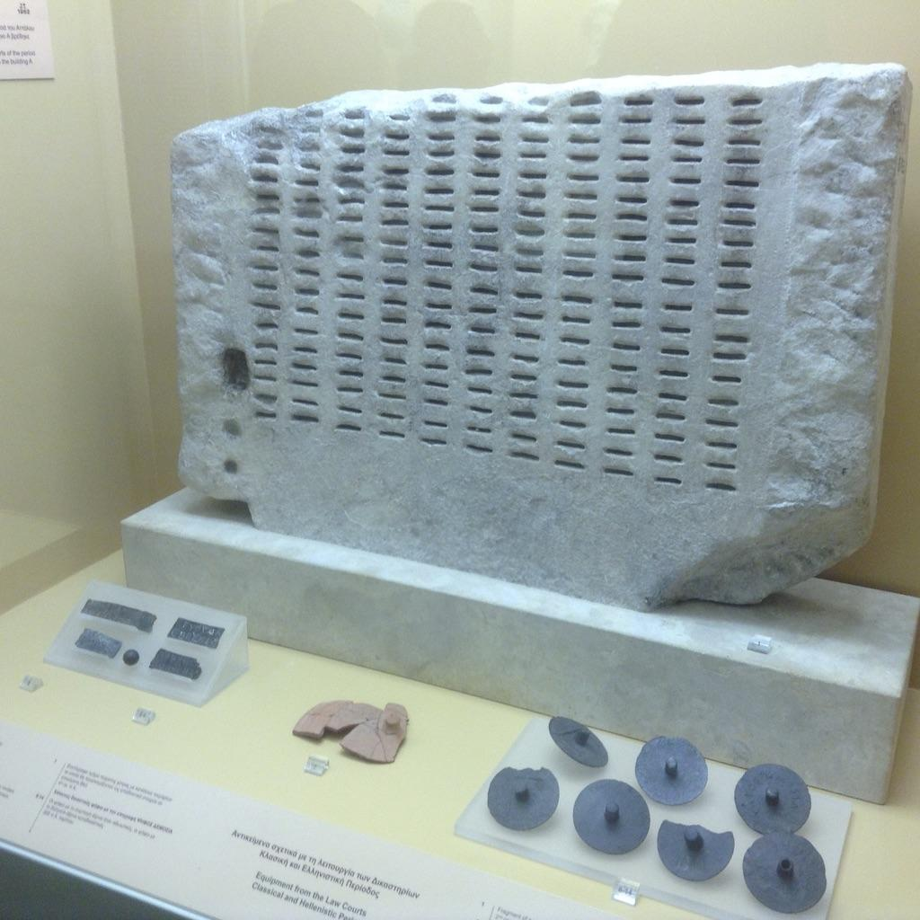
General Education Area D.2. Language & Rationality: Communication & Analytical Thinking
Example: Automotive Technology
A licensed automotive technician must use mathematical skills to manage and calculate ratios, measurements, comparisons, and specifications related to investigation of problems; may also use mathematical skills and reasoning to machine parts and tools to exact specification.
Purpose for Including One Course in
Language and Rationality for General Education
For students to demonstrate competence in mathematics at a level equivalent to intermediate algebra
For students to develop oral communication and analytical thinking skills
For students to develop skills interpreting and assessing data and statistics to draw conclusions.
Title 5 §55063

Slide 22
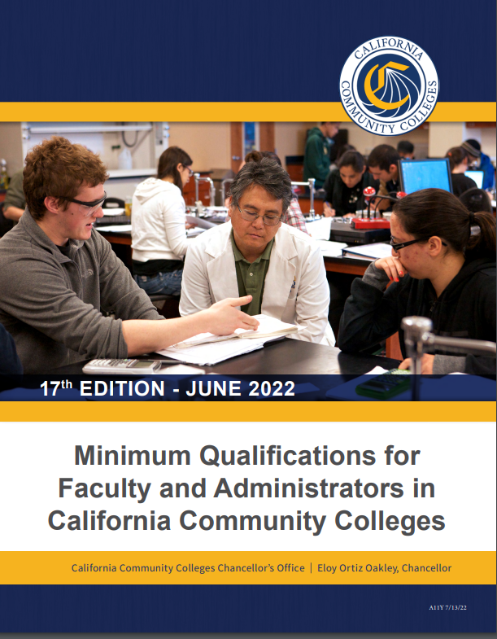
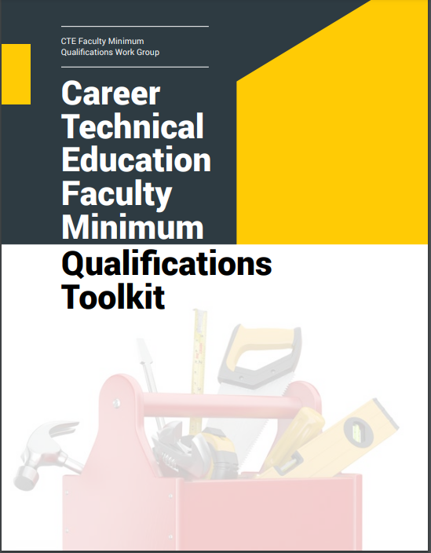
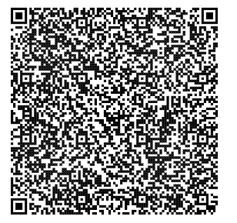
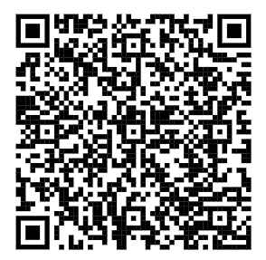
MQ Handbook & CTE Minimum Qualifications Toolkit
Notes:
Although we already have a published CCCO MQ handbook that recognizes CTE, the toolkit is a supplemental document/resource that colleges and districts can use to elevate their local practices.
Equivalency
Faculty Internship
Apprenticeship Minimum Qualifications

Slide 23
Questions?

Slide 24
Contact Info
Lynn Shaw
shawlynn@gmail.com

