Slide 1
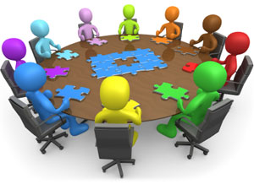
Minimum Qualifications & Equivalency Committee Activity Directions
Imagine you are serving on your District Equivalency Committee.

Slide 2
Minimum Qualifications & Equivalency Committee Activity
There are general descriptions of the roles you will be assigned in this exercise. Please feel free to embellish as you like. Maybe you have had experience in an equivalency committee and want to change the viewpoint of your assigned character. Feel free!

Slide 3
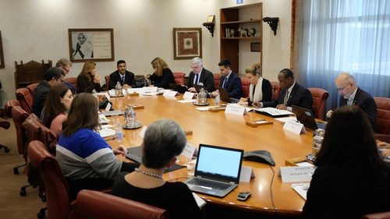
Minimum Qualifications & Equivalency Committee Activity 2
Your job in this exercise is to determine if the candidate will be recommended for equivalency. Your internal process for the working of the committee is for you to decide.

Slide 4
Career Technical Education Minimum Qualifications & Equivalency Committee Roles
Senate President or designee
You chair the Equivalency Committee. Your concern is that the process is followed and that discipline faculty take the lead.

Slide 5
Career Technical Education Minimum Qualifications & Equivalency Committee Roles
Human Resources Director
You have worked at your District for 12 years and you have rarely seen an equivalency to minimum qualifications be approved. As a matter of fact, your college has a process on paper but you know that the unwritten policy is to not approve any equivalencies. The District has great concerns about accreditation and audits and does not want any risk by giving an equivalency.

Slide 6
Career Technical Education Minimum Qualifications &Equivalency Committee Roles
CTE Dean
You are hyper concerned about the unstaffed classes for next semester and beyond. You are feeling the pressure of the new funding formula and need enrollment. You know that the candidate is perfect for the classroom and have verified that what the candidate has in his/her portfolio of documentation is true.

Slide 7
Career Technical Education Minimum Qualifications & Equivalency Committee Roles 2
English or Math or General Education Faculty
You are concerned about the breadth of education that general education classes provide. You believe a transcripted course is the best way to show the deep understanding of learning. You do not understand why everyone cannot just get a degree like you did. After all we are only asking for an Associate Degree and you have a Masters or PhD or EdD.

Slide 8
Career Technical Education Minimum Qualifications & Equivalency Committee Roles
Faculty Candidate
You are a well-recognized industry expert with years of experience in your area. You have provided the committee with documentation that you feel easily meets or exceed the minimum qualifications required. You live in the local community and want to give back. You have a hard time seeing why you have to go through all this paperwork just to help your community.

Slide 9
Career Technical Education Minimum Qualifications & Equivalency Committee Roles 3
Faculty Champion
Your department desperately needs some new faculty with relevant current industry experience. All the current faculty in your department have not worked in industry in the last decade. Your candidate has served on both the local and regional advisory boards for the last three years. You know the candidate from when you both worked at the same company. While the candidate is not your friend, you have had a professional relationship over the last 10 years.

Slide 10
Scenario
Diesel Mechanics
Tanisha Drivetrain is actively managing one of the largest diesel repair facilities in the region. She has 15 years of experiences in diesel repair and maintains power plant certifications from Cummins, Detroit, Mack, Freightliner and Volvo. Tanisha is considered one of the region’s most highly respected diesel repair experts. Tanisha has extensive experience in training new mechanics and has established the first online, industry supported, professional development program in California for diesel professionals. Tanisha sits on the local college’s Green Diesel advisory board. She also provides education at Statewide training events, speaks at a statewide manufacturer’s conference and hires about 35% of the local program graduates. Tanisha ensures that her employer strongly supports CTE pathway efforts at several inner city high schools. Tanisha has been recognized by the High School Board of Trustees for her work with non-traditional students. Tanisha has a high school and certification from a private trade school.

Slide 11
WHAT DO YOU THINK?
Does your equivalency committee recommend Tanisha Diesel for equivalency in the discipline of Diesel Mechanics?
Why or why not?

Slide 12
Scenario 2
Health Information Technology (Medical record technology)
Debbie Datawinski currently manages an office of 5 staff at a regional Health Information Technology (HIT) company and has 15 years experience implementing HIT recommendations from California’s Department of Health Services. Debbie is has completed several industry recognized credentials. She is responsible for the staff development of her employees and has developed a training handbook as a resource. Debbie’s organization provides internships for the local community college’s HIT graduates. As an armed forces reserve soldier, Debbie recently returned from a 3-month deployment to Peru, where she actively trained HIT professionals from several state-run medical systems. Debbie speaks fluent Spanish. Debbie has a certificate of achievement in HIT from her local community college. She has no additional college credit.

Slide 13
WHAT DO YOU THINK? 2
Does your equivalency committee recommend Debbie Datawinski for equivalency in the discipline of Health Information Technology?
Why or why not?

Slide 14
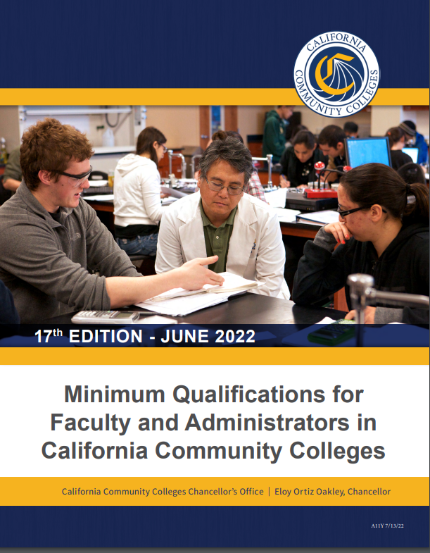
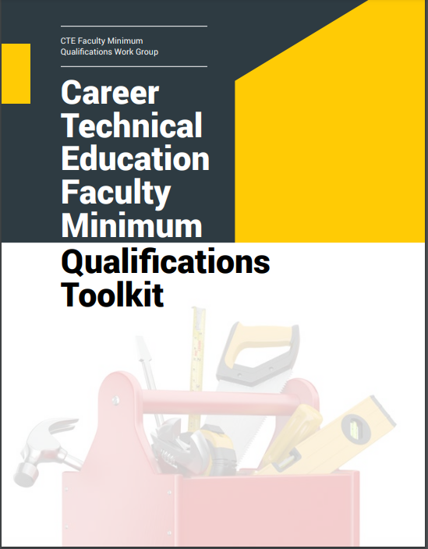
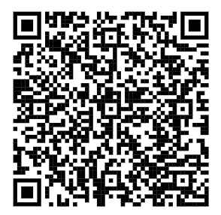
MQ Handbook & CTE Minimum Qualifications Toolkit

