Slide 1
Hot Topics for Part-Time Faculty Friday February 10th 9:00 – 10:25am

Slide 2
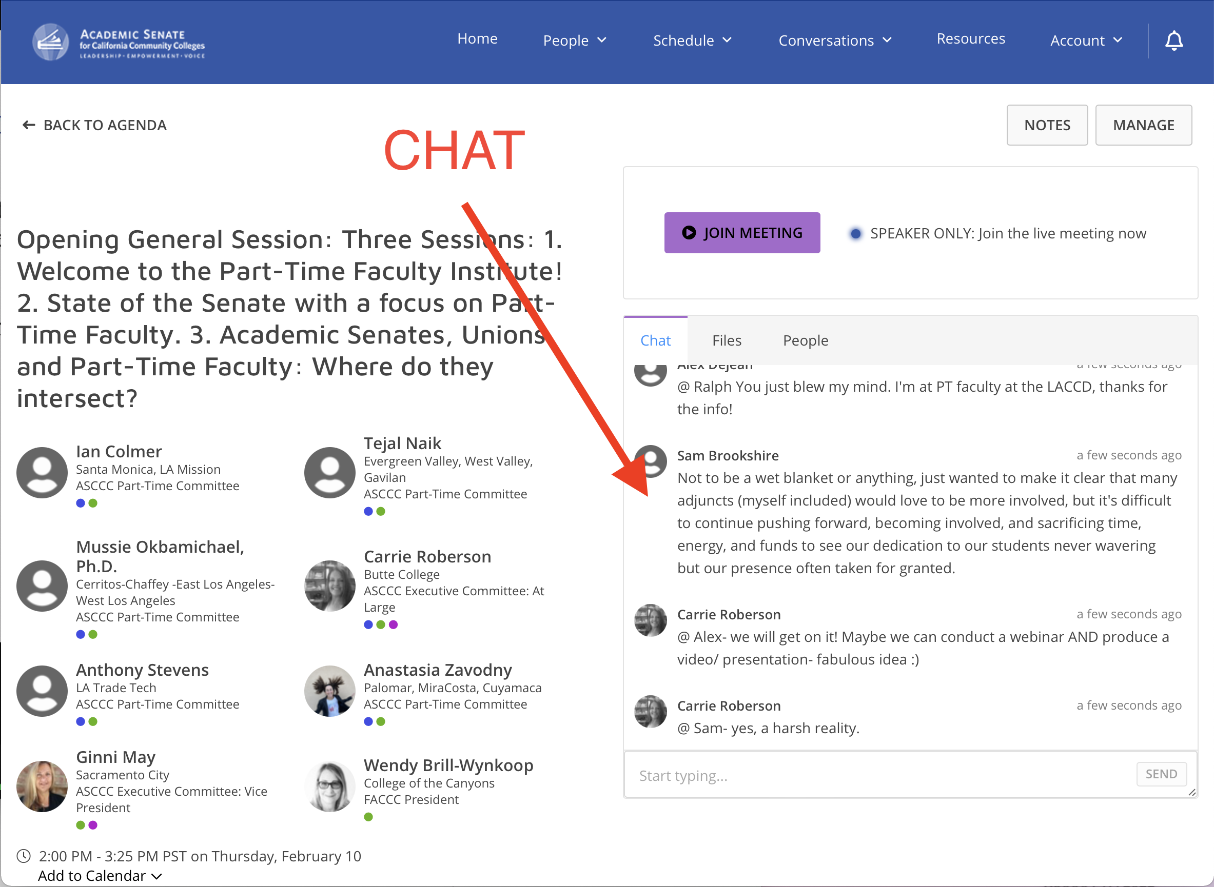
Introductions
In the Pathable chat:
What do you teach?
Where do you teach?
Breakfast?
Notes:
John 5 minutes

Slide 3
We (Virtually) Welcome You
The ever-changing nature of higher education in California directly and indirectly impacts the largest employed group at our colleges: part-time faculty. While part-time faculty play a significant role in supporting students in their educational endeavors, many statewide policies and local decisions turn into HOT TOPICS that impact the roles and responsibilities of part-timers, who are often left to deal with the fallout on their own. Listen and learn about current and ongoing HOT TOPICS, how dynamics contribute to college morale, and ultimately student success!
Notes:
Ian 3 minutes

Slide 4
Overview & Objectives
Understand ongoing issues
Challenges of earning a living
Part-time equity & student equity
Explore potential solutions
Share your perspective
Build community
In the Pathable chat, what are some hot topics that concern you?
Notes:
John 2 minutes

Slide 5
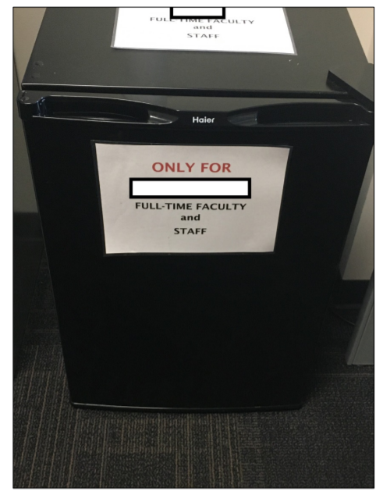
Food for Thought
“I recall one semester having only two classes, and not having enough money to pay rent or food. I am never going to forget the feeling of failure and hunger. It still brings me to tears when I remember how it felt to have to divide a Jack in box $1 taco between me and my child for lunch for weeks. Unfortunately, I know that my story is not unique. Many of our part-time faculty live in poverty, or are on the brink of living in poverty from one semester to the next. But despite this, they still give so much. So it is imperative that we try our best to support our part-time faculty, and increase equity among our colleagues that do so much for so little.”
Notes:
Ian 2 minutes

Slide 6
Ed Source Video
“Gig by Gig at California Community Colleges”

Slide 7
Challenges of Earning a Living
Part-time faculty “temporary” (yet many have been working for decades)
Anxiety about money
Lost health insurance
Unpaid labor
Ageism in being hired full-time
Evaluations (one full-timer can tank your career)
What do you call ‘em?
Raise your hand or chime in using the Pathable chat!
Notes:
John 1 minute

Slide 8
Perception Is Everything!
Notes:
John 5 minutes

Slide 9
Evaluations: One Full-Timer Can Tank Your Career!
Notes:
John 5 minutes

Slide 10
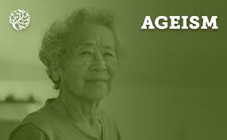
Ageism in Being Hired Full Time
Notes:
John 5 minutes

Slide 11
Lost Health Insurance
Notes:
John 5 minutes

Slide 12
Encouraged to Take On Unpaid Labor
Notes:
John 5 minutes

Slide 13
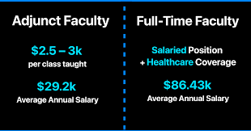
Anxiety about Money
Notes:
John 5 minutes

Slide 14
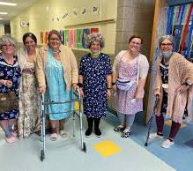
Part-Time = “Temporary”?
Administrators say part-time faculty are temporary, yet many have been working for decades.
Notes:
John 5 minutes

Slide 15
Part-Time Equity & Student Equity
Invited to department meetings?
Segregated physical spaces
Participation/voice in participatory governance
Vision for Success
Opportunities for paid professional development
Raise your hand or chime in using the Pathable chat!
Notes:
Ian 1 minute

Slide 16
Invited to Department Meetings?
Notes:
Ian 5 minutes

Slide 17
Segregated Offices (& Refrigerators)
Notes:
Ian 5 minutes

Slide 18
Voice in Participatory Governance & Departments
Notes:
Ian 5 minutes

Slide 19
Vision for Success
How can we support our students when we aren’t supported?
Notes:
Ian 5 minutes

Slide 20
Opportunities for (Paid) Professional Development

Slide 21
Your Turn!
What ideas do you have for how we might be able to increase equity for part-time faculty?
Raise your hand or type your answer in the chat!
Notes:
John

Slide 22
Resources
ASCCC Part-Time Faculty Committee
Part-Time Faculty Nexus
FACCC Part-Time Faculty Resources
ASCCC Part-Time Listserv
CalSTRS
Notes:
ADD MUSIC

