Slide 1
Leveraging Regional Resource$: Collaborating with Your Regional Consortium
Dr. Lynn Shaw, ASCCC CTE Leadership Committee
Rock Pfotenhauer, Bay Area Regional Co-Chair
Blaine Smith, North Far North Region Executive Director

Slide 2
WHY WAS THE CONSORTIA ESTABLISHED? (Perkins-which began in the early 90’s)
Build on the efforts of states and localities to develop challenging academic and technical standards to assist students in meeting such standards, including preparation for high skill, high wage or high demand occupations in current or emerging professions:
Promote the development of services and activities that integrate academic, CTE instruction and that link secondary and post-secondary education for participating CTE students:
Increase state and local flexibility to provide services and activities designed to develop implement and improve CTE, including tech prep education;
Ensure the dissemination of information on best practices that improve CTE programs, services and activities;
Provide technical assistance that:
Promotes leadership, initial preparation and professional development at the state and local levels; and
Improves the quality of CTE teachers, faculty, administrators and counselors;
Support partnerships among secondary schools, post-secondary institutions, baccalaureate degree granting institutions, local workforce investment boards, business and industry; and
Provide individuals with opportunities throughout their lifetimes to develop, in conjunction with other education and training programs, the knowledge and skills needed to keep the United States competitive

Slide 3
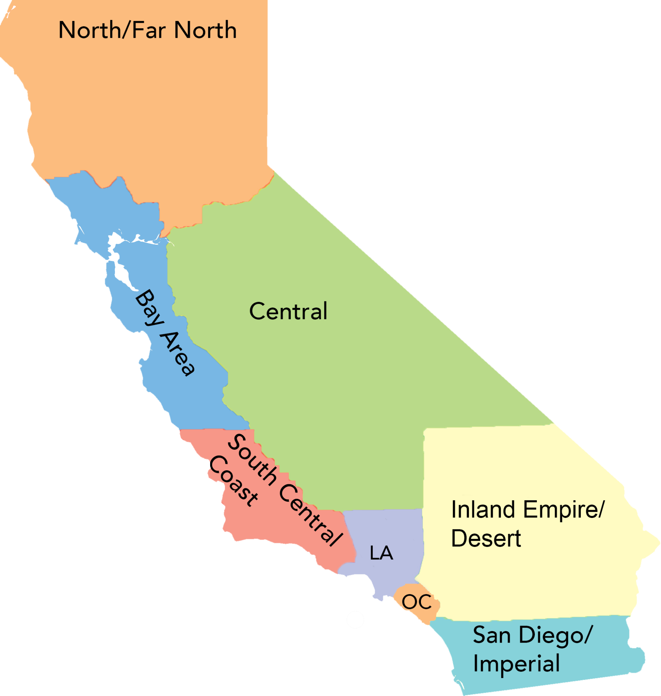
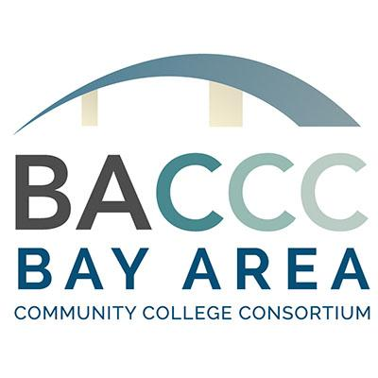
COMMUNITY COLLEGE REGIONS IN THE STATE

Slide 4
Why Regional Consortia? - Employers Perspective
10,200+ K12 Schools
400 Adult Education programs
116 Community Colleges
23 CSUs
10 UCs
45 Workforce Development Boards
58 counties
482 cities
Silver Tsunami
Low unemployment rates
High cost of living

Slide 5
Why Regional Consortia? - State’s Perspective
10,200+ K12 Schools
400 Adult Education programs
116 Community Colleges
23 CSUs
10 UCs
45 Workforce Development Boards
58 counties
482 cities
Capitol
Chancellor’s Office
CDE
Cal WDB

Slide 6
Evolution of Regional Consortia Role
2012: 1st CA Economic Summit (Action Plan, pg 19)
Issue: Current approach to solving the growing skilled worker shortage is fragmented & under-resourced—not meeting the needs of our regional economies
Goal: Prioritize workforce-training resources to support the growth of major regional industry sectors.
Legislative Action:: SB1402 - Bill Text, Analysis
2013: Creation of Workforce and Economic Development Division (WEDD) - Resourced statewide + regional network of industry initiatives directed at 10 priority sectors
2016: Strong Workforce Program (announcement)
2018: K12 Strong Workforce Program introduced;
2021: RFA for Regional Collaboration and Coordination

Slide 7
Regional Collaboration & Coordination (re- authorization) Jan. 2022-June 2026
Regional Collaboration and Coordination Grant
Background & Context
This grant is made and entered into by the California Community Colleges Chancellor’s Office, on behalf of the California Community Colleges Board of Governors
The purpose of the grant is to fund and support regional infrastructure and operations to provide leadership and coordination of workforce and career education programs within regions and facilitating collaboration and support of the region’s member colleges in improving student success and employment outcomes to meet Vision for Success Goals.

Slide 8
Regional Collaboration and Coordination Grant
Support a regional team that serves the needs of the region and member colleges, the operations and delivery of the Grantee activities.
Manage associated program funding streams, including recommending all new career education curricula developed by colleges in its region. The Grantee will collaborate with key stakeholders in their respective regions to meet all workforce program requirements (federal and state), as well as support colleges in the region in meeting the Board of Governor’s Vision for Success goals.

Slide 9
Regional Collaboration and Coordination Grant
Provide and support strategies to assist colleges in providing career education and workforce training to all in a manner that is accessible, efficient, responsive and data driven; work with the colleges and key stakeholders in the regional workforce and economic development ecosystem to help drive:
Collaboration and coordination of career education programs among colleges in each identified region;
Regional strategies and partnerships to reduce skills, employment and equity gaps;
Capture and dissemination of valuable, region-specific employer, industry, and student success data;
Develop strategies and structures that provide comprehensive support to serve parttime and adult learners; and
Evolution of current regional governance structures and employer engagement functions that are much more inclusive and outcomes based.

Slide 10
Regional Collaboration and Coordination Grant
These goals and activities will be measured by the following outcomes:
The expansion of work-based learning for all students;
The increase of student employment outcomes; and
The responsiveness of colleges to the training needs of employers by providing a relevant and diverse pipeline of skilled workforce.
The regions shall be the entity responsible to coordinate, collaborate, organize, and facilitate interaction in the region to ensure career technical education, and workforce and economic development efforts drive towards improving student outcomes and closing skills, employment and equity gaps in the region.

Slide 11
Regional Collaboration and Coordination Grant
Assist colleges in their region in fostering relationships (employer engagement) with key employers and identifying opportunities to enrich career and work-based learning opportunities and activities for students
Assist colleges in developing and establishing appropriate student support that drive toward student employment outcomes.
Convene and coordinate complex organizations and agendas toward a common student-centered goal.
Remove barriers to decision making and group progress to achieve common goals.
Conduct complex project management and budget management.
Deliver timely reports and data to the Chancellor’s Office.

Slide 12
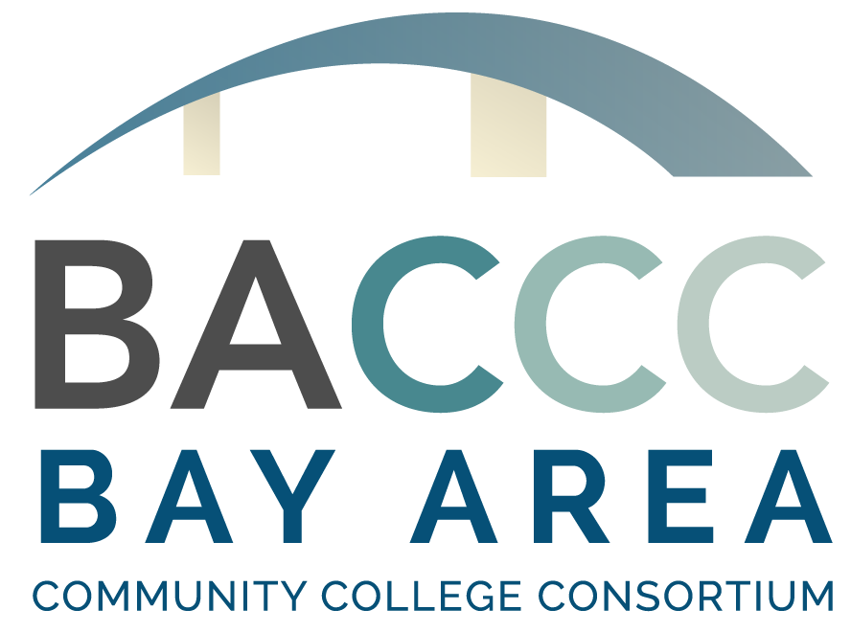
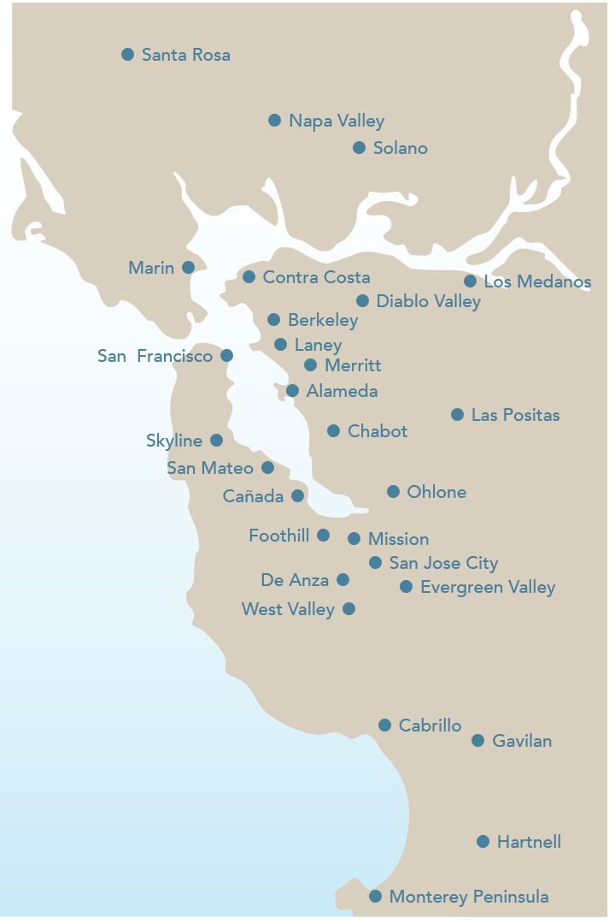
28 Colleges
~345,000 Students
~180,000 CTE Students
200 Unique CTE Programs

Slide 13
BACCC Communications
BACCC Website - www.baccc.org
BACCC Regional Meetings Calendar: https://baccc.org/baccc-meetings/
Monthly recurring BACCC facilitated calls organized by date with links to recordings, agendas, Zoom details ( BACCC Monthly Call, Adult Ed Pathways Call & Biweekly K14 Pathways Call)
Current fiscal year agendas via labeled buttons
Archived agendas by fiscal year (scroll down)
Bay Region Events Calendar - https://baccc.org/events/-Submit events for posting at this link
BACCC listserv - general CE related info distribution channel; click HERE to subscribe
BACCC maintained Google Groups - targeted email lists organized by title/entity
Primary audience - College Reps (CTE Deans/Workforce Directors) voting members
CEO, CIO, CSSOs, SWP Managers (Regional K12 list managed by CO)
Moving to Salesforce CRM platform - stay tuned!
Have a question? Email help@baccc.net & a team member will respond

Slide 14
Providing Leadership in Career Education and Workforce Development The region so nice, they named us twice!
NFNRC.ORG

Slide 15
NORTH FAR NORTH REGIONAL CONSORTIA MISSION
The Mission of the NFNRC is to:
Provide
Provide access to high quality post-secondary educational programs for immediate employment in living wage careers.
Promote
Promote economic and workforce development that is responsive to local employer demand for workforce training to collectively support regional needs.
Advocate
Advocate for policy and legislative actions that support inclusive workforce training and economic development.
NFNRC.ORG

Slide 16
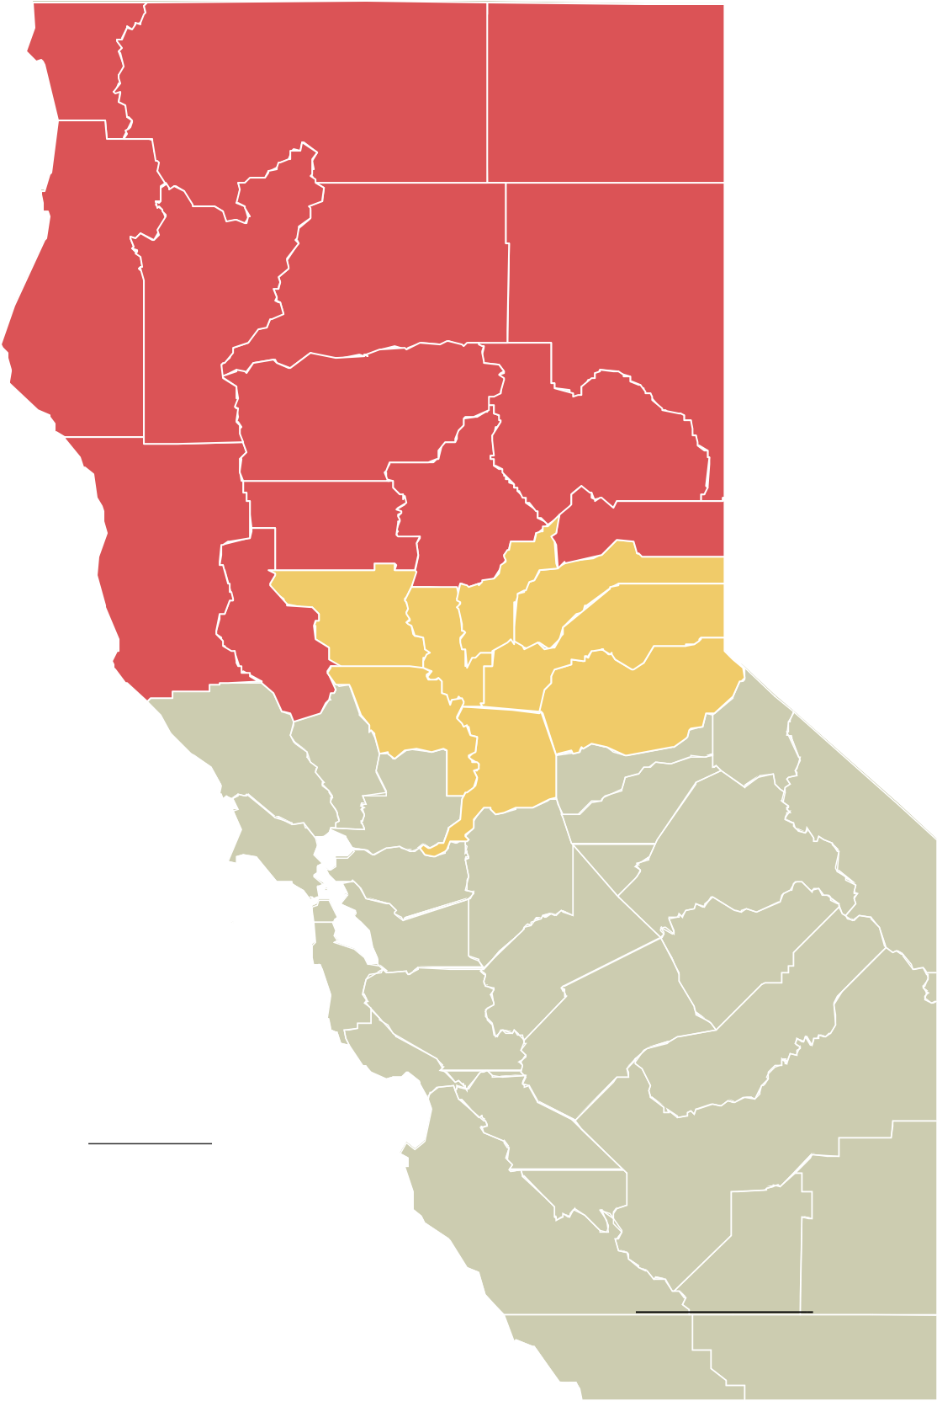
Del Norte
A. INTRODUCTION
The work of the North Far North Regional Consortium (NFN RC) contributes to and is aligned with the California Community College Chancellor's Offices' Vision for Success, Strong Workforce Program and goals.
Siskiyou
Modoc
NFN RC's planned activities and investments over the next three years are guided by these goals and strategies. More detail is provided in Section F.
Trinity
Shasta
Lassen
GOAL: Improve coordination of workforce training To improve the flow of information to and from employers and key stakeholders, the Coordinating Council will be expanded to include a broader range of partners and stakeholders.
Further, more digital resources will be added for employers.
Humboldt
NFN Career and Technical Education (CTE) strategies, activities, programs, and investment strategies presented in this plan, are aligned with economic and workforce development partners and informed by data provided from multiple sources including
North Far North Center of Excellence
Economic Forensics and Analytics
U.S. Census Bureau
Tehama
Plumas
Glenn
Butte
Sierra
GOAL: Improve responsiveness to employers Employer engagement personnel will be established in each district to build new and strengthen existing employer relationships through regular outreach, employer roundtables, and improved coordination with Workforce Training and Development Department (Contract Education).
Mendocino
Nevada
Colusa
Yuba
Sutter
California Employment Development Department
Lake
Placer

El Dorado
Launchboard
Yolo

State and national research documents
Personal interviews
Sacramento
The North Far North Regional Consortium (NFN RC) uses these goals set by the Chancellor's Office to guide its investment and program strategies:
Increase degree and certificate attainment
Reduce excess unit accumulation
Increase transfers to four-year institutions
Close equity gaps
Secure gainful employment
Close regional achievement gaps
GOAL: Increase equitable student completions With improved performance reporting and by offering professional development opportunities designed to enrich
cultural proficiency, the NFN faculty and administration will have a better understanding of how to more-effectively guide and teach students from diverse backgrounds.
The North Far North Regional Consortium (NFN RC) serves the largest geographic area of the state, from the Sacramento Metro area north to the Oregon border, and from the North Coast across the Cascade and Sierra Nevada Mountain Ranges to the Nevada border. A list of all counties included in the region is located in the References section.
GOAL: Further organizational effectiveness
Staffing levels will be monitored and adjusted to assure there is sufficient support given to Projects in Common, employer engagement, and that information is distributed and shared efficiently.

Slide 17
B. REGIONAL ECONOMY
The NFN Region, the largest geographic area of the state, consists of 15-member community colleges, and two sub-regions—North and the Far North. Butte College in Oroville is the host college.
Broadband. Availability and quality of broadband service is much more robust in the more urban areas. In the increasingly digital world, this disparity presents substantive challenges for students, businesses, and training partners attempting to provide services.
NFN Region
State of California
3.62 million 39.2 million
Population (California Department of Finance, Jan 2022)
Colleges in the North—especially those in the Sacramento Metropolitan area—have larger enrollment, American River College serves more than 45,000 students. Colleges in the Far North typically have smaller student populations.
Digital Literacy. Access to broadband is not just an issue for rural communities. Affordability and technical literacy are obstacles that urban areas also face. Even where broadband may be widely available, students and workers may lack the skills to use it and the cost of accessing it can be prohibitive. The disparities with broadband have been even more evident with activities forced to go online due to the COVID-19 pandemic.
1.6 million 19.2 million
Civilian Labor Force (California EDD LMI, Nov 2022)
Most of the colleges in the North sub-region are part of the urban Sacramento Metropolitan area. They are geographically close—under one hour of driving time between colleges (the exception is Lake Tahoe Community College). Member colleges in the Far North sub- region, by comparison, are scattered geographically across hundreds of miles in the more rural and remote parts of the state, making in- person gatherings more challenging.
Employer Resources. Access to training facilities, expertise, and employer partners to offer internships and apprenticeships is much more limited in the rural areas.
4.0% 4.0%
Unemployment Rate (California EDD LMI, Nov 2022)
The NFN Region also has a diverse economy that includes both large and small businesses in manufacturing, agriculture, services, retail and tourism, information technology, health, education, and government.
Wildfires. Hundreds of fires have destroyed land, buildings, and lives in the NFN Region. As of September 2021, nine of the state's 20 most destructive fires occurred in the region. These fires burned 3.4 million acres, destroyed over 30,000 buildings, and took 122 lives (CalFire). Tens of thousands of people have been evacuated and thousands remain permanently displaced and unemployed. Many have moved out of the area, leaving an already tight labor market even more challenging for employers.
13.8% 12.6%
Average Poverty Rates (U.S. Census Bureau, ACS 5-Year Estimate, 2020)
42% 44%
Share of Population over age of 25 with Associate or higher degree (U.S. Census Bureau, 2021)
Shared Challenges
The region's mix of rural and urban communities results in many differences between economies, workforce, and assets. Yet many of the challenges are shared throughout the region, they are discussed here and on the following pages.
Drought. 100% of the NFN Region is in some degree of drought - Severe (9%), Extreme (50%) or Exceptional (41%). (National Integrated Drought Information System)

Slide 18
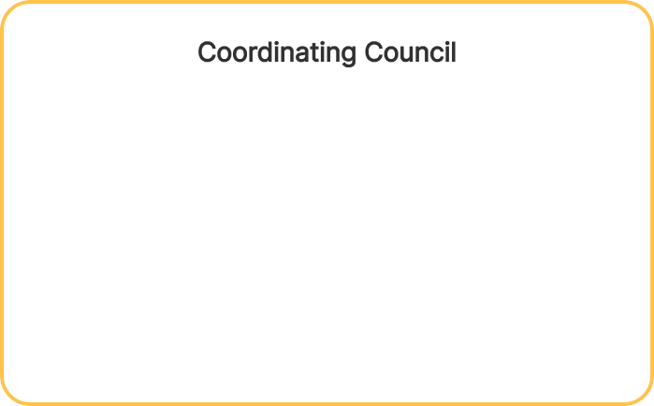
Members of the Governance Structure
Consortia Voting Members
Derrick Booth, American River College Denise Adams, Butte College
Kerry Mayer, College of the Redwoods Mark Klever, College of the Siskiyous Dana Wassmer, Cosumnes River College Derek Lerch, Feather River College Chris Morris, Folsom Lake College
Brad Deeds, Lake Tahoe College Michell Williams, Lassen College Christy Smith, Mendocino College Rick Hodge, Sacramento City Yanna Iatridis, Shasta College Amy Schultz, Sierra College Sandra Fowler, Woodland College Dwayne Newman, Yuba College
NFN Coordinating Council
Blaine Smith, NFNRC Executive Director Theresa Milan, Los Rios CCD
Tammy Montgomery, Los Rios CCD Joe Wyse, Shasta College
TBD, Woodland College Erik Shearer, Butte College Amy Schulz, Sierra College
Yanna Iatridis, Shasta College
Jeff Stephenson, American River College Char Perlas, College of the Siskiyous Rick Haas, Cosumnes River College Nicholas Petti, Mendocino College Tanya Meyer, Feather River
Aaron Wilcher, COE Sara Phillips, COE
Roy Kim, SETA/Sac Works Frank Gerdeman, Lake Tahoe Josh Sweigert, Lake Tahoe Pamela Heston, Mendocino Michael Jackson, Sierra College
Employer Engagement
Wendy Porter, Generalist
Josh Sweigert, RHT and Ag/WET Pamela Heston, Generalist
Molly Stimpel, Generalist Alena Anberg, ICT & Business Gabe Miller, Generalist
Emily Purificacao, Generalist Shinder Gill, ECU
Karen Hubbard, Health & Public Safety
Other Key Talent and Stakeholders
Aaron Wilcher, North Center of Excellence Sara Philips, Far North Center of Excellence Ebony Benzing, North Center of Excellence Timothy Morehouse, Guided Pathways RC Sunny Greene, Guided Pathways RC
Cindy Sanches, Guided Pathways RC Workforce Development Boards Adult Education Partners
County Offices of Education
America's Job Center of California Operators Economic Development Organizations Industry Leaders
K-12 Strong Workforce
Tanya Meyer, K14 TAP
Becca Mortimer, Fiscal & NOVA Assistant K-12 Pathway Coordinators:
Sharon Nilsson, Butte-Glenn CCD Lisa Kelly, Feather River CCD
Kim Carr, Lake Tahoe CCD Tiffiney Lozano, Lassen CCD Raelynn Sharp, Los Rios CCD Emily Morgan, Mendocino CCD William Row, Redwoods CCD
Rosemary Mitchell, Shasta-Trinity-Tehama CCD Christina Overmiller, Sierra CCD
Bright Nichols-Stock, Siskiyous CCD Edwin Ortega Beltran, Yuba CCD
NFN Regional Consortium
15 member college CEOs
NFN RC
Executive Director
Voting Members
One representative from each of the 15 community colleges designated by each college president Strong Workforce Regional Plan development
and funding recommendations
Employer Engagement Professionals

Pathways Coordinator
Technical Assistance Provider
Centers of Excellence
Internal Stakeholders
External Stakeholders
Coordinating Council
One representative from the North and one from the Far North from the following positions, appointed by the Regional Consortium College Chief Executive Officers (CEOs), Chief Instructional Officers (CIOs), Chief Student Support Officers (CSSOs), Career Tech Education Deans (CTE), Economic & Workforce Development Advisory Committee (EWDAC)
Strong Workforce Program plan endorsement, communication, and dispute resolution.
Voting Member Proxy:
Raquel Arata, American River Don Robinson, Butte College
Morgan Solem, College of the Redwoods Christina Van Alfen, College of the Siskiyous Cori Burns, Cosumnes River College Theresa Milan, Los Rios
Ray Gamba, Lake Tahoe Colleen Baker, Lassen Amanda Xu, Mendocino Cynthia Sommer, Los Rios
David Gatewood, Shasta College Jill Alcorn, Sierra College
TBD, Woodland College Jeremy Brown, Yuba City

Slide 19
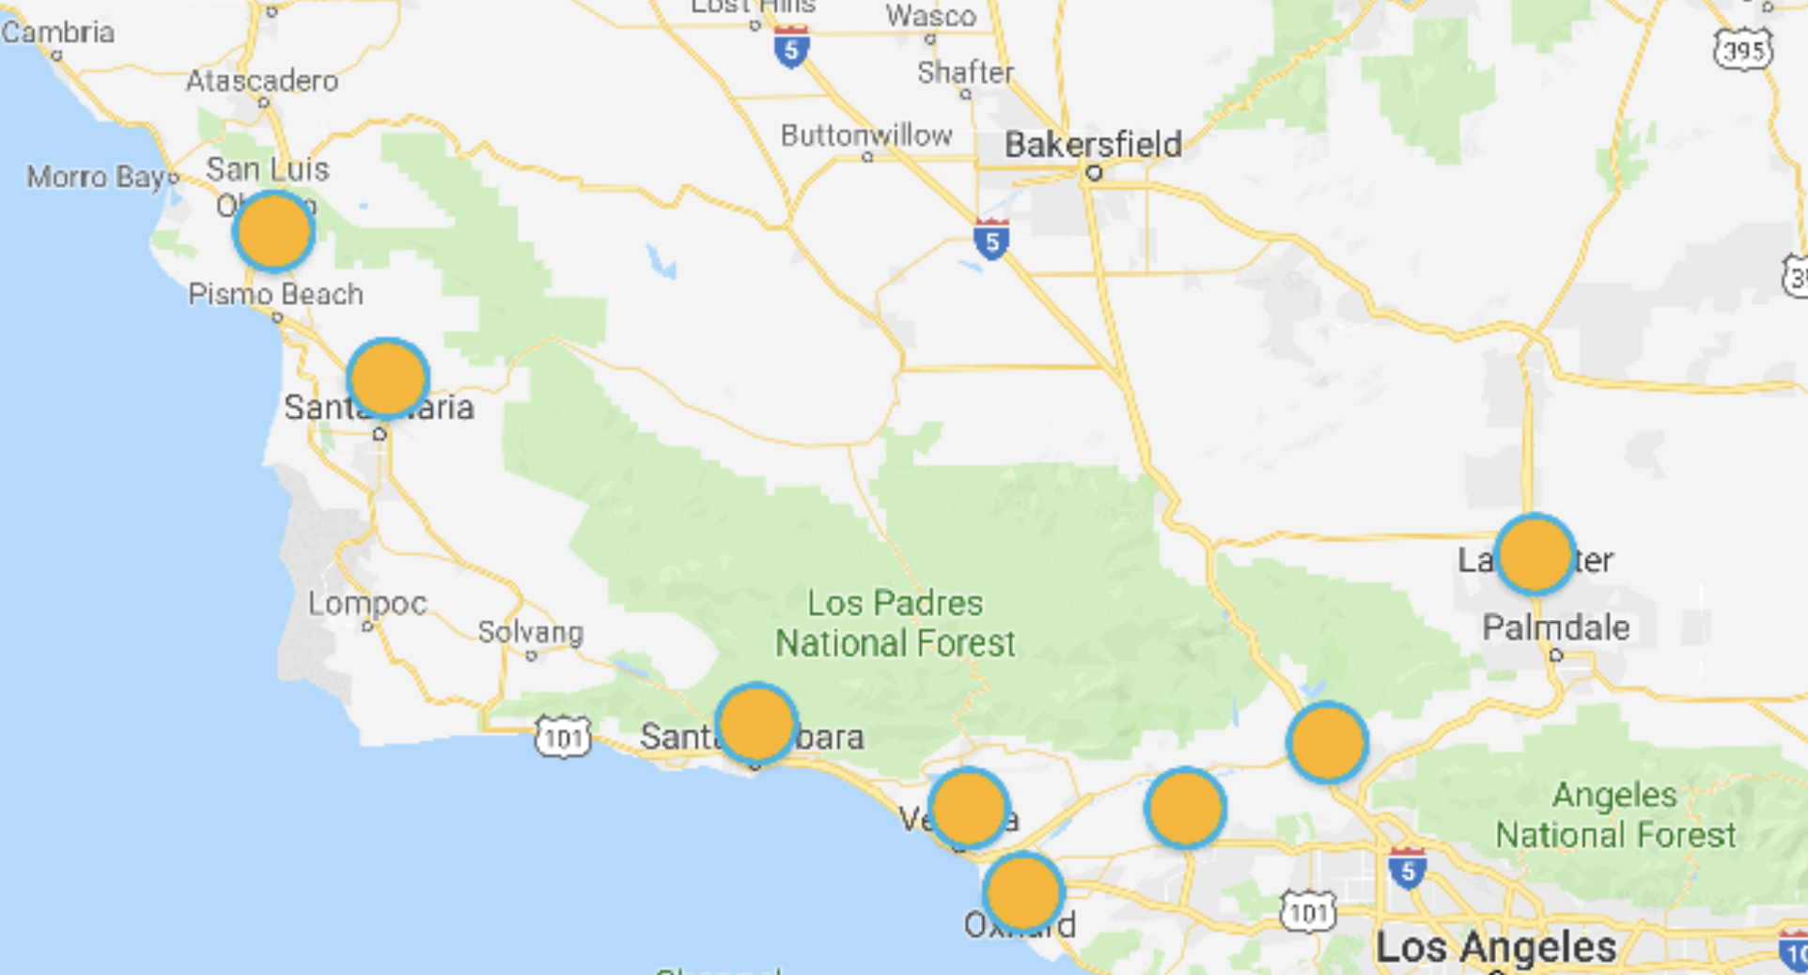
South Central Coast Regional Consortium
Serving 8 colleges

Slide 20
SCCRC Mission and Colleges
The South Central Coast Regional Consortium facilitates and promotes effective regional initiatives for its member colleges and key stakeholders in support of local, regional, and statewide workforce development efforts. We collaboratively leverage employer, community, and educational resources in partnership to create and maintain a highly skilled workforce that meets identified regional needs.
SCCRC Colleges
Cuesta College
Allan Hancock College
Santa Barbara City College
Ventura College
Oxnard College
Moorpark College
College of the Canyons
Antelope Valley College

Slide 21
Regional Priority Sectors
Advanced Manufacturing
Health
Information Communications Technologies & Digital Media
Public Safety
For additional information:
SCCRColleges.org
Holly Nolan Chavez, Executive Director/Chair hchavez@vcccd.edu
Luann Swanberg Fiscal Agent Director lrswanberg@pipeline.sbcc.edu
Dr. Giselle Bice, K14 TAP Giselle.bice@canyons.edu

Slide 22
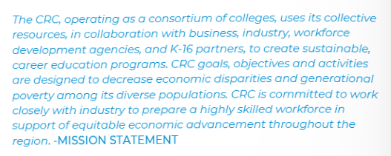
Jessica Grimes, PhD
Regional Chair
jessica.grimes@crconsortium.com

Slide 23
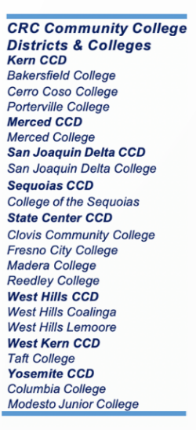
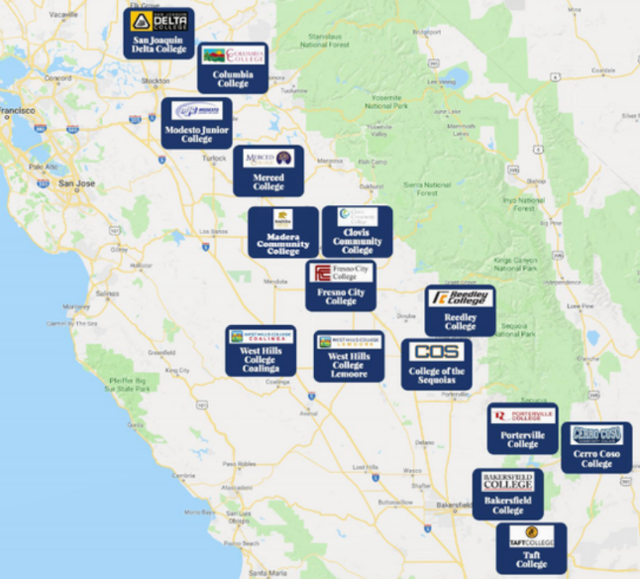

Slide 24
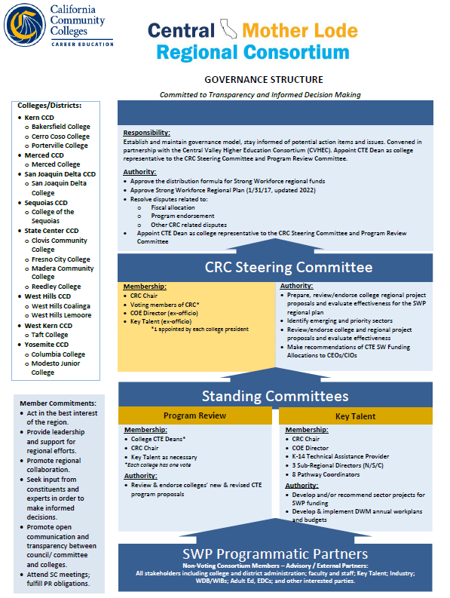
GOVERNANCE STRUCTURE

Slide 25
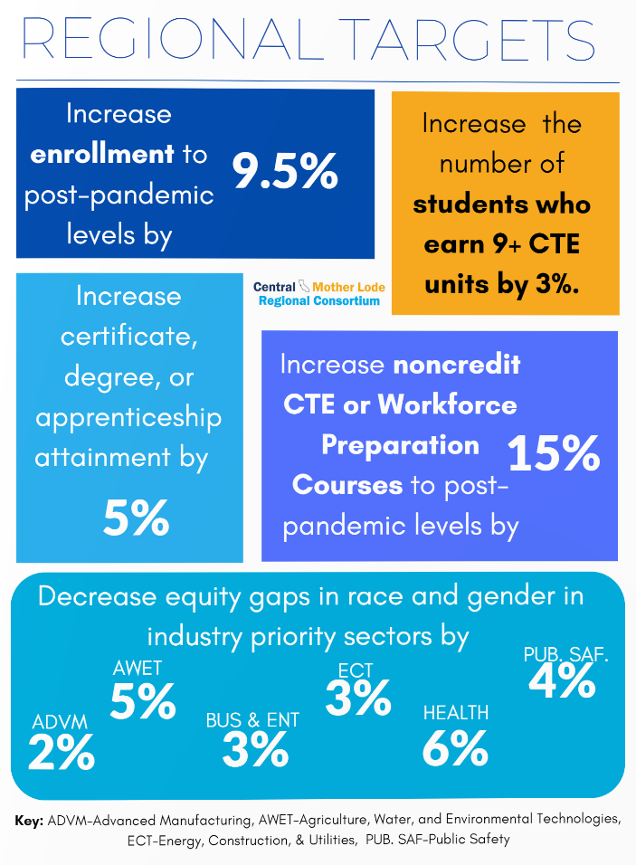
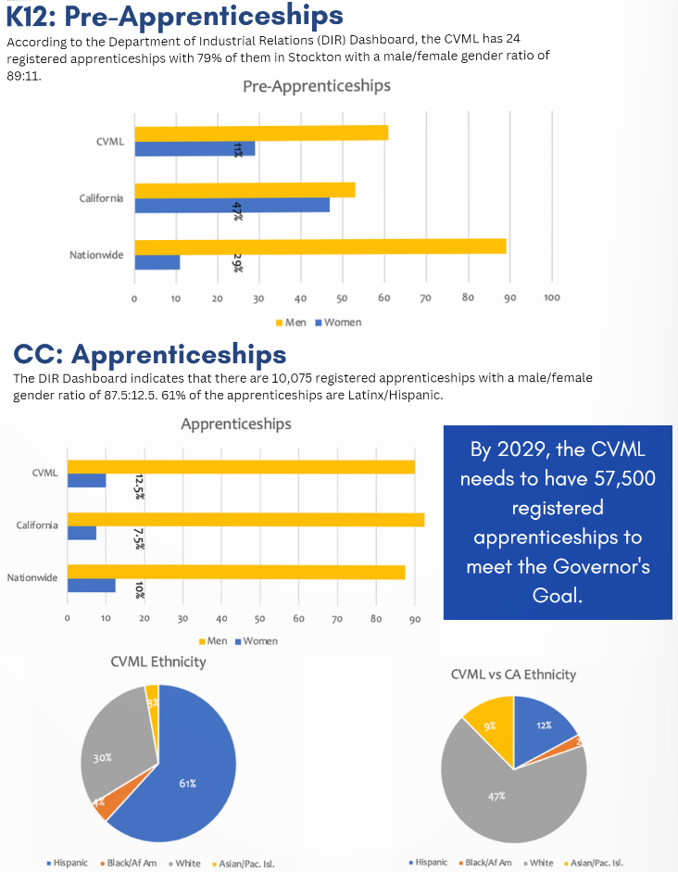
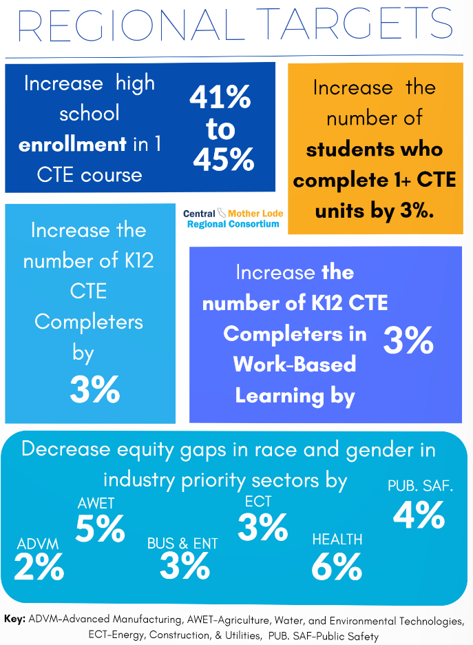

Slide 26
Ways to Engage with IEDRC
Get involved with SWP planning.
Utilize regional staff for industry advisory committees, professional development, and more.
Leverage regional marketing resources to promote your programs.
Access current and relevant labor market data related to your programs.
Connect to K-12 Strong Workforce projects and partners.

Slide 27
How to engage with IEDRC
Sign up for meeting announcements and newsletters:
info@desertcolleges.org
For employer engagement and community college strong workforce projects contact:
Lori Sanchez, Director of Strategic Partnerships
Lori.sanchez@rccd.edu
For regional labor market data and research contact:
Michael Goss, Director of Center of Excellence for Labor Market Research
Michael.goss@chaffey.edu
For K-12 strong workforce projects and resources contact:
Stephanie Murrillo, K14 Technical Assistance Provider
Stephanie.murrillo@rccd.edu
For regional marketing resources contact:
James Meier, Director of Communications and Marketing
James.meier@rccd.edu

Slide 28
Regional SWP Decision Making Process
Planning
Faculty
Decision-Making
Steering Committee
Invest & Implement
Colleges
CTE Administrators
Approves project proposals
Executive Council
Approves Strategic Plan and Budget Allocation
Regional Partners
Invest regional allocation in various projects
Evaluation
Review outcomes data
Student Success
Employer Satisfaction
Faculty, staff and administrators implement activities

Slide 29
LOS ANGELES REGIONAL CONSORTIUM (LARC)
Dr. Narineh Makijan
Chair/Assistant Vice President
nmakijan@pasadena.edu
626.585.7304 (Office)
818.445.4750 (Cell)
https://losangelesrc.org/
Framing the future of
Los Angeles’ Workforce

Slide 30
BRIDGING
THE GAP
The Los Angeles Regional Consortium (LARC) consists of 19 community colleges in Los Angeles County. It serves to coordinate, collaborate, organize, and facilitate interaction in the region to ensure workforce training is provided to all in a way that is accessible, efficient, responsive, data-driven and improves outcomes.
Our mission is to bridge the gap between LA’s workforce and the employers fueling our cutting-edge economy. Our goal is close the supply and demand gap and increase economic and social mobility for LA County residents.
LARC Regional PLAN 2023 Update

Slide 31
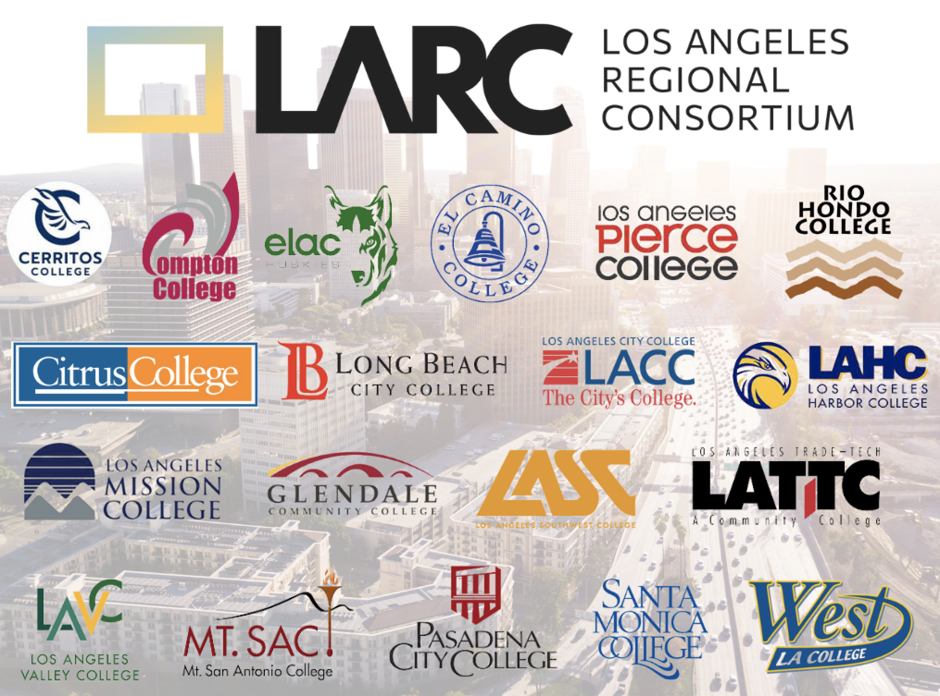
WE ARE LARC!
19 COMMUNITY COLLEGES. ONE MISSION.
https://losangelesrc.org/meet-the-larc/
https://ccla.com/programs

Slide 32
Information

Slide 33
LARC Team
Sign up for LARC Updates:https://losangelesrc.org/contact-us/

Slide 35
California Community College Regional Consortia
California Community Colleges are organized into ten economic regions, served by eight consortia. The Regional Consortia of Career Education faculty and administrators from community colleges:
..
Establish regional strategic priorities,
Administer state and federal funding,
Form industry partnerships and public private partnerships, and
Review curriculum and approve proposals for credit Career Education programs
[Title 5, Section 55130(b)(8)E]

Slide 36
Orange County Regional Consortium
The Orange County Regional Consortium (OCRC) consists of nine community
colleges and one continuing education center across four community college districts, and
serves as a regional framework for communicating, coordinating, collaborating, promoting and
planning career and technical education, and workforce and economic development initiatives
in the Orange County Region. The goal of the OCRC is to support the connection of individuals and the alignment of programs and curriculum to the needs of business & industry.
The OCRC strives to provide local and regional decision-makers with the increased capacity to measure regional progress toward goals of efficiency and effectiveness, while also improving their access to indicators that measure student/incumbent worker progress through the educational system.
The OCRC invites the collaboration of business, non-profits, labor, government agencies and industry leaders in order to improve the decision-making and responsiveness of our educational institutions to reflect changing market and technological trends.

Slide 37
The OCRC Organizational Structure
Dr. Adriene “Alex” Davis
Assistant Vice Chancellor Economic and Workforce Development
Educational Services, RSCCD OCRC Regional Chair
Maria Madrigal
Executive Secretary
Marbella Ruiz
Administrative Secretary
Lorena Ruiz
Administrative Clerk
Michael Sacoto
Orange County
K14 SWP Technical Assistance Provider
Dr. Jesse Crete
Orange County Director, Center of Excellence
Jorge Saucedo Daniel
Talent Development & Retention Director
TBC
Regional Workforce & Employer Engagement Director
Jacob Poore
Orange County
Assistant Director, Center of Excellence
TBC
Orange County
Research Analyst, Center of Excellence

Slide 38
Regional Collaboration and Coordination Grant
Two Components
Regional Collaboration/Coordination | Employer Engagement
Employer Engagement Regional Strategy | WBL, Apprenticeships, Internships, and Faculty Externships
Develop and Support Career Pathways Programs | Career Placement
Increase Middle-Skill, Industry-Valued Credentials | Comprehensive Supports & Pathways, APL, and Articulation
Target Unemployed and Low-Income Residents | Industry Training and Education Needs
Increase Completions, Graduation Rates, and Reduce Units

Slide 39
OC Regional Consortium Governance Structure 3.0 Draft
Governance Council
(Chancellors and Presidents)
OCRC Operations and Key Talent Resources
ORCR Operations OCRC Executive Director Assistant Vice Chancellor, EWD/Educational Services | Fiscal Services OCRC Fiscal Agent Director Assistant Vice Chancellor, Resource Development
Workforce & Employer Engagement Director | K-14 SWP Technical Assistant Provider
Talent Development & Retention Directors | Center of Excellence Staff
Governance Council Chair/Vice Chair
Regional Projects Proposal
Review Committee (VPI’s & Voting CTE Deans)
CRLC
Program Recommendation (Voting CTE Deans)
Regional Projects Proposal Development Committee (CTE Deans & Resources)
Collaborative Partners
College stakeholders, WDBs, K-12 LEAs, K-12 SWP Pathway Coordinators, Adult Ed., Chambers, Corporations, Business, Industry, Economic Development etc.

Slide 40
San Diego & Imperial Counties Community Colleges Regional Consortium
SDIC COMMUNITY COLLEGES CAREER EDUCATION |
CareerEd.org

Slide 41
Transforming the way educators, industry, and community partners equitably advance economic mobility.
OUR VISION
SDIC COMMUNITY COLLEGES CAREER EDUCATION | 2
The San Diego & Imperial Counties Community Colleges Regional Consortium (SDICCC RC) provides leadership and guidance on regional career education initiatives that serve its members and stakeholders. Driven by an equity framework, we collaborate with educators, industry, community partners, and students to develop a skilled workforce and align to the future needs of the regional ecosystem.
OUR MISSION
CareerEd.org

Slide 42
SDICC RC Provides Support to Work Across This Continuum

Slide 43
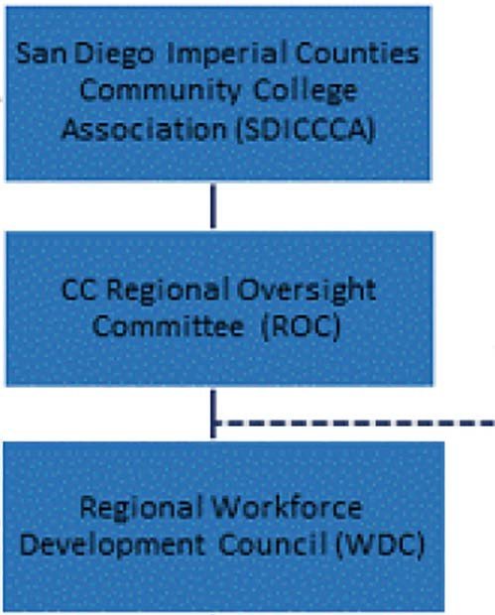
Strong Workforce Program Implementation SDICCCA Governance
COMMUNITY COLLEGES
SAN
CAREEI� EDUCATION
RffllD�Al COIRORTIUM
Danene Brown, Ph.D.
Regional Consortium Chair danene.brown@gcccd.edu
fsscal•nt
VPls
)
Deans· Council
Implementation Committtt Worl(aroup Leads
Car^{e}er Pathways
Patnway Nav111ation
WBL &Job
Placement
Retention, Success & Support
Employer Engagement & Job Development
Marlcetin1
Data & Research

