Slide 1
Curriculum and Data: Making Every Course Count
Cheryl Aschenbach, ASCCC Secretary, 2019-20 Curriculum Chair
Darla Cooper, RP Group Executive Director
Ginni May, ASCCC Treasurer, 2018-19 Curriculum Chair
Erik Shearer, Napa Valley College
Curriculum Institute, Hyatt Regency San Francisco Airport
July 12, 2019, Third General Session

Slide 2
Description
With AB 705, AB 1805, the Student Centered Funding Formula, Guided Pathways, the SEA Program, and the Vision for Success, college faculty, staff and administrators are working feverishly to make sure their curriculum meets the needs of the student populations and surrounding community. Colleges are also working to make sure their data truly represent the colleges' and students' stories. The panelists will discuss from various perspectives the importance of faculty, researchers, and managers working together to collect the right data – asking questions, qualifying data, and understanding the many possible confounding variables in order to effectively and accurately evaluate impacts for the purpose of making further curricular adjustments that best serve the diverse student populations in the California Community College system.

Slide 3
Overview
Data Collection, Analyses, and Conclusions
Implementation of AB 705, AB 1805,
Student Equity and Achievement (SEA) Program,
Guided Pathways,
Vision for Success
Collaboration among Faculty, Researchers, and Administrators
Perspectives of Faculty, Researchers, and Administrators on collecting the right data
Questions and Comments
Notes:
We can remove our names after we agree on the content.

Slide 4
Analyses of Implementation…
AB 705 and AB 1805
Throughput
Pass rates vs No pass rates
Enrollment
SEA Program
Achievement Gaps
Disproportionate Impact
Guided Pathways
Scheduling
Course and Program offering changes
Vision for Success
Meeting goals

Slide 5
Research
Who is presenting the data and conclusion and what are their interests?
Follow the money…who is paying for the research?
Sound research should be based on a desire to answer a question. Be prepared for answers you may not be hoping for…
When is a change, really a change?
Notes:
Ginni - Use example of stepping on scale everyday, while it may vary from day to day or even week to week, when is there a real change?

Slide 6
Correlation vs Causation It’s Complicated!
Notes:
Ginni

Slide 7
Lurking variables…What might they be?
The following are examples of strong correlation caused by a lurking variable:
The average number of computers per person in a country and that country’s average life expectancy.
The number of firefighters at a fire and the damage caused by the fire.
The height of an elementary school student and his or her reading level.
Notes:
Ginni

Slide 8
And then there is just some silliness…
Notes:
Ginni

Slide 9
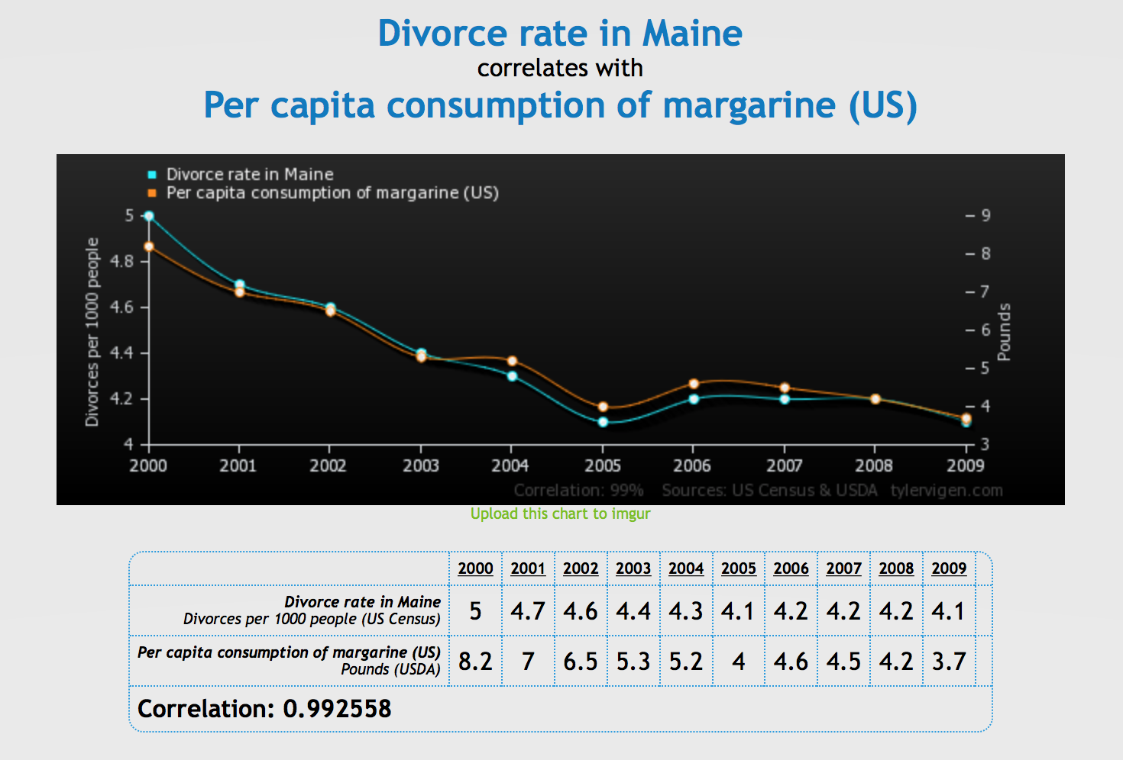
Notes:
Ginni

Slide 10
Notes:
Ginni

Slide 11
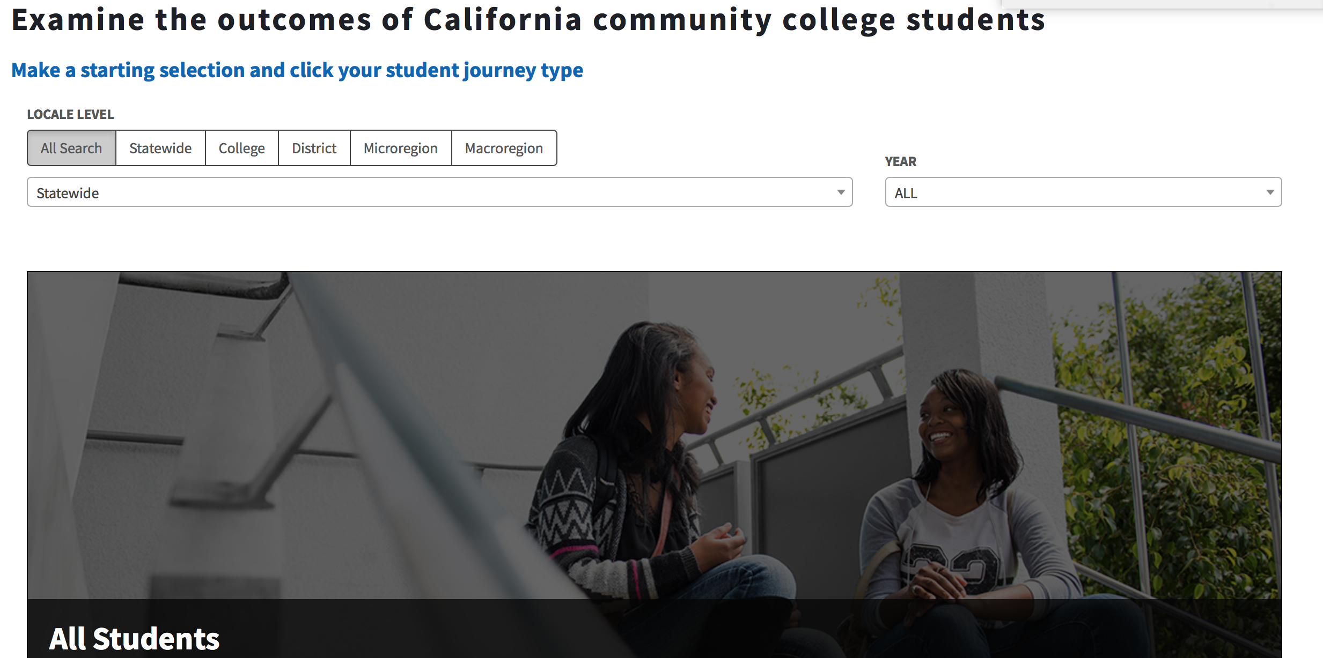
From the Chancellor’s Office Management Information System
https://www.calpassplus.org/LaunchBoard/Student-Success-Metrics
Click on
All Students
Notes:
Ginni

Slide 12
Skills Gains – CB21/EFL
Notes:
All students are in the denominator, but who are the possible students that could make skills gains in basic skills courses?

Slide 13
Applicants that Enroll in a Community College
Notes:
Ginni
Who is in the denominator?
Many high schools have all students apply for the community college.
Has your college had staff apply to see what the process is like for students?
Students apply to CCC often as a “safety” school.

Slide 14
What about 2019-20?
Data Collection needs to begin now:
Two-year timeline passes quickly
Analyze first set during spring 2020
Faculty and Curriculum Committees need to be nimble and flexible in order to be responsive to curricular and programmatic changes to meet student learning needs
Faculty and Researchers need to work together – What is the process at your college for faculty and researchers to consider data collection needs?
How does AB 705 Implementation fit in a Guided Pathways framework?
How does the Student Centered Funding Formula (performance funding) fit in a Guided Pathways framework?
Notes:
Ginni

Slide 15
How do you create a joint definition of success?
Notes:
It matters how you look at it! Faculty, Researchers, and Administrators MUST work together

Slide 16
What Does Collaboration between Faculty and Researchers Look Like?
Both play role in understanding and ensuring that data reflect what is actually happening on the ground
Faculty provide context for the data
Researchers check data validity, report data locally and to state
Collaborate to review data for “reality check”
Does it match what they see?
How is the research office involved in curriculum?
How are they informed of curricular changes?
Make space/time for discussion and collaboration on impact of curricular decisions on data usage and reporting
Regularly review of data with multiple groups

Slide 17
Relationship Between Researchers and Faculty
Researchers need to understand the program/project
Faculty need to understand the demands on the researcher
Develop the research question and methodology together
Researcher is seen as a member of the team
Ongoing relationship is key to ongoing success of the evaluation

Slide 18
How Researchers Can Help Faculty
Provide options for assessment methods
Share knowledge of data already available
Facilitate accurate data interpretation
Listen
Do NOT dictate data to be used
Do NOT advocate changing program/project to fit data

Slide 19
How Faculty Can Help Researchers
Invite and include the researcher in the conversation early
Share details of the project/program with the researcher (e.g., goals, data, interventions, intended outcomes)
Consider the options provided by the researcher and provide constructive feedback
Keep the researcher involved and informed about ongoing progress and changes
Work with the researcher to make the data meaningful and useful
Be patient and understanding

Slide 20
Reality Check: Balance between Reality and Rigor
First identify data already being collected
Data collection should not place an undue burden on the program/project
Use direct measures whenever possible and reasonable
Need to ensure that data being collected are actually measuring what you intended to assess
Requires conversation between faculty and researcher to achieve a suitable balance

Slide 21
Advice from Collaborators
Start discussion with what you want to know about program/project
Decide on data collection BEFORE implementation, if possible
Be flexible, open and available
Be involved, invested and stay informed
Work together as partners
Data and research are your friends!!!

Slide 22
Administrators Are Your Friends!
Critical role in collection, analysis, and communication of data on student success to key college stakeholders, including presidents, chancellors, other senior administrators, and governing boards.
CIOs are primary advocates within the college to secure resources that make academic and curricular reforms possible.
Responsible for managing key resources to support curricular and academic innovations for student success.
Part of the collaborative team with faculty, researchers, and other staff
Use data analysis to guide critical instructional and academic processes.

Slide 23
How Administrators Can Support Faculty and Researchers
Provide administrative perspectives on student success data through the lens of enrollment management, college strategic plans, and trends and challenges in course scheduling, staffing and personnel, resources, and instructional facilities and technology.
Ask the right questions to support collection of the right data
Anticipate need for future data to support key decisions.
Keep college presidents and governing boards informed and out of the weeds.
Advocate for resources to support the work of faculty and staff.
Keep everyone informed of submission deadlines and compliance verification requirements.

Slide 24
Local and State Curriculum Perspectives
As you review data and student performance,
Have an open mind
Be solutions-oriented
Keep students at the center of your discussions

Slide 25
Local and State Curriculum Perspectives: Coding
Are your courses correctly coded?
CB 21 (updated rubrics)
CB 25 (updated - English & math/quantitative reasoning)
CB 26 (new - identifies support courses)
This summer is the time to evaluate coding and prepare to update coding, especially for English and math/quantitative reasoning courses and support courses
MIS and COCI are being updated to include the new & revised codes

Slide 26
Local and State Curriculum Perspectives: Flexibility
Are your faculty prepared to adjust curriculum or instruction based on early data?
Will data collected help inform faculty how initial curricular design in response to AB705 is working?
Will data collected help inform faculty which supports were most helpful to students’ success?
Is the collaboration in place with researchers to discuss data and possible adjustments to data collection (researchers) or support (faculty)?
Is there room to make curricular design adjustments based on data?
Is there an opportunity to scale up successful supports?

Slide 27
Local and State Curriculum Perspectives: Professional Development
Have faculty - full-time and part-time - had ample opportunities for professional development by faculty and for faculty to support curricular and instructional changes?
What opportunities or structures exist locally for faculty collaboration within disciplines and across disciplines?
What assistance may be needed regionally? statewide?
ASCCC is here to help!

Slide 28
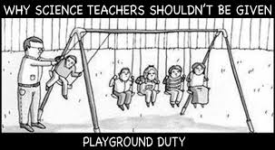
Q and A

Slide 29
Resources
Student Success Metrics: https://www.calpassplus.org/LaunchBoard/Student-Success-Metrics
CCCCO MIS Data Mart:
https://datamart.cccco.edu/DataMart.aspx

