Slide 1
Counseling and Student Services for Noncredit Guided Pathways
Diane Edwards-LiPera, Southwestern College
Ginni May, Area A Representative
Career and Noncredit Education Institute
May 4, 2018, Westin South Coast Plaza

Slide 2
Overview
Noncredit SSSP and other Student Services
Noncredit Programs and Guided Pathways
Local Story - Southwestern College
Your Story

Slide 3
The Student Success Act of 2012 was a Mandate for Rethinking and Redesigning Student Services
“Matriculation” became the “Student Success and Support Program (SSSP)”
Established ‘front loaded services’ for entering students
Performance-based funding structure for the colleges

Slide 4
The Student Success Act of 2012 Brought New Emphasis to:
Assisting student career exploration
Assisting student identification of career goals and interests
resulting in education plans
Leveraging local partnerships, including workforce partnerships
Assessment---broad and multiple-measures
Broad delivery of services (including use of technology)
Developing and implementing a college Student Services Program Plan
Notes:
Focus on Career Exploration
Emphasis on providing: “Assistance to students in the exploration of educational and career interests and aptitudes and identification of educational objectives, including, but not limited to, preparation for transfer, associate degrees, and career technical education certificates and licenses”
Identification of Career Goals and Interests
Development of an education plan leading to a course of study and guidance on course selection that is informed by, and related to, a student’s academic and career goals.
Workforce Partnerships
78211. Legislative Intent to..
“Recognize the importance …of establishing local and regional partnerships with school districts, workforce agencies, and other system partners to leverage resources to assist students in exploring career options, preparing for college, and developing and achieving educational goals and plans.”
Broad Delivery of Services
“The provision of information, guided by sound counseling principles and practices, using a broad array of delivery mechanisms, including technology-based strategies to serve a continuum of student needs and abilities, that will enable students to make informed choices”
Assessment defined in SB 1456:
“the process of gathering information about a student regarding the student’s study skills, English language proficiency, computational skills, aptitudes, goals, learning skills, career aspirations, academic performance, and need for special services.”
“ Assessment methods may include, but not necessarily be limited to, interviews, standardized tests, attitude surveys, vocational or career aptitude and interest inventories, high school or postsecondary transcripts, specialized certificates or licenses, educational histories, and other measures of performance.”

Slide 5
SSSP Mission
The mission of the SSSP is to increase community college student access and success by providing effective core services, including orientation, assessment and placement, academic advising, and early intervention. SSSP supports student equity in assessment, student services, access to college resources, and provides a foundation for students to achieve their educational goals.
California Community Colleges Chancellor’s Office. (2015). California Community Colleges Student Success and Support Program Handbook.
Notes:
(Read the Mission)

Slide 6
Student Success Act Brought Eight Focus Areas for SSSP:
Strengthen support for entering students
Incentivize successful student behaviors
Align course offerings to meet student needs
Increase college and career readiness
Improve education of basic skills students
Revitalize and re-envision professional development
Enable efficient statewide leadership and increase coordination among colleges
Align resources with student success recommendations
California Community Colleges Chancellor’s Office. (2015). California Community Colleges Student Success and Support Program Handbook.

Slide 7
Purpose of the Student Success and Support Program
The purpose of the SSSP is to ensure that all credit and noncredit students:
Promptly define their educational and career goals
Complete their courses
Persist to the next academic term, and
Achieve their educational objectives in a timely manner.
Planning and implementation of SSSP needs to reflect the underlying expectation that student success is a joint responsibility of the student and the institution.
California Community Colleges Chancellor’s Office. (2015). California Community Colleges Student Success and Support Program Handbook.
Notes:
For noncredit students, we recognize that this may be a series of goals for which they enter, complete, and re-enter our noncredit programs and, that while we make clear the pathways into the credit program, for some students their end goal is gainful employment, skills development, and personal improvement that may or may not lead to further academic studies.
For some students this first step into noncredit is one that provides awareness and confidence to identify and create goals they had not previously considered.
And for credit students who access noncredit, this may be a s a supplement to their credit experience, or might be for accomplishment of goals that are separate from the credit program offerrings.

Slide 8
Fitting the Pieces Together: Student Success and Support Program Student Success Act of 2012 SSSP
Declaring a
Course of Study
Early
Credit SSSP
Declaring a
Course of Study
Early
K-12 Alignment
BOGFW
Student Equity
Mandated
Services
Technology
Solutions
Scorecard
Registration
Priorities
Noncredit SSSP
Registration
Priorities
Mandated
Services
Assessment
Student Equity

Slide 9
Noncredit SSSP
Declaring a
Course of Study
Early
AEBG
Declaring a
Course of Study
Early
K-12 Alignment
BOGFW
Strong Workforce
Student Equity
Mandated
Services
Technology
Solutions
Scorecard
Guided Pathways
Registration
Priorities
???
AB 705
???
Registration
Priorities
Mandated
Services
Assessment
Student Equity
Notes:
Many of the state policy changes underway are the result of the work of the Student Success Taskforce that met throughout 2011 to examine best practices and models for accomplishing student success and develop recommendations which the Board of Governors adopted in January 2012.
8 Focus Areas, 22 Recommendations
Increase college and career readiness
Strengthen support for entering students
Incentivize successful student behaviors
Align course offerings to meet student needs
Improve education of basic skills students
Revitalize and re-envision professional development
Enable efficient statewide leadership and increase coordination among colleges
Align resources with student success recommendations
Challenges and Opportunities:
Increased demand on the system. Overall, while in the last 15 years, enrollment grew by 44% … “total enrollment at California’s community colleges has declined by almost a half-million students…. The PPIC notes that if participation rates had remained at 2008–09 levels, California’s community colleges would have served an additional 600,000 students.”
PPIC’s March report: “the state’s population and the number of community college students has grown substantially over the past couple of decades… between 2006–07 and 2011–12, total funds per student (in full-time equivalents) fell by about $1,600 dollars, declining from almost $6,700 to $5,100 (in 2011 dollars). By comparison, during the almost equally severe recession of the early 1990s, support per student declined by less than $700 per student. Total revenues per student have declined to the lowest levels in two decades”
Substantially reduced resources. 47% of CCC students report they cannot enroll in needed classes, compared to 28% nationwide… PPIC: the total number of sections offered has plunged to its lowest level in the past fifteen years.
Unacceptable completion rates. Of the 18% of students who begin one level below transfer-level, only 42% ever achieve a certificate, degree, or transfer preparation
Significant cuts to Matriculation Funding… 2008/09: $101.8 M… 2009/10: $49.18 M ⬇ from 08-09, 52% funding loss
2008-09, the height of Matriculation funding was over $101 million to fund, on a 3-1 local match basis, college admissions, assessment, orientation, counseling & advising, and follow-up services for students;
Since the budget cuts of 2009-10, Matriculation funding was reduced by 52% and is currently funded at a level of $49 million
Orientation: 49%, Assessment: 63.2%, Counseling: 39.4%
First-Time Students - First-time status is defined as a student who took a credit or noncredit course in the CCC system for the first time. Students with prior enrollments outside the CCC system are excluded.
As we implement policy changes…
Keep the dialogue focused on what works for students
Research provides a foundation for continuous improvement– and honest dialogue…
We need to do things differently…
Face the challenge of bringing strategies that work to scale
Think about how can we incentivize student and institutional behaviors to increase student success
Be mindful of equity impacts… need to track student outcomes- especially for underrepresented and educationally disadvantaged student groups…
Student equity and achievement gaps– how do we assess disproportionate impacts? And, more importantly, what can institutions do when we identify achievement gaps?
Realize that no magic easy solutions or one size fits all approaches
Balance need for consistency among 112 colleges while developing a state policy framework, while without being overly prescriptive to allow for local flexibility to meet student needs
Careful use of technology to serve greater numbers of students… but needs to be meaningful…

Slide 10
Noncredit SSSP
SSSP core services are to be offered to students enrolled in designated noncredit courses.
Colleges with noncredit programs are required to complete an annual certification in order to receive SSSP funding.
Beginning in the 2015-16 fiscal year, colleges are now also required to provide program and budget plans (showing compliance with reporting requirements) to receive SSSP funding.
Core Services:
Orientation
Assessment and Placement
Counseling
Follow-up
Noncredit Categories:
Elementary & Secondary Basic Skills
ESL
Short-term Vocational
Workforce Preparation
Notes:
Note the four core services
Note the four noncredit categories that correspond to SSSP funding
Read the two blurbs about what colleges are required to do to be in compliance

Slide 11
Student Services and SSSP are Well Poised to Address the Guided Pathways Framework
In order to improve student achievement and learning outcomes, the principles of guided pathways require that strong, integrated partnerships exist between the student services area, instructional area, and all other areas of a campus.
Colleges around the state are at varying stages in the creation and design of a guided pathways framework.
Prior reforms in student services (e.g. SSSP) have created a structure that can align well within a guided pathways framework.

Slide 12
Guided Pathways is not a “one-size-fits-all” initiative…
The enormity and diversity of the California Community Colleges system requires that each college take a customized, self-guided approach.
Guided Pathways is an opportunity for your college to set your own goals and determine your best path to success.
Guided Pathways requires a coordinated cross-departmental and divisional effort from college staff, faculty and leadership to share, engage, and discuss.

Slide 13
Four Pillars of Guided Pathways (GP) are also a Foci for GP Counseling and Student Services

Slide 14
Translating the Four Pillars of Guided Pathways for Implementation
Create clear
curricular
pathways to
employment
and further
education.
Help students
choose and
enter their
pathway.
Help students
stay on
their path.
Ensure that
learning is
happening
with
intentional
outcomes.

Slide 15
Key Elements of Guided Pathways
Programs that are fully mapped out and aligned with further education and career advancement while also providing structured or guided exploration for undecided students.
Redesigning and integrating basic skills/developmental
education classes to accelerate students to college-level classes.
Proactive academic and career advising from the start through completion and/or transfer, with assigned point of contact at each stage.
Structured onboarding process including improved placement tests
and co-requisite instruction that provide students with clear, actionable, and usable information they need to
get to the right start in college.
Early alert systems aligned with interventions and resources to help students stay on the pathway, persist, and progress.
Instructional support and
co-curricular activities aligned with classroom learning and career interests.

Slide 16
What Guided Pathways Means for Students
Less confusion and more clarity about the steps toward completion and course-taking behavior.
More guidance from counseling and other student services early in students’ journeys.
Greater likelihood of completion, as a result of:
Improved placement
Basic skills/developmental education reform
Reduced unit accumulation
Improved chances for transition, transfer and career placement.

Slide 17
Clarify the Path: Begin with the End
Create the shortest path of courses the students will take from their first day of attendance to their graduation by designing curriculum with the end goal of their program’s outcomes in mind
Requires discussion across traditional discipline boundaries and sacred cows
Considers Employment and further education opportunities targeted by each program in the beginning
Makes sense of general education
Introduces the concept of “Meta Majors”
AACC, “Guided Pathways: Planning, Implementation, Evaluation.” Diagram. https://www.aacc.nche.edu/wp-content/uploads/2017/09/PathwaysGraphic462017.pdf

Slide 18
Clarify the Path: Student Services
Collaborate with program faculty to identify appropriate transition, transfer or career-oriented outcomes to drive curriculum to identify areas of interest (meta majors).
Help identify courses in the general education pattern that align with program outcomes or goals,
Transfer Centers, Career Centers, Specialty Counseling (Athletics, CTE programs).
Relies on dialog across all faculty groups
AACC, “Guided Pathways: Planning, Implementation, Evaluation.” Diagram. https://www.aacc.nche.edu/wp-content/uploads/2017/09/PathwaysGraphic462017.pdf

Slide 19
Enter the Path: Student Services
Expanded and early Career Counseling
Career counseling coursework linked to areas of interest
Use of multiple measures to assess students’ needs
First-year experiences to help students explore the field and choose a major
Full program plans based on required career/transfer exploration
Contextualized, integrated academic support to help students pass program gateway courses
K–12/AEBG partnerships focused on career/college program exploration (Outreach)
AACC, “Guided Pathways: Planning, Implementation, Evaluation.” Diagram. https://www.aacc.nche.edu/wpcontent/uploads/2017/09/PathwaysGraphic462017.pdf

Slide 20
Stay on the Path: Student Services
Work with discipline faculty to identify student habits relevant to their course-taking habits
Ongoing, intrusive counseling intervention strategies
Systems for students to easily track their progress
Systems/procedures to identify students at risk and provide needed supports
Capacity to help students redirect and change their goals without amassing significant numbers of units.
AACC, “Guided Pathways: Planning, Implementation, Evaluation.” Diagram. https://www.aacc.nche.edu/wp-content/uploads/2017/09/PathwaysGraphic462017.pdf

Slide 21
Suggested Strategies for ‘Guided Pathways’ to Get and Keep Students on Track from “Redesigning America’s Community Colleges: A Clearer Path to Student Success”
Establishing a Goal (career exploration and planning)
Choosing a Major (specific or initial Meta-Major selection)
Academic and career counseling/advising (in-person individual and group sessions)
Technology-based advising and tracking resources
Follow-up services
Student success courses
Integrated supports along the path
“Just In Time” feedback
Intrusive counseling models and strategies
District-wide simplifying of information on programs and services
Emphasis not just on providing information and an array of disjointed services (‘cafeteria-style’), but on teaching students the skills to also self-advise and to increase their access and utilization of services (designed on an integrated model).
“The guided pathways perspective suggests that reforms to student services will be much more effective if they are implemented in concert with the development of program maps that provide a default course of study that students can follow to achieve clearly specified end goals for further education and employment”. (p.213)

Slide 22
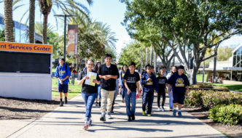
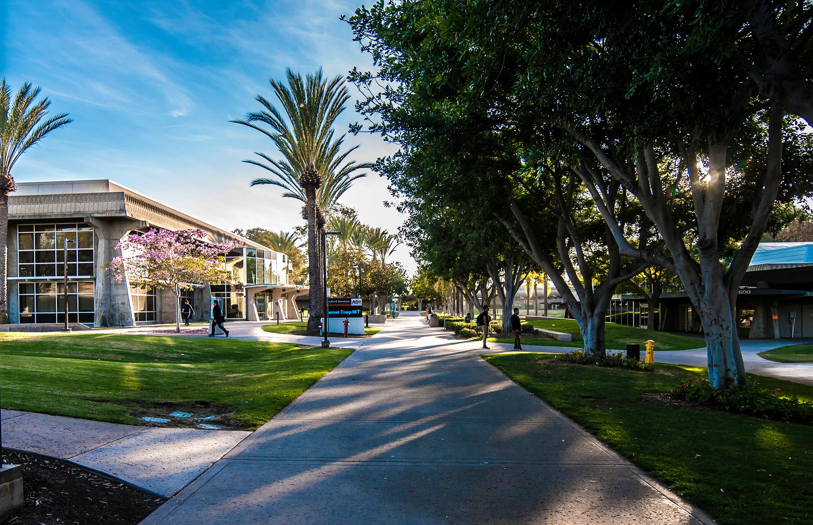
A Local Story –
960 × 640Images may be subject to copyright
Notes:
So lets take a look at how we’re rolling out NC SSSP at Southwestern College, and this will help us scale up services and delivery for Guided Pathways and other initiatives (e.g. AEBG, BSI, etc.)
Need SWC info--- single college district with one large traditional campus and four higher education center, and multiple (MANY!) community off-site locations for noncredit offerings, student #’s credit/noncredit; diversity, location (souther sd county xx miles of the US/Mexico border
SWC is a n Hispanic Serving Institution.

Slide 23
Continuing Education
(Director)
Noncredit
Fee Based
Contract Ed
*Note: AEBG is housed and delivered in Continuing Education, but is a direct report to the Dean of Continuing and Adult Education, and Workforce Development.
*Note: NCSSSP is housed and delivered in Continuing Education, but is overseen by the student services general college counseling program, with direct report to the Dean of Counseling.
Notes:
Here’s how noncredit fits within the SWC structure:
NC is under the umbrella of our Contiuing Education program, but is not a separate entity as some noncredit programs are around the state.
Cont Ed at SWC includes Noncredit, Fee-Based (Community Service) and Contract education.
AEBG is housed within Continuing Education but is a direct report to the dean of Workforce, Continuing Education and AEBG.
NC SSSP is delivered through the CE umbrella, but is overseen by the Dean of Counseling. We have a NC SSSP clerk who is also housed with us in Continuing Education.
This structure influences, and to a great extent determines, how we deliver NC SSSP, and what we might look like in the future as we grow and expand.
What does your structure look like ? How are your services housed and delivered? How is this influencing how you do business now…and might in the future?
Are you in collaboration with general counsleing (credit side) or are your noncredit program and services separate and distinct entities from counseling and the credit program

Slide 24
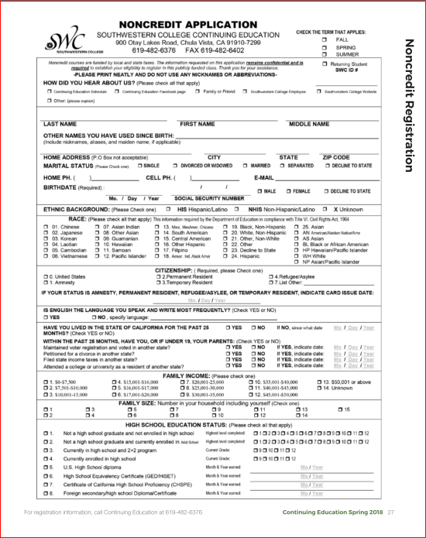
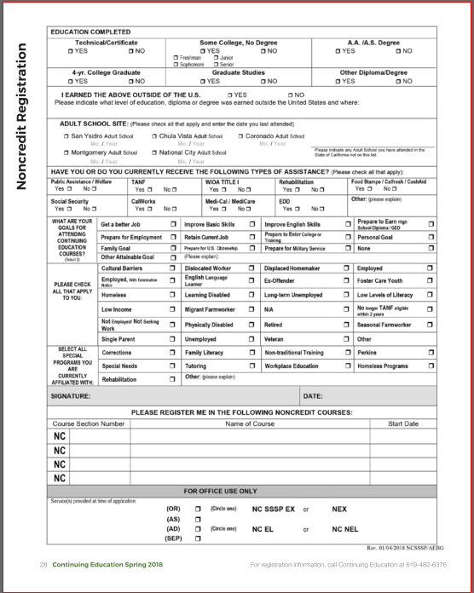
SWC Noncredit Application
2
Currently a two-page hard copy, an online version is anticipated for Fall 2018 .
Gathers all data elements for AEBG and NC SSSP …which overlap with Guided Pathways elements such as student goal
Notes:
We don’t know if or when our noncredit application will be mandated under CCC Apply, but meanwhile we have updated our hardcopy application to include all of the data elements for multiple initiatives, and most especially to align with the data reporting elements for AEBG and WIOA. This also includes data elements that will help us identify students who will receive SSSP services.
We expect this to go online in Fall 2018 (currently under construction), but know that given our community demographics there will always be a need and a mechanism for hardcopy applications. The DIGITAL DIVIDE is a serious concern in segments of the community we serve.

Slide 25
Some of the Topics Typically Addressed in Noncredit SSSP Counseling:
Orientation to SWC
Multiple Measures Assessment--- identifying current skills levels and “starting points” to inform course placement/choices
Exploring and identifying personal/career options and goals
Transitioning from the noncredit program to the credit college programs and/or to the workforce
How to pay for college! How to access and manage resources to cover the varied expenses of attending college
Awareness of and skills to access the many campus/community services and resources.
Individual/personal considerations
Developing and learning how to use an educational plan— a student road-map to success.
Active referrals to other resources and services
Confidential Support for Students with Disabilities
Notes:
We have embedded services for NCSSSP and AEBG counseling, including face-to-face orientation for large and small groups as well as individuals. Under construction we have an online orientation that will align in look and format to our recently updated online credit orientation. That will fit nicely with the online application and potentially enable students to complete an application AND ORIENTATION IN ONE SITTING—REMOTE SITTING.
SWC noncredit has been small, and only recently have we completed a CASAS pilot project within our NC ESL program. We anticipate more involvement from other discipline faculty to explore assessment possibilities for NC including use of progress indicators. We are also waiting to see how AB705 will roll out at SWC.

Slide 26
SWC Noncredit Student Education Plan (SEP)…page one
Notes:
Our noncredit SEP is a compilation of borrowed info and format from other college districts, from our AEBG adult ed partners, and from our SWC credit SEP. Here you’re seeing page one…page two includes next steps, follow-up plans and a place for both the student and the counselor to sign---as a contract for shared responsibility for student success.

Slide 27
The SWC Noncredit Program and NC-SSSP is involved with Noncredit Curriculum
Noncredit has a ‘seat’ on the district Curriculum Committee.
Curriculum development and modification for Noncredit includes a review of how the courses/programs align with various initiatives (e.g. AEBG, BSI…and will include Guided Pathways).
Discipline faculty creating/modifying noncredit curriculum have access to the lead NC faculty member (who is also a counselor) to help them consider student-centered factors as they work with their curriculum.
A full range of AEBG noncredit categories are/will be reflected in noncredit curricula, and will be part of the noncredit Student Success Academy. Some examples include…

Slide 28
Your Story
How is your noncredit program and NC-SSSP structured? What does your NC-SSSP look like?
What is the relationship of your noncredit program to the credit program? How about to specific discipline areas?
What is the relationship of your NC-SSSP to your Cr-SSSP?
Is your NC program and NC-SSSP at the Guided Pathways table, other initiative tables, and part of your district ‘integrated planning model’ ?
How does/can your NC-SSSP address the Guided Pathways program pillars?
Which student services, campus and community resources does your NC program have access to and what, if anything, is missing?
How ready is your NC-SSSP to align with Guided Pathways? What needs to happen to improve your readiness?

Slide 29
Questions and Comments

Slide 30
References
AACC, “Guided Pathways: Planning, Implementation, Evaluation.” Diagram. https://www.aacc.nche.edu/wp-content/uploads/2017/09/PathwaysGraphic462017.pdf
Academic Senate for California Community Colleges. (2006). The Role of Noncredit in the California Community Colleges. Sacramento, CA.
Academic Senate for California Community Colleges. Noncredit Committee webpage. www. asccc.org/directory/noncredit-committee.
Bailey, T.R., Smith Jaggars, S. & Jenkins, D. (2015). Redesigning America’s community colleges: A clearer path to student success. Cambridge, MA; Harvard University Press.
California Community Colleges Chancellor’s Office. (2015). California Community Colleges Student Success and Support Program Handbook.
California Community Colleges Chancellor’s Office. (2017). Guided Pathways at California Community Colleges. https://www.iepi.cccco.edu/guided-pathways

