Slide 1

Wrap-around Counseling Services at San Diego Continuing Education
Ginni May, ASCCC Executive Committee
Edith Quintero, San Diego Continuing Education
Career and Noncredit Education Institute
May 4, 2018, Westin South Coast Plaza

Slide 2
Overview
Counseling and Wrap around services that San Diego Continuing Education (SDCE)
Crucial role of counselors at SDCE
Collaboration:
  Counseling and discipline faculty
  Faculty and staff

Slide 3
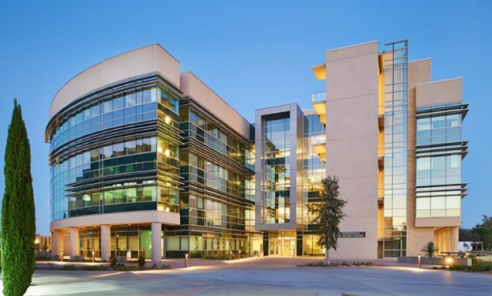
San Diego Community College District
San Diego City College
San Diego Mesa College
San Diego Miramar College
San Diego Continuing Education

Slide 4
San Diego Continuing Education
One of the largest noncredit institution in the state
Classes are free (community education have a nominal fee)
Serve over 40,000 students each year (3 credit colleges serve approx. 60,000 students combined)
Students range in age from 18-102+
Over 100 languages spoken
Serve a diverse array of students

Slide 5
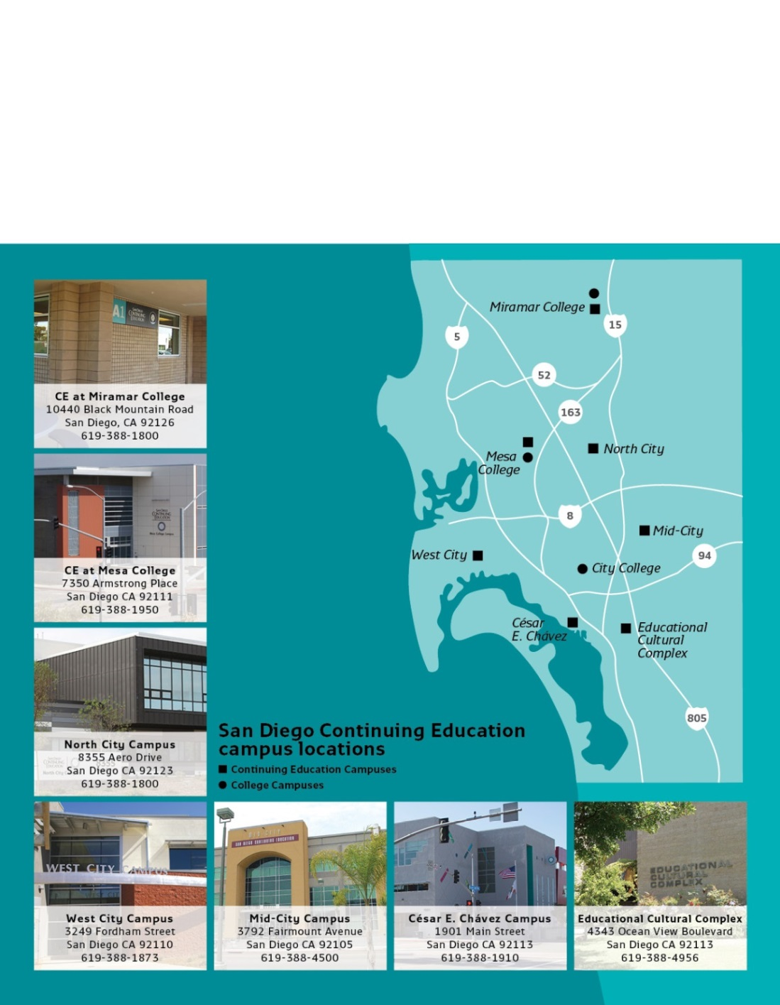
San Diego Continuing Education has 7 individual campuses
Educational Cultural Complex (ECC)
Cesar Chavez
West City
Mid City
North City
Continuing Education at Mesa College
Continuing Education at Miramar College

Slide 6
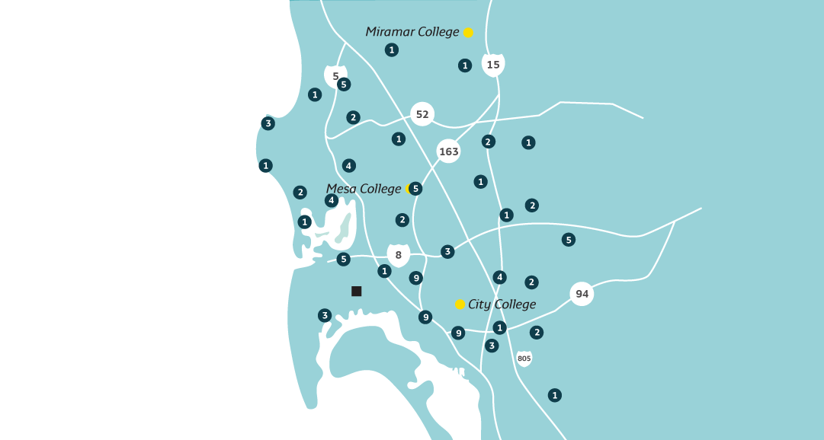
Over 200 Offsite Locations

Slide 7

Free Career Education
70+ SHORT-TERM (LESS THAN 1 YEAR) PROGRAMS
Along with ESL and DSPS Classes
Accounting / Business Information Worker
Automotive Technician
Auto Body and Paint Technician
Business
Child Development
Computers and IT
Culinary & Bakeshop Academy
Electronic Technician
Fashion & Textiles
HVAC
Healthcare Careers
Plumbing
Upholstery
Welding / Metal Fabrication

Slide 8
Division of Student Services
Admissions and Records
Career and College Transition
Counseling (SSSP)
Student Equity Services (R2S)
Student Affairs

Slide 9

Career & College Transition
  Transition from SDCE to SDCE
    HSE to CTE
    CTE to CTE
  Transition from SDCE to Career
    Career Counseling
    Employment Connections
      Job Placement & Tracking
  Transition from SDCE to College
  Transition from college to
  SDCE (basic skills)

Slide 10

Counseling
Core Elements
  Orientation
  Assessment
  Counseling
  Educational Plans
  “Follow Up”

Slide 11

Student Equity
Academic & Career Counseling
Career Exploration
Work Readiness & Job Development
Paid Work Study
Parenting Success
Dress for Success/Clothes Closet
CalWORKs
Lending Library
Career & College Transition
Academic Planning
Financial Literacy
Resource & Referrals
Uniform Loan Program
Transportation Assistance
LGBTQ & Gender Equity
Foster Students
Homeless
Immigrants & Refugees
Opportunity Youth (18-24)
Re-entry
DSPS
Veterans
FG & LI
NEW
HORIZONS
TARGETED STUDENTS
R2S
SUPPORT SERVICES
Counseling
Outreach
Resource & Referrals
HHSA
Caltrans Veterans Outreach Programs
Food Pantry (SDCEats)
Mental Health Referrals
External and Internal Partnerships

Slide 12
San Diego Gateway to College & Career
Opportunity Youth (Grant)
Provides additional support for any 18-24 year old
Left school without a diploma; can be attending an ASE program
Unemployed but with a diploma; can be attending a CTE program
Recruiting young adults from the community
Resource Center for Opportunity Youth
Dedicated academic counseling
Welcoming atmosphere
Program expansion
Special SDWP Grant ($2+ million over 5 years)
Earn and learn/paid internships
Personalized case management
Life skills and job readiness workshops
Priority for San Diego Promise
Pursuing new funding to widen eligibility

Slide 13


Student Affairs
ASB
Discipline
Title IX
Special Events
  Scholarship
  Commencement

Slide 14

SDCE Partnerships
CalTrans Veterans Outreach Program
Electrical Worker Minority Caucus
Feeding San Diego
GRID Alternatives
Health and Human Services Agency
Jackie Robinson YMCA
Jacobs Center for Neighborhood Innovation
Junior Achievement
KRA/South Metro Career Center
Monarch School
Project Concern International
Rise San Diego
San Diego Green Building Council
San Diego Workforce Partnership (Tech Hire)
San Diego Housing Commission
San Diego Rescue Mission
San Diego Youth Development Office
Second Chance
Teach for America
Urban Corp

Slide 15
Counselors Role at SDCE
Provide matriculation services
  SSSP funding
First point of contact
Academic, Personal and Career counseling
  Academic: CTE pathways and Articulation
  Personal: There to listen and if needed we refer to Mental Health agencies
  Career Counseling: Resume writing, Career pathways, Interviewing etc.

Slide 16
Counselors Role at SDCE
Collaborate with Deans and Instructors
  Course scheduling
    What will be offered
    Student feedback
  Certificate program Orientations
    # of seats
    Possible assessments
  Counseling referrals
Collaboration is crucial when developing new curriculum or certificate programs

Slide 17
Collaboration
Example at CE’s North City campus
  Revamping Certificate programs
    Instructor Perspective
      Develop the program
      Make certain it is relevant
      Adequate hours to cover material
      Get the program approved
      Offer the classes
      Away we go!
    Counselor Perspective
      Pre-Orientation required?
      How does this fit within the rest of the programs?
      Is this an approved Certificate program? (Orientation)
      What is the recommended skill level? (Assessment)
      What courses are needed to receive certificate? (Student Edu. plan)
      What is the content/skills? (Counseling)
      What careers can they pursue? (Follow Up)
      Is it managed enrollment?
      Who else does it impact?
        Student services, Facilities, Public Information Office

Slide 18
Collaboration is Crucial
Create a positive working relationship with all Faculty and Staff
  All will need to rely on each other
Discussions are important
  Constructive criticism
  Discussion at every level of the planning phase
Understanding that each campus and program is different
It takes time

Slide 19
Counseling and Discipline Faculty
Discipline Faculty can:
provide information regarding programs, career opportunities, and course selection in their disciplines;
refer students to appropriate services;
coordinate with counseling departments for assistance beyond discipline specific information.
Counseling Faculty are required when:
the student needs more than just specific information;
goals are not yet set;
decisions are not yet made;
a student needs counseling.

Slide 20
Faculty and Staff
Must work together to provide services for students;
Streamline access to services for students;
Understand the roles and responsibilities of each other so as not to send students in circles.

Slide 21
Questions and Comments

Slide 22
References
Academic Senate for California Community Colleges: The Role of Counseling Faculty and the Delivery of Counseling Services in the California Community Colleges, Spring 2012: https://asccc.org/sites/default/files/CounselingS12_0.pdf

