Slide 1
Meta Majors Design with the Undecided Student in Mind
Janet Fulks, Guided Pathways Lead
Ya’Mese Johnson, SSCCC VP of Communications
Ginni May, ASCCC Treasurer, Guided Pathways Task Force Chair
Musamim Mubtakir, Moreno Valley College ASO VP
Academic Academy, Queen Mary, Long Beach
September 13, 2019, 3:45-5:00

Slide 2
Description
There have been many conversations about appropriately grouping and categorizing programs of study in ways that make sense for undecided students. Do those categories mean anything to students viewing them in a catalog or through onboarding processes? How are student voices incorporated into the construction and evaluation of the college meta majors? Join us, faculty and students for a lively discussion on designing meta majors with the undecided student in mind.
Notes:
We can remove this slide when we are done. I just included for our reference when preparing…

Slide 3
Overview
The “undecided” student
Meta Majors
Why redesign
Some examples…

Slide 4
The Undecided Student…
Pair and Share
What is an undecided student?
Were you an undecided student?
Do you know undecided students?
How do you think Meta Majors can help the “undecided” student?
Notes:
Purpose – gather many and diverse reasons for a student might be undecided
By the end of this presentation, we hope #4 will be easier to answer

Slide 5
The Undecided Student…
The Student Perspective
What is an undecided student?
Are or were you an undecided student?
Do or did you know undecided students?
Notes:
Student presenters respond
Then if there are any students in the audience is there anything they would like us to know

Slide 6
Potential Benefits of a Redesign
Provides clarity and support
Clustering helps students to navigate the college, and more importantly navigate career opportunities and educational needs
Provides embedded support structures with customized needs assessment

Slide 7
What are Meta Majors?
Meta Majors are collections of academic majors that have related courses.
Meta Majors cluster groups of degrees and certificates that are considered similar from a student’s perspective.
Meta Majors give incoming students an opportunity for early exploration within a cluster of academic and career choices while still making progress to graduation.
More…
Notes:
Anything additional ideas or thoughts from the audience?

Slide 8
Pair and Share
Does your college have meta majors?
If yes, what does your college call them, and how did your college arrive at this “name”?
If no, is your college developing them? Why or why not?

Slide 9
Other “names” for Meta Majors
Focus Area
Academic Cluster
Clustering Majors
Career and Academic Pathways
Interest Areas
Career Clusters
Program Clusters
Learning and Career Pathways
Others???

Slide 10
Benefits of a Redesign – no matter what you call it…
Institution – Student case management, data, messaging, milestones, collegial dialogue
Faculty – engagement in the important cross-disciplinary PROGRAM dialogue
Students – clarity, optimized course-taking in terms of units and time, helpful and guided exploration, clearer paths and expanded options, connection to real careers

Slide 11
Citrus College

Slide 12
Lake Tahoe Community College Meta Majors

Slide 13
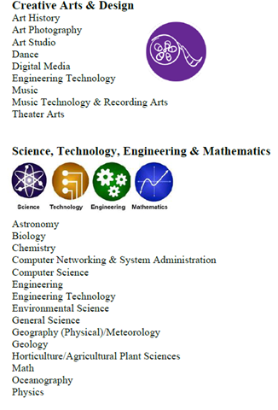
Cabrillo College Academic and Career Pathways (CAPs)

Slide 14
Sierra College – Interest Areas

Slide 15
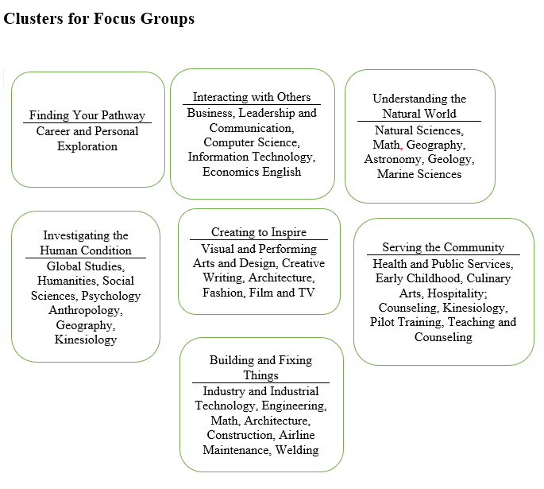
What about an Undeclared Major?
Orange Coast College – draft meta majors
Colleges that have decided to offer such a meta major:
Southwestern
Mt. San Antonio
Bakersfield
Others?

Slide 16
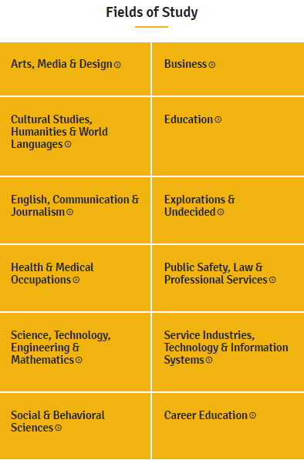
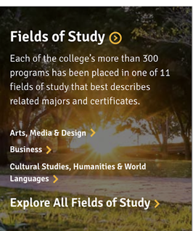
Southwestern College

Slide 17
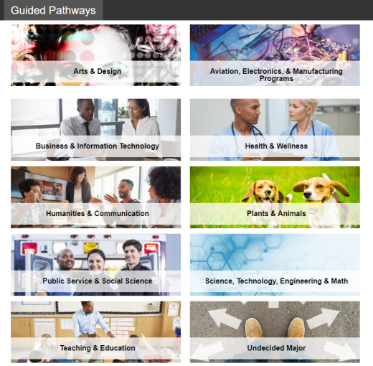
Mt. San Antonio College… Career Clusters

Slide 18
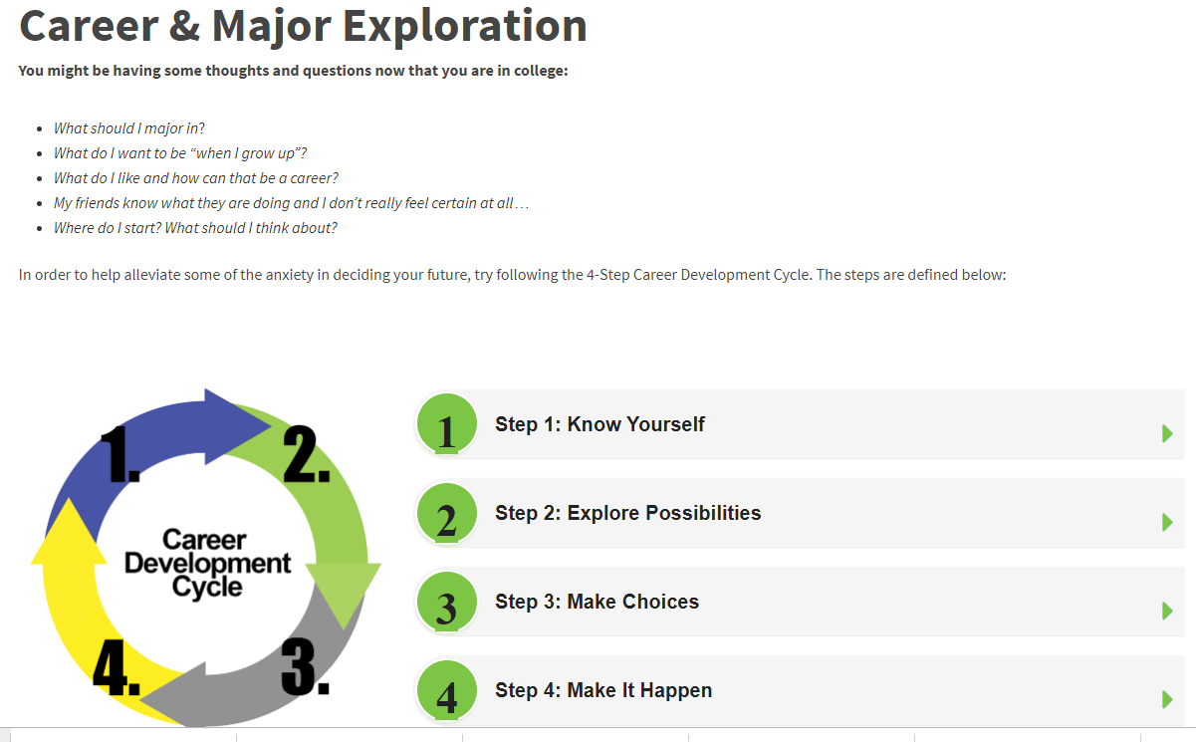
The Undecided Student…

Slide 19
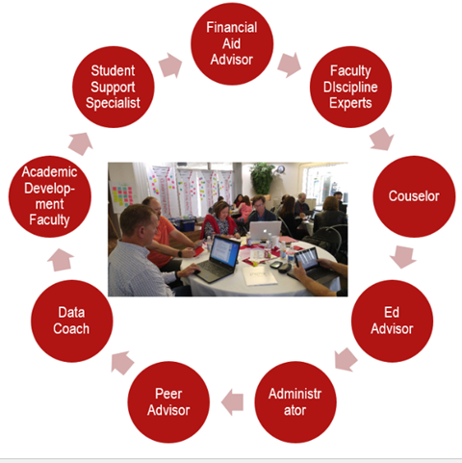
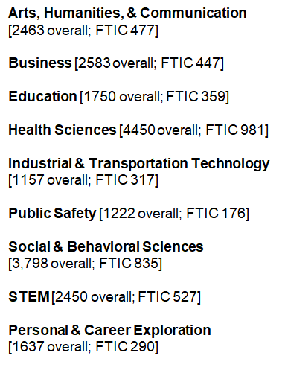
Bakersfield College Completion Coaching Teams

Slide 20
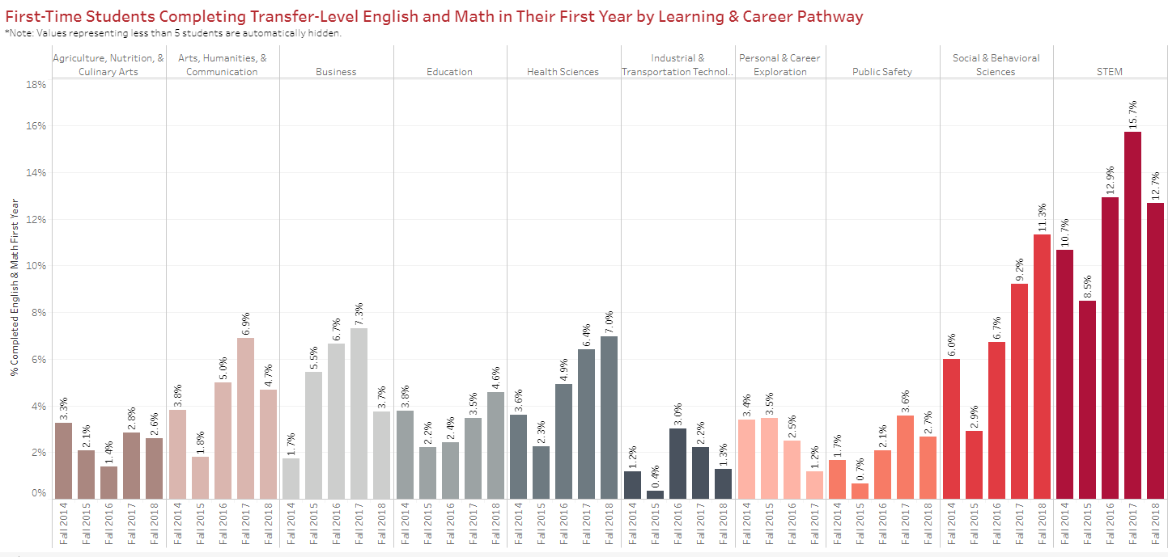
First Time in College (FTIC) Milestones

Slide 21
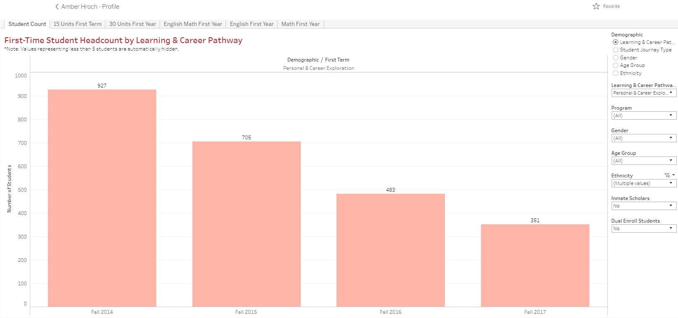
The Goal of Onboarding: Help students to know “why” or “what”—Reducing the numbers of “undecided”

Slide 22
Design so that students optimize their course taking—units and time
Example: SOC 101 is either a required or a major elective for 17 programs listed to the right…
Course_Id | # of Prog | Overlap_Programs
SOC101 | 17 | Administration of Justice, X; Alcohol & Drug Counseling, C; Alcohol & Drug Counseling, A; Communication Studies, Y; Liberal Arts & Sciences: Social & Behavioral Sciences, A; Liberal Arts: Biomedical Sciences, A; Liberal Studies: Education Emphasis, A; Political Science, A; Psychology, Y; Sociology, Y; Political Science, Y; Journalism, Y; Anthropology, Y; Spanish, Y; Economics, Y; Global Leadership, A; Global Leadership, C
MATH117 | 16 | Administration of Justice, X; Business Administration, X; Communication Studies, Y; Kinesiology, Y; Liberal Arts and Sciences: Science & Mathematics Emphasis, A; Liberal Arts: Biomedical Sciences, A; Political Science, A; Psychology, Y; Sociology, Y; Political Science, Y; Journalism, Y; Geography, Y; Anthropology, Y; Mathematics, X; Economics, Y; Healthcare Data Analytics, C
ANTH103 | 15 | Communication Studies, Y; Liberal Arts & Sciences: Social & Behavioral Sciences, A; Liberal Arts: Biomedical Sciences, A; Liberal Studies: Education Emphasis, A; Political Science, A; Psychology, Y; Sociology, Y; Political Science, Y; Art History, Y; Journalism, Y; Geography, Y; Anthropology, Y; Spanish, Y; Global Leadership, A; Global Leadership, C

Slide 23
RP Group/ASCCC Collaboration
Could we help colleges by electronically analyzing the curricular overlap among courses and programs as a draft start on clustering?
Could RP develop the algorithm and then use the posted Chancellor’s Office Curriculum Inventory and provide colleges with the data to examine?
Could ASCCC help integrate program and curriculum considerations and dialog regarding the factors contributing to clusters?
Would colleges like the help and additional data?
Would students like this information in choosing their majors and course options?

Slide 24
Clusters and Programs/Cross Mapped Courses
Clusters and Programs
Arts
Digital Arts, A
Digital Arts, C
Music, A
Music, Y
Photography, A
Photography, C
Studio Arts, Y
Theatre Arts & Cinema, A
Theatre Arts, Y
Business, Agricultural, and Industrial Studies
Advanced Automotive Technology, C
Agricultural and Industrial Technologyâ€”Industrial Mechanics, C
Agricultural and Industrial Technologyâ€”Industrial Technician, B
Agriculture Business, C
Agriculture Business, S
Agriculture Business, X
Agriculture Production, C
Agriculture Production, S
Automotive Technology - Advanced Diesel Technology, S
Automotive Technology--Auto Shop Management, C
Course_Id | # of Prog | Overlap_Programs
SOC101 | 17 | Administration of Justice, X; Alcohol & Drug Counseling, C; Alcohol & Drug Counseling, A; Communication Studies, Y; Liberal Arts & Sciences: Social & Behavioral Sciences, A; Liberal Arts: Biomedical Sciences, A; Liberal Studies: Education Emphasis, A; Political Science, A; Psychology, Y; Sociology, Y; Political Science, Y; Journalism, Y; Anthropology, Y; Spanish, Y; Economics, Y; Global Leadership, A; Global Leadership, C
MATH117 | 16 | Administration of Justice, X; Business Administration, X; Communication Studies, Y; Kinesiology, Y; Liberal Arts and Sciences: Science & Mathematics Emphasis, A; Liberal Arts: Biomedical Sciences, A; Political Science, A; Psychology, Y; Sociology, Y; Political Science, Y; Journalism, Y; Geography, Y; Anthropology, Y; Mathematics, X; Economics, Y; Healthcare Data Analytics, C
ANTH103 | 15 | Communication Studies, Y; Liberal Arts & Sciences: Social & Behavioral Sciences, A; Liberal Arts: Biomedical Sciences, A; Liberal Studies: Education Emphasis, A; Political Science, A; Psychology, Y; Sociology, Y; Political Science, Y; Art History, Y; Journalism, Y; Geography, Y; Anthropology, Y; Spanish, Y; Global Leadership, A; Global Leadership, C

Slide 25
Let’s hear from the students…
How do you think meta majors could help the “undecided” student?
Can you think of anything that has not been addressed to assist the “undecided” student?
What can colleges do to encourage student input into meta major design?

Slide 26
Discussion with Q and A

