Slide 1
Student Onboarding Processes – Helping Students Determine their Path
Janet Fulks, Guided Pathways Lead
Ginni May, ASCCC Treasurer, Guided Pathways Task Force Chair
Rogéair Purnell, Senior Researcher, RP Group
Alexis Zaragoza, Board of Governors Member
Academic Academy, Queen Mary, Long Beach
September 13, 2019, 11:00-12:15
Notes:
Ginni will start and we introduce ourselves

Slide 2
Description
Many colleges have special onboarding processes for select student populations such as First-year Experience, EOPS, Puente, and Umoja. How can onboarding processes be expanded for all students and reflect a more comprehensive and student-centered approach to orientation, assessment for placement, and student advising within the confines of the law? What are guided placement, self placement, and student onboarding, and how are they different? Increasing research evidence points to the linkage between developing student self-agency and persistence and completion. What information do students want to make informed decisions in the onboarding process? Providing quality information and high expectations that enable students to make their own evidence-based decisions is the goal of guided onboarding. Join us for a discussion on the importance of Guided Pathways Onboarding with a review of some current onboarding methods and data reported by local colleges.
Notes:
This is here so those that access the ppt know the session description.

Slide 3
Overview
Initial thoughts…
A Snapshot of Some Colleges
The Student Experience
Guided Placement, Self Placement, and Student Onboarding
Nationwide Research Results – Self Agency
Important Onboarding components
Helping students make informed choices
But…what is permitted?
Notes:
Ginni

Slide 4
Learning Outcomes
Participants will be able to…
Outline key elements of a more expansive definition of onboarding
Refer to research findings that underscore the importance of effective onboarding to student success
Identify ways to revamp, strengthen, and improve onboarding on their campuses
Notes:
Ginni

Slide 5
Notes:
Ginni - Today, we are addressing Pillar II, but of course nothing we do should be in silos, so we will touch on other pillars as well.

Slide 6
Onboarding, Guided Placement, Self Placement—Definitions
Guided Placement: A process or a tool used to encourage a student to reflect on his or her academic history and educational goals that may include the student evaluating their familiarity and comfort with topics in English or mathematics. After completing the process, students will receive their course placement.
Onboarding: A process of orienting a student to the college and the programs and courses offered. The process often includes collection of information from the student about the student’s educational and career goals, elements of the student’s life that may impact their studies, and additional information about the student’s educational and life experiences that will inform and assist the student to choose appropriate courses.
Self Placement: The process in which a student chooses their placement after consideration of the self-assessment survey results and other relevant factors.
From CCCCO Memo AA 19-19: AB 705 Guided and Self Placement Guidance and Adoption Plan Instructions
Notes:
Ginni

Slide 7
For clarity…
GSP – Guided Self Placement
NOT defined in Education Code nor Title 5
Generic term often used for onboarding, guided placement, and self placement
DSP – Directed Self Placement
Term used outside of California instead of GSP
Notes:
Ginni

Slide 8
Elements of Effective Onboarding Components
One word…popcorn style!
Notes:
Janet
A Practice Guide for College and University Administrators, Advisors, and FacultyWhat Works Clearinghouse https://ies.ed.gov/ncee/wwc/Docs/PracticeGuide/wwc_dev_ed_112916.pdf

Slide 9
Timeline of Student Placement, Onboarding or GSP Movement
2013-14 Collegial Multiple Measures Project examines placement tools and practices
AB 705 (Irwin, 2017) focuses on placement practices for courses in Mathematics, English and ESL
An ASCCC resolution 18.01 F18 resolved that the ASCCC make available GSP strategies and urged local senates to give all student access to GSP.
Fall 2018 RP Group statewide survey of AB 705 (Irwin, 2017) current and planned implementation strategies that indicated 76% of colleges intend to use some form of self placement for English, ESL, or Mathematics.
Notes:
Janet – one of the first things we discovered in onboarding and pillar 2 was the issues with placement. It became a focus and to some extent, derailed the holistic process that should include all of the “onboarding” experience such as orientation, financial aid, wayfinding, career exploration, major decisions and enrollment

Slide 10
Students’ Onboarding Experiences and Perspectives Alexis Zaragoza
Notes:
Alexis

Slide 11
Students’ onboarding experiences and perspectives
What constitutes effective onboarding?
What might you add to the elements provided?
In what ways did you experience these elements?
Are there institutional policies, practices, and processes that could be changed or strengthened to ensure that more students experience these elements?
Notes:
Alexis

Slide 12
Onboarding from the Perspective of the RP Group Rogéair Purnell
Notes:
Rogeair

Slide 13
Differing Perspectives
Notes:
Rogeair
Rogeair
Refer back to foundational elements
Image for post-GP world of student perspectives, experiences?
Before jumping into specific ways everyone can help – it is important to acknowledge the differing perspectives that faculty, the college, and students have of the learning environment.
The left side reflects how the college organizes and perceives the support it provides its students. Every college has divisions that serve very distinct functions such as Instruction, Student Services, Fiscal, etc. We love org charts!
On the right side, this reflects what the student sees. An what does the student see? People – people who will be able to help them or not. The systems we put in place were designed with the intent to help students but sometimes those same systems are creating barriers for students. At the end of day, student see people and what matters is “how can you help me?”

Slide 14
Focusing on the Student Experience
Why focus on the student experience?
Ensure students’ actual experience in our colleges informs and drives institutional change that practically results in improved equitable outcomes
What do we mean by “student experience?”
Look through the student lens to:
Identify how students’ experience of the institution does (or doesn’t) align with what the college intends
Determine how to bridge the gap through redesign of policies, programs, processes, and practices -- inside classroom and across the institution
RESOURCE: Grounding College Redesign in Your Students’ Experience: A Student-
Centered Guide for Institutions - https://tinyurl.com/yytr8rw9
Notes:
Rogeair

Slide 15
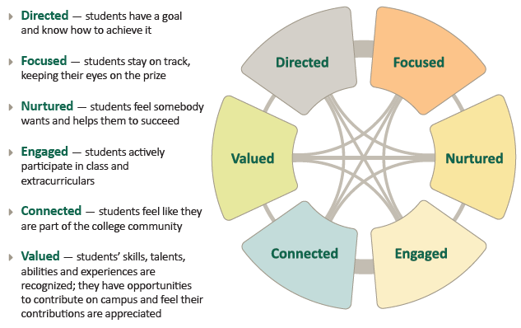
Six Success Factors
Notes:
Rogeair
RP: Everything that students said helped them succeed inside and outside of the classroom can be synthesized into these six factors shown here in this wheel. The wheel depicts the fix factors ordered in the how students prioritized the factors going clockwise. The lines in the center connecting all the factors represent the interconnectedness of these factors.
What follows are short descriptions of the factors organized by similarities what factors helped foster their experiences of these six factors.

Slide 16
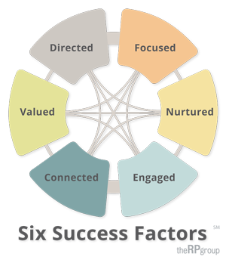
Grounding Onboarding Redesign in the Student Experience: A Student-Centered Guide for Institutions
Provides a structured process for examining the real onboarding experiences of students (compared to what the institution intends) to inform and determine redesign priorities
Applies the approach of the general student experience guide to examining the real onboarding experiences of diverse student groups to inform redesign priorities
Focuses on students’ entry and experiences in the first year
Uses the Student Support (Re)defined six success factor framework to:
Identify outcomes for successfully onboarded students
Vision what onboarding experience you want different student groups
Examine how students experience onboarding now using quantitative data, student engagement, and systems / process mapping from the student perspective
Identify gaps and determine what specific aspects of onboarding to redesign
Notes:
Rogeair

Slide 17
Current Onboarding…
Notes:
Janet

Slide 18
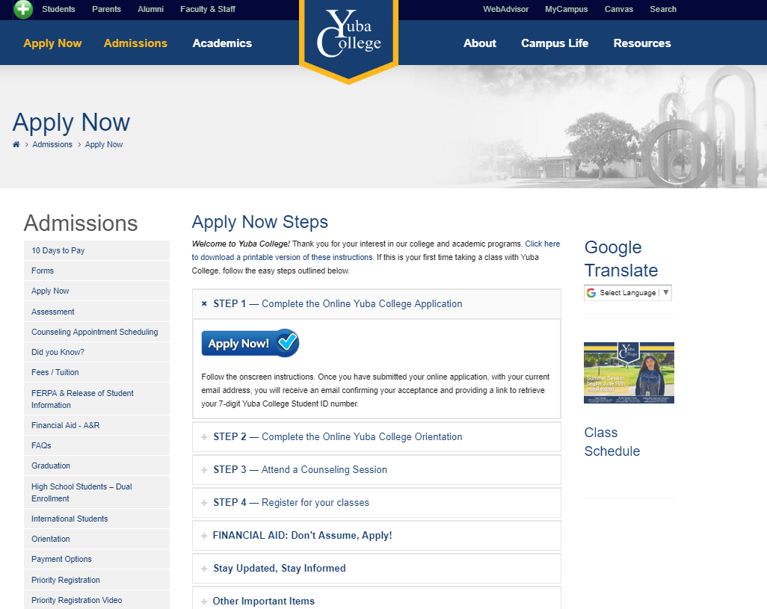
Notes:
Janet

Slide 19
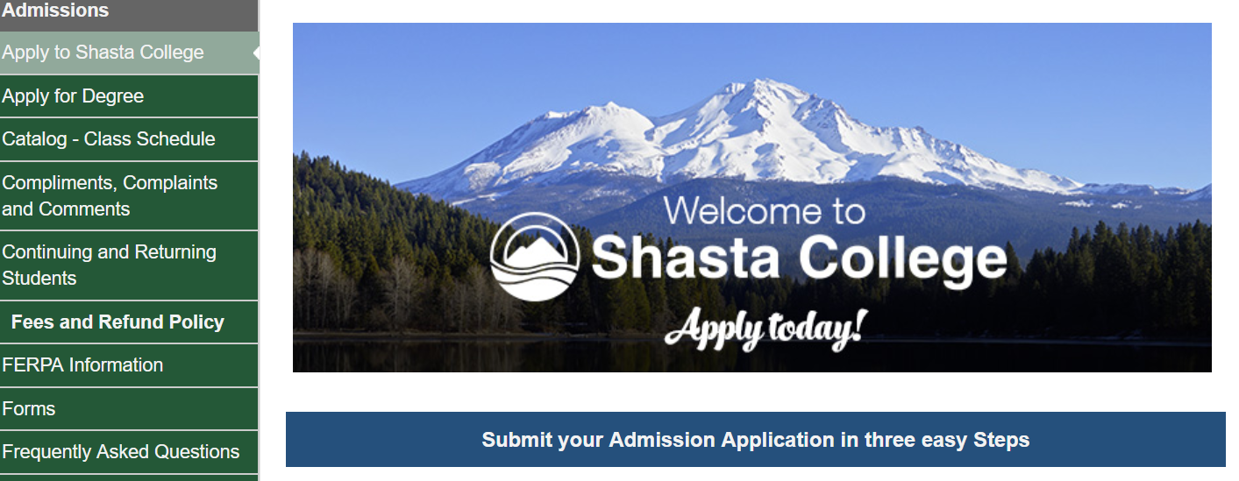
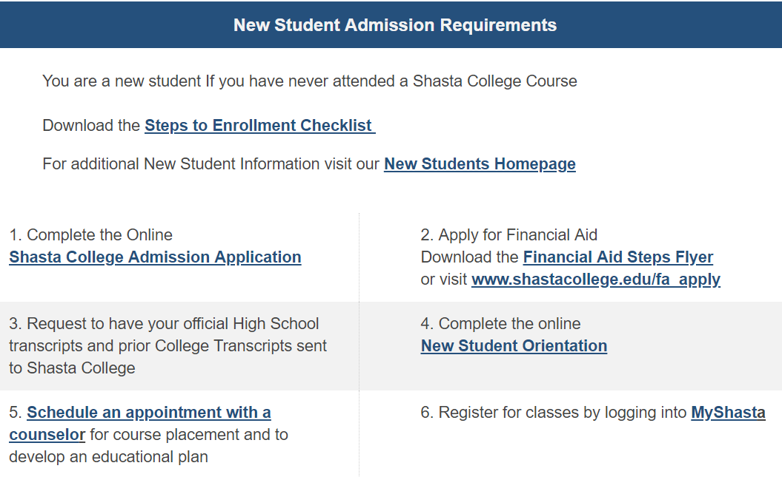
Notes:
Janet
San Diego Mesa website

Slide 20
First step after logging in name and address – Select an Educational Goal
These goals are driving a lot of planning and accountability.
Do students understand what they are selecting i.e. Associate degree without transfer, Earn a technical certificate without transfer, Educational development?
How do we help them understand these choices and what they mean?
Do you know what they mean?
Notes:
Janet

Slide 21
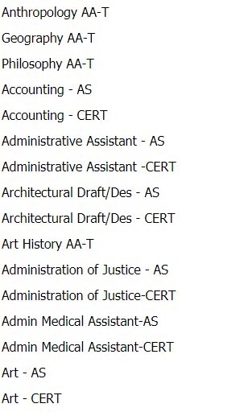
Choosing the ADT, Local AA/AS, Certificate
More choices…
Notes:
Janet

Slide 22
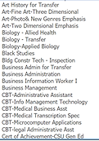
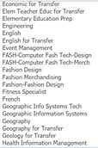
Choosing a Major
Eventually, all students must choose a major – but what do they go through to do this?
Notes:
Janet

Slide 23
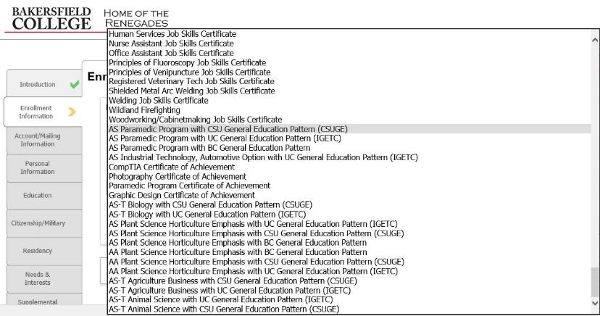
Choosing General Education
CSU GE Breadth,
IGETC,
Local,
Private,
Out of State…
Notes:
Janet

Slide 24
What’s the Student Experience Like?
Make a choice, any choice…
Is alpha order good?
Do students understand the degree and certificate lingo?
Who scrolls through all of this?
Is this a good start to Onboarding?
Notes:
Janet

Slide 25
Financial Aid – no problem…NOT
Requires various offices and signatures
No office seem to speak to each other or share data
Each office has independent expectations the other offices don’t know or explain
Students have issues with parental information
Students don’t understand the FAFSA
Many times students lose financial aid because they are missing a final signed page
Notes:
Janet

Slide 26
So many choices…
Notes:
Ginni

Slide 27
Yet, we know students with declared majors tend to persist longer…
Notes:
Janet

Slide 28
Nation-wide Studies on Onboarding or GSP
Notes:
Janet

Slide 29
Nation-wide Research Results – Self Agency
Higher Education is not done TO YOU but a Choice YOU MAKE
Nationally GSP is recognized as a High Impact Practice because:
The strategy transforms student services and support into approaches that provide students the locus (Kuh & Chickering 2005; Schunk & Zimmerman, 2006; Shushok & Hulme, 2006; Toth, 2019; Weiner, 2000).
Academic advising increases academic success, retention, graduation, and transfer rates What Works in the Community Colleges: A Synthesis of the Literature on Best Practices by Bourdon and Carduzzi (2002)
Notes:
Janet
Academic advising increases academic success, retention, graduation, and transfer rates, especially for "at risk" students from first generation, low-income families and students with disabilities. Academic advising, using both developmental and prescriptive approaches, gives students important information in order to make informed choices while also teaching those students who need assistance how to make informed choices. What Works in the Community Colleges: A Synthesis of the Literature on Best Practices by Bourdon and Carduzzi (2002)

Slide 30
Nation-wide Research Results – Self Agency
GSP focuses on providing students with:
Adequate information (full disclosure) about programs and courses
Agency
Choice
Trust that students will make appropriate placement choices
(Royer & Gilles, 1998; 2003). Washington University
Notes:
Janet
Be sure to clarify verbiage GSP, DSP, SP etc

Slide 31
Nation-wide Research Results – Self Agency
“A well-developed DSP process invites students to consider a range of factors regarding their prior writing knowledge and experiences, learning preferences, and the values and practices associated with college-level writing at their new institution. We should not assume that a numerical score—or, for that matter, a questionnaire—is a necessary part of that process… In fact, DSP processes vary from institution to institution depending on local curricular configurations, student populations, and available resources (Toth, 2019).”
Notes:
Janet

Slide 32
Nation-wide Research Results – Self Agency
Toth (2019) warns that colleges should not seek a “tool” because:
“DSP is not a single procedure, product, or algorithm, but rather a set of principles grounded in student choice that can be implemented in a variety of ways with varying consequences in local contexts.
Those implementations often evolve over time as student bodies and curricula change and as new technologies and theoretical insights emerge.”
Notes:
Janet

Slide 33
What Works – Data supporting 6 Practices
Notes:
Janet
The Institute of Education Sciences (IES) publishes practice guides to share evidence and expert guidance on addressing education-related challenges not readily solved with a single program, policy, or practice. Each practice guide’s panel of experts develops recommendations for a coherent approach to a multifaceted problem. Each recommendation is explicitly connected to supporting evidence. Using What Works Clearinghouse (WWC) design standards, the supporting evidence is rated to reflect how well the research demonstrates the effectiveness of the recommended practices (see Table A in the Introduction for more details on levels of evidence): • Strong Evidence means positive findings are demonstrated in multiple well-designed, well-executed studies, leaving little or no doubt that the positive effects are caused by the recommended practice. • Moderate Evidence means well-designed studies show positive impacts, but there are questions about whether the findings can be generalized beyond the study samples or whether the studies definitively show evidence that the practice is effective. • Minimal Evidence means that there is not definitive evidence that the recommended practice is effective in improving the outcome of interest, although there may be data to suggest a correlation between the practice and the outcome of interest.

Slide 34
Research on Placement – State University of New York (SUNY)
7 SUNY community colleges used alternative multiple measures placement
Included both placement test scores and HS GPAs — using predictive algorithms developed at each college to place incoming students into remedial or college-level courses
Many students were placed differently than they would have been under the status quo placement system.
In math, 14% of students were placed higher than test-only systems (in college-level); 7% placed lower (i.e., in remedial).
In English, 41.5 percent placed higher, while 6.5 percent placed lower
4,729 students in the fall 2016 cohort were evaluated comparing traditional with multiple measures
In math 3.1 percentage points higher completion and in English 12.5 percentage points higher completion
Notes:
Janet
Recognized as Strong research on placement
Multiple Measures Placement Using Data Analytics An Implementation and Early Impacts Report https://www.mdrc.org/sites/default/files/CAPR_Multiple_Measures_Assessment_implementation_report_final.pdf

Slide 35
Research – Implies work beyond placement
Notes:
Janet
Even if we place students; they need to enroll; and then pass that is why onboarding is important. Looking at a single course or a single discipline will not accomplish our goal

Slide 36
Important Onboarding Components
Student Point of View
Should relate directly to career choice
Clarity: It must be clear to the student
Notes:
Alexis

Slide 37
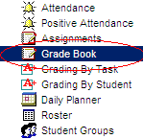
Select a Metamajor and/or major
Select English/ESL and Mathematics/Quantitative Reasoning Pathways
Identify appropriate General Education (GE)
Review other Data and Default or Local Placement Rule Set
Career Counseling
Clarify your educational goal
Interests
Wages
Benefits
Skills
Long term plans
Life values
Personality
Occupational research
Location
Responsibilities
Employment trends
What you love
STEM (Science, Technology, Engineering, or Math
Business and Accounting
Education
Social Sciences & Public Safety, Communication, Allied Health, Human Resources, Journalism
Humanities, Hospitality, Technical Majors
Public Safety
Other
Complete guaranteed transfer degree to CSU
Complete AA and transfer
Complete short-term certificate or local AA
Complete a course or two for work advancement
Complete courses for individual interest
English
English as a Second Language (ESL)
Mathematics/Quantitative Reasoning by major
STEM calculus
Business
Education
Statistics
Career Technical
High School GPA
High School Courses & other curriculum
test scores e.g. AP, SAT
CLEP test results
Employment experience
Military Experience
Time available for classwork & support
Financial needs
See default placement using high school GPA
Transfer to CSU or private college – CSU breadth
Transfer to UC - IGETC
No transfer local degree or certificate – local GE
No GE requirements
Guided Self – Placement (GSP) 8/30/2018
Notes:
Janet

Slide 38
Helping Students Make Informed Choices
What do students feel they need?
What do faculty want students to know?
Notes:
Ginni
In the panels I have done they say they need data shared between offices, a single set of advice based on expertise not 50 ways to become a biologist, help navigating transfer requirements, examples of the class work, and connection to careers with the course content

Slide 39
National Recommendations for Onboarding
Recommendation 1: Use multiple measures to assess postsecondary readiness and place students.
Recommendation 2: Require or incentivize regular participation in enhanced advising activities.
Recommendation 3: Offer students performance-based monetary incentives.
Recommendation 4: Compress or mainstream developmental education with course redesign.
Recommendation 5: Teach students how to become self-regulated learners.
Recommendation 6: Implement comprehensive, integrated, and long-lasting support programs.
Notes:
Janet

Slide 40
But…what is Permitted? Memo AA 19-19
The Chancellor’s Office is providing provisional approval for districts that opt to develop guided placement and self-placement methods that require Chancellor’s approval.
The district must collect data to demonstrate that students benefit from the guided and self placement models implemented.
Data reported shall include throughput and successful pass rates, and the college’s placement results (e.g., the number of students assessed, the number of students placed into the colleges curricular offerings in English and mathematics/quantitative reasoning, and whether concurrent support was recommended, disaggregated by race and ethnicity).
Districts will be allowed no more than two years to innovate and validate their own guided and self placement methodologies.
Districts will be required to provide a preliminary report on their validation data after one year of implementation.
Notes:
Ginni

Slide 41
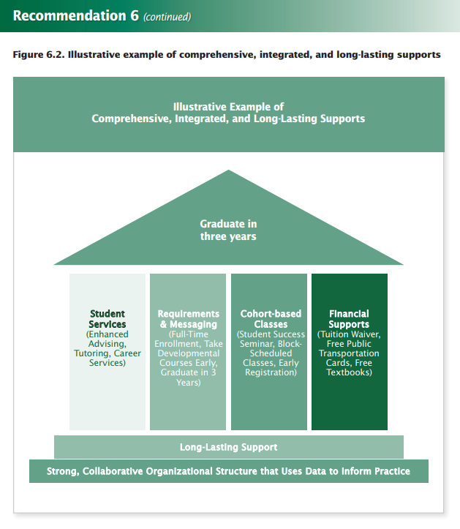
Notes:
Janet
A Practice Guide for College and University Administrators, Advisors, and FacultyWhat Works Clearinghouse https://ies.ed.gov/ncee/wwc/Docs/PracticeGuide/wwc_dev_ed_112916.pdf

Slide 42
Share Your Onboarding (or GSP) Practices
In what ways is your college orienting students to the college and the programs and courses offered? How is effective has it been?
Has your college been developing a guided or self placement model? Is it the same for Math and English? What about other disciplines?
If so, who has been included in the development/implementation process and how smoothly has it been working?
Who should be involved?
Notes:
Rogeair

Slide 43
Discussion with Q and A

Slide 44
Upcoming Events…
ASCCC Events:
A list of all ASCCC Events can be found here: https://asccc.org/calendar/list/events
Guided Pathways Regional Meetings
Guided Pathways Webinars
Other events
ASCCC is presenting at the RP Group’s Strengthening Student Success: https://rpgroup.org/Events/Strengthening-Student-Success/overview
RP Group Events:
Strengthening Student Success Post-Conference Session:
Keeping the Student Experience Central to Institutional Redesign
Offer examples for how colleges can act on the factors students indicated were critical to their success through GP adoption and share stories from colleges using Student Support (Re)defined to initiate change. Participants will leave with action steps for applying these resources to advance your Guided Pathways work—no matter where your college is in your adoption process
Friday, October 11 – 9 to 2 (Hyatt Burlingame/SF)
Registration - https://www.regonline.com/registration/Checkin.aspx?EventID=2563275

Slide 45
Resources used by ASCCC Guided Pathways Task Force
A practice guide for college and university administrators, advisors, and faculty. Washington, DC: Institute of Education Sciences, What Works Clearinghouse. https://ies.ed.gov/ncee/wwc/Docs/PracticeGuide/wwc_dev_ed_112916.pdf
What Works in the Community Colleges: A Synthesis of the Literature on Best Practices. INSTITUTION California Univ., Los Angeles. Graduate School of Education. PUB DATE 2002-12-00 NOTE 57p.; Prepared by the Higher Education and Organizational Change Division. https://pdfs.semanticscholar.org/909d/94498abfe9d8606994c319509f43ac6b06fa.pdf?_ga=2.264020940.1746833798.1553632938-1415424856.1553632938
Chickering, A. W., & Kuh, G. D. (2005). Promoting student success: Creating conditions so every student can learn (Occasional Paper No. 3). Bloomington, Indiana: Indiana University Center for Postsecondary Research.
IES, Strategies for Postsecondary Students in Developmental Education – A Practice Guide for College and University Administrators, Advisors, and FacultyWhat Works Clearinghouse https://ies.ed.gov/ncee/wwc/
Schunk, D.H. & Zimmerman, B.J. (2006). Competence and control beliefs: Distinguishing the means and ends. In Alexamder, P.A. & Winnie, P.H. (Eds.). Handbook of educational psychology (2nd ed.). Mahwah, NJ: Lawrence Erlbaum Associates.
Shushok, F. r., & Hulme, E. (2006). What's Right with You: Helping Students Find and Use Their Personal Strengths. About Campus, 11(4), 2-8.

Slide 46
Supporting a Focus on the Student Onboarding Experience: Resources from RP Group
Understanding the Student Experience Through the Loss/Momentum Framework: Clearing the Path to Completion (Research and Planning Group for California Community Colleges)
A guide to ensure students successfully transition through critical junctures in their educational journey, https://tinyurl.com/y5u93yxl
Student Engagement in Guided Pathways Development
An overview of six design principles for effective student engagement, https://tinyurl.com/y3ovco7w
Students Shaping Change: Engaging Students as Essential Partners in Guided Pathways Development
Resource demonstrating design principles for meaningfully partnering with students throughout redesign, with examples from Santa Monica College’s Student Advisory Squad, https://tinyurl.com/y4ay7xye
Collecting Student Voices for Guided Pathways Inquiry and Design: Why Do It, How It Works, and What It Looks Like in Action
A hands-on guide providing college stakeholders—particularly cross-functional teams—an introduction to engaging students in early GP development efforts, Found in the California Community Colleges Vision Resource Center at https://visionresourcecenter.cccco.edu/
New Student Onboarding Diagnostic: What First Impression Does Your College Make? (EAB)
A tool to assess key onboarding processes and how they can be improved or strengthened, https://tinyurl.com/y4fv5zgc
What We Are Learning About Guided Pathways (Community College Resource Center)
A summary of key practices from national Guided Pathways efforts including recommendations for strengthening onboarding practices, https://tinyurl.com/yyk4bv9p

