Slide 1
K-16 Alignments and Beyond to Support Transfer

Slide 2
Presenters
Emily Berg, Reedley College
Stephanie Curry, ASCCC Area A Representative
Marisa Marquez, Bakersfield College

Slide 3
Breakout Description
Come, learn and discuss efforts to incorporate early college courses and outreach to increase transfer rates. Learn from colleges that are using K-16 alignment and program mapping through bachelor’s degrees to encourage and support students transferring to 4-year institutions.

Slide 4
Intersegmental alliance
K-16 Collaborative: A Signature Initiative of the Governor's Council for Post-Secondary Education Council and Fresno DRIVE, 2020-2022 and beyond
Presented by Dr. Emily Berg, K-16 Collaborative Coordinator

Slide 5
Mission statement
With dual enrollment pathways, the pilot work is intended to create an integrated, replicable, regional K-16 educational system foundation to systemically and sustainably address race equity and inclusion of our most vulnerable student populations by:
improving socioeconomic mobility with increased educational attainment levels;
increasing employability in high-demand, living wage jobs;
and lowering the poverty rate.

Slide 6
Partners involved

Slide 7
Design elements
Dual enrollment (including high school teacher pipeline)
Year-round operations (focus on summer)
Support systems (academic, student & community support)
Employer partnerships (work-study, apprenticeships)
Integrated data system
Shared assets (physical & personnel)
Virtual Lab
Equity and outreach (race equity & inclusion North Stars for all work; creating connectivity with K12, CCC, 4yr and DRIVE, and other CBO efforts)
Curriculum alignment

Slide 8
Pilot project, 2020-2022
Concentration on four prioritized pathways:
Accounting and Financial Management
Engineering
Education - Single Subject Teachers
Education – Dual Enrollment Teachers (Master’s degrees for high school teachers to teach dual enrollment)

Slide 9
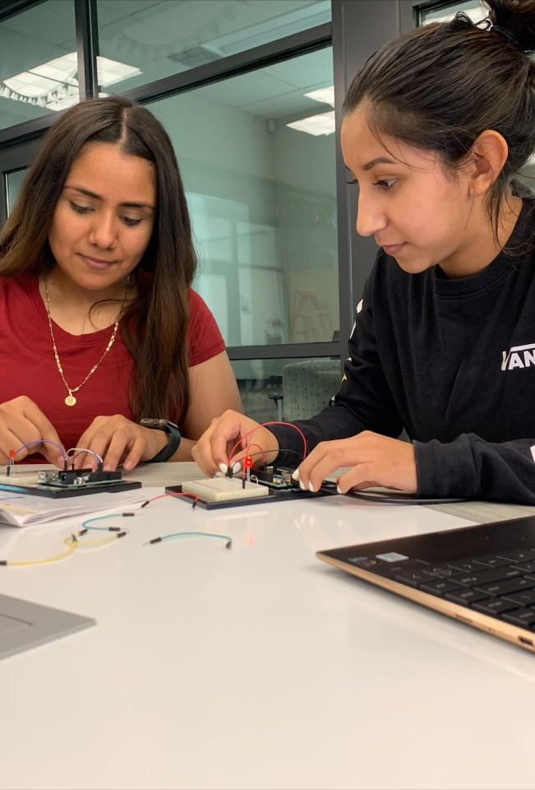
Who are the engineering students at reedley college?

Slide 10
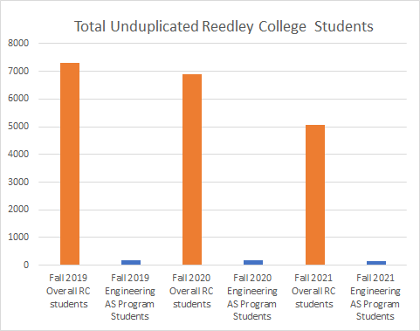
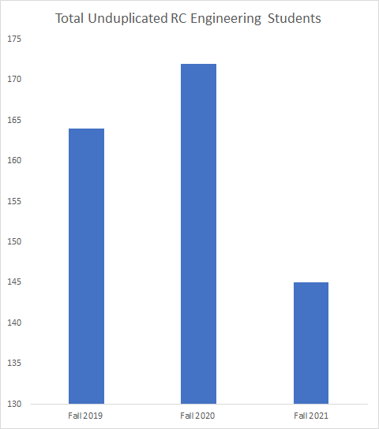

Slide 11
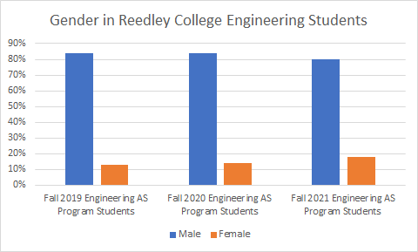

Slide 12
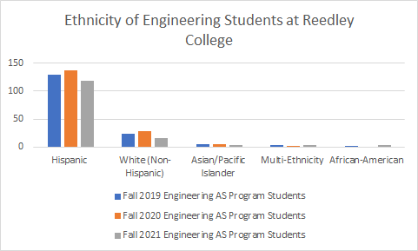

Slide 13
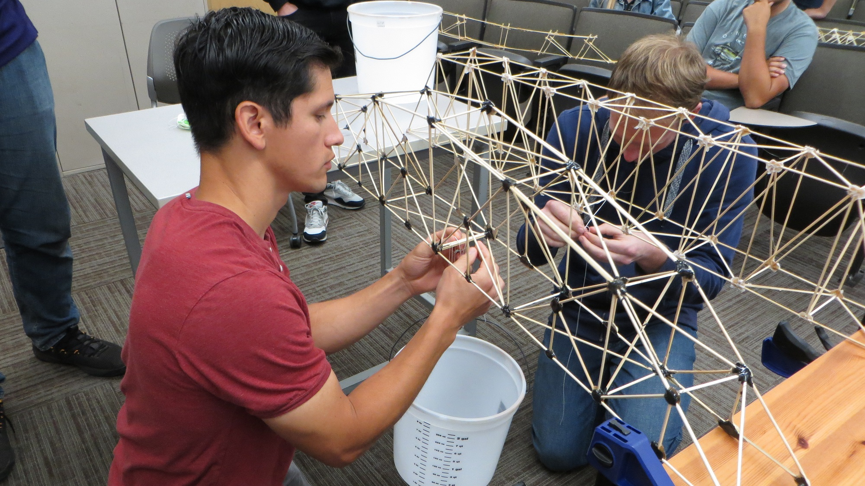
What work has been done on the engineering pathway?

Slide 14
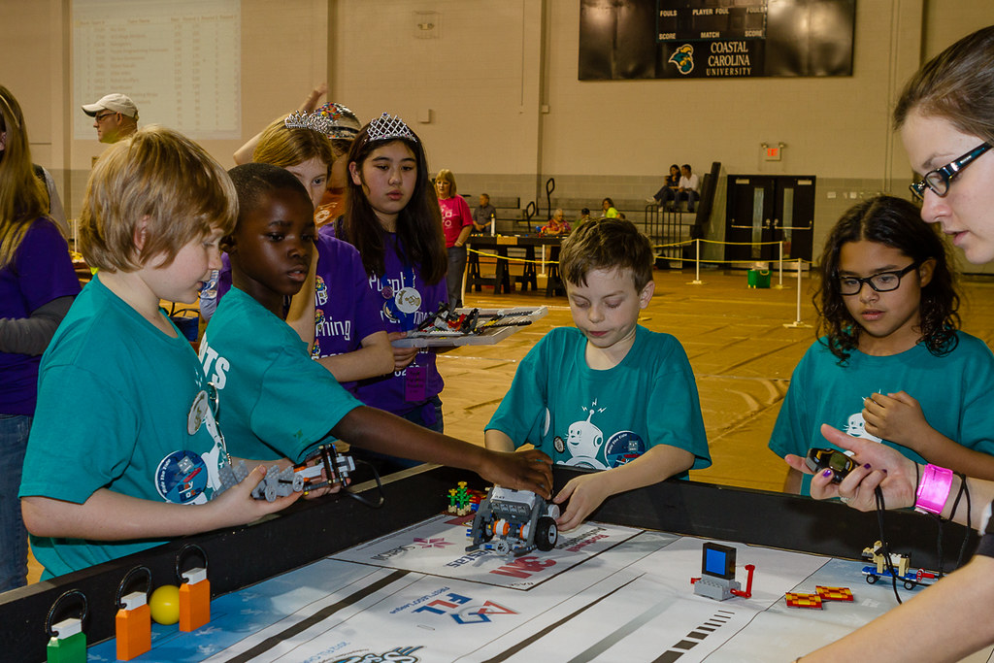
Engineering Pathway
Outreach/Awareness
Master calendar of engagement events
Regional robotics workshops, “Robotics is for Everyone”
Biopic video series “Engineering is for Everyone”
Guided Pathways and Student Support
Hiring of K-16 Retention Counselors
Role alike group convening, including:
Recruitment and Outreach
Math Teachers and Tutors
Counselors/Building a Culture of STEM
Design principals (Jobs for the Future consultants)
Shared dashboard
Engineering student journey map with critical milestones

Slide 15
JFF NORTH STAR STATEMENT FOR INTERSEGMENTAL INTEGRATION
Students in the Fresno region—particularly those from groups underrepresented in engineering fields— have the engagement, role modeling, support systems, financial resources, math instruction, and work-based learning experiences to meet critical milestones from K-12 through bachelor’s degree completion and see that engineering is for people of all backgrounds. ​
This set of co-curricular supports is co-designed by K-12, community college, and university partners, with shared responsibility for key pathway assets, addressing institutional barriers, and increasing student achievement.

Slide 17
Engineering Pathway
Curriculum
Curriculum maps across systems
Dual admissions across systems
Tutoring/Academic Support
Pool of tutors across systems
Training
Homework Help Tutoring
Textbook Lending Library

Slide 18
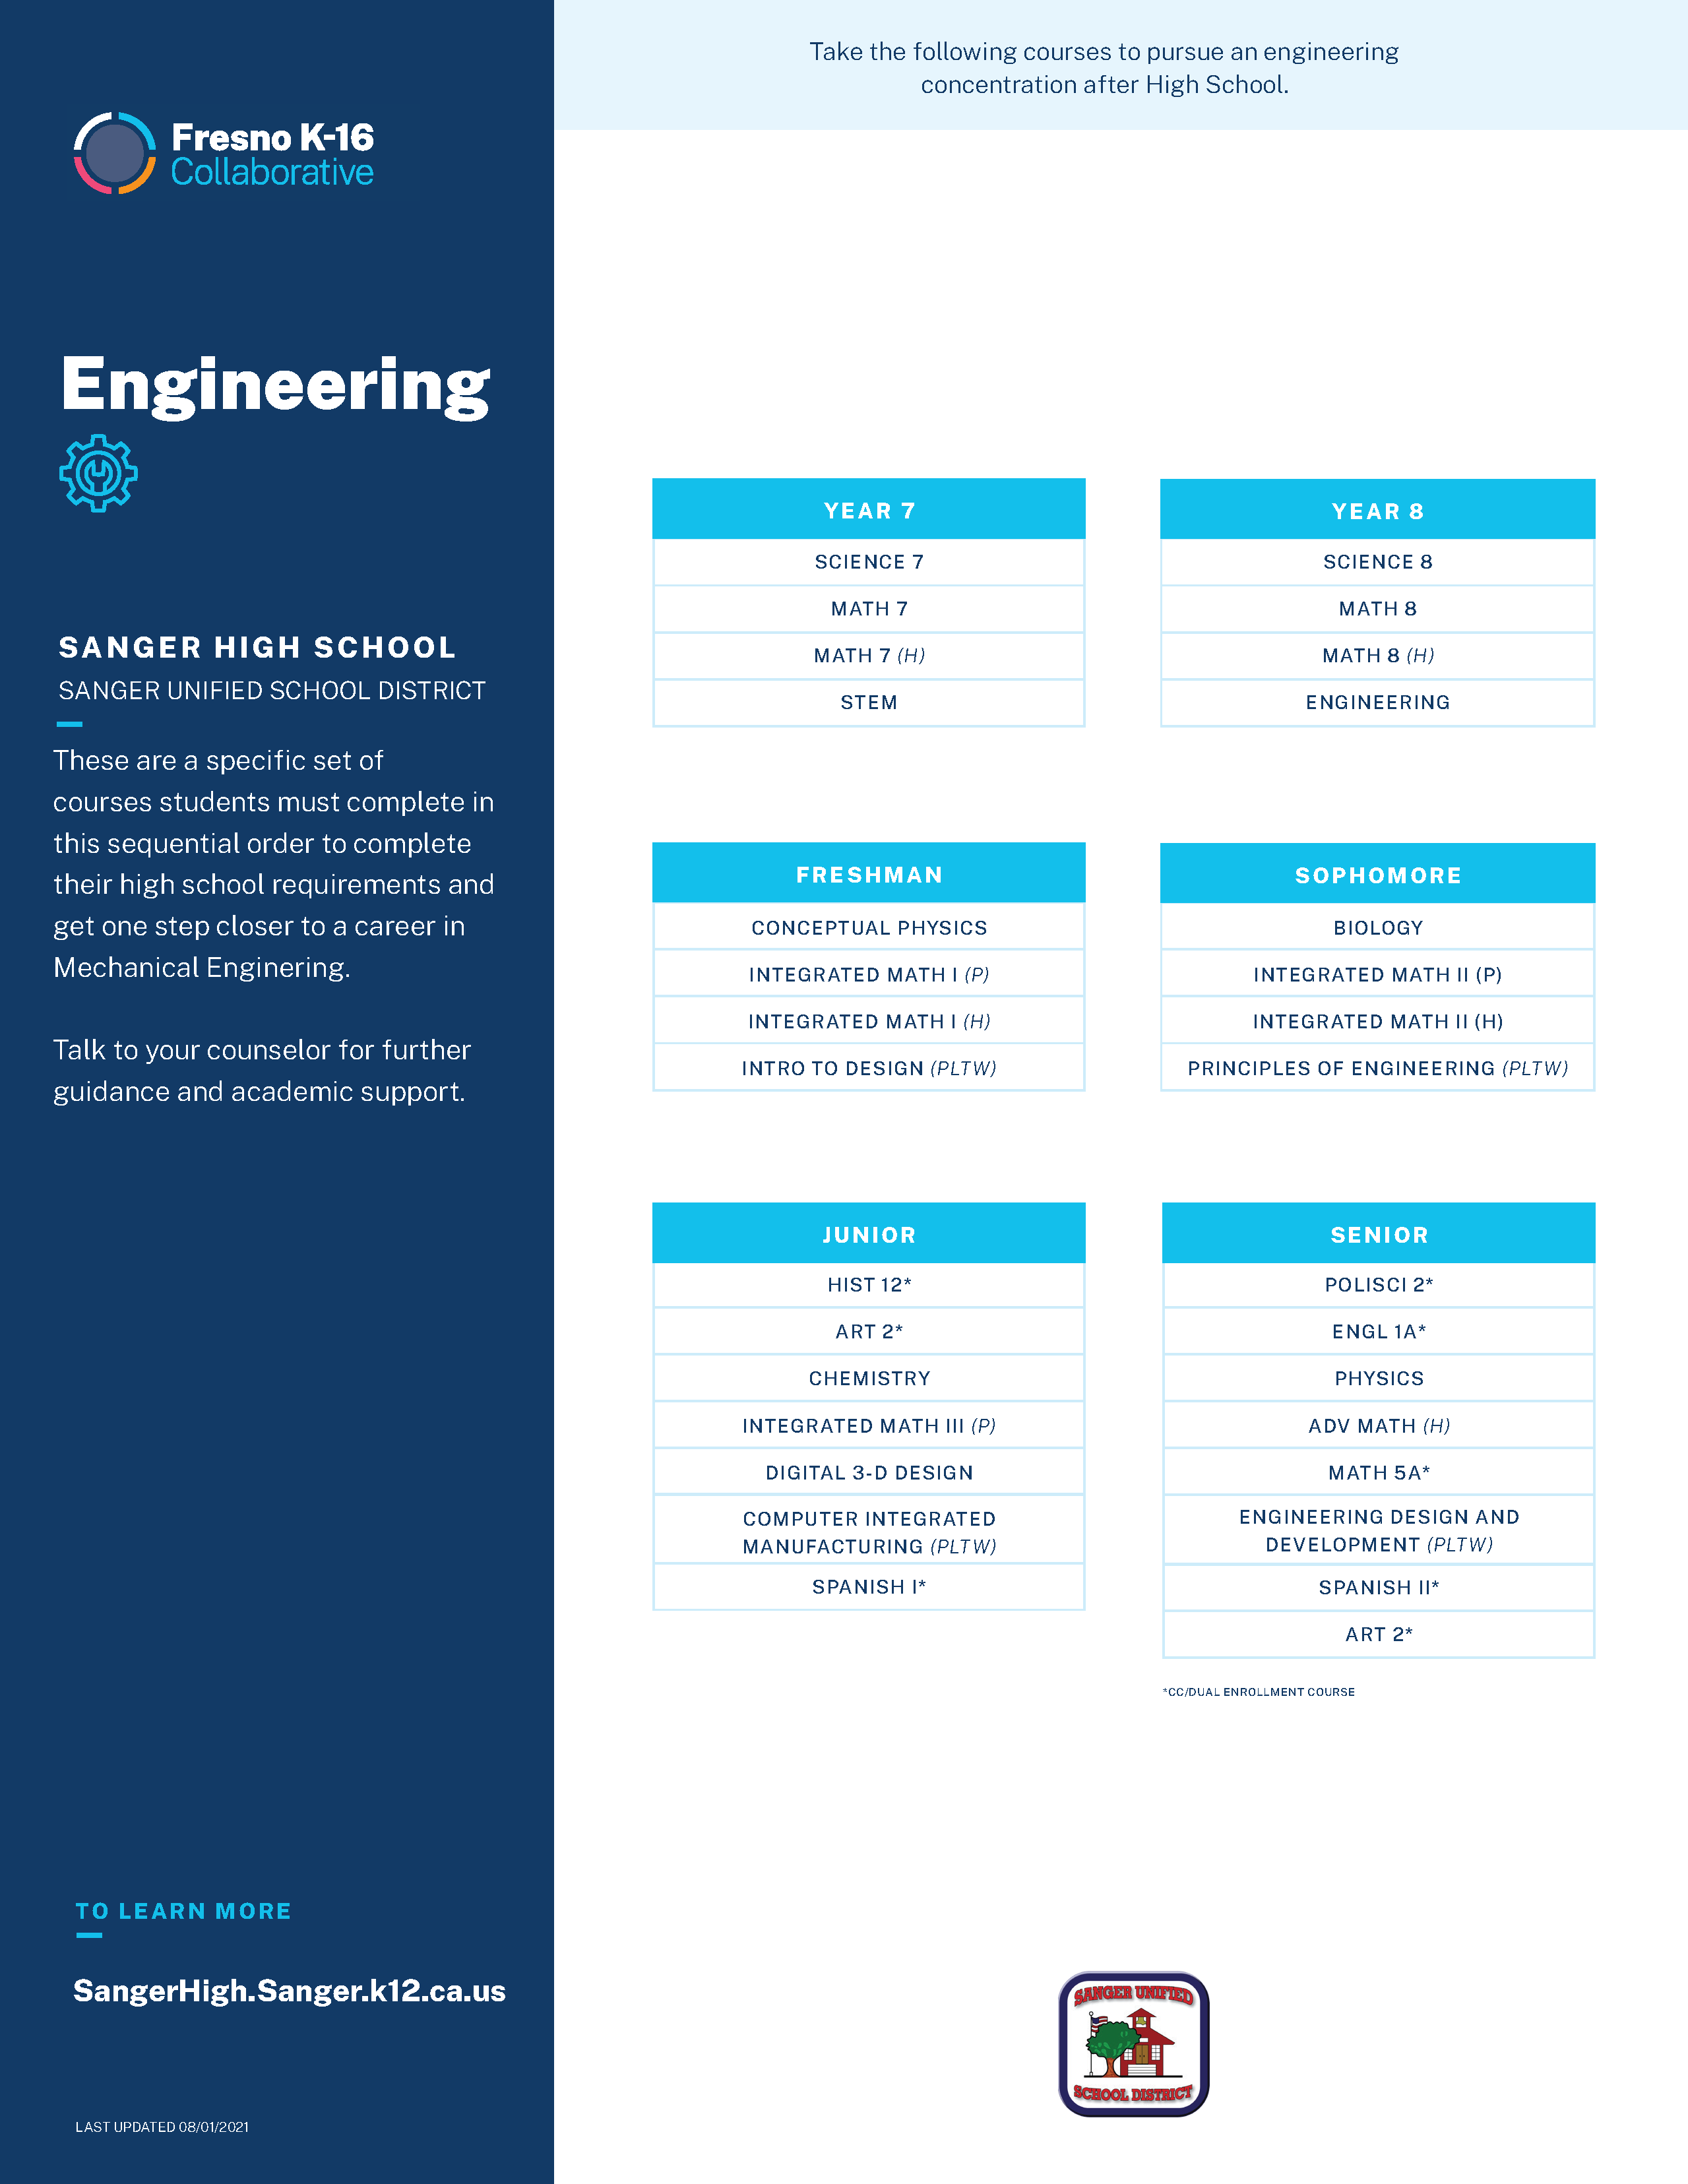

Slide 20
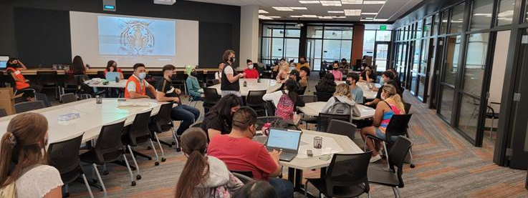
Developing the tutor pipeline

Slide 21
Summer STEm camp: the trial run
July free camp for middle school students, Virtual Arduino and Scratch workshops​
83 applications​
53 accepted; 51 attended with 49 having perfect attendance ​
Students attended from all over Tulare, Kings, Madera, and Fresno counties​
Looking Towards the Fall Tutoring Project:​
Employing student tutors from entire SCCCD (advertising; interviewing)​
Learning student onboarding paperwork, time reporting across colleges
Training tutors (mandated reporting; role of mentoring; skill development)
Leadership development for tutors​
Learning what challenges may arise when working with minors​
Generational impact

Slide 22
FOCUS: CALCULUS READY PROJECT FALL 2021​
IN-PERSON HOMEWORK HELP: ​
Reedley College Math Center ​
Tuesdays & Thursdays ​
3pm-8pm ​
​
VIRTUAL HOMEWORK HELP: ​
Fresno City College Math Center ​
Mondays-Thursdays ​
3pm-9pm
Target for Pilot Project:
High Schools with Engineering Pathways

Slide 23
Next Steps: Short term goals
Identify
Identify existing resources at each district for tutoring (referrals)
Increase
Increase number of participants with existing structure
Develop
Develop a sustainable projection for the number of mentors and tutors required to support the K16 engineering pathway.
Work
Work with partners to standardize tutor training and identify needs that arise for ongoing support

Slide 24
Long term goals of Algegra Readiness
Develop, train and assign a pool of tutors to support students in STEM courses, especially math courses.
Work with California Teaching Fellows to identify and help recruit tutors in their tutoring pool who could teach higher level math at the participating high schools with engineering pathways.
Work with California Teaching Fellows to develop tutor pipeline program and work with the K-16 Collaborative to identify districts interested in piloting such a project.
Assessing sustainable funding opportunities involved with dual enrollment in non-credit tutoring courses for students as young as middle school.

Slide 25
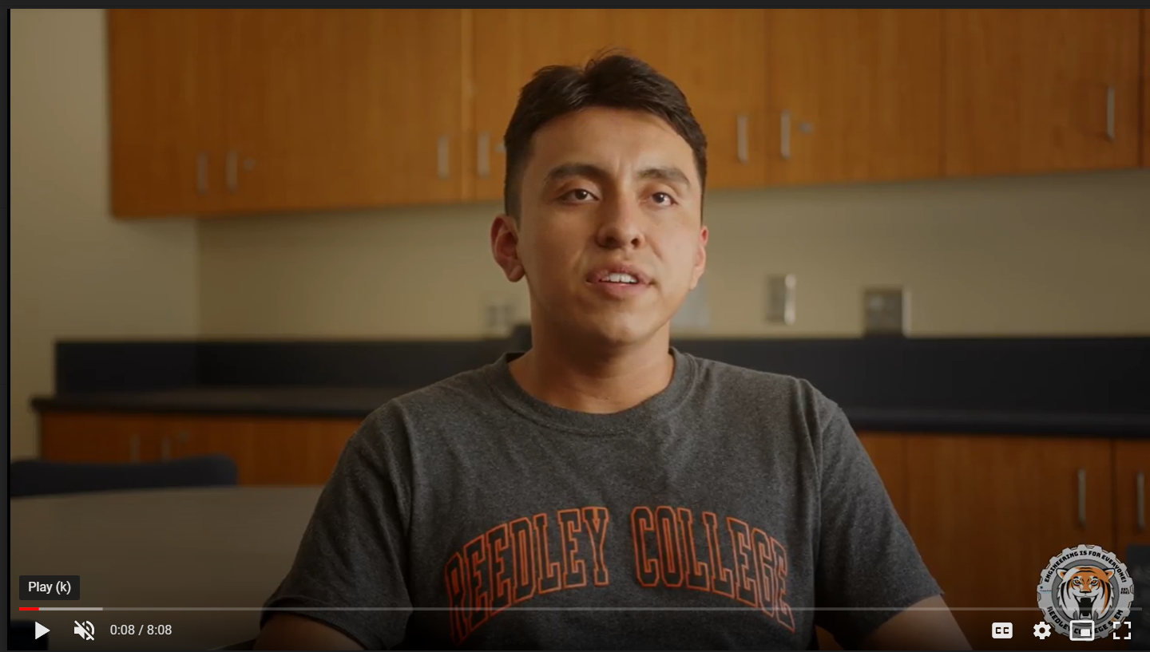
Engineering is for Everyone video series
Two students, both first generation community college:
Computer Engineering
Mechanical Engineering
Two professionals:
Geomatics/surveying/construction engineering
Manufacturing engineer (longboard company)
Themes that have emerged:
Importance of seeking help
Need to persevere through challenges
Need for more knowledge of engineering in high school

Slide 26
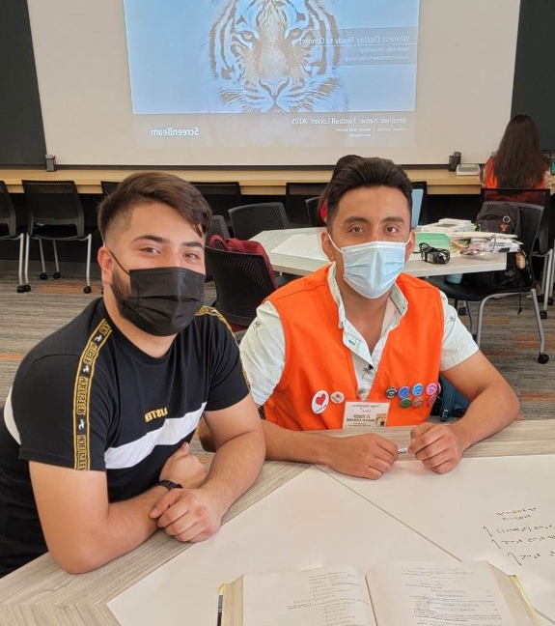
What's next?

Slide 27
Grant duration
Funding request for all Fresno K-16 Collaborative Projects:
July 1, 2020-December 31, 2021
No-cost quarter extension was granted in early August 2021:
March 31, 2022

Slide 28
Chapter SB 129, Section 244, $250m allocation
Encouraged by the governor’s office to reapply with major enhancements for four year funding (June 2022-2026) with significant, demonstrated progress within two years:
Executive steering committee must have 25% local employers
Commit to implement at least four of the following seven recommendations from the Recovery with Equity report to promote student success (progress in two by 2024 for continued funding):
Improve faculty, staff, and administrator diversity.
Cultivate inclusive, engaging, and equity-oriented learning environments.
Retain students through inclusive supports.
Provide high-tech, high-touch advising.
Support college preparation and early credit.
Subsidize Internet access for eligible students. Improve college affordability.
Commit to create occupational pathways, including accelerated degree and/or credential programs (e) that incorporate work-based learning, in at least two of the following sectors, based on regional needs:
Healthcare.
Education.
Business management.
Engineering or Computing.

Slide 29
A Collaborative Effort:
Community College and High School Partners
Improving Student Success
Through Degree Completion in Early College
Marisa Marquez
Director, Counseling and Student Success

Slide 30
How It All Began…
Pathways Conceptual Framework

Slide 31
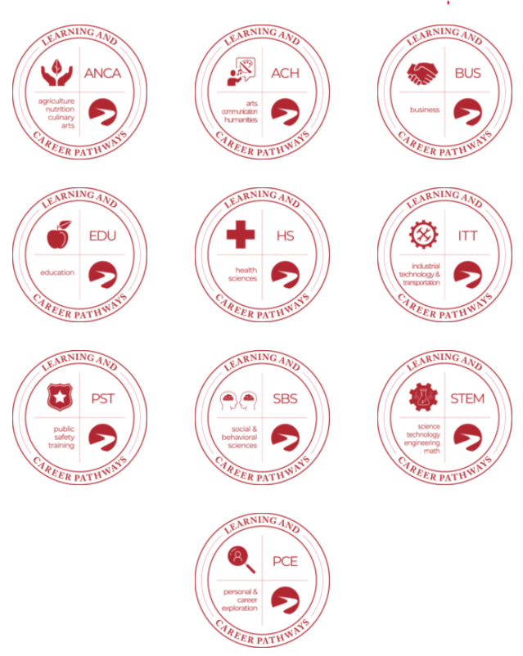
Learning and Career Pathways
BC has grouped degree and certificate programs together in categories to better support students.
Select one of the Learning and Career Pathways to access to resources to stay on track.
Each Pathway has a list of programs, contacts for support and career exploration information.
https://www.bakersfieldcollege.edu/academics/pathways

Slide 32
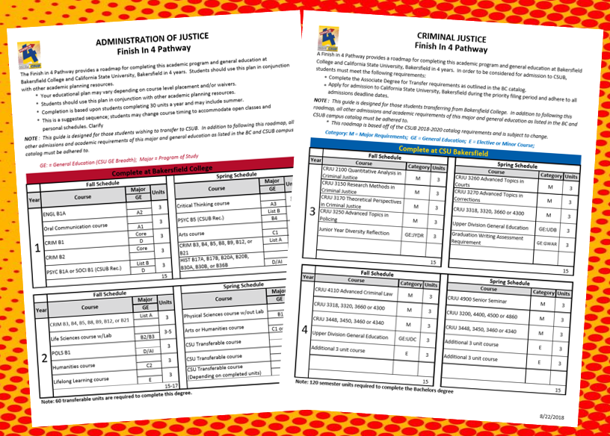
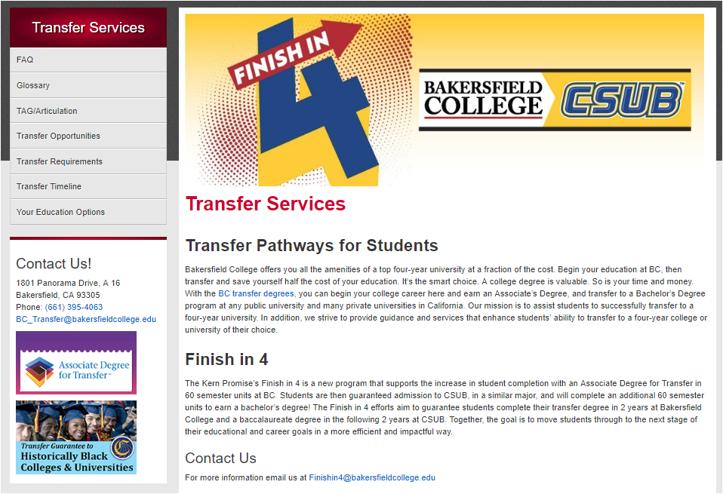
Initiative I:
Bakersfield College and CSU Bakersfield Finish In 4! Program

Slide 33
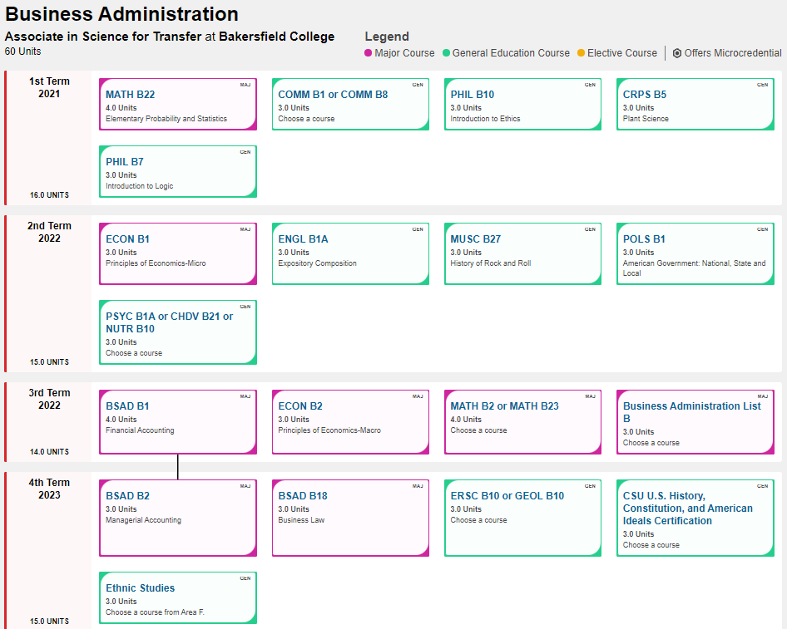
Initiative II:
Bakersfield College Pathways to CSU and UC
https://www.bakersfieldcollege.edu/academics/program-mapper

Slide 34
Initiative III: The Next Generation…
Bakersfield College and Kern High School District
Early College Pathways Program

Slide 35
Initiative III: The Next Generation…
Bakersfield College and Kern High School District
Early College Pathways Program
Summer 2020
Stakeholders: Bakersfield College, Kern High School District, university partners, KHSD students and community
Access:
CTEC
BC Southwest
After school (concurrent enrollment)
BC Degrees:
Administration of Justice, AS-T
Industrial Automation, A.S.
Psychology, AA-T
Public Health Science, AS-T

Slide 36
BC Contributions
High School Contributions
Needs | Funding Source(s) Used
Facility (BCSW) | Measure J Funds
Course materials (textbooks, lab supplies, equipment, etc.) | Sponsor donations through the Bakersfield College Foundation
Staffing (Counseling/advising, instructors, peer mentors) | Student Equity and Achievement Program (SEAP) Funding Strong Workforce Grants
Needs | Funding Source(s) Used
Facility (CTEC) | CTE Facilities Program Grants
Course materials (textbooks, lab supplies, equipment, etc.) | General Funds/LCAP
Transportation | Strong Workforce Grants
Staffing (Enrollment support, student services, supervision, etc.) | General Funds Strong Workforce Grants

Slide 37
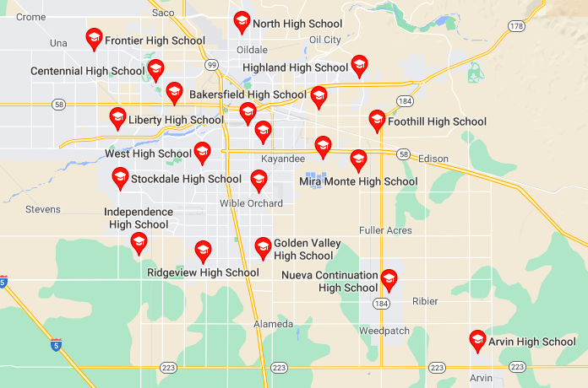
Early College:
Centralized Location Selections
Career & Technical Education Center (CTEC)
KHSD facility
Open for evening programs
State of the art labs and equipment
Transportation provided by KHSD
Bakersfield College, Southwest Campus
College campus
Open for evening classes
Located next to California State University (CSU) Bakersfield
*Outlying schools (Shafter & Arvin) have their own Early College programs

Slide 38
Selecting Pathways with a Purpose
Industrial Automation AS Industry need: energy, agriculture, distribution, etc. Student interests (robotics & engineering) Continue at Bakersfield College for Bachelor’s Degree | Public Health AS-T Industry need: Public Health Department, hospitals, education, etc. COVID response CSU Bakersfield similar Bachelor’s Degree
Psychology AA-T Industry need: Counselors (school, private, hospitals, etc.) Mental health response CSU Bakersfield similar Bachelor’s Degree | Administration of Justice AS-T Industry need: Police, prison system, law, etc. Transformational policing CSU Bakersfield similar Bachelor’s Degree

Slide 39
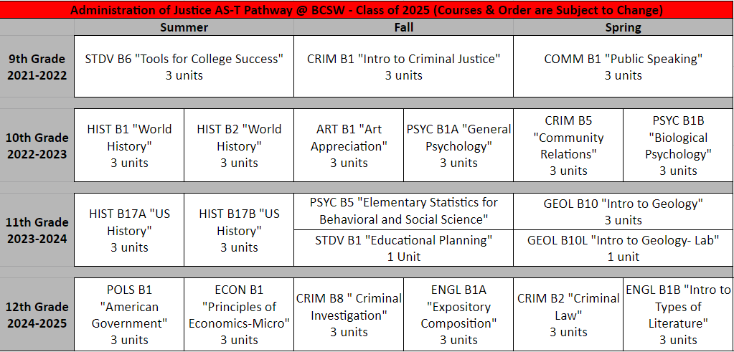

Slide 40
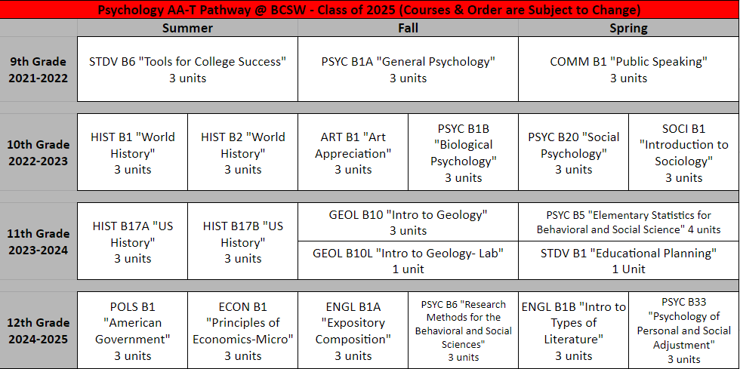

Slide 41
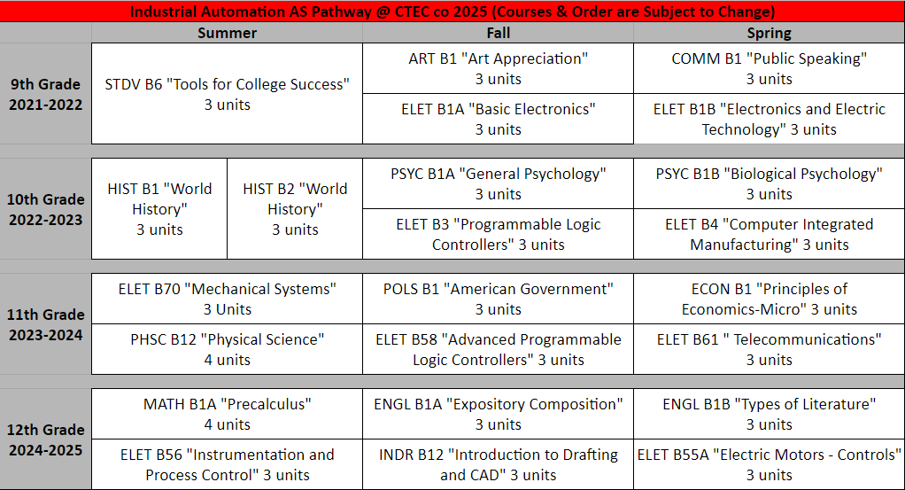

Slide 42
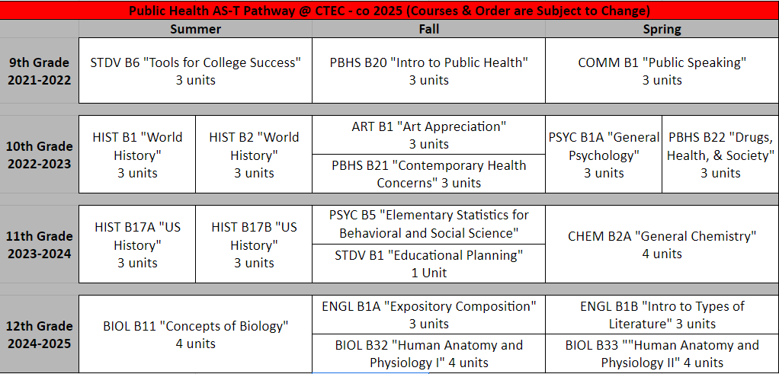

Slide 43
Year 1 Enrollment:
2020-2021
850 student applicants, 368 selected
Four 9th grade cohort groups
Four 10^{th -} 12th grade cohort groups
Fall 2020- Each student took one 12-week long course
Spring 2021- Each student took two 8-week long courses

Slide 44
Year 1 Student Success Rates (Course grades of 70% or higher)
Course Grades of
70% and Above
Program Retention (Enrolled at start/end of term)

Slide 45
Year 2 Enrollment:
2021-2022-In Progress
268 new student applicants, 206 selected
202 returning students (1st Year)
Five 9th grade cohort groups
Five 10th-12th grade cohort groups
New Students- Each student to take 1 course in Summer and Fall
Returning Students- Each student to take 2 courses in Summer and Fall

Slide 46
Year 2 Student Success Rates-In Progress (Course grades of 70% or higher)

Slide 47
What Have We Learned? What Is Next?
It is our collective responsibility as educators to provide opportunities for higher education attainment for all students, despite their educational level.
Collaborating with High School partners is essential to college degree completion in high school as it is transformational for all involved: students, parents and educators.
Optimizes a student’s educational experiences to achieve their dreams, goals, and potentials.
Building degree pathways and making them accessible to the public works, as it simplifies the process from beginning to end.
Academic support services should be specialized for high school cohort groups.
College Probation Program must be expanded to include high school cohort groups.
High School Counselor involvement and advocacy is critical to Program and student success, therefore information must be shared on a consistent basis.
Counseling course moving to zero cost textbooks.

Slide 48
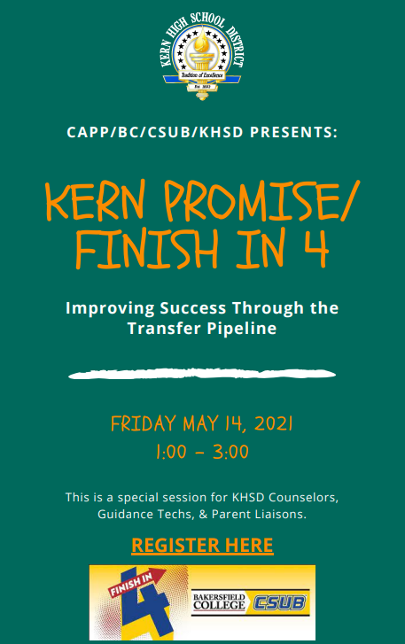
What Have We Gained?
A New Partnership!
Development of Kern High School District, Bakersfield College, and CSU Bakersfield Collaborative
BC degree completion training for High School Counselors
(high school vs community college)
Community College to CSU transfer training for High School Counselors

Slide 49
Thank you!
Marisa Marquez
Bakersfield College
marimarq@bakersfieldcollege.edu

