Slide 1
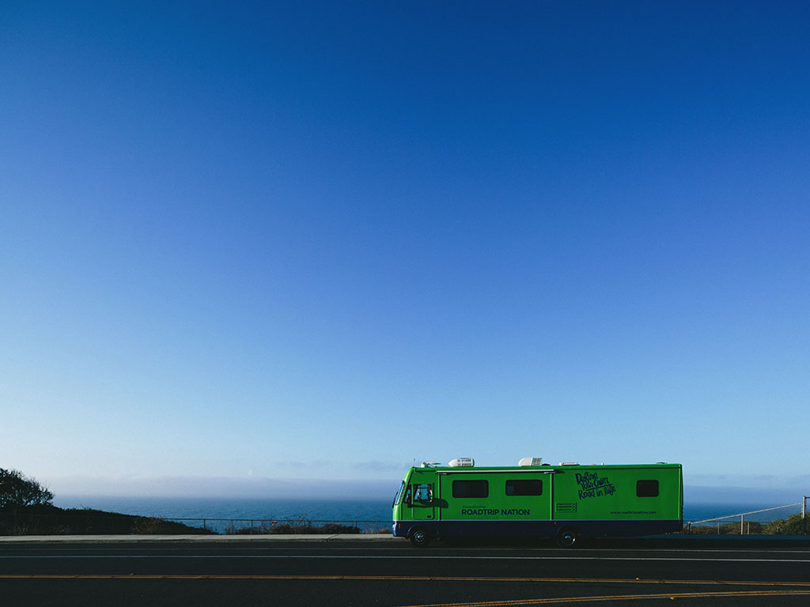

Slide 2
Roadtrip Nation
We create experiences that help people connect interests to careers.

Slide 3
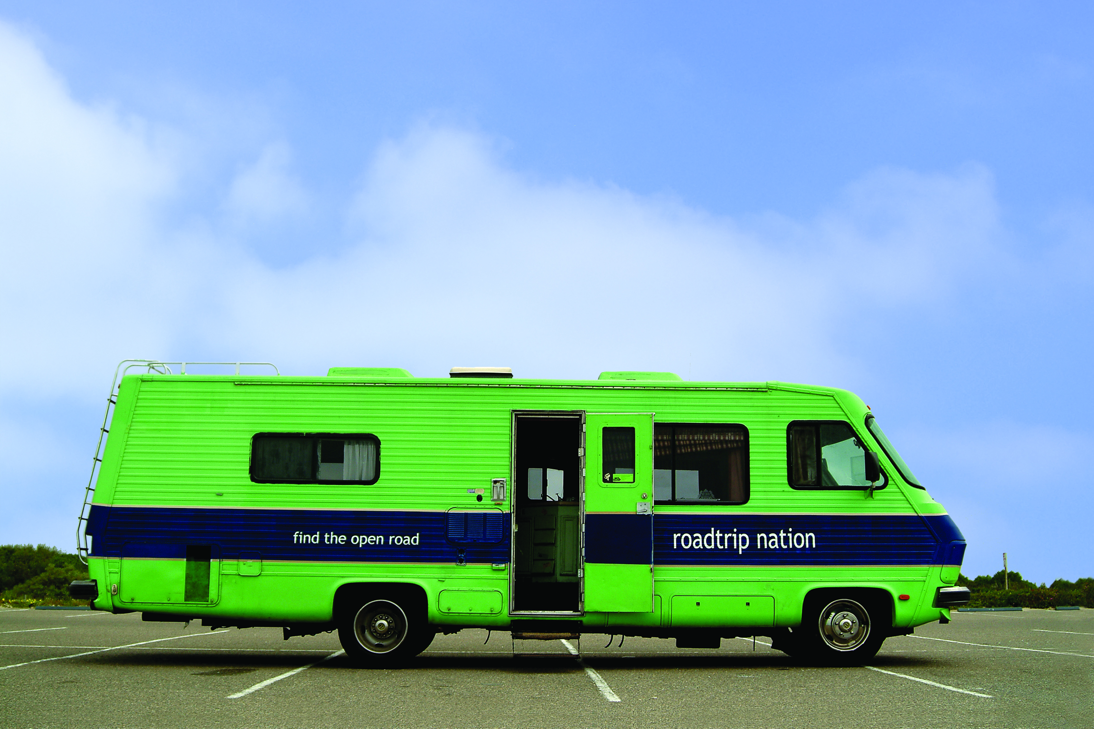
Roadtrip
Nation
Life & Career Exploration
15 Years
History

Slide 4
Roadtrip
Nation
Road Trips
PBS Series
Curriculum for MS, HS, Post-Secondary

Slide 5
Roadtrip
Nation
I have no idea what to do with my life.
I know exactly where I want to be, but I don’t know how to get there.

Slide 6
Roadtrip Nation
Let Go
What’s “the noise”?
How does the noise impede student success?
How do we, as educators contribute to the noise?
How can we help students shed the noise?

Slide 7
Roadtrip Nation
Define
There is rarely one way to get to a desired destination.

Slide 8
Roadtrip Nation
Become
No one expects that you’ll know everything about the rest of your life.
Start failing.

Slide 9
Romel Antoine
Education Partnerships Director
romel@roadtripnation.org
408-771-7776

