Slide 1
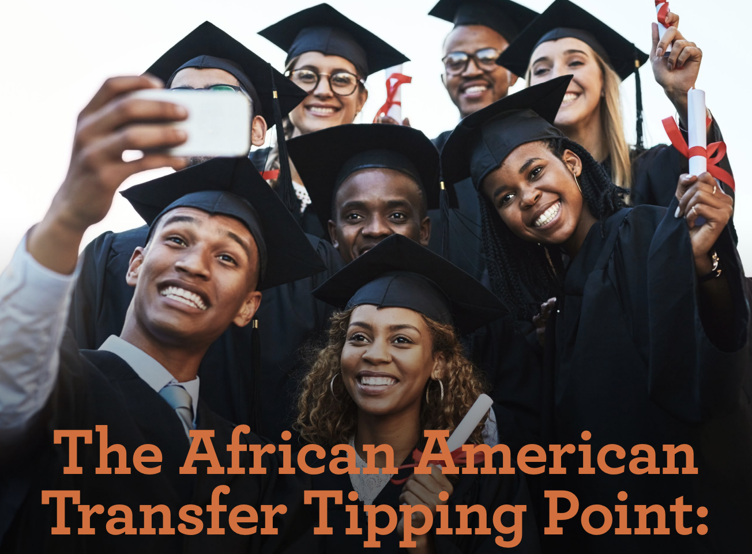
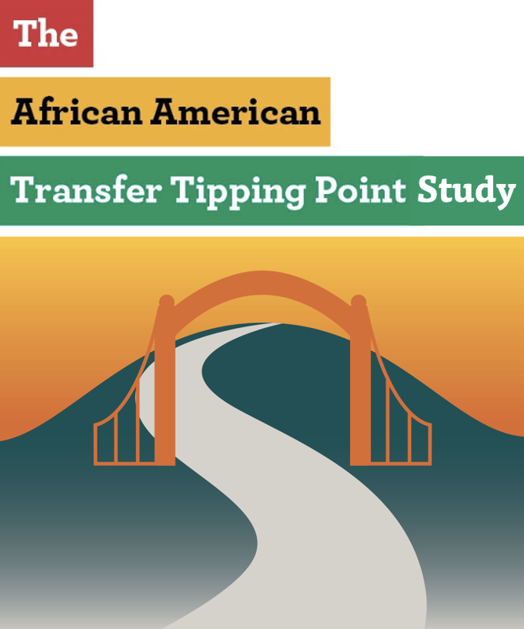
The African American Transfer Tipping Point
Dr. Darla M. Cooper
Executive Director
The RP Group

Slide 2
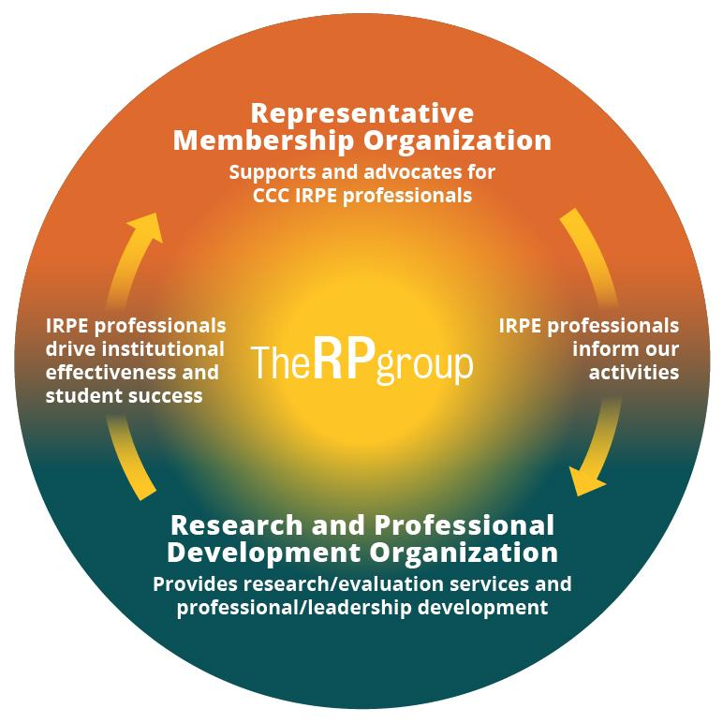
About The RP Group
Mission: As the representative organization for Institutional Research, Planning, and Effectiveness (IRPE) professionals in the California Community Colleges (CCC) system, The RP Group strengthens the ability of CCC to discover and undertake high-quality research, planning, and assessments that improve evidence-based decision-making, institutional effectiveness, and success for all students.
Services: Research, evaluation, planning, professional development, and technical assistance—designed and conducted by CCC practitioners
Organization: 501(c)3 with roots as membership organization

Slide 3
Guiding
Questions
What factors (both academic and non-academic) contribute to students' likelihood of reaching the tipping point?
Which programs and practices are associated with greater persistence to and through the tipping point, and ultimately, the transfer gate?

Slide 4
Methods
Phase 1: Exploring student course-taking patterns
Phase 2: Interviews and focus groups with college practitioners and transfer-motivated students at colleges having higher success with transfer among African American students
Phase 3: A survey of African American/Black students across the CCC

Slide 5
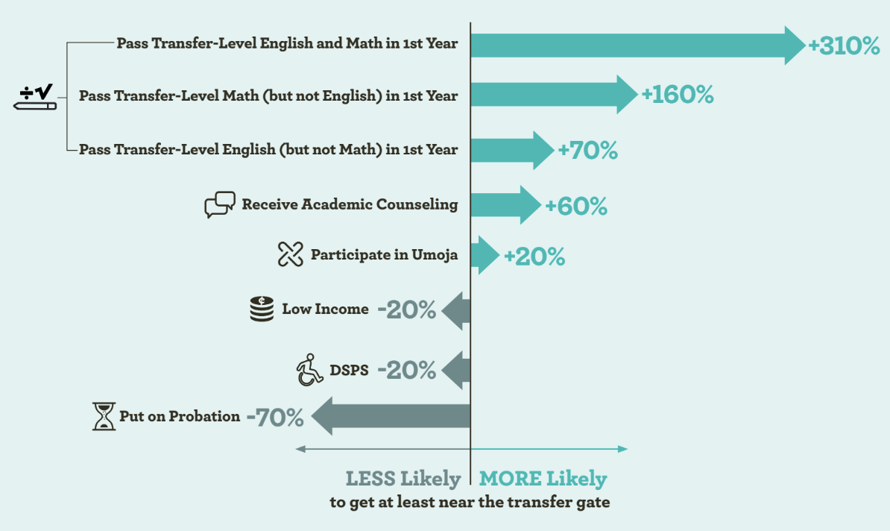
Phase 1 Results
Notes:
Katie

Slide 6
Phase 1 Results (continued)
41% of African American/Black students are put on probation vs 29% of non-African American/Black students

Slide 7
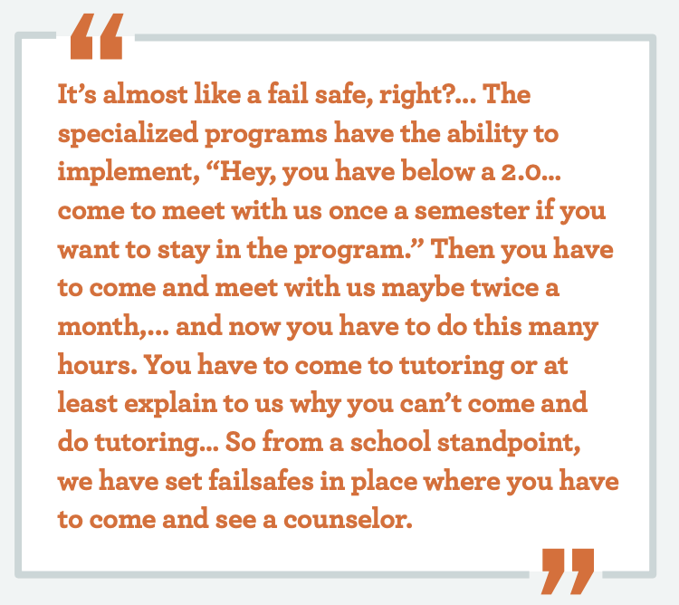
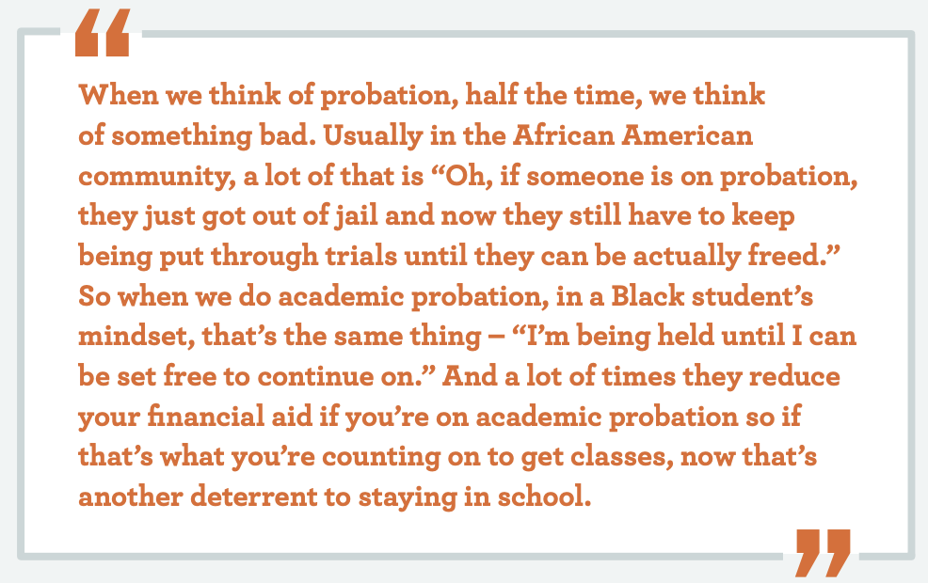
Phase 2: In Their Words….
Administrators say…
Students say…
vs.

Slide 8
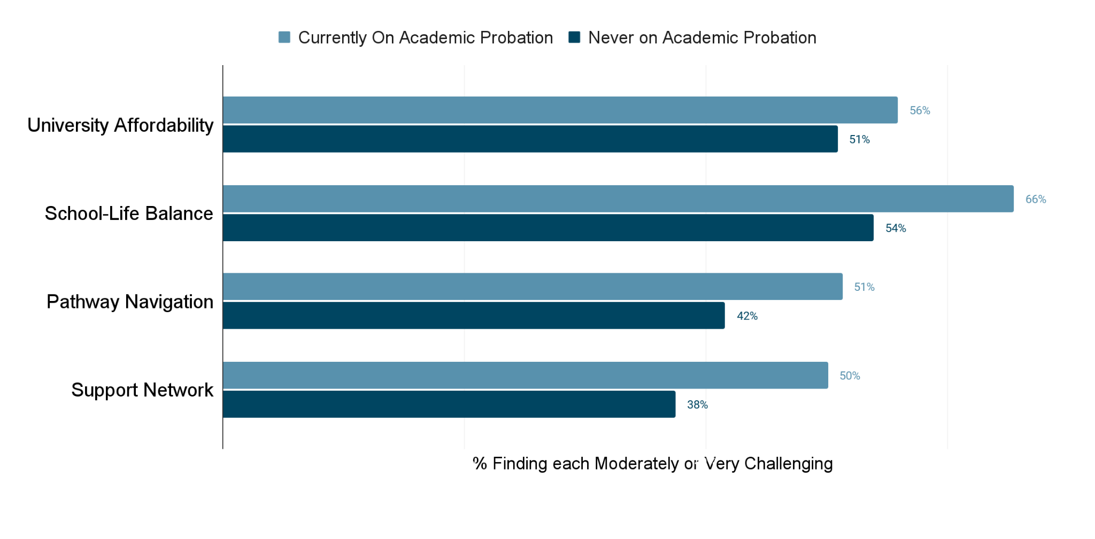
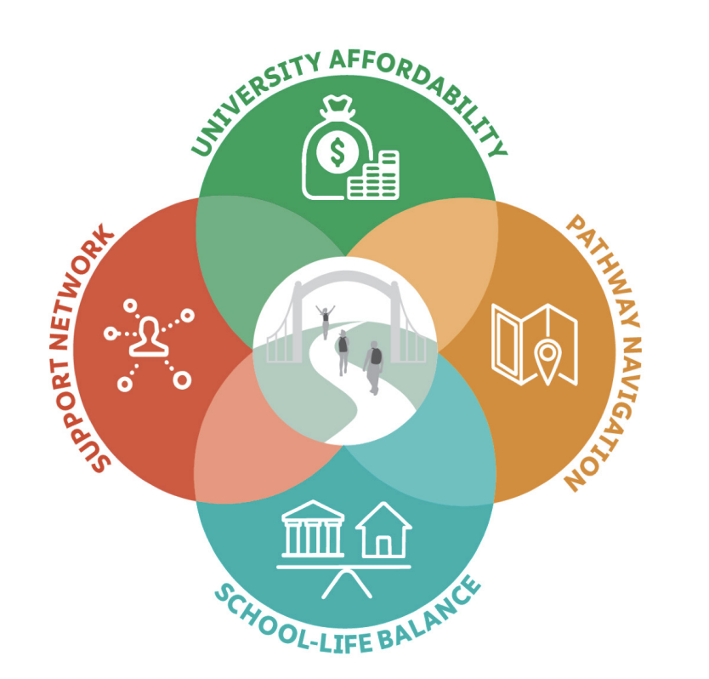
Phase 3: Statewide Survey
Students who were currently on probation were much more likely than students never on probation to report the challenges of University Affordability, School-life Balance, Pathway Navigation, and finding a Support Network

Slide 9
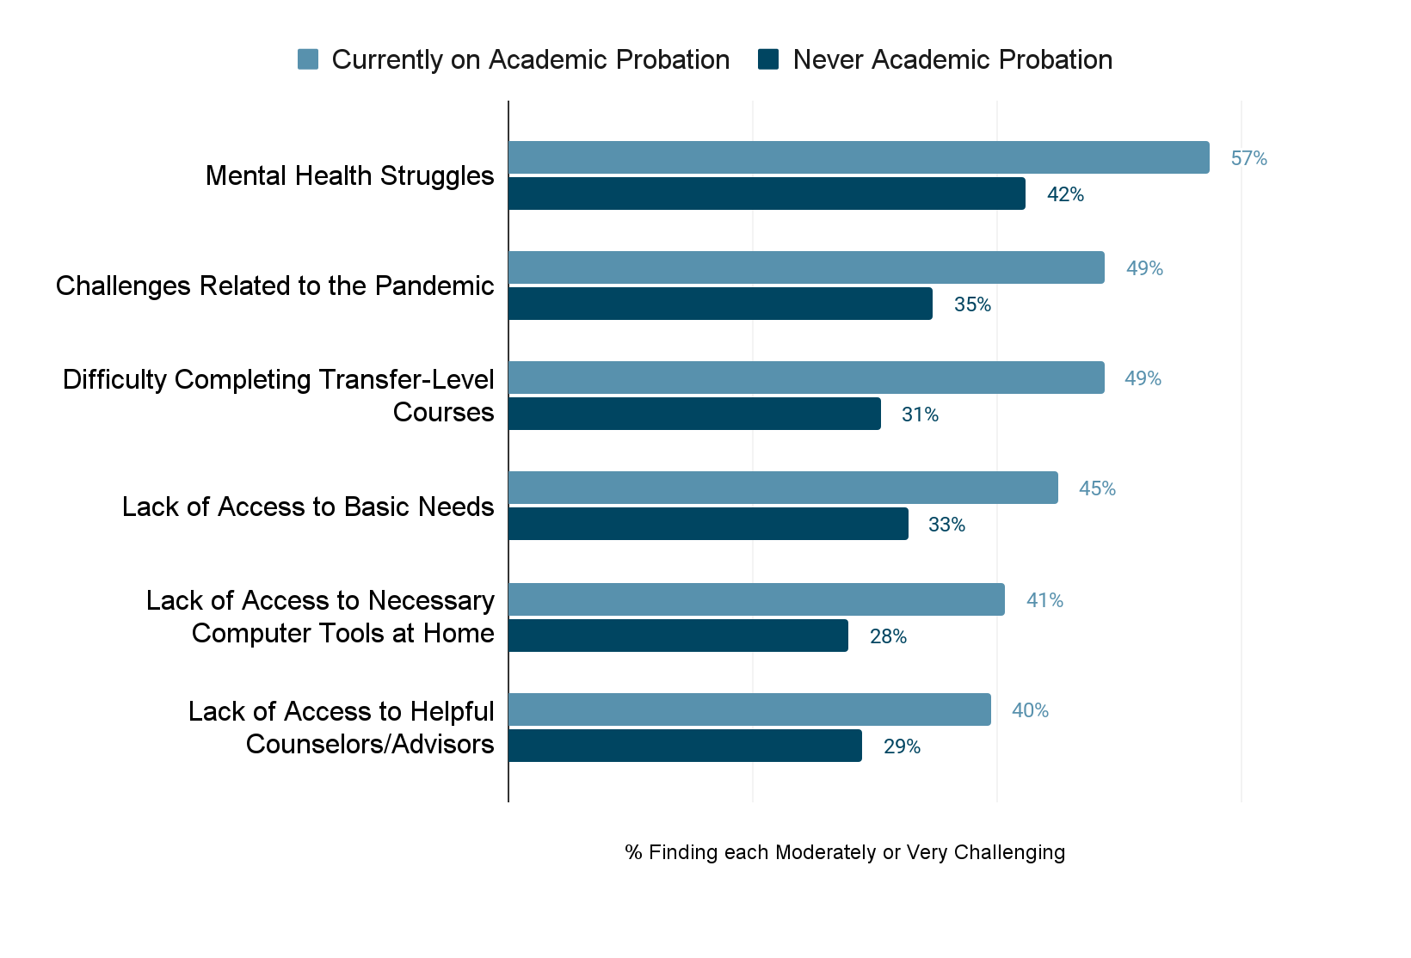
Phase 3: Statewide Survey (continued)
Students who were currently on probation were much more likely than students never on probation to report the challenges of University Affordability, School-life Balance, Pathway Navigation, and finding a Support Network.

Slide 10
Local Research Options
What you can do to learn more about your students

Slide 11
Overview
Research is needed to learn more about the students who have been placed on academic probation and their experiences
Intention is to use data to inform efforts to better support these students
Recommend a mixed methods approach where you pair qualitative and quantitative data to tell the story of the students and identify what more colleges can do

Slide 12
Academic Standing Categories (MIS SB22)
Good Standing
Progress Probation (percent of withdrawals/incompletes, usually more than 50%)
Academic Probation (low grade point average, usually below 2.0)
Both Progress and Academic Probation
Progress Dismissal / Disqualification
Academic Dismissal / Disqualification
Progress and Academic Dismissal / Disqualification

Slide 13
Quantitative Data
For each primary term over the past 3-5 years, identify the cohort of students who are being placed on probation for the first time, and then track them forward and look for differences among cohorts over time.

Slide 14
Quantitative Data 2
Initial Term
How many are in the cohort?
What was their average term GPA?
What was their cumulative GPA before being placed on probation?
How many were in their first semester at the college?
What was their average number of terms at the college before being placed on probation (e.g., second semester, fourth quarter)?
What was the average number of units they attempted in the term?
What was the average number of units they had earned at the college before being placed on probation?
How many and what percentage were enrolled in math? English?
What is the average number of math attempts?
Did any of these students take dual enrollment at your college while in high school?

Slide 15
Quantitative Data 3
Progress
How many and what percentage enrolled in the next primary term?
Of those who enrolled:
How many and what percentage returned to good standing after one term?
How many and what percentage improved their GPA and/or did not receive any Ws in the term, but are still on probation?
Did they enroll in the next term?
What were their results (i.e., returned to good standing, continued on probation, dismissed/disqualified)?
How many and what percentage were dismissed/disqualified?
Of those who did not enroll in the next primary term:
How does their average GPA compare to that of those who did return? How do they compare in other ways?
How many and what percentage returned within one academic year?
What were their results (i.e., returned to good standing, continued on probation, dismissed/disqualified)?
How many and what percentage returned after one year?

Slide 16
Quantitative Data 4
Disaggregation
For all of the previous questions:
Look at progress probation and academic probation separately
Examine the following characteristics and look for differences among groups:
Race/ethnicity
Gender
Age
Financial aid
EOPS
DSPS
First generation
Major
Education goal
For all of the above characteristics and any others you identify, identify which groups are more/less likely to be on probation, continue on probation, get dismissed/disqualified, and return to good standing

Slide 17
Qualitative Data
Through surveys and/or focus groups, ask students about their experiences before getting on probation, while on probation, after being dismissed/disqualified, and after returning to good standing.
Ask questions based on where students are in the probation cycle.

Slide 18
Qualitative Data First term on probation Returning students
Returning students (those who enrolled in the next primary term)
How did you find out that you had been placed on probation?
What did you know about probation before being placed on it?
What led to them getting on probation?
What support do they think will help them return to good standing?
What will they be doing differently this term to help them return to good standing?
Looking back, what could have helped you avoid probation?
What do you think colleges can/should do to help students avoid probation?

Slide 19
Qualitative Data
First term on probation
Stopped out students
Stopped out students (those who did not enroll in the next primary term)
How did you find out that you had been placed on probation?
What did you know about probation before being placed on it?
What led to them getting on probation?
Why have they decided not to enroll this term?
Are they planning to return to the college?
What needs to happen for them to return to college?
What support do they think will help them return to good standing?
Looking back, what could have helped you avoid probation?
What do you think colleges can/should do to help students avoid probation?

Slide 20
Qualitative Data
Continuing on probation
What led to them getting on probation?
What support do they think will help them return to good standing?
What changes have they made to help them return to good standing?
How is the current semester going?
What has been helping them in their efforts to return to good standing?
Looking back, what could have helped you avoid probation?
What do you think colleges can/should do to help students avoid probation?

Slide 21
Qualitative Data
Returned to good standing
What led to them getting on probation?
How did they return to good standing?
What support did they receive? From whom? How helpful was this support and how?
What did they do differently?
What advice do they have for other students on probation?
What do they know now that they wish they had known before getting on probation?
Looking back, what could have helped you avoid probation?
What do you think colleges can/should do to help students avoid probation?
What do you think will be most important to you not returning to probation?

Slide 22
Qualitative Data
Dismissed/ Disqualified
What led to them getting on probation?
What led to them getting dismissed/disqualified?
What support did they receive that was designed to help them return to good standing?
What support did they not receive that would have been helpful?
What could the college have done to better support your return to good standing?
Do they know the steps to get readmitted to the college?
Are they planning to apply for readmission to the college?
What support do they need to get themselves ready to be readmitted to the college?
Looking back, what could have helped you avoid probation?
What do you think colleges can/should do to help students avoid probation?

Slide 23
Qualitative Data Dismissed/ Disqualified 2
What led to them getting on probation?
What led to them getting dismissed/disqualified?
What support did they receive that was designed to help them return to good standing?
What support did they not receive that would have been helpful?
What could the college have done to better support your return to good standing?
Do they know the steps to get readmitted to the college?
Are they planning to apply for readmission to the college?
What support do they need to get themselves ready to be readmitted to the college?
Looking back, what could have helped you avoid probation?
What do you think colleges can/should do to help students avoid probation?

Slide 24
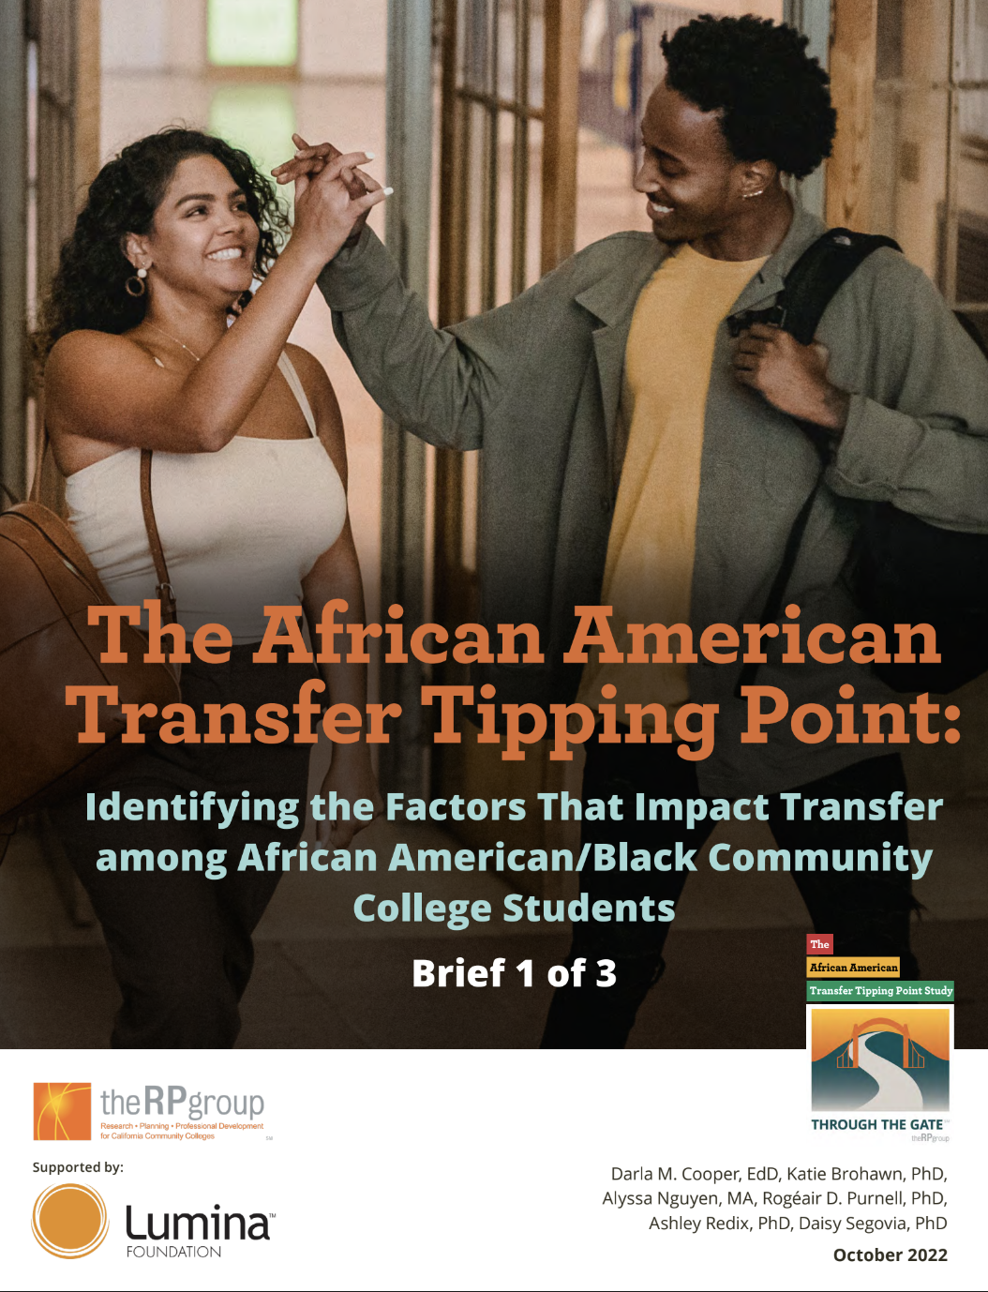
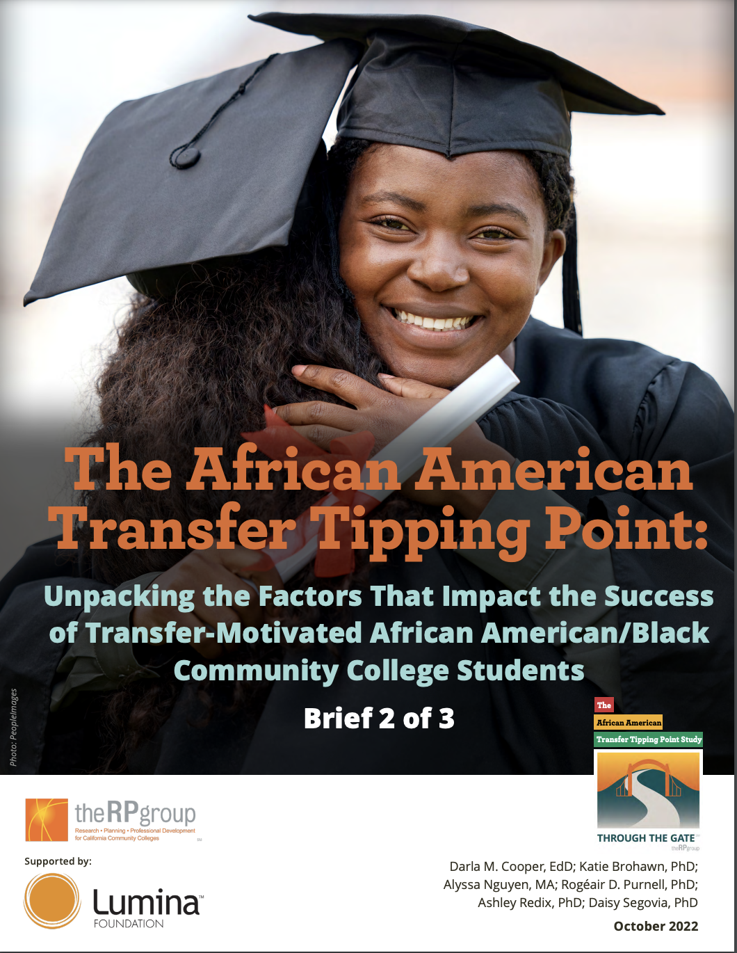
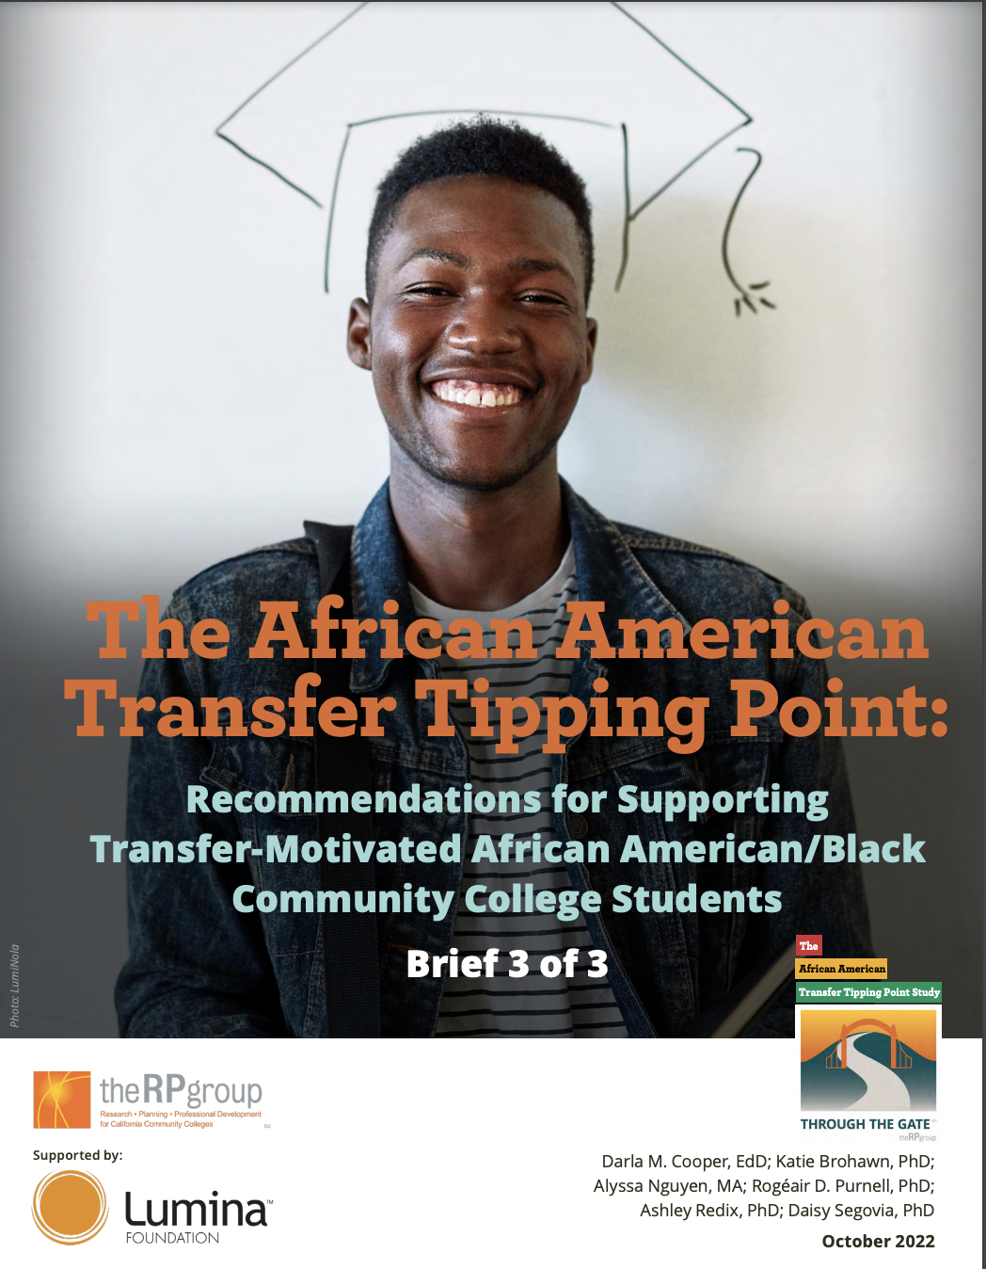
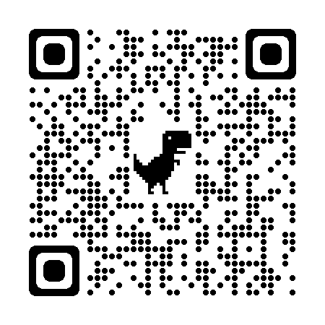
Learn More Here
Click on the QR Code to access the project webpage.
Click on Resources tab to access briefs.

Slide 25
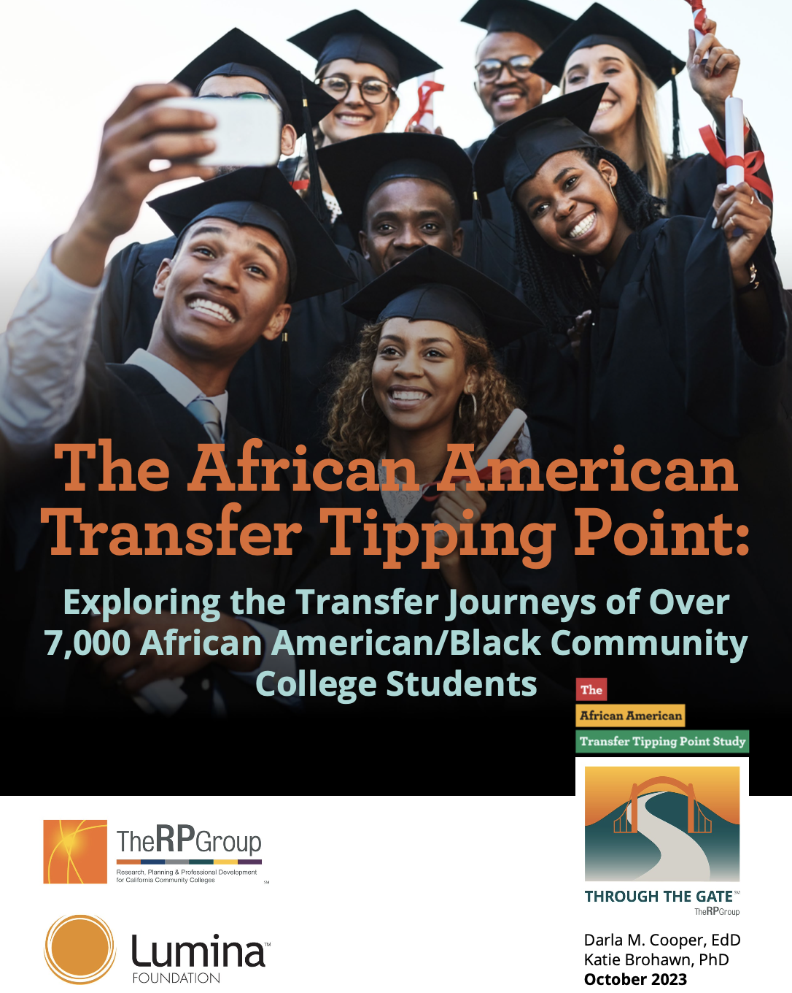
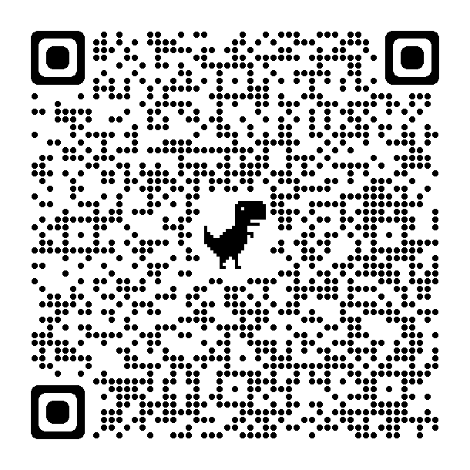
New
Report!
Notes:
https://rpgroup.org/Portals/0/Documents/Projects/African_American_Transfer_Tipping_Point-(AATTP)-Study/AATTP_ExploringTransferJourneys_October2023.pdf?ver=2023-10-28-111932-313

Slide 26
Interested in conducting this research but need some support?
Contact us!
research@rpgroup.org

