Slide 1
Wayfinding: Empowering Students toward their Educational Goals
Academic Academy
September 15, 2018
11:00-12:15 Breakout
Janet Fulks
ASCCC Guided Pathways Faculty Lead, Capacity Building
Carrie Roberson
ASCCC Guided Pathways Task Force, Chair

Slide 2
Typical pathway… to the first day of entering college!
Notes:
Janet

Slide 3
Wayfinding
Traveling to a new destination is always better with a knowledgeable guide, whether that is a real person or a trusty GPS. What wayfinding tools do students need as they travel their educational pathways? This breakout will describe various strategies colleges have implemented to help students accomplish their educational goals.
Notes:
Carrie

Slide 4
Notes:
Janet

Slide 5
Notes:
Carrie

Slide 6
Wayfinding
How have we helped students find their way through our colleges in the past?
Catalog
Counseling
Orientation
Signage
Other?
Notes:
Carrie

Slide 7
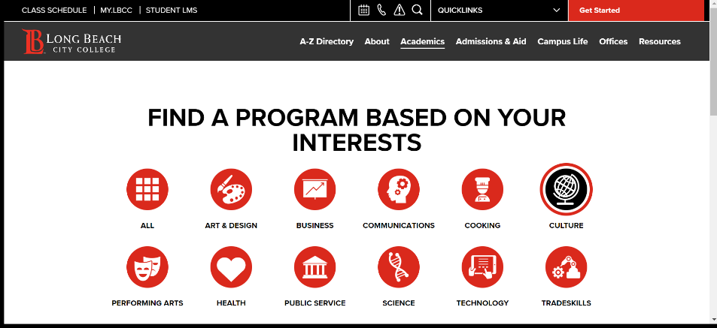
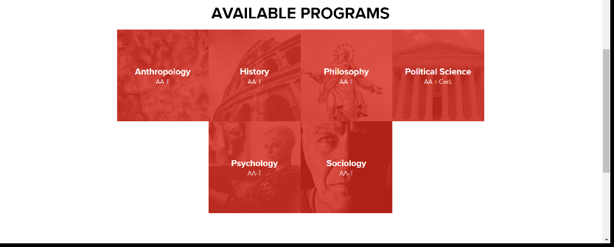
Notes:
Janet

Slide 8
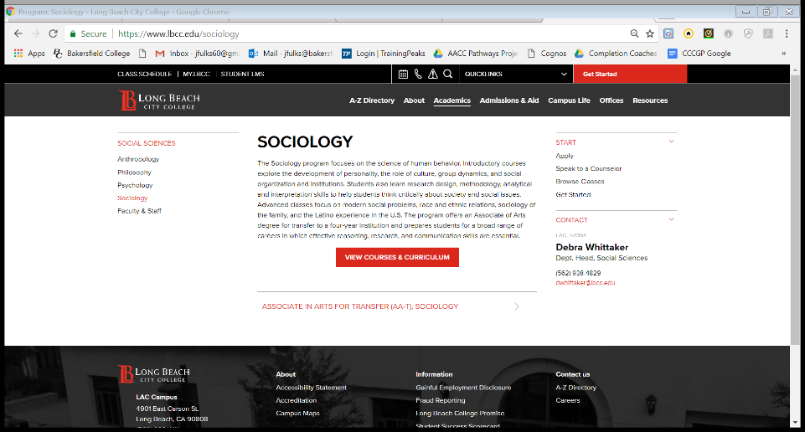
Notes:
Janet

Slide 9
CLARIFY the Path
Simplify choices to show students a clear pathway to completion, further education, and/or employment –
What have your colleges done to create clear pathways?
Notes:
Carrie

Slide 10
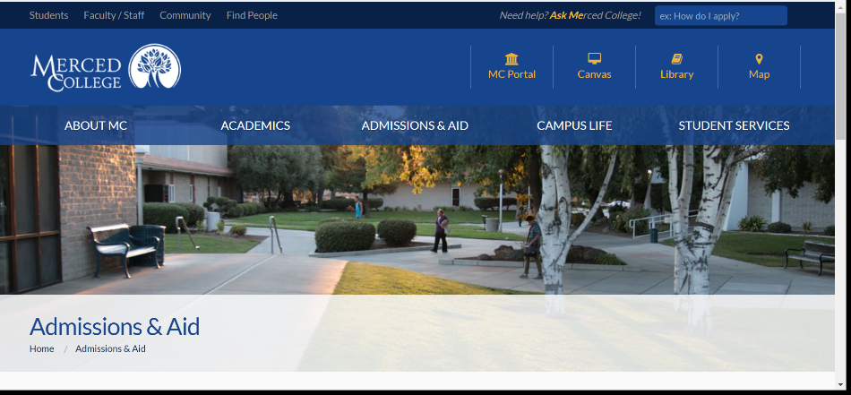
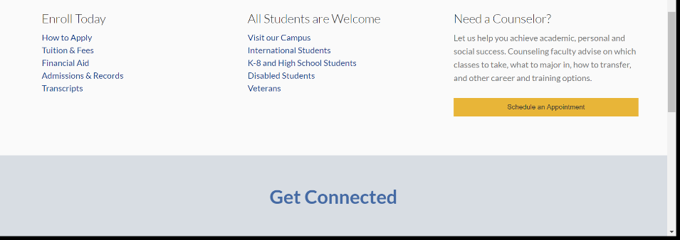
Notes:
Janet

Slide 11
ENTER the Path
Bridging K-12 to higher education
Redesign pathways through the college experience
How does your college help students find and enter the path?
Notes:
Carrie

Slide 12
STAY ON the Path
Support students with ongoing advising mechanisms to support *informed choices, strengthen clarity about opportunities, develop an academic plan with a predictable schedule, monitor progress, and intervene if they go off track
Embed academic and nonacademic support services throughout programs to promote student learning, persistence, and retention
*an informed choice COULD be choosing a different path
Notes:
Carrie

Slide 13
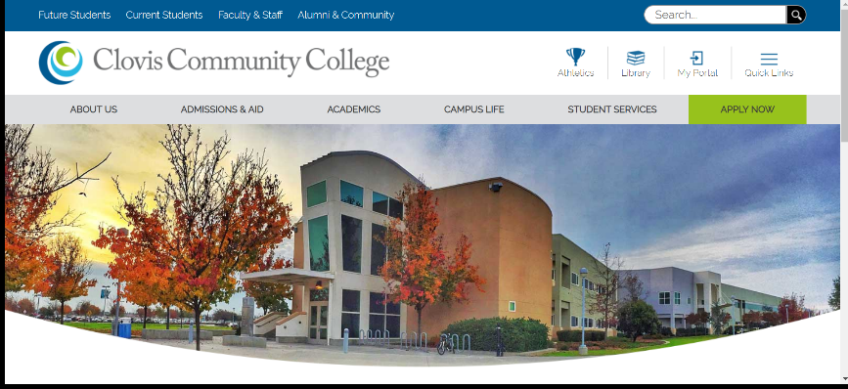
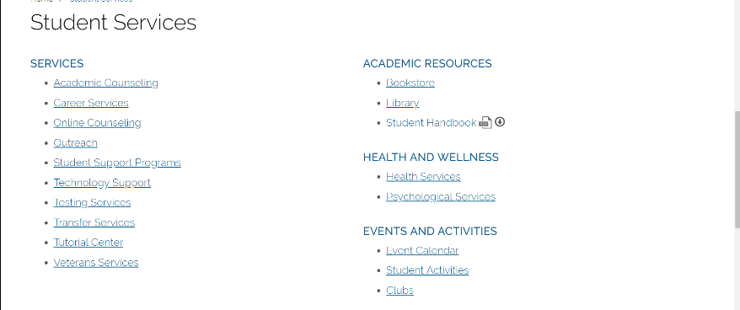
Notes:
Janet

Slide 14
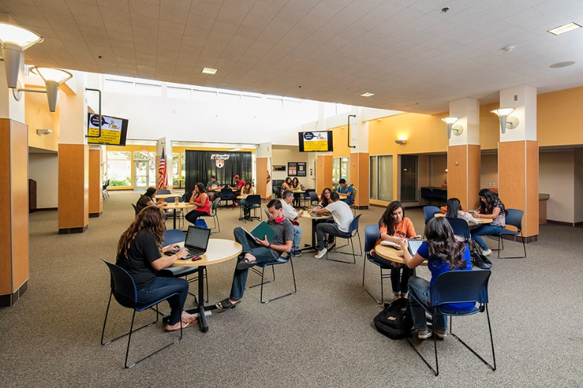
CCC Education Planning Initiative
EPI Pilot Colleges
Phase II Colleges:
Ohlone College
Modesto Jr. College
Columbia College
Butte College
Shasta College
Foothill College
DeAnza College
Long Beach City College
Palomar College
Pasadena City College
Barstow College
Bakersfield College
Rio Hondo College
Coastline Community College
Berkeley City College/Peralta CCD
College of Alameda/Peralta CCD
Laney College/Peralta CCD
Merritt College/Peralta CCD
Hartnell College
Allan Hancock College
Legacy Colleges:
Imperial Valley College
Sierra College
“Our students are most successful when they have multiple resources – a rich support system to which they can easily turn to for help.
Starfish is the high-tech solution that creates a high-touch network for our students.”
Beth Ervin, Dean of Student Services , Sierra College
Notes:
Janet
PROBLEMS TO SOLVE:
“We really wanted to look at our students from a holistic perspective. We wanted to avoid a deficit model and look instead at how our system could adapt to meet the needs of our students.”
Difficult to share information appropriately
-- Commuter Campus
-- Very high student to counselor ratio 1000-1.
-- Decentralized academic support
-- Needed to leverage existing funding structures (no new $)
Only 3% of students complete 30 units by the end of their first year. 50% of students don’t persist from fall to fall.
Grade policies and most communications are written at post-doctoral level!! This has helped change the culture.
In first year:
Faculty feedback was really important
Use attributes based on counselor feedback
Success Network – start small and build
Communication loop between all students’ educational partners
68% of faculty created profiles in Year 1
85% of faculty who opened the survey completed it
- We learned we had to require comments! It wasn’t helpful without them. But we trained them and gave them templates. Everyone needs a scoreboard.
14,422 total items
Students responded so positively to both kudos and even “in danger of failing” flags, which can be devastating.
An attribute is “HOW SURE ARE YOU OF YOUR GOAL?” An opportunity for counselors to talk to “somewhat sures” about majors, careers, options.
Athletic coaches are AMAZING partners in this program

Slide 15
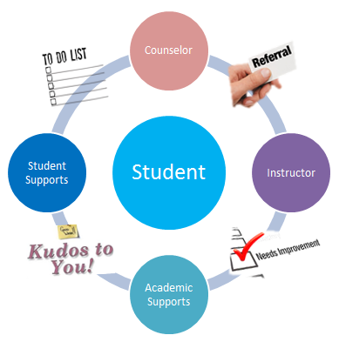
Starfish and the Educational Portal Initiative EPI
Early Alert
Facilitate communication and referral through tracking items (Flags, Kudos, Referrals, To Do’s, Raise a Hand)
Refer and connect to Academic/Student Support Programs
Follow up and Close the loop
Degree Planner
Accessible electronic Student Educational Plans to detail courses and timeline to goal
Connect (Calendaring)
Schedule appointments, office hours, workshops, send messages
Notes:
these tools help address factors that impact retention and student success. Collaborated between instruction and Student Services to provide additional support or resources for students.

Slide 16
COMPLETION COACHING COMMUNITIES
Notes:
Janet - completion teams development
10% do 100% of the work so how do we engage the other 90%
Utilize all members of the community

Slide 17
COMPLETION COACH RESPONSIBILITIES
Coach Title | Expert in
Counselor/Ed Advisors | Educational planning and transfer decisions
Dean | Coordination of team meetings and outcomes
Data Coach | Finding and interpreting cohort data
Discipline Faculty | Discipline-specific coursework, transfer, and career
ACDV Faculty | Remediation component of academic pathways
Financial Aid Expert | Tracking financial aid information
Student Support Expert | Intrusive guidance for support in academic career
Notes:
Janet-completion teams responsibilities

Slide 18
Meta-Major | Arts & Humanities
Departments | Art, Performing Arts, Foreign Languages, English
Programs | American Sign Language (AA) Communication (AA-T) History (AA-T) Commercial Music (CA) English (AA-T) Graphic Design (CA Journalism (AA-T) Media Art (CA) Music (AA-T) Philosophy (AA-T) Photography (CA Spanish (AA-T) Studio Art (AA-T) Theater Arts (AA-T)
# Students | 1862
Faculty Discipline Expert(s) | Gloria Dumler (English) Paul Beckworth (History) Keri Wolf (English) Talita Pruett (Comm) Qui Jiminez (Spanish) John Gerhold (Music) Brian Sivesind (Theatre) Yuki Takeuchi (Japanese) Jaclyn Krause (ASL) Vacant (Media Art) Vacant (Studio Art) Vacant (Journalism) Vacant (Commercial Music) Vacant (Philosophy) Angela Bono (Comm Adj)
ON-RAMPING: Intake Experts | Abraham Castillo (Ed Advisor) Roberta Ayala (FinAid Tech)
Academic Support Services Experts | Kim Collins (Delano) Miguel Cuate (Writing Center)
Academic Development Expert | Phil Feldman
Data Coach (where necessary) | Talita Pruett (Communication) Eleonora Hicks (Sociology)
Administrators/Managers | Manny Mourtzanos (Lead) Nicky Damania Nan Gomez-Heitzeberg
Notes:
Janet

Slide 19
ENSURE LEARNING
Establish program-level learning outcomes aligned with the requirements for success in employment and/or further education
Apply the results of learning outcomes assessments to improve the effectiveness of instruction across programs
Ensure incorporation of effective teaching practice throughout the pathways
Notes:
Carrie

Slide 20
Finding your way
Imagine you are a student at your college.
Pull out your phone or laptop.
Look at your college.
Examine available educational pathways.
Look at the matriculation requirements.
Search the financial aid website.
What do you notice about your college and a student’s first contact?
Notes:
Janet/Carrie

Slide 21
Involving STUDENTS!
Student participation critical; how has your college involved them in making clearer communications?
When should students be engaged?
Notes:
Carrie

Slide 22
Selecting a Major and Metamajor
What could students consider for wayfinding?
Begin with the end in mind
Careers
Transfer
What else?
Notes:
Janet

Slide 23
What else?
General Education
Degrees and Certificates
Course Sequences
Student Development Courses
Guided Self Placement
Math/English in First Year
Golden Four
Notes:
Janet

