Slide 1
Breakout III Evaluation of Placement and Course-Taking Success
Wednesday, July 8 1:00pm-2:15pm

Slide 2
Evaluation of Placement and Course-Taking Success
After a year of updated placement practices, it's important that colleges evaluate student course-taking success. This session will discuss:
statewide success given available statewide data
ways to evaluate local data
the importance of properly coding CB 25 and 26 to ensure quality data
other considerations for evaluating student success based on new placement practices.
Participants are encouraged to also attend the follow-up session for discipline-specific dialog and sharing of practices.
Notes:
Janet

Slide 3
Presenters
Math
Angela Echeverri – LA Mission College, LACCD District Academic Senate President
Mike Davis - Glendale College
Eddie Tchertchian –LA Pierce College, Math Chair & Quantitative Reasoning Taskforce
English
Juan Buriel - College of the Canyons, ASCCC Equity and Diversity Action Committee
Karen Chow - DeAnza College, ASCCC Executive Committee, AB705 Implementation Committee
ESL
Lisa Saperston, LACCD, ASCCC Curriculum Committee
Kathy Wada, Cypress College, AB705 Implementation Committee
Host: Janet Fulks Guided Pathway co-chair, AB 705 Implementation Committee
Notes:
Janet – introduce yourselves in this order

Slide 4
The Plan for this breakout
Legislation and Memos
Concepts of Placement
Math Placement data
English Placement data
ESL Placement data
Outcomes and Equity
Qualitative Input from Faculty and Students
Coding Issues for good data
Resources
Follow-up Breakout by Discipline

Slide 5
Assembly Bill (AB) 705 was unanimously passed by the legislature and signed into law by Governor Brown in October 2017. This bill is designed to accomplish several important outcomes that are paramount to the Chancellor’s Vision for Success:
Increase the numbers of students who enter and complete transfer-level English and mathematics/quantitative reasoning in one year.
Minimize the disproportionate impact on students created through inaccurate placement processes.
Increase the number of students completing transfer-level English as a Second Language (ESL) within three years.
Notes:
Janet – note this is the official email from the CCCO April 2019

Slide 6
Evaluate your AB 705 Implementation
Required Evaluation July 11, 2018 memo AA 18-40
As title 5 currently allows in 55003(g), colleges have not more than two years to innovate and validate their own innovations and compare the effectiveness of those designs to the tables above. The primary philosophy in this recommendation is that students should not be placed or directed in any way such that their completion of the transfer-level gateway course would be less likely than it would have been with direct placement into the course.
Recent Memo ES 20-24
GSP Guided Self Placement Evaluation – extended to December 30, 2020
Extended ESL Placement Assessments to July 1, 2021
Extended ESL Implementation Plans to July 1, 2021
Notes:
Janet - Supply Demand and Equilibrium – slide with example/diagram
Highlight success, Increased access, positive Throughput data
Innovative support (ESL support for stats; Intrusive support; ESL/ English collaboration; ESL certificates; ESL – GE; Language issues in math; ESL placement and math placement should not be two separate actions)
Co-requisites are not panacea
Variety of curricular approached – DeAnza English – stretch, additional support 5 qtr units to 8 qtr units standard typical single term. Glendale stretch innovation for math
Second attempts and success (problems with support success and target course failure; sidecar versus integrated support; lab versus additional class)
Equity gaps - Curricular implications of social justice and relationship to data
Reasons for dropping are critical
GPA change – ripple effect of failure
Changes in curriculum with COVID DE addenda etc.
Support for the underprepared student – pedagogical concerns, mitigation – pairing, mentoring, late start ESL, Working with ESL – don’t miss collaboration opportunities
Colleges offering one level below in English had an important effect for those feeling under-prepared and noncredit opportunities

Slide 7
You may have heard the following claims
“Early adoption of AB 705, which eliminates remedial classes at California community colleges, is already showing promising results, as support for the new law outside of the California Community Colleges continues to grow.”
“Success rates jumped for students completing English 101”
“Some students are forced to take non-credit remedial classes before they really get started on their degree, this sets them up for failure.”
“AB 705 has erased all equity gaps.”
that are simply not accurate
Notes:
Wouldn’t it be great if we implemented something and it worked perfectly and benefited all students!
This is not real life and implementations that dictate specific actions for all 115 institutions and all 2.5 million students are going to need tweaking and improvement
Maybe this should be a quiz
Some quotes from an online search – some unfortunately from CCCCO
“Early adoption of AB 705, which eliminates remedial classes at California community colleges, is already showing promising results, as support for the new law outside of the California Community Colleges continues to grow.”
False – colleges were not required to eliminate remedial courses & many did not eliminate them
“Success rates jumped for students completing English 101”
False - most colleges experienced a decreased success rate- statewide the success rates in transfer English TOP code 1501 dropped from 71.2% to 66.2%; some colleges saw very small declines in success rates and some much larger – the concern is disparity between ethnicities and special populations
Because of AB 705 throughput in transfer courses has increased
False – It depends upon the course and the students; while English and statistics throughput has increased for some colleges and some groups, STEM math has seen some considerable declines among nearly all populations and at most colleges
“AB 705 has erased all equity gaps.”
False – equity gaps, have increased when examining success; placement has been the same for all students therefore no equity gaps in placement, success is a different story

Slide 8
Clarifying the data
Placement data
Enrollment data
Success data
Non-success data
Support data
Second and third attempt data
Subsequent pathway data
Placement data – swimming example
Guppies
Dolphins
Sharks
Notes:
Janet When optimizing student success in CCCs there are many kinds of data we can and must look at to optimize a student’s experience and overall success.
Example of data issue – when I taught swimming in the summer, kids would arrive the first day of lessons and we would provide a simple swim test. Those that were uncomfortable putting their face in the water joined the guppy class and worked in the shallow end of the pool to develop basic skills, those that could float and were somewhat at ease in the water were placed in the dolphin class and began in the 4ft end of the pool, those that swam fairly well but needed stroke work and some diving skills were placed in the shark class and met in the diving pool 12 ft deep. There was disproportionate impact – students with less access to pools and no pool in their backyard needed some basic skills – but the goal was always a water safe kid. If we had placed all the kids into sharks – there would be no disproportionate impact in the placement – how would that affect the enrollment (12 ft pool) and the success in the class?

Slide 9
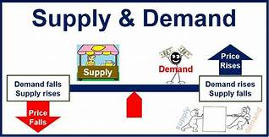
The Issue with Throughput and Success
“Throughput rate” – maximizing throughput is a function based upon many variables and focuses on a cohort of students
Optimizing success is a complex process that focuses on individual students and directly responds to CA Ed Code section 66010.2 which declares “the opportunity for educational success, for all qualified Californians”
An example of this can be seen in a business model where the main goal is to maximize profit while many constraints on the variables significantly impact outcomes. Profit = Revenue – Cost.
To maximize profit, it seems that one would simply maximize revenue and minimize cost, and that is true, but they must be done at the same time. As revenue increases, so does cost. So, equilibrium points or levels need to be determined. However, revenue is based on many variables: price of the commodity, which is based on demand. As the price goes up, generally, demand will go down and vice-versa . As one will notice, this becomes complicated quickly. Similarly, while maximizing throughput or throughput rates, it is also important, and student-centered to maximize pass rates and numbers, minimize fail rates and numbers, maximize retention , minimize equity and achievement gaps, and so something that seems so simple, becomes complicated .
Notes:
Mike

Slide 10
The balance between Access, Success and Failure and Equity Implications
Notes:
Mike – its beyond throughput Access, Placement, Enrollment, Success – distinctions between data
Everyone can take a swim test, placement = course, if everyone becomes a shark then we need to examine outcomes

Slide 11
Examining Equity in Mathematics Placement and Completion
Statewide Data source: CCCCO Data Mart. Fall 2018 & Fall 2019. TOPS Code 1701, transfer
Notes:
Mike – There are good things here – places to examine equity gaps – dealing with the changes statewide – highlight success but also discuss optimizing
Every college should be looking at this for their own institution – take it to your own institution
Add overall data

Slide 12
Equity Issues around placement and Course success; moving beyond throughput
*English 28 (Intermediate Reading and Composition) is a one level below-transfer English course.
English 101 (College Reading and Composition) is a transfer-level course and an associate degree requirement.
Math 125 (Intermediate Algebra) is a one-level below-transfer course that satisfies LACCD’s Math Competency requirement.
Math 227 (Statistics) and Statistics 101 (Statistics for the Social Sciences) are transfer-level courses.
Notes:
Angela
Significant Equity Gaps Exist in LACCD Course Success Rates
*English 28 (Intermediate Reading and Composition) is a one level below-transfer English course.
English 101 (College Reading and Composition) is a transfer-level course and an associate degree requirement.
Math 125 (Intermediate Algebra) is a one-level below-transfer course that satisfies LACCD’s Math Competency requirement.
Math 227 (Statistics) and Statistics 101 (Statistics for the Social Sciences) are transfer-level courses.

Slide 13
Notes:
Angela – the increased rates of unsuccessful completion translate into numbers such as these in LACCD

Slide 14
English Examining Equity in Placement and Completion
All students have been placed into English by default placement rules; some colleges used their own placement methods
By and large – more students overall are getting through (the cohort of new students each year)
However, there are disparities among special populations and among ethnicities, as well as between males and females, particularly African American Males.
Notes:
Juan or Karen

Slide 15
What are we learning?
English
Overall good success
Variety of curricular approached – DeAnza English – stretch, additional support 5 qtr units to 8 qtr units standard typical single term. Glendale stretch innovation for math
2nd and 3rd attempts Second attempts and success (problems with support success and target course failure; sidecar versus integrated support; lab versus additional class)
Support for the underprepared student – pedagogical concerns, mitigation – pairing, mentoring, late start ESL
Working with ESL – don’t miss collaboration opportunities
Declines in success rates were not as significant as math
Colleges offering one level below in English had an important effect for those feeling under-prepared and noncredit opportunities
Innovative support (ESL support for stats; Intrusive support; ESL/ English collaboration; ESL certificates; ESL – GE; Language issues in math; ESL placement and math placement should not be two separate actions)
Notes:
Juan, Karen Kathy and Lisa
Consider the implications of noncredit and one-level below and remote options with covid
Math has had some good effect

Slide 16
Important Factors for English AB 705 Implementation
How do we help under-prepared students?
What pedagogical changes can be made?
How soon do we proactively communicate with the student?
Interpersonal pairing and mentoring in the class may mitigate some issues for students
How do we work collaboratively with ESL and noncredit?
Notes:
Juan

Slide 17
Notes:
This compares the growing enrollment, increasing enrollment counts in transfer English from 2016-2019 The increase in number of successful completions but also the number of failures increasing at a faster rate than success.

Slide 18
Examining English Equity in Placement and Completion
Data
source is CCCCO Datamart Statewide data
Transfer level English
Notes:
Statewide English data for Changes in Enrollment, Success and Failure from Fall 2018 to Fall 2019. Please note the total population for each group is in the label with the first number representing Fall 2018 and the next number representing Fall 2019 absolute number)
While the percentage of enrollment numbers increased for many groups, it decreased for Whites and Native Americans.
While the percentage success numbers increased for most groups it decreased for Native Americans, Asians and Whites.
What is concerning is that these data represent rates of change and the rate of failure (percentage increase of failure numbers) far outstrips the rate of success and the increased rate of enrollment.

Slide 19
College of the Canyons English Data
Data source: College of the Canyons Impact of AB 705on Math and English
Notes:
Juan – This is good data showing a higher percent of students in every ethnicity completing transfer level English – but also showing a persistent equity gap in success with some improvement among LatinX and a widening gap among African Americans.
https://www.canyons.edu/_resources/documents/administration/irpie/CanyonsAB705Fall2019Data.pdf

Slide 20
Breakout III Evaluation of Placement and Course-Taking Success
Wednesday, July 8 1:00pm-2:15pm

Slide 21
What Are We Learning?
Completion data for various ESL student typologies is limited.
ESL CB21 Update
Chaptering of ESL regs changing placement into English with any HS diploma shifting many away from ESL placement
Innovation in ESL
Transferability & GE fulfillment
Making courses count: Guided Pathways ESL Milestone Certificates
Notes:
Lisa will do bullets 1 & 2 (data & regs). Kathy will do bullets 3 & 4 (innovation points)

Slide 22
Completion Data for ESL
Completion data for ESL …. in progress.
Some questions come to mind:
How are our placement processes progressing?
Who are our ESL students?
What is the “credit ESL throughput rate” that colleges need to meet or exceed?
Notes:
Lisa

Slide 23
Training Aspects of Implementation
ESL & CB21
Adopted at Fall 2019 Plenary
Training was possibly going to happen in Spring 2020, but …
CB coding for ESL is tricky:
Some courses have transferability (UCTCA) but are still in the pathway to TLC.
Other courses may be optional support courses in discrete skills.
Notes:
Lisa

Slide 24
ESL Regulations – § 55522.5
ESL regulations were adopted on the Monday, March 16 of COVID-19
Highlights of changes: §55522.5(b)(2)
Students who have acquired a United States high school diploma or the equivalent shall be placed according to section 55522.
Highlights of changes: §55522.5(b)(4)(B)
(B) The district's failure to demonstrate that the local placement method meets or exceeds the credit ESL throughput rate(s) of a placement method, once published, by the Chancellor's Office.
Notes:
Lisa

Slide 25
ESL Regulations - §55522.5
Highlights of changes: §55522.5(5) and §55522.5(6)
(5) Districts must inform students placed into credit ESL coursework prior to fall 2020 of their right to access the newly adopted placement processes that comply with this section and students who have completed a United States high school diploma or the equivalent shall be placed according to section 55522. Districts shall disclose their plans to implement retroactive placement recommendations as part of the adoption plan described in subparagraph (b)(4).
(6) Any placement for the fall semester or quarter of 2020 must comply with this section and Education Code section 78213.
Notes:
Kathy

Slide 26
Innovation in ESL
ESL, Transferability, and GE Requirements
Rooted in AB 705 amendments that recognize …
ESL instruction as distinct from “remediation” in English
Students in ESL courses are engaged in foreign language learning
Rooted in evidence:
“ …improves the likelihood of earning a degree by almost 13 percentage points” (PPIC 2019)
Rooted in success:
Small but mighty ESL with A2 have had high success.
Eight colleges now have ESL with 1A/A2 approval! More have A2
Small number of advanced ESL courses have 3B/C2 approval.
Notes:
Kathy
Rodriguez, O., Bohn, S., Hill, L., & Brooks, B. (2019). English as a second language in California’s community colleges. San Francisco, CA: Public Policy Institute of California. Retrieved from https://www.ppic.org/wp-content/uploads/english-as-a- second-language-in-californias-community-colleges.pdf

Slide 27
Innovation in ESL
Guided Pathways ESL Milestone Certificates
Rooted in AB 705 amendments that recognize …
ESL instruction as distinct from “remediation” in English
Students in ESL courses are engaged in foreign language learning
Amazingly Successful:
Fall 2019: 79 students for a total of 301 certificates!
Spring 2020: 124 students for a total of 407 certificates!
For 2018-2019, Cypress awarded approximately 1,200 certificates. In our first year, we have awarded 700+ so far!
Notes:
Kathy

Slide 28
Equity outcomes for Special Populations
It is a mixed bag; good for some, not so good for other

Slide 29
From the CCCCO Vision Resource Center _ VRC
This statement was made based on predictive analytics.
Let’s look at some data after the first implementation semester
Notes:
Janet - This is a screen capture from the AB 705 course on the VRC. The Statement seems incontrovertible – direct placement benefits all DSPS< EOPS< and ESL – The data DOES NOT support that claim

Slide 30
Notes:
Is this better for DSPS students?

Slide 31
Notes:
Puente is a success story with a larger transfer enrollment, tremendous increase in success with only a moderate increase in failure compared to increased transfer success.

Slide 32
Examining Equity in Math Enrollment and Successful Completion– EOPS Students
Data source: CCCCO Data Mart. Fall 2018 & Fall 2019. TOPS Code 1701, transfer
Notes:
Mike - We need to examine special student populations – beyond ethnicity – EOPS - low income as a proxy

Slide 33
Data
source is CCCCO Datamart Statewide data
Transfer level English for Special Populations
Notes:
Statewide data for veterans in English. Since 2016 enrollment in transferable English has increased 339;
Success only increased by 153
And failure (which can impact GI bill) increased by 186 – ,more failed than succeeded what are the unintended consequences

Slide 34
Data
source is CCCCO Datamart Statewide data
Transfer level English for Special Populations
Notes:
Can we use our Fall 20109 data to improve our serve? The foster youth data on placement into transfer, as well as other special populations

Slide 35
Notes:
Here are more special populations data for you to consider and look at within your own college

Slide 36
Examining Equity in Successful Math Completion
Data source: CCCCO Data Mart. Fall 2018 & Fall 2019. TOPS Code 1701, transfer
Notes:
Mike – success rates

Slide 37
Examining Statewide Equity in Successful Math Completion
Data source: CCCCO Data Mart. Fall 2018 & Fall 2019. TOPS Code 1701, transfer
Notes:
Mike compared the equity gap in math growing
These data are from the CCCCO Datamart looking at Math TOP Code success and comparing ethnicity

Slide 38
Notes:
Why is coding important?
Because we know that some of our strategies are working and some are not.
This is some data we are examining in the Guided Pathways Taskforce. Faculty POV may vary from other POV. For instance, I was reviewing a MMAP presentation of data from a college that showed success and throughput rates. It included a comment about the throughput rate increasing even with a “slight decrease” in success. But that “slight decrease” meant that as many students as were succeeding were now failing. And when the failures are disaggregated new stories come to light. Here the success rates of White non-Hispanic students are compared with the other ethnicities regarding success rates. Some refer to this as an equity gap.

Slide 39
Unintended Consequences
Transfer-level corequisite course packages are, generally, higher number of transferrable units. With an unsuccessful attempt, students risk:
Not making Sufficient Academic Progress
Losing financial aid
Permanent negative impact on transfer-level GPA/transcripts
Repeatability of co-requisite support courses
Disillusionment and attrition
What are we doing to mitigate these negative effects?
Notes:
Mike

Slide 40
Input from students and faculty
Notes:
Juan

Slide 41
Glendale Comprehensive AB 705 Implementation

Slide 42
Notes:
Angela

Slide 43
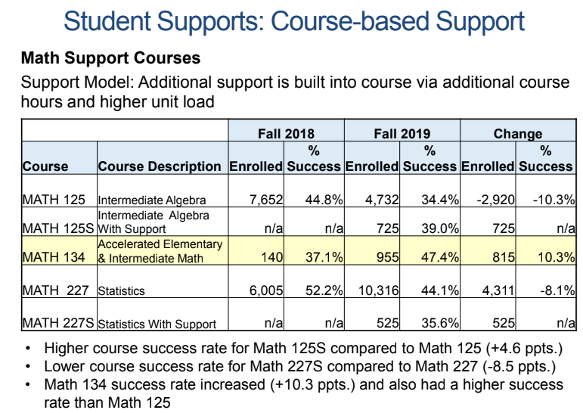
Notes:
Angela – Outlier and combined skills from lower level classes and was an important option for students who did not do well in HS

Slide 44
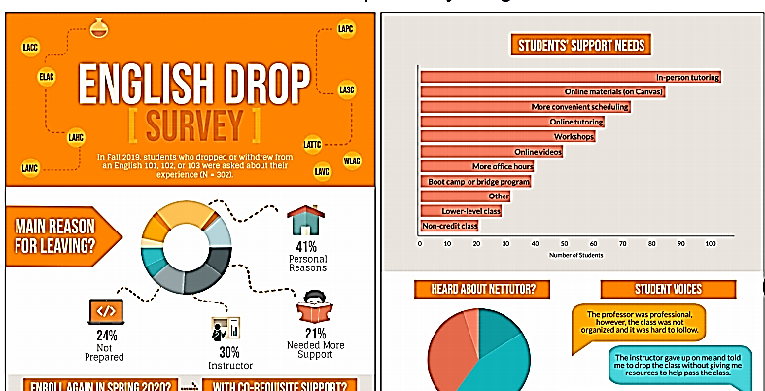
Notes:
Angela

Slide 45
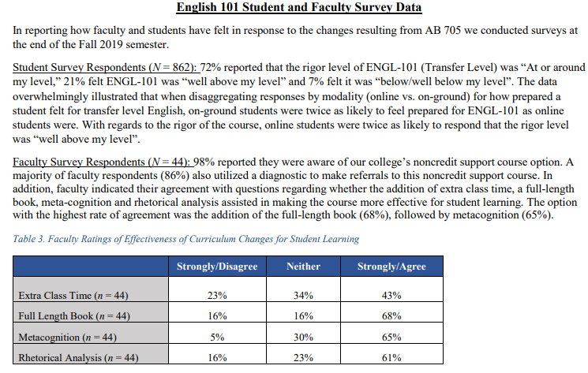
College of the Canyons Student and Faculty Input
Notes:
Juan Input from COC

Slide 46
LACCD Student Input
Notes:
Angela – LACCD Student input from those that dropped English or Math in Fall 2019

Slide 47
Training Aspects of Implementation
CB 21, 25 & 26
ESL
Credit and Noncredit

Slide 48
CB 25 General Education
https://webdata.cccco.edu/ded/cb/cb25.pdf
Notes:
Janet
https://webdata.cccco.edu/ded/cb/cb.htm
From the COCI data courses (CB05 A –transferable to UC and CSU) with CB25 A 347 Courses with CB 25 B 628 Courses with CB 25 C135 Courses with Y 53789 total courses 88496

Slide 49
Training Aspects of Implementation and ESL
ESL & CB21
Adopted at Fall 2019 Plenary
Training was possibly going to happen in Spring 2020, but …
CB coding for ESL is tricky:
Some courses have transferability (UCTCA) but are still in the pathway to TLC.
Other courses may be optional support courses in discrete skills.
Notes:
Lisa

Slide 50
CB 26 Course Support Status https://webdata.cccco.edu/ded/cb/cb26.pdf
Notes:
Janet
https://webdata.cccco.edu/ded/cb/cb.htm
Some are at transfer level and some are not both should be coded to enable analysis of your current placement

Slide 51
Type in the chat any other thoughts, information or concerns on your radar

Slide 52
Effect of???
No pre-transfer level courses
Covid-19 which was most impactful on those struggling
High unit support coursework

Slide 53
Resources
AB 705 Language
AB 705 Implementation memo for English and Math
AB 705 memo initial memo for ESL
ASCCC Resources for AB 705
CCCCO webpage with AB 705 information
CB 21, 25 and 26 Coding
Coding
Noncredit Courses and Coding Table Document
ESL Recoding, New SCFF, and Guided Pathways - PPT | Recording
AB 705 Recoding Project for MATH/ Quantitative Reasoning and English/Reading/ESL - PPT | Recording
Rodriguez, O., Bohn, S., Hill, L., & Brooks, B. (2019). English as a second language in California’s community colleges. San Francisco, CA: Public Policy Institute of California. Retrieved from https://www.ppic.org/wp-content/uploads/english-as-a- second-language-in-californias-community-colleges.pdf

Slide 54
Specific College Research
https://www.canyons.edu/_resources/documents/administration/irpie/CanyonsAB705Fall2019Data.pdf
College of the Canyons Brief on AB 705 Implementation in Math and English
LACCD Academic Senate President Summary
LACCD AB705 Evaluation Plan – Curriculum Institute
Glendale Comprehensive AB 705 Implementation plan – Curriculum Institute

Slide 55
Please join us for our follow up session

Slide 56
True or False
“Early adoption of AB 705, which eliminates remedial classes at California community colleges, is already showing promising results, as support for the new law outside of the California Community Colleges continues to grow.”
False – colleges were not required to eliminate remedial courses & many did not eliminate them
“Success rates jumped for students completing English 101”
False - most colleges experienced a decreased success rate- statewide the success rates in transfer English TOP code 1501 dropped from 71.2% to 66.2%; some colleges saw very small declines in success rates and some much larger – the concern is disparity between ethnicities and special populations
Because of AB 705 throughput in transfer courses has increased
False – It depends upon the course and the students; while English and statistics throughput has increased for some colleges and some groups, STEM math has seen some considerable declines among nearly all populations and at most colleges
“AB 705 has erased all equity gaps.”
False – equity gaps, have increased when examining success; placement has been the same for all students therefore no equity gaps in placement, success is a different story
Notes:
Quotes from online

