Slide 1
Breakout IV Evaluation of Placement and Course-Taking Success: Follow-up Conversations for Math, English, and ESL
Wednesday, July 8 2:45pm-4:00pm

Slide 2
Breakout IV Evaluation of Placement and Course-Taking Success: Follow-up Conversations for Math, English, and ESL
Math, English and ESL faculty will review and discuss discipline-specific statewide data and share placement practices in a brief introduction and then go into breakout rooms by disciplines. The ESL dialogue will also include a sharing of planned placement practices for Fall 2020. This session will conclude with a final discussion summarizing what was learned in all the breakout rooms.

Slide 3
AB 705 Discipline –specific discussions
Brief overview
Breakout room discussions – please indicate your desired breakout room in the chat (English, ESL or Mathematics
Presentation by discipline experts
Google Sheets to collect information and comment

Slide 4
English Breakout Leads
Juan R. Buriel – ASCCC Equity and Diversity Action Committee, English Faculty, College of the Canyons
College of the Canyons AB705 Impact Report
Karen Chow– ASCCC Executive Committee, English Faculty, DeAnza College
https://www.deanza.edu/assessment/guided/english.html

Slide 5
English Examining Equity in Placement and Completion
All students have been placed into English by default placement rules; some colleges used their own placement methods
By and large – more students overall are getting through (the cohort of new students each year)
However, there are disparities among special populations and among ethnicities, as well as between males and females, particularly African American Males.

Slide 6
What can explain the variances in student success across all sections of a course? Possibilities to explore:
compare & discuss success data pre- & post-AB 705
student variables such as race/ethnicity/gender
student preparation (e.g. below & above 2.6 HS GPA)
course modality (F2F, hybrid, online)
pre & post-COVID: day of the week course section meets?
pre & post-COVID: time of the day course section meets?
difference in successful completions by individual instructor with 2+ sections of the same course
variations across individual instructors

Slide 7
Notes:
LACCD Data

Slide 12
English: What are we learning?
Overall higher success, which means higher numbers of students from all groups are succeeding. However, there are still significant numbers of “unsuccessful” students--what are colleges doing to address that? In addition, are colleges tracking students who drop courses before Census and possibly never return? Are colleges tracking students who repeat and hit repeatability limit and still do not pass?
Variety of curricular approached – DeAnza English – stretch, additional support 5 qtr units to 8 qtr units standard typical single term. Glendale stretch innovation for math
2nd and 3rd attempts Second attempts and success (problems with support success and target course failure; sidecar versus integrated support; lab versus additional class)
Support for the underprepared student – pedagogical concerns, mitigation – pairing, mentoring, late start ESL
Working with ESL – don’t miss collaboration opportunities
Declines in success rates were not as significant as math
Colleges offering one level below in English had an important effect for those feeling under-prepared and noncredit opportunities
Innovative support (ESL support for stats; Intrusive support; ESL/ English collaboration; ESL certificates; ESL – GE; Language issues in math; ESL placement and math placement should not be two separate actions)

Slide 14
Important Factors for English AB 705 Implementation
How do we help under-prepared students?
What pedagogical changes can be made?
How soon do we proactively communicate with the student?
Interpersonal pairing and mentoring in the class may mitigate some issues for students
How do we work collaboratively with ESL and noncredit?

Slide 15
Notes:
CCCCO Datamart data on statewide English Enrollment, Success and Failure and percent change of each – not the rate of failure exceeds the increase in enrollment and success

Slide 16
Examining English Equity in Placement and Completion

Slide 17
Examining English Equity in Placement and Completion
Notes:
Statewide English data for Changes in Enrollment, Success and Failure from Fall 2018 to Fall 2019. Please note the total population for each group is in the label with the first number representing Fall 2018 and the next number representing Fall 2019 absolute number)
While the percentage of enrollment numbers increased for many groups, it decreased for Whites and Native Americans.
While the percentage success numbers increased for most groups it decreased for Native Americans, Asians and Whites.
What is concerning is that these data represent rates of change and the rate of failure (percentage increase of failure numbers) far outstrips the rate of success and the increased rate of enrollment.

Slide 18
College of the Canyons English Data

Slide 19
Notes:
Puente is a success story with a larger transfer enrollment, tremendous increase in success with only a moderate increase in failure compared to increased transfer success.

Slide 20
Notes:
Why is coding important?
Because we know that some of our strategies are working and some are not.
This is some data we are examining in the Guided Pathways Taskforce. Faculty POV may vary from other POV. For instance, I was reviewing a MMAP presentation of data from a college that showed success and throughput rates. It included a comment about the throughput rate increasing even with a “slight decrease” in success. But that “slight decrease” meant that as many students as were succeeding were now failing. And when the failures are disaggregated new stories come to light. Here the success rates of White non-Hispanic students are compared with the other ethnicities regarding success rates. Some refer to this as an equity gap.

Slide 21
AB705 Implementation & Equity - Some Considerations
Clarifying the Path
What processes are in place to identify underprepared students during the enrollment process?
Entering the Path
When students refuse to register in math, English, or ESL, drop before or during a course, or do not receive a passing grade, what are the tracking protocols to ensure they do not fall through the cracks?
Staying on the Path
What collaboration do math, English, and ESL departments participate in with special support programs (EOPS, Umoja, Puente, DSPS, Veterans, etc.) to understand the needs of disproportionately impacted students?
Ensured Learning
What professional development for faculty in math, English, and ESL is specifically designed to support their understanding of equity and culturally responsive teaching and learning?
Notes:
Juan

Slide 22
ESL Breakout Leads
Lisa Saperston: ESL Faculty, LACCD
ASCCC Curriculum Committee , CCCCO AB705 ESL Advisory committee & CB21 ESL Workgroup
LACCD Placement Information
Kathryn Wada: ESL Faculty, Cypress College
CCCCO AB705 Implementation committee, CCCCO AB705 ESL Advisory committee & CB21 ESL Workgroup
Cypress College Assessment Center Link

Slide 23
Fielding Questions
We invite you to share your questions, thoughts, local practices, and any concerns during our presentation.
Please type any information that you want to share in the Google Doc available here.
A representative from ASCCC is monitoring the document and will share your thoughts and questions with the presenters.

Slide 24
AB 705 and ESL::
Success into and beyond the Goal of Transfer-Level Composition

Slide 25
LACCD ESL District Discipline Committee
Nine Colleges – One District GSP Tool
Directions in Korean, Russian, Spanish, Armenian
Survey Questions
Guided self-placement
Regular communication with counseling faculty
May 'look' differently at each of the nine campuses
Notes:
LACCD Data

Slide 26
Cypress College Guided Placement Tool

Slide 27
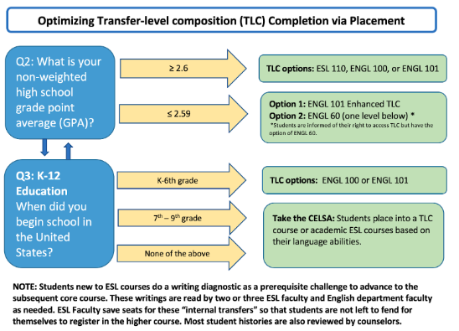
Notes:
CCCCO Datamart data on statewide English Enrollment, Success and Failure and percent change of each – not the rate of failure exceeds the increase in enrollment and success

Slide 28
Email to students who entered the U.S. educational system in 7th-9th grade
Thank you for completing the Cypress College Guided Self-Placement tool!
Here are your recommended classes you have been placed in. We highly recommended that you register for these courses within the first or second term of being at Cypress College:
English Placement
You have the right to take ESL 110 C College Composition for Non-Native Speakers, ENGL 100 C College Writing, or English 101 C Enhanced College Writing. (Green font indicates possible revision for Fall 2020.)
You also have the right to take English as a Second Language (ESL). If you want to improve your language skills, academic credit ESL is the program for you. Please take the CELSA (ESL placement test). The results will tell you the ESL course for your language level. To take the test, please [instructions on how/where to take the CELSA].
Math Placement
… Math placement info intentionally omitted for this presentation.
Counseling Recommendation
In order to get the results and full benefit from the assessment process, we recommend that you speak with one of our counselors and bring a copy of your high school transcripts. Visit our Counseling Center webpage for more information.
If you feel that you may have made a mistake on any of the questions, you can also speak with one of our counselors who can help you choose the right placement for you. Counselors are located on the 2nd floor of the Student Center Complex (near Lot 1).
Thank you

Slide 29
ESL Course Taking Success
CB 25 ( S / N coding)
ESL 101
CB 26 ( S / N coding)
ESL support courses (e.g. discrete skill courses with ESL TOP code)

Slide 30
Three Ways to Optimize Success for ELLs in Transfer-level Composition
The First Way:
Create an ESL equivalent to transfer-level composition with IGETC 1A and CSU A2 approval (ESL TLC)
Completion rates are impressive:
Explore credit ESL pathways to transfer-level English that allow for credit ESL faculty to 1) teach English Composition to ESL students or 2) create a credit ESL course that is the equivalent of transfer-level English
AB 705 ESL Guidance Memo AA 18-41 (July 2018):
Explore credit ESL pathways to transfer-level English that allow for credit ESL faculty to 1) teach English Composition to ESL students or 2) create a credit ESL course that is the equivalent of transfer-level English

Slide 31
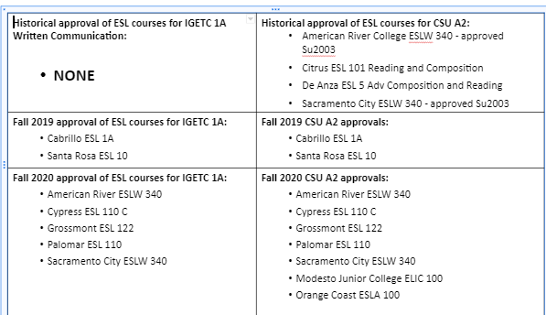
IGETC 1A/A2 Approvals for ESL Courses (ESL TLC)

Slide 32
Three Ways to Optimize Success for ELLs in Transfer-level Composition
Public Policy Institute of California (PPIC) April 2019 report,
English as a Second Language in California’s Community Colleges,
p. 18:
We find that the only ESL sequence feature that is associated with obtaining a community college degree is a transferable ESL course— which improves the likelihood of earning a degree by almost 13 percentage points.
Notes:
Rodriguez, O., Bohn, S., Hill, L., & Brooks, B. (2019). English as a second language in California’s community colleges. San Francisco, CA: Public Policy Institute of California. Retrieved from https://www.ppic.org/wp-content/uploads/english-as-a- second-language-in-californias-community-colleges.pdf

Slide 33
Three Ways to Optimize Success for ELLs in and beyond Transfer-level Composition
The Third Way:
Submit courses for IGETC 3B/CSU C2 Humanities GE fulfillment
AB 705 ESL Guidance Memo AA 18-41 (July 2018):
Pursue the possibility of submitting transfer level ESL courses for inclusion in CSU General Education Breadth Area C2 and for course-to-course articulation
IGETC 3B approval for advanced ESL courses can save a student up to 15 units!

Slide 34
IGETC 3B/CSU C2 Approvals for ESL Courses

Slide 35
Other Considerations for ELL Student Success
ESL Title 5 regs: Changing placement into transfer-level composition or ESL equivalent with any high school diploma may shift students away from the language instruction they need to succeed.
CB coding for ESL courses: Are ESL courses properly coded to reflect success?
Success Beyond AB 705: ESL Certificates

Slide 36
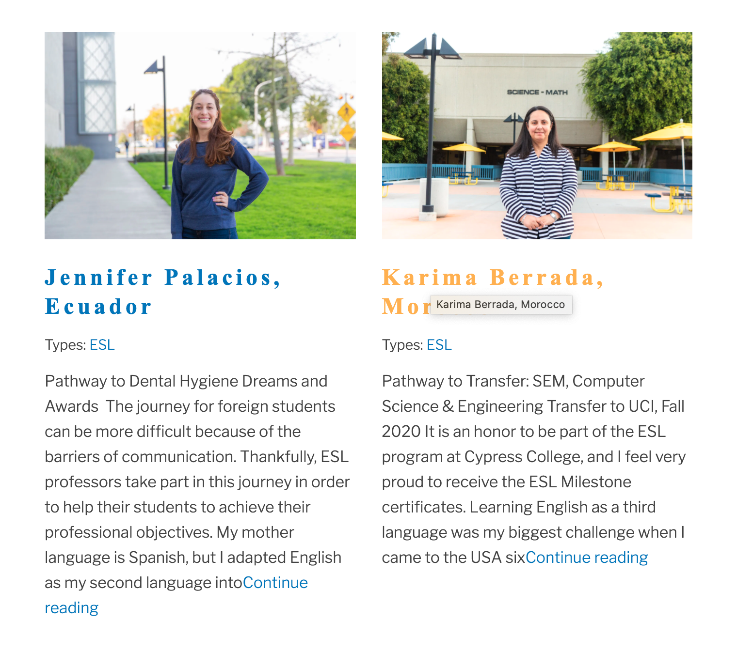
Cypress College Guided Pathways ESL Milestone Certificates
Links:
Overview of the Certificates
ESL Student Testimonials

Slide 37
Cypress College Guided Pathways ESL Milestone Certificates
Chancellor Office-approved Certificates of Achievement for English Language Learners (ELLs) which recognize their achievement of:
1) academic reading & writing skills at an advanced, post-secondary level;
2) successful completion of one or two introductory or prerequisite coursework in a meta-major.
*They align with PCAH 7 guidelines.

Slide 38
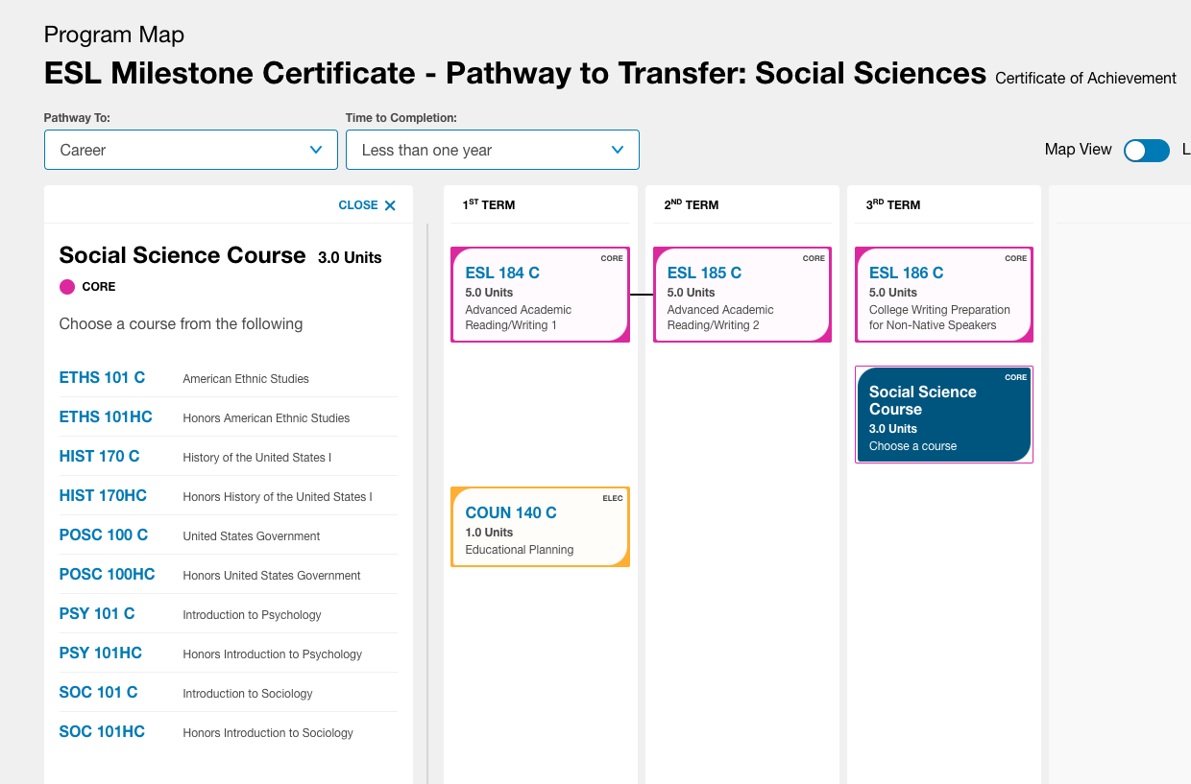
The Certificates & One Example
Notes:
Cypress College Language Arts Program Mapper: https://programmap.cypresscollege.edu/academics/interest-clusters/22923f76-3941-452f-8d9b-5d07d83f17dd
Cypress College ESL Student Testimonials: https://www.cypresscollege.edu/esl-testimonials/
Cypress College Announcement re: Guided Pathways ESL Milestone Certificates: https://www.cypresscollege.edu/2019/08/14/cypress-college-announces-first-of-their-kind-esl-milestone-certificates/

Slide 39
Innovation in ESL
Guided Pathways ESL Milestone Certificates
Rooted in AB 705 amendments that recognize …
ESL instruction as distinct from “remediation” in English
Students in ESL courses are engaged in foreign language learning
Amazingly Successful:
Fall 2019: 79 students for a total of 301 certificates!
Spring 2020: 124 students for a total of 407 certificates!
For 2018-2019, Cypress awarded approximately 1,200 certificates. In our first year, we have awarded 700+ so far!

Slide 40
Innovation in ESL
Guided Pathways ESL Milestone Certificates
Rooted in AB 705 amendments that recognize …
ESL instruction as distinct from “remediation” in English
Students in ESL courses are engaged in foreign language learning
Amazingly Successful:
Fall 2019: 79 students for a total of 301 certificates!
Spring 2020: 124 students for a total of 407 certificates!
For 2018-2019, Cypress awarded approximately 1,200 certificates. In our first year, we have awarded 700+ so far!

Slide 41
Certificate Data – Spring 2020
First Generation College Student | Educational Goal: degree or transfer
56% | 90%
Spring 2020 | N | Spring 2020 Certificate students | ESL Dept. Overall
Asian or Pacific Islander | 86 | 79% | 69%
African American | 3 | 3% | 2%
Hispanic | 13 | 12% | 12%
White | 7 | 6% | 14%
Not Reported | 15 | 14% | 3%
Total | 124 | 109 | 100%
Certificate Types: ESL Milestone SPRING 2020 | N | Percent
Pathway to Transfer: Written Communication | 106 | 26%
Pathway to Transfer: Social Science | 77 | 19%
Pathway to Dental Hygiene, Nursing, Psych Technology | 53 | 12%
Pathway to Transfer: Oral Communication | 49 | 12%
Pathway to Business & Computer Information Systems | 46 | 11%
Pathway to Science, Engineering, and Mathematics | 38 | 9%
Pathway to Diagnostic Medical Sonography, Health Information Technology, Radiological Technology | 25 | 6%
Pathway to Kinesiology | 7 | 2%
Pathway to Aviation and Travel Careers | 6 | 1%
Total | 407

Slide 42
Math Breakout Room
Leads
Michael Davis, Mathematics Faculty, Glendale Community College
https://www.glendale.edu/students/student-services/assessment-test-center
Angela Echeverri, Life Science Faculty, LA Mission College, LACCD Academic Senate District President
Eddie Tchertchian –LA Pierce College, Math Chair & Quantitative Reasoning Taskforce
https://www.laccd.edu/Students/Documents/Student%20FAQ/LACCD-EnglishMath-Placement-Criteria.pdf

Slide 43
Institutional Data Dive
Examine Outcomes
Placement
Course Level Success

Slide 44
LACCD Mathematics
Notes:
Please add slides you would like to have here

Slide 45
LACCD Math Enrollment

Slide 46
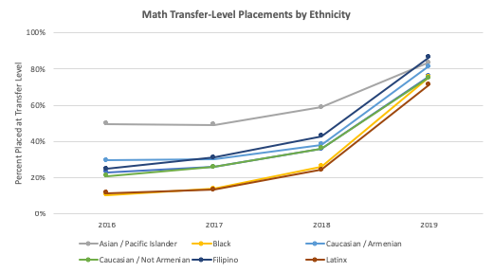
GCC Math Placement by Ethnicity
- Equity Gaps Narrowed

Slide 47
GCC Math Placement, Enrollment, and Success

Slide 48
LACCD Math Success
Overall Completion of Transfer-Level Math and Statistics Increased 29.4%
American Indian (21.4%), Asian (8.1%), Black (74.3%), Filipino (28.8%), Hispanic (34.3%), Multiethnic (67.7%), Pacific Islander (66.7%), White (19.7%), Unknown (8.6%)
Large increases were also observed in females ( 34.2%), age 35-54 (57.9%), and 55+ (60.6%)

Slide 49
LACCD Transfer Math Course Success Rates by Ethnicity
Overall Success Rate for all Students in Transfer-Level Math 227 (Statistics) declined by 15.5%
Declines were observed for Asian (-3.1%), Black (-8.5%), Filipino (-4.9%), Hispanic (-19%), Multiethnic (-8.1%), Pacific Islander (-21.4%), and White (-12.8%) students.

Slide 50
LACCD Math Outcomes by Ethnicity

Slide 51
LACCD Remedial Math Success Rates by Ethnicity
Overall Success Rate for all Students in Math 125 (Intermediate Algebra) declined by 15.3%
Declines were observed for most groups: Asian (-0.2%), Black (-37.5%), Hispanic (-23.2%), Multiethnic (-21.2%), Pacific Islander (-56.7%), Unknown (-15.9%), and White (-17.9%) students.

Slide 52
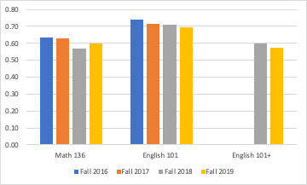
GCC – Success Rates (Statistics & English)

Slide 53
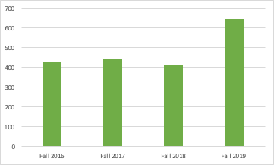
GCC - Number of Students Passing Statistics

Slide 54
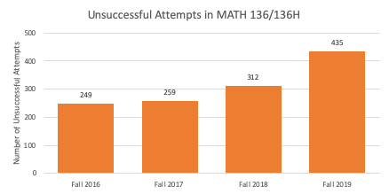
Although success rates are relatively flat, more students are failing statistics

Slide 55
College of the Canyons Math Data
Transfer Level B-STEM actually had a drop in throughput from 378 students in Fall 2018 to 288 in Fall 2019
Liberal Arts Math throughput in Fall 2018 was 920 and increased to 1423 in Fall 2019
Other Transfer Level Math throughput did not change significantly with throughput of 702 in Fall 2018 and 707 in fall 2019
Notes:
This is data from Juan’s COC report and

Slide 56
Math Success at College of the Canyons
Notes:
The college claims by the 80% to have greatly reduced the African American gap – it actually grew larger between whites and Asians and African Americans and LatinX
Here is the quote from the report – is it something I do not understand or is it absolute bunk
“Disaggregating throughput rate by race/ethnicity showed that rates of transfer-level completion in math increased for all groups substantially (Figure 7). Disproportionate impact (D.I.) analyses using the 80% benchmark indicated that the gap was significantly reduced for previously identified D.I. groups (i.e. African American/Black students and Latinx students). In 2016 African American/Black students’ rate was at 50% of the 80% benchmark, and increased to 74% of the 80% benchmark in 2019. Among Latinx students, disproportionate impact for throughput in math was also substantially reduced between 2016 and 2019.”

Slide 57
Unintended Consequences
Transfer-level corequisite course packages are, generally, higher number of transferrable units. With an unsuccessful attempt, students risk:
Not making Sufficient Academic Progress
Losing financial aid
Permanent negative impact on transfer-level GPA/transcripts
Repeatability of co-requisite support courses
Disillusionment and attrition
What are we doing to mitigate these negative effects?
Notes:
Mike

Slide 58
Glendale Comprehensive AB 705 Implementation

Slide 59
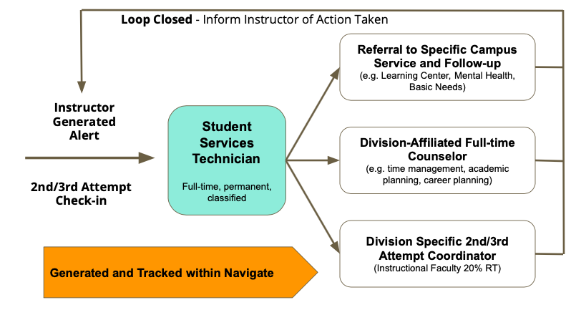
Glendale Comprehensive AB 705 Implementation

Slide 60
Summary of Information from the Discussion

Slide 61
Resources
AB 705 Language
AB 705 Implementation memo for English and Math
AB 705 memo initial memo for ESL
ASCCC Resources for AB 705
CCCCO webpage with AB 705 information
CB 21, 25 and 26 Coding
Coding
Noncredit Courses and Coding Table Document
ESL Recoding, New SCFF, and Guided Pathways - PPT | Recording
AB 705 Recoding Project for MATH/ Quantitative Reasoning and English/Reading/ESL - PPT | Recording
Rodriguez, O., Bohn, S., Hill, L., & Brooks, B. (2019). English as a second language in California’s community colleges. San Francisco, CA: Public Policy Institute of California.

Slide 62
Specific College Research
https://www.canyons.edu/_resources/documents/administration/irpie/CanyonsAB705Fall2019Data.pdf
College of the Canyons Brief
LACCD Academic Senate President Summary
LACCD AB705 Evaluation Plan – Curriculum Institute
Glendale Comprehensive AB 705 Implementation plan – Curriculum Institute

