Slide 1
Qualitative and Quantitative Data Collection for AB705
Janet Fulks, ASCCC Guided Pathways Task Force
Alyssa Nguyen, RP Group, Director of Research and Evaluation
LaTonya Parker, ASCCC Area D Representative
2019 Academic Academy
The Queen Mary – Long Beach
Qu8
Notes:
LaTonya

Slide 2
Description
As colleges have moved from the planning to implementation phase of AB705, it is important to evaluate the choices colleges have made and adjust, if necessary to available data. It is also important to learn from each other and continue to explore ways to help students achieve their goals.
Notes:
Latonya

Slide 3
Overview
Looking at AB 705
Implications
Research and collaboration
Activity: Develop some research questions
Share out
What else have we missed?
Notes:
Latonya

Slide 4
Assembly Bill No. 705 Chapter 745
EC. 2. Section 78213 of the Education Code is amended to read:
The board of governors may adopt a list of authorized assessment instruments pursuant to the policies and procedures developed pursuant to this section and the intent of this article. The board of governors may waive this requirement as to any assessment instrument pending evaluation.
Resource: https://leginfo.legislature.ca.gov/faces/billTextClient.xhtml?bill_id=201720180AB705
Notes:
Latonya

Slide 5
78213 (continued)
(b) The board of governors shall review all assessment instruments to ensure that they meet all of the following requirements:
(1) Assessment instruments shall be sensitive to cultural and language differences between students, and shall be adapted as necessary to accommodate students with disabilities.
(2) Assessment instruments shall be used as an advisory tool to assist students in the selection of appropriate courses.
(3) Assessment instruments shall not be used to exclude students from admission to community colleges.
Resource: https://leginfo.legislature.ca.gov/faces/billTextClient.xhtml?bill_id=201720180AB705
Notes:
Latonya

Slide 6
78213 (continued)
(c) The board of governors shall establish an advisory committee to review and make recommendations concerning all assessment instruments used by districts and colleges pursuant to this article.
(d) (1) (A) A community college district or college shall maximize the probability that a student will enter and complete transfer-level coursework in English and mathematics within a one-year timeframe, and use, in the placement of students into English and mathematics courses in order to achieve this goal, one or more of the following measures:
(i) High school coursework.
(ii) High school grades.
(iii) High school grade point average.
Resource: https://leginfo.legislature.ca.gov/faces/billTextClient.xhtml?bill_id=201720180AB705
Notes:
Latonya

Slide 7
Don’t forget
The bill would also authorize the board of governors to establish regulations that ensure that, for students who seek a goal other than transfer, and who are in certificate or degree programs with specific requirements that are not met with transfer-level coursework, a community college maximizes the probability that a student will enter and complete the required college-level coursework in English and mathematics within a one-year timeframe.”
Notes:
LaTonya

Slide 8
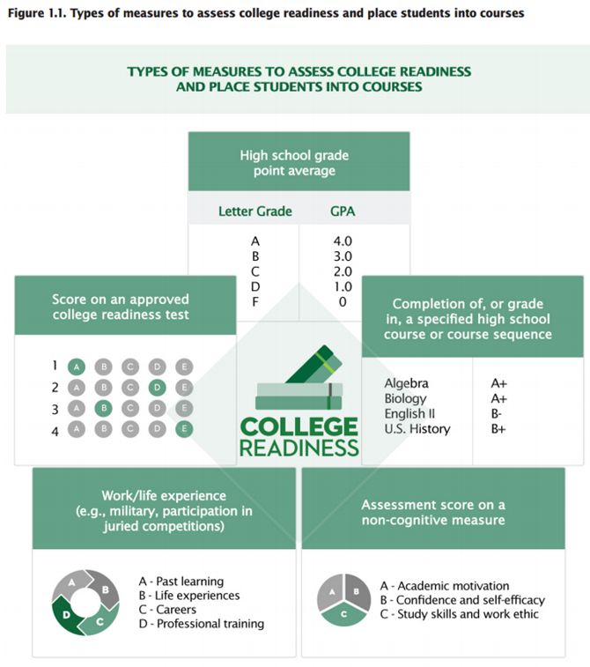
National Data on Placement
A Practice Guide for College and University Administrators, Advisors, and FacultyWhat Works Clearinghouse https://ies.ed.gov/ncee/wwc/Docs/PracticeGuide/wwc_dev_ed_112916.pdf
Notes:
Janet – It is clear from the validated research projects that the analysis of effective practices includes many variables. Clarifying the research question, focusing your analysis and including appropriate variables are all key to understanding effective practices.
Also this is a small fraction of the work that must be done. Placement is not the panacea, nor is corequiristes.

Slide 9
Research
Collaboration is key between faculty, students, staff, and institutional researchers to examine the local impacts of AB 705
Notes:
Alyssa

Slide 10
Collaboration Opportunities
Review and assess the role of new MIS codes to understand how courses are coded and can be used
Joint development of a research plan and priorities
Inviting researchers to the curriculum committee meetings
Notes:
Allysa Collaboratively review the role of new MIS codes in collecting data and review the re-coding developed to track AB 705 changes
Jointly develop a research plan and agenda in collaboration with your AB 705 workgroup/steering committee and/or with faculty from each department/discipline

Slide 11
What conversations and activities have taken place at your institution to evaluate the impact of AB 705?
Notes:
Include some known studies: Citrus did a terrific study on self reported GPA, Bakersfield did a study on completion including throughput with Int Algebra, what other studies and conversations.

Slide 12
Types of Data to Consider
Onboarding Effectiveness
Students, Faculty, Staff, Institution
Curricular Attributes
Types of supports and resources embedded
Unit load changes
Outcomes that can be measured
Course outcomes (e.g., success rates, retention rates)
Differential impact of outcomes by student characteristics
Time to completion
Notes:
These were taken from the regional meetings and the RP paper
Is there anything else we missed? What are some other types of data to consider
The important of documenting the practices in order to understand the impacts
Are there differential impacts of the outcomes by students based on what was implemented? Based on the supports provided? What are effective supports to support these students?

Slide 13
What are other types data and considerations your institution has discussed that would be important to understand/measure the impact of AB705?
Let’s briefly look at what some other college systems done with regard to placement research?
Notes:
Alyssa - have people comment on what they are thinking. And then look at some of the research studies that have been identified as what works research in the IES national database

Slide 14
Research on Placement State University of New York (SUNY)
7 SUNY community colleges used alternative multiple measures placement
included placement test scores and HS GPAs — using predictive algorithms developed at each college to place incoming students into remedial or college-level courses
Many students were placed differently than they would have been under the status quo placement system.
In math, 14 % of students were placed higher than test-only systems (in college-level); 7 % placed lower (in remedial).
In English, 41.5 % placed higher, while 6.5 % placed lower
4,729 students in the fall 2016 cohort evaluated comparing traditional with multiple measures
In math 3.1% higher completion and in English
Notes:
Janet and Alyssa

Slide 15
Multiple Measures Placement Using Data Analytics: An Implementation and Early Impacts Report (9/2018)
Alternative system was more complex than expected (n=4,729)
Many program-group students were placed differently than they would have been under the status quo placement system some placed higher some lower
Program group students were 3.1% (college math) and 12.5% (English) more likely than control group to both enroll in and complete (w/ C or higher)
Enrollment and completion rates among the control group were 14.1 percent in math and 27.2 percent in English
Women benefited more than men in college level math
Black and Hispanic students appeared to benefit more in English
Implementation of the alternative system = roughly $110 per student to status quo fall-term costs for testing and placing students at the colleges & ongoing costs in the subsequent fall term were roughly $40 per student above status quo costs
Further study: need persistence & accumulation of college credits & sub-group analysis
Notes:
Janet and Alyssa
Conclusions: These early results are broadly positive but assess outcomes based on merely one semester of data. Further impact analyses using additional data will include data on persistence and accumulation of college credits over the longer term to fully evaluate the effects of using a multiple measures system to place incoming students. Additional sub-group analyses will also be conducted.
Data from last Fall regarding n=4,729 from Fall 2016 cohort at CC in SUNY https://www.mdrc.org/sites/default/files/CAPR_Multiple_Measures_Assessment_implementation_report_final.pdf
Elisabeth A. Barnett, Peter Bergman, Elizabeth Kopko, Vikash Reddy, Clive R. Belfield, and Susha Roy

Slide 16
Research on Math - City University of NY (CUNY)
Design: 3 colleges, randomly assigned students, assessed as needing elementary algebra, to one of 3 courses
traditional elementary algebra
traditional elementary algebra with weekly workshops
college level statistics with weekly workshops
*note this is elementary algebra CB 21 B two levels below transfer
Notes:
Janet and Alyssa

Slide 17
Research on Math – City University of NY (CUNY)
Implementation: n=2,860 but 1,953 would not sign consent therefore n=907 were placed; some did not enroll, some went to other colleges
Results:
traditional elem. algebra (n=244) 39% pass
traditional elem. algebra with weekly workshops (n=313) 45% pass
college level statistics with weekly workshops (n= 297) 56% pass

Slide 18
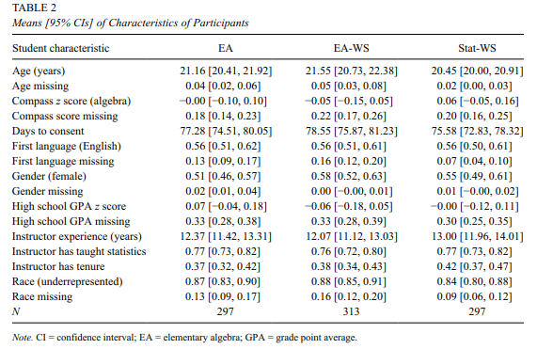
Types of data they examined
Notes:
Janet and Alyssa

Slide 19
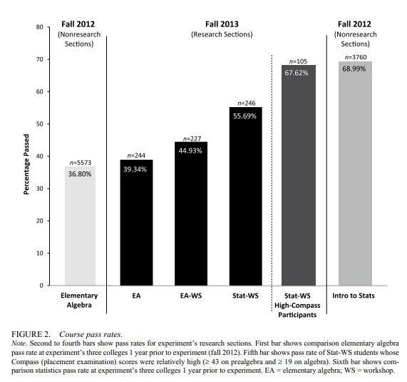
Notes:
Janet and Alyssa

Slide 20
Onboarding Effectiveness
How were students guided to the right courses for their education goals?
How effective was professional development to help the institution manage the change?
Were faculty and staff providing the same coursework for a particular student or major or metamajor?
Did students end up in the right courses for their majors?
Was each method of onboarding equally effective e.g. face2face, online, just in time, etc?
Notes:
Janet

Slide 21
Curriculum considerations
Corequisite support
Integrated support
External support
Unit impact
Articulation issues
Required versus optional
Same faculty member versus other
Question of tracking students
What happens with a fail
Notes:
Janet

Slide 22
Key Findings from RAND study in Texas
Challenges
Lack of stakeholder buy-in* key to implementation
Scheduling and advising issues
Uncertainty on state policy
Strategies - may cost more
Dedicated time for design
Professional development
Small class size
Unique features =more challenges but important to effectiveness
Single instructor for corequistes
Mixed ability peer groups
Designing and Implementing Corequisite Models of Developmental Education
https://www.rand.org/pubs/research_reports/RR2337.html
Five co-requisite models studied
Paired course
Extended instruction
Accelerated (ALP)
Academic Support
Technology mediated
Notes:
Many practitioners support state and institutional DE reforms; however, some faculty and administrators have expressed concerns. Critics of the reform movement argue that the reforms have been pushed through too quickly, with limited research on the effectiveness of these reforms prior to
scaling. There have also been concerns about reformers pushing a one-size-fits-all approach for students of all ability levels. In addition, DE practitioners worry that they and other experts have had too limited a role in advising on and driving these changes. Reformers counter that the opposition among practitioners stems largely from organizational inertia and individual concerns about jobs for DE instructors. However, rigorous research evidence
on the effectiveness of corequisites is limited to the studies of the ALP model.

Slide 23
Rand Study looked at Randomized Cohorts in English
1) How are institutions across the state responding to state corequisite policies? What are the challenges to implementation?
What strategies have helped to overcome challenges?
2) Are corequisites being implemented in ways that align with promising practices for DE instruction (e.g., alignment,
personalization)?
3) How do student experiences in corequisites compare to student experiences in traditional DE?
4) What are the impacts of corequisites on short-run and long-run student outcomes?
5) How do the impacts of corequisites vary according across corequisite models, schools, and student subgroups?
6) What are the costs of implementing corequisites?

Slide 24
Potential Activities
Contextualization of AB 705 implementation
Examination and documentation of specific curricular innovations and examining differential impacts on students’ success
Surveys/focus groups with students and faculty to learn about their experiences with the changes
Outcomes Analyses
Short-term vs. long-term outcomes
Course success rates, throughput rates, degree completion
Cohort tracking
Disaggregation
Notes:
identify coding for support versus target courses in order to determine efficacy of support formats for specific groups and in order to validate whether support courses should be required, optional, embedded or some other modification
Faculty and IR should work together to develop surveys to gather feedback from students and faculty including: why students may drop or withdraw, the perceived rigor of the course, if they felt the course was a good fit for their skill level, if enough support was provided, if the type of support provided was effective, etc.
Faculty may choose to be surveyed on their perceptions around student ability, supports, additional needs such as professional development, etc.
Consider that part-time faculty may have a different set of needs, concerns, or feedback than full-time faculty
Include a variety of disciplines in order to understand the scope across the institution

Slide 25
Develop a Research Question
There may be many things you want to research, but as a group:
Collaborate to select and create a research question important to all of you.
Focus on a question that allows action research
Create a draft plan
What data will you measure?
What is the best timeline?
Who needs to be involved?
How might you act on these data?
Notes:
15 - 20 minutes group think time
Tag Team

Slide 26
Have you included?
Qualitative and Quantitative data?
A timeline that facilitates change quickly?
A set of data that are easily selected and analyzed and do you know where to find the data?
Is your question focused enough to provide clear action?
Notes:
Tag Team

Slide 27
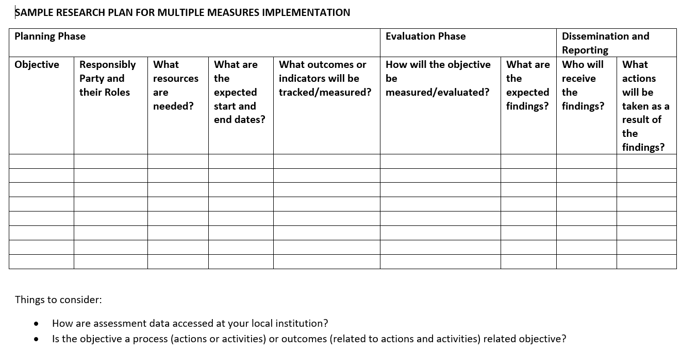
RP Resource page https://rpgroup.org/Our-Projects/All-Projects/Multiple-Measures/Resources

Slide 28
Check in on project ideas?
Report out what your tables developed.
Notes:
10 minute share out

Slide 29
What other activities and analyses could your institution plan for, or do, to better understand the impact of AB 705 based on what you have heard today?

Slide 30
Resources
https://www.asccc.org/ab-705-resources
ASCCC AB 705 Resources https://www.asccc.org/ab-705-resources
AB 705 Research and Analysis Ideas for Collaboration between Researchers and Faculty- https://rpgroup.org/Portals/0/Documents/Projects/MultipleMeasures/Publications/AB705_Faculty_IR_Collaboration_FINAL.pdf?ver=2019-08-26-191218-853
MMAP - AB705 - https://rpgroup.org/Our-Projects/All-Projects/Multiple-Measures/Resources

Slide 31
Resource List with Links
Barnett , E.A., Bergman, P., Kopko, E., Reddy, V., Belfield, C.R., and Roy,s., (2018) Multiple Measures Placement Using Data Analytics: An Implementation and Early Impacts Report https://www.mdrc.org/sites/default/files/CAPR_Multiple_Measures_Assessment_implementation_report_final.pdf
Chickering, A. W., & Kuh, G. D. (2005). Promoting student success: Creating conditions so every student can learn (Occasional Paper No. 3). Bloomington, Indiana: Indiana University Center for Postsecondary Research.
Daugherty, L., Gomez, C. J., Carew, D. G., Mendoza-Graf, A., & Miller, T. (2018). Designing and Implementing Corequisite Models of Developmental Education. Retrieved from https://www.rand.org/pubs/research_reports/RR2337.html
Logue, A. W., Watanabe-Rose, M., & Douglas, D. (2016). Should students assessed as needing remedial mathematics take college-level quantitative courses instead? A randomized controlled trial. Educational Evaluation and Policy Analysis, 38(3), 578-598. Retrieved from https://journals.sagepub.com/doi/pdf/10.3102/0162373716649056
Toward Better College Course Placement: A Guide to Launching a Multiple Measures Assessment System https://ccrc.tc.columbia.edu/media/k2/attachments/2018_Multiple_Measures_Guide_1.pdf
Placement and Multiple Measures Research Overview (2019) https://ccrc.tc.columbia.edu/presentation/placement-multiple-measures-research-overview.html
Daugherty,L., Gomez, C.J., Carew, D.G., Mendoza-Graf, A., Miller, T. (2018) Designing and Implementing Corequisite Models of Developmental Education: Findings from Texas Community Colleges file:///C:/Users/jfulk/Downloads/RAND_RR2337%20(1).pdf

