Slide 1


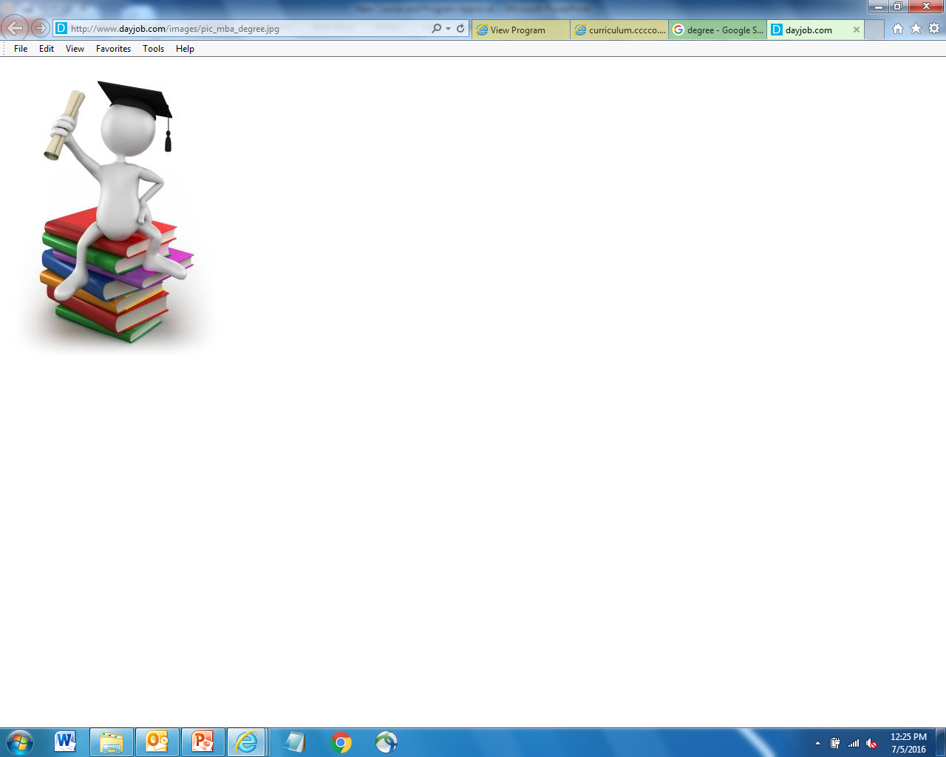
Associate Degree of Transfer
ADT Review
Jackie Escajeda, Chancellor’s Office
Raul Arambula, Chancellor’s Office
Aimee Tran, ASCCC Curriculum Committee, Saddleback College

Slide 2

ADT Marketing Campaign
Funding -
  Total campaign investment of $11 million for five years
  $3 million campaign budget of for year one
  $2 million campaign budgets of for up to four additional years
  Campaign funding anticipated to end June 30, 2020
Increase transfer opportunities
English and Spanish focus groups
Radio and television commercials

Slide 3

ADT’s Awarded
ADT Review

Slide 4

Demographics for ADTs

Slide 5
Demographics for ADTs

Slide 6
Demographics for ADTs
Notes:
Challenges not to exceed the 60 unit requirement
Survey colleges to
Determine barriers?
How did colleges meet the 60 units?
Does decreasing math or science units to not exceed 60 units impact the students?

Slide 7

Transfer Model Curriculum
ADT Review
  Areas of Emphasis -
    Global Studies
    Social Justice
    Law, Public Policy, and Society
    Social Work and Human Services
ADT Review
http://extranet.cccco.edu/Divisions/AcademicAffairs/CurriculumandInstructionUnit/TemplatesForApprovedTransferModelCurriculum.aspx
Notes:
SB 440 mandated 4 areas of emphasis
Broader
College can choose to do them

Slide 8

ADT Review: Reminders
Verify the completion of all the proposal fields
Ensure all the required CORs are attached
Match CORs to the courses listed in the Narrative and Course Report Section
Review Narrative for completion and accuracy
Verify total Unit count on the TMC
Verify Double Count calculation

Slide 9
Common TMC errors
FACT: Very few ADT’s past review the first time, maybe 1 in every 25 submitted. 95% of all ADT’s submitted have at least one of these issues.
All CORS are not attached
GE Area (both CSU and IGETC) – incorrect or incomplete breadth requirement next to the course
Double count discrepancies
ASSIST Supporting Documents (AAM, BCT, GECC) – incorrect report or not attached at all
Courses “expired” or not submitted to C-ID
Old template is used
Narrative not updated when TMC is updated

Slide 10
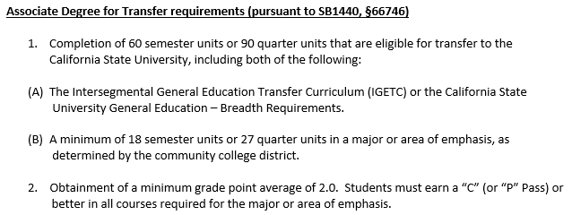
Common TMC errors
Missing information in the Narrative or Education Code Section 66746(a) is misquoted or altered
  Degree should follow the convention “Associate in (Arts/Science) in (Discipline) for Transfer Degree”
    Associate in Arts in English
  DEGREE COMPLETION REQUIREMENTS SHOULD FOLLOW THESE CONVENTIONS:

Slide 11
Common TMC errors
FACT: CCCCO is not punitive, isn’t keeping a tally of your errors. CCCCO is partners with CCCs to provide final TMC review for approval.
  Program requirements (when included) does not match template
  Name the baccalaureate program, specifies preparation for transfer to a CSU

Slide 12
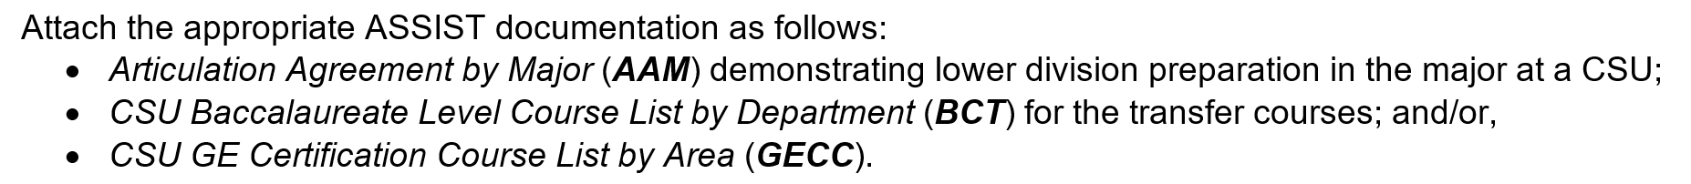
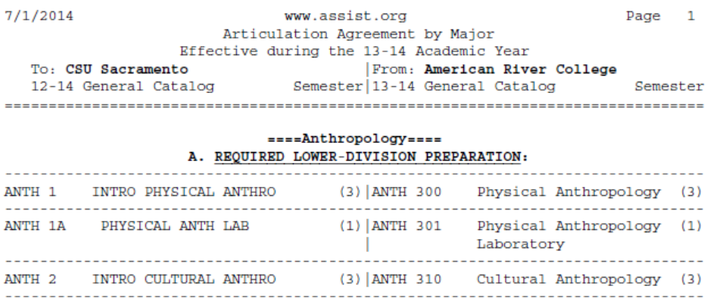
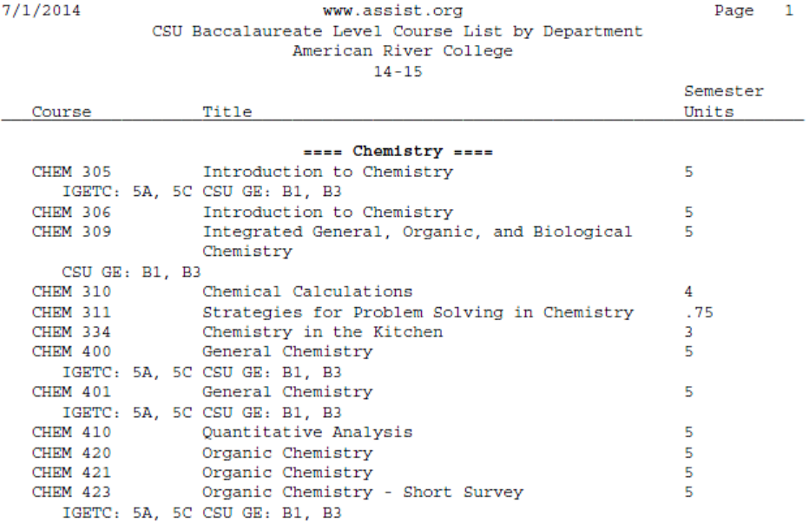
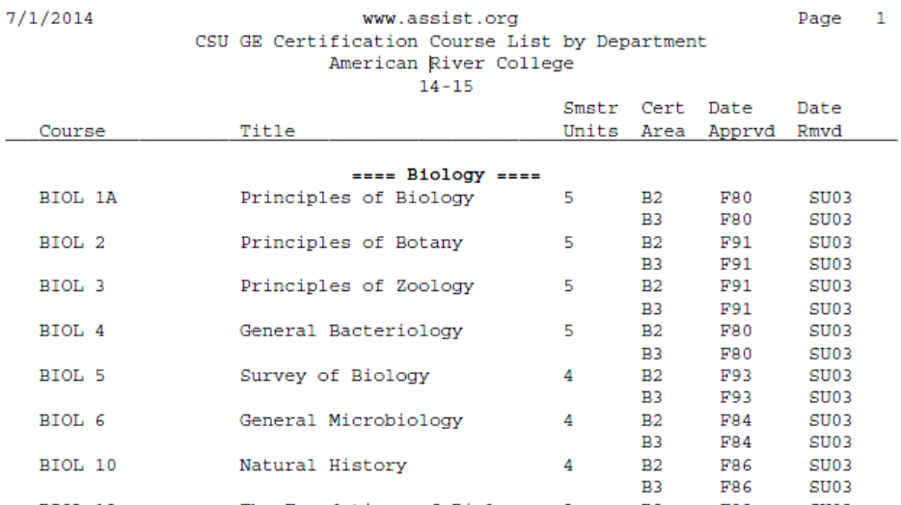
ASSIST Documentation: AAM, BCT & GECC

Slide 13
ASSIST Documentation: AAM, BCT & GECC
ASSIST 17/18 & 18/19 documentation: submit screenshots from ASSIST NG
AAM- Letter/email from CSU stating the specific course is articulated in major.
BCT & GECC:

Slide 14
Double Count Practice
3
3
3
3
3
3
9
9

Slide 15
9
3
3
3
3
3
3
3
3
3
3
3
3
3
3
3
3
3
30
39

Slide 16
Other tips & examples
Unit range in List A, B, C and impact on final unit counts: count all possibilities in each area or at least 1 combo that degree can be achieved with 60 units.
CSU GE Area B w lab = 3 or 4 units? If B4 and B1 is being used, the max double count is 9 units. If no B4 then total is 7 units (2 science courses, 1 lab).
IGETC Area 5 w lab = 3 or 4 units? MAX unit double count = 7 units (3 for each science course, 1 for lab)
Minimum courses & units (hidden meaning to bold/unbold TMC) There is no hidden meaning to bold type on TMC. Units reflect minimum units.

Slide 17
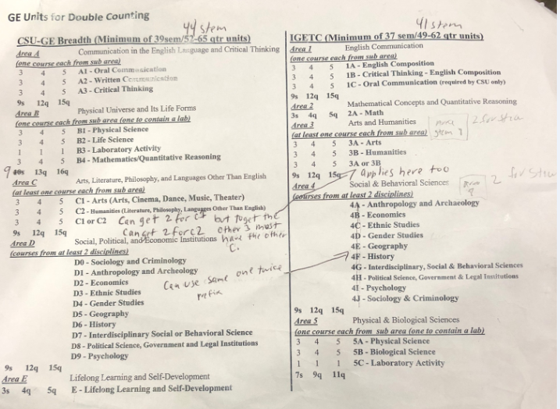
GE Units for Double Counting
Provided by Raul Arambula, CO

Slide 18


Questions

