Slide 1
AEBG
Adult Education
Spring
2018

Slide 2
Agenda
Hot Topics
Policy
Student Data Reporting
Planning
Fiscal Reporting
Other Stuff
Questions

Slide 3
Current Hot Topics

Slide 4
Current Hot Topics
Funding Formula
On Line College
Guided Pathways
AB705 Implementation
Proposed Restructuring Student Services
Noncredit curriculum processing

Slide 5
AEBG

Slide 6
AEBG
Planning

Slide 7
AEBG
Policy
AEBG
Planning

Slide 8
AEBG
Policy
Student Data
Collection
AEBG
Planning

Slide 9
AEBG
Policy
Student Data
Collection
AEBG
NOVA
Planning

Slide 10
AEBG
Policy
Student Data
Collection
AEBG
NOVA
Planning

Slide 11
AEBG
Policy
Student Data
Collection
AEBG
NOVA
Planning

Slide 12
AEBG
Policy
Student Data
Collection
AEBG
NOVA
Planning

Slide 13
Policy Alignment

Slide 14
Policy Alignment
Brown Act / Public Meetings
AEBG Fees Policy
Adult Education Program Areas
Use of ID tracking across systems
Serving students under 18 years of age
CTE course approval requirements
Priority of Service – target populations
Oversight / audit requirements

Slide 15
AEBG Student Reporting
Requirements and Systems

Slide 16
AEBG Reporting Requirements
Population: All adult education students enrolled in ABE, ASE, ESL, AWD, K-12 Success or CTE programs enrolled at a:
K12 adult education school
Community college noncredit program
Third party provider supported by a consortium for the purposes of providing training or supportive services
This includes all students regardless of funding source including AEBG, Noncredit, Perkins, WIOA II, CalWORKS, Adults on Correctional Facilities, Strong Workforce (noncredit programs), LCFF, etc.

Slide 17
Reporting Systems
For 17-18 - all AEBG consortia members and providers will use TOPSPro Enterprise
Quarterly reporting of enrollment and outcomes
K12 adult school, community college noncredit, 3rd party providers supported by consortia
AEBG Office will use LaunchBoard to match AE student data with MIS, EDD wage file, HS equivalency testing data

Slide 18
LaunchBoard Adult Education Tab
General info: http://calpassplus.org/launchboard/home.aspx

Slide 19
LaunchBoard Data Sources
Student Demographics (MIS/TOPSPro)
Coursetaking (MIS/TOPSPro)
Completion (MIS/TOPSPro/GED/TASC/HiSet)
Transfer (National Student Clearinghouse)
Employment (EDD Wage File, CTE Outcomes Survey)
Labor market information (EMSI)

Slide 20
LaunchBoard Adult Ed Tab Scope/Timeline
Comprehensive consortium & member data
Disaggregated program, demographics, barriers and other criteria
Current build includes 57 student, course taking & outcome metrics
Conducting test matching of TE, MIS and other data sources Fall 2017
Available to consortia Spring/Summer 2018
Regional training on tools and how to use the data

Slide 21
AEBG Reporting Requirements 18-19
18-19 Changes to MIS effective July 1, 2018:
Add MIS data elements to align MIS with adult education reporting requirements (missing population flags, pre apprenticeship, diploma, etc…).
Community colleges will use MIS to report students in noncredit ABE, ASE, ESL, and CTE programs.
K12 adult schools will continue to report all ABE, ASE, ESL and CTE students in TOPSPro.
Data elements and webinars have been posted on the AEBG website.

Slide 22
Reporting Elements
Outcomes

Slide 23
Population Definitions
Number of adults served by the consortium – Aligned to WIOA reportable individual definition. 1 or more contact hour of instruction or participation in self directed or information only activities
Adults who attain milestones or outcomes – Aligned to WIOA definition of a participant under AEFLA WIOA Title II. 12 or more contact hours of instruction in ABE, ASE, ESL or CTE.
AEBG will analyze outcomes for reportable individuals using the supplemental data report but not include that data in the primary report to the legislature for 17/18

Slide 24
Measurable Skills Gain (MSG)
The WIOA Performance Indicators, along with the 5 types of MSG, comprise the framework for the six AB 104 outcomes:
Indicators:
Employment
Wages
MSGs:
Literacy gain
Secondary
Post-Secondary
Training Milestone
Skills Progression
AB 104 Outcomes:
Improved literacy skills
Completion of high school diplomas or their recognized equivalents
Completion of postsecondary
Placement into jobs
Improved wages
Post Secondary Transition

Slide 25
AEBG Outcomes
Improved Literacy Skills
High School Diploma/HSE
Post-Secondary
Job Placement
Improved Wages
Transition to Post-Secondary

Slide 26
Learning Gains
Improved Literacy Skills
For ABE/ESL/ASE programs, measured by pre/post learning gains
ABE/ESL/ASE: Career Development and College Preparation (CDCP) certificate
HS Diploma can report gains through achieving high school credits/Carnegie Units
Occupational Skills gain
Workforce Readiness Milestone

Slide 27
Adult Education Crosswalk for MSG
Basic Skills Crosswalk:
AEBG (WestEd) convened faculty and leadership to build a crosswalk of the National Reporting System Educational Functioning Levels and the CB21 levels below transfer.
Three teams of faculty & teachers (close to 30 in all)
ESL, Math & English.
In the process of finalizing recommendations.
Will discuss with field team prior to issuing final policy for usage in the 18-19 school year.

Slide 28
Learning Gains
Other CTE-Related Skills Gains
Occupational Skills Gain – Participants who achieve milestones in CTE programs, but who do not complete their credential or certificate because they obtain employment or realize a shorter-term goal related to occupational advancement.
Workforce Preparation Milestone – Participants who complete workforce preparation courses or certificates. This is an exploratory metric for AEBG in PY 2017-18.

Slide 29
Post-Secondary
Post-Secondary
Postsecondary Credential Completion
For K12 community college CTE programs - Completion of a credential that leads to employment in a clearly-defined occupation including, but not necessarily limited to:
Locally approved certificates eligible for inclusion on the Eligible Training Provider List (ETPL)
CDCP CTE certificates with more than 48 instructional contact hours
Certificates that meet the minimum threshold for inclusion under Perkins
Certificates that meet the threshold for Title IV federal student aid
Completion of any degree or for credit certificate over 6 units

Slide 30
Post-Secondary
Post-Secondary
Postsecondary Credential Completion
Workforce preparation (work readiness) or occupational safety certificates (e.g. OSHA or Safeserve) ARE NOT counted for completion under this metric
These outcomes should count as short term services, not Post-Secondary outcomes

Slide 31
Enter Employment
Employment and Wages
AEBG will primarily capture and report data elements related to employment and wages after participant exit, using a data match with the EDD wage file.
WIOA II related follow up employment outcomes:
Entrance into unsubsidized employment two quarters after exit
Entrance into unsubsidized employment four quarters after exit
Median earnings two quarters after exit
AEBG follow up outcomes not related to WIOA II:
Change in earnings from one year before to one year after exit
Attainment of regional living wage
Employment in field of study (starting in 2018-19)

Slide 32
Transition
Transition
Transition to ASE: AEBG will track transitions from ABE to ASE or ESL to ASE.
Transition into Post-secondary: Applies to participants transitioning into 1) Any K12 adult education or community college CTE program or 2) Community college for-credit coursework that is not developmental.

Slide 34
AEBG Outcomes
Literacy Gains
HSE/HS Diploma
Post-Secondary
Enter Employment
Increase Wages
Transition Post-Sec
Pre/Post Level Completion
Carnegie Units /HS Credits
CDCP Certificate
Occupational Skills Gain
Workforce Preparation
High School Diploma
Passed GED
Passed HiSET
Passed TASC
College Degree – AA, AS, BA, BS
Graduate Studies
Training Credential
Occupational Licensure/Certificate
Apprenticeship
Get a Job
Retain a Job
Enter Military
Increase Wages
Get a Better Job
Transition to ASE
Transition to Post-Secondary/CTE
Transition to Post-Secondary/College

Slide 35
AEBG Planning

Slide 36
AEBG Levels of Planning
3 Year Plans – Consortium Level
Once a Year – Annual Plan – Consortium Level
Once a Year – Work Plans – Member Level

Slide 37
AB104 Planning (ec 84906)
An evaluation of the educational needs of adults in the region:
A list of adult education providers
A description of services
An evaluation of current levels & types of services
An evaluation of all funds available to members to serve adults

Slide 38
AB104 Planning (ec 84906)
Actions that the members of the consortium will take to address the educational needs:
Actions to improve member effectiveness
Actions to improve integration of services
Actions to improve transition to post-secondary & workforce.
Description of the alignment of adult education services with WIOA programs

Slide 39
AEBG Levels of Planning – 3 yr plan
3 Year Plans – Consortium Level
Current 3 year plan has been extended to June 30, 2019.
Planning requirements covered in AB104 legislation – education code 84906.
Plans will be due May/June 2019.
Will be input into NOVA.
May include performance targets.

Slide 40
AEBG Levels of Planning – Annual Plans
Consortium Level Objectives & Strategies
Gaps in Service / Maintaining Capacity
Seamless Transitions
Student Acceleration
Shared Professional Development
Leveraging Resources

Slide 41
AEBG Levels of Planning – Annual Plans
Annual Plan – Consortium Level
Due August 15th in NOVA
Almost done programming & testing in NOVA
Annual plan is based on the 3 year plan
Tactical plan for the state fiscal year
Submit strategies for the AB104 objectives
Similar to last year’s annual plan – but streamlined!!

Slide 42
AEBG Levels of Planning
Work Plans – Member Level
Based on Annual Plan Strategies
Member checks the box of the strategies they will be focused on during the state fiscal year.
For 18-19 – work plans due by September 30th
Includes state fiscal year member budget too.
Consortium Lead will provide oversight to see if members are following workplans compared to expenses.

Slide 43
AEBG Levels of Planning
3 yr plans
Annual Plans
Member Work Plans

Slide 44
Period | Process
January | Governor Releases Budget
February | AEBG Preliminary Allocations Released
May | CFADs is due
August | Annual Plan is due
September | Member Work Plans & Budgets are due
October | Consortium certifies member budget & plans

Slide 45
NOVA for 2018

Slide 46
NOVA for 2018

Slide 47
NOVA for AEBG
CFAD Reporting
Annual Planning
Member Workplans
Member Budgets
Allocation Amendments
Expense Reporting
Spending Targets

Slide 48
NOVA for AEBG – Coming Soon!
3 year plans
Performance Data

Slide 49
NOVA for Calendar
18-19 CFADs were due - 5/2.
17-18 Member expenses reports & budget changes – Q1, Q2, & Q3 – due by June 1st .
Consortium certification due June 30th.
18-19 Annual plans in NOVA due by August 15th
17-18 Member end of the year Financial Reports and Q4 - due September 1st.
Consortium certification due Sept. 30th.
18-19 Member work plans & budgets due by 9/30.
Consortium certification due by October 30th.

Slide 50
NOVA for Calendar (cont.)
18-19 Member work plans & budgets due by 9/30.
Consortium certification due by October 30th.
July-August-Sept. Q1 expense reports (18-19) due December 1st.
Consortium certification of expenses by 12/30.
Q2 repeat 90 day cycle
Q3 repeat 90 day cycle
Q4 repeat 90 day cycle

Slide 51
Period | 90 Day Fiscal Processing
Quarter Ends | Expenditure end at each quarter
Within 30 days | Consortium may amendment member allocations with State level approval and member approval
Within 60 days | Members may change their budgets. If more than 15%, the member is required to receive consortium level approval
Within 60 days | Member reports expenditures.
Within 90 days | Consortium must certify member expenditure reports (which would include any budget changes).
Next Quarter | Start this 90-day process over again for the next quarter.

Slide 52
Field Teams are Rolling!
AEBG Field Teams started March 6th.
Currently getting up to speed.
Close to 60 volunteers, plus experts, and partner agencies are involved.
Teams covering consortia effectiveness & evaluation, data & accountability, regional collaboration, integrated education & training, and professional development.

Slide 53
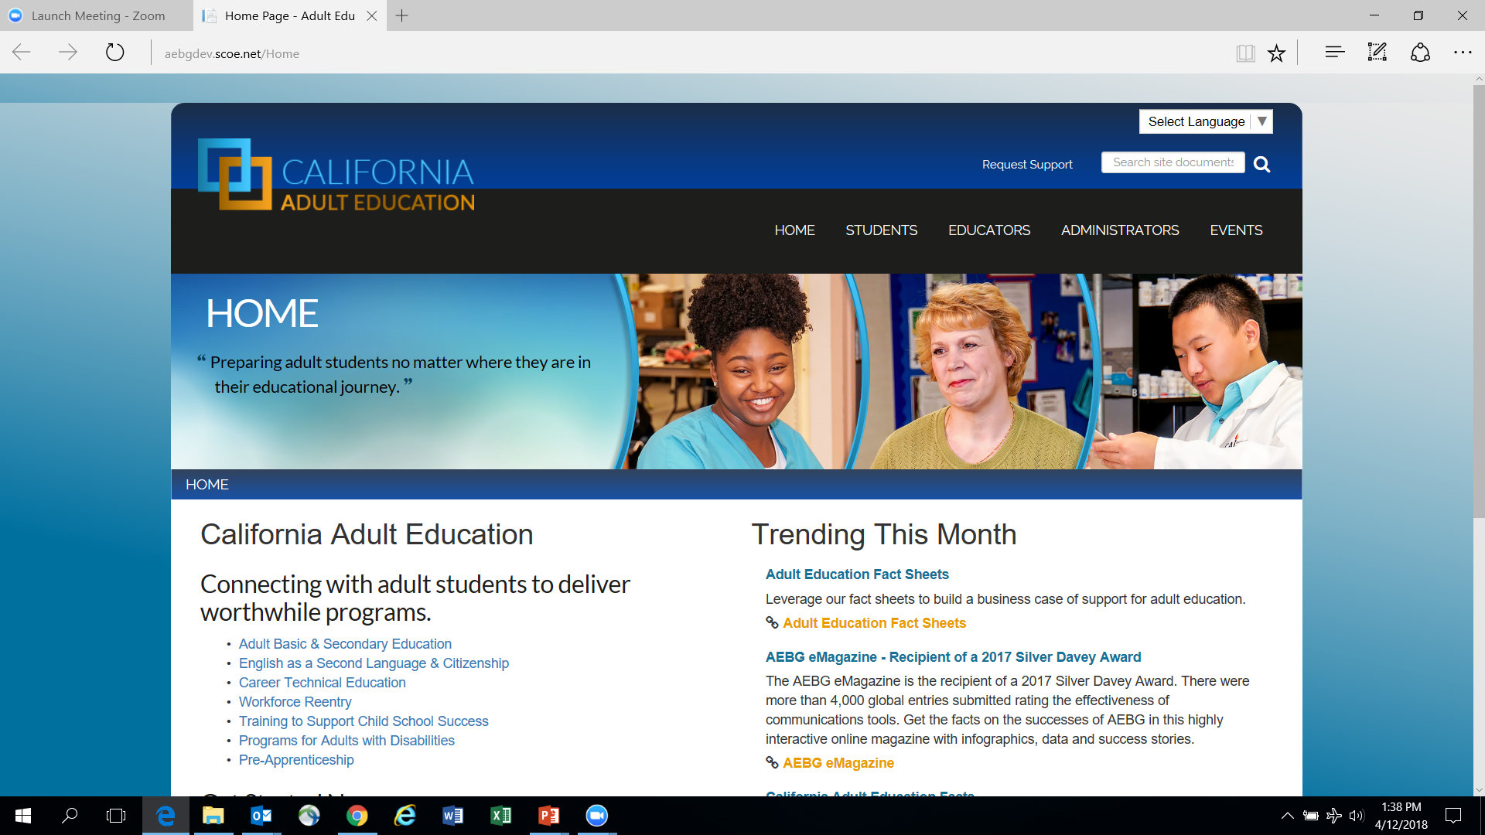
New Website!!!

