Slide 1
Effective Practices in Accreditation:
Standard IV – Leadership and Governance
Sunita Cooke, President, MiraCosta College
John Freitas, Los Angeles City College
Bobbi Kimble, Dean, Los Angeles Community College District
Craig Rutan, Santiago Canyon College
2016 ASCCC Accreditation Institute

Slide 2
What brings you here?
What questions would you like answered?

Slide 3
Standard IV – Leadership and Governance
Standard IV.A Decision-Making Roles and Processes
Standard IV.B Chief Executive Officer
Standard IV.C Governing Board
Standard IV.D Multi-College Districts or Systems

Slide 4
Standard IV.A - Decision Making Roles and Processes
The institution recognizes and utilizes the contributions of leadership throughout the organization for continuous improvement of the institution.
Governance roles, structures, processes, and practices are designed to facilitate decisions that support student learning programs and services and improve institutional effectiveness.

Slide 5
Standard IV.A – Decision Making Roles and Processes
Standard | Description
IV.A.1 | Institutional leaders create and encourage innovation
IV.A.2 | Policy and procedures for constituent input and in decisions
IV.A.3 | Administrators and faculty have clearly defined roles and a substantive voice in institutional governance, planning and budget
IV.A.4 | Faculty and administrators have responsibility for recommendations about curriculum and student learning programs and services
IV.A.5 | Ensures appropriate consideration of relevant perspectives, with timely action
IV.A.6 | Decision-making processes and resulting decisions are documented and widely communicated
IV.A.7 | Leadership roles and governance regularly evaluated and widely communicated

Slide 6
Participatory Governance is Good Practice
Effective leadership and governance:
Recognizes talents and contributions of individuals regardless of position
Encourages innovation and taking initiative
Encourages collegial dialog for the common cause of student success
Notes:
John

Slide 7
Senates, the 10+1, and Standard IV.A
10+1 Area | Relevant Standard
Curriculum, including establishing prerequisites and placing courses within disciplines | IV.A.4, 5, 6
Degree and certificate requirements | IV.A.4, 5, 6
Grading policies | IV.A.4, 5, 6
Educational program development | IV.A.4, 5, 6
Standards or policies regarding student preparation and success | IV.A.4, 5, 6
District and college governance structures, as related to faculty roles | IV.A.2, 3, 4
Processes for program review | IV.A.3, 5, 6
Processes for institutional planning and budget development | IV.A.3, 5, 6

Slide 8
Important Changes to IV.A in 2014 Standards
IV.A.4 (formerly II.A.2.b) – no longer specifically identifies academic senates and curriculum committees
IV.A.5 (formerly II.A.3) – now expects timely action on institutional plans, policies, curricular change, etc.
IV.A.6 (new!) – requires documentation and wide communication of resulting decisions

Slide 9
Document, document, document!
Document Institutional Processes and Evaluate Effectiveness
  Are they clear and accessible to all?
  What is the level of awareness and understanding of the governance process? Is there evidence of how they are developed, approved, and revised?
  Are roles of faculty, administrators, staff and students well-defined?
  Are responsibilities of academic senates, classified senates and college councils well-defined?

Slide 10
Document, document, document!
Document and Widely Communicate Decision-Making
  How are recommendations documented and transmitted to the CEO or Board of Trustees?
  How are final decisions by the CEO or Board on recommendations documented and widely communicated?
  How are decisions translated into actions that improve the institution?
  How is the governance process evaluated and improved?
  How are changes to governance processes documented and widely communicated?

Slide 11
Some Effective Practices
Announce meetings and and pending actions to the entire campus, not just the committee members
Make agendas, minutes and meeting materials easily accessible to everyone
Make board policies and administrative procedures easily accessible
Create clear, understandable, and easily-accessible handbooks that explain the institutional planning and governance processes
Create clean, clear committee web pages
Create a governance committee assessment process with documentation
Institute a monthly newsletter that includes highlights of the work and outcomes planning and governance
Include status of previous actions on meeting agendas
Others?

Slide 12
Standard IV.B – Chief Executive Officer
The CEO leads and guides the institution in a teaching and learning environment that promotes student success, sustained academic quality, integrity, fiscal stability, and continuous improvement of the institution.
Governance roles are clearly defined.
The superintendent/president has the executive responsibility for interpreting and administering the policies, supporting student learning programs and services, and improving institutional effectiveness.

Slide 13
Standard IV.B – Chief Executive Officer
Standard | Description
IV.B.1 | CEO has primary responsibility for the quality of the institution
IV.B.2 | CEO plans, oversees, and evaluates an administrative structure CEO delegates authority to administrators and others
IV.B.3 | CEO guides institutional improvement of the teaching and learning environment
IV.B.4 | CEO has primary leadership role for accreditation
IV.B.5 | CEO assures the implementation of statues, regulations, and governing board policies and assures that practices are consistent with institutional mission and policies
IV.B.6 | CEO works and communicates effectively with the communities served by the institution

Slide 14
Some Effective Practices
When hiring a CEO, look for experience in accreditation within the institution and on visiting teams
Be sure CEO understands nuts & bolts of accreditation and supports the work at the institution
CEO participation on accreditation visiting teams
Appreciate the roles that all constituent groups have in governance, student success, institutional quality and effectiveness
Mock interviews with constituent and governance groups

Slide 15
Standard IV.C – Governing Board
The board has authority and responsibility over clearly defined duties and acts as an independent policy making body, acts collectively, and advocates for the needs of the community served by the district.
The board sets expectations for academic quality, student success, programs and services, fiscal health, and ethics through regularly revised board policies.
The board abides by its policies and ethics standards.
The board delegates full responsibility for interpretation and implementation of the policies to the CEO and holds the CEO accountable.
The board is informed about accreditation expectations, policies and practices, and supports institutional improvement.

Slide 16
Standard IV.C – Governing Board
Standard | Description
IV.C.1 | Responsible for policies to assure the academic quality, integrity, and effectiveness of the student learning programs and services and the financial stability of the institution
IV.C.2 | Acts as a collective entity
IV.C.3 | Adheres to a clearly defined policy for selecting and evaluating the CEO of the college and/or district
IV.C.4 | Reflects the public interest in the institution’s educational quality. Advocates for and defends the institution and protects it from undue influence or political pressure.
IV.C.5 | Establishes policies consistent with the college/district/system mission to ensure the quality, integrity, and improvement of student learning programs
IV.C.6 | Publishes the board bylaws and policies specifying the board’s size, duties, responsibilities, structure, and operating procedures

Slide 17
Standard IV.C – Governing Board (cont.)
Standard | Description
IV.C.7 | Acts in a manner consistent with its policies and bylaws
IV.C.8 | Ensures the institution is accomplishing its goals for student success
IV.C.9 | Has an ongoing training program for board development, including new member orientation
IV.C.10 | Board policies clearly establish a process for board evaluation
IV.C.11 | Upholds a code of ethics and conflict of interest policy, and individual board members adhere to the code
IV.C.12 | Delegates full responsibility and authority to the CEO to implement and administer board policies without board interference and holds CEO accountable for the operation of the district
IV.C.13 | Informed about the eligibility requirements, the accreditations standards, commission policies, accreditation processes, and the college’s accredited status.

Slide 18
Some Effective Practices (CEOs)
Board retreats/workshops (accreditation, board/CEO relations, evaluation)
Membership in the CCLC policy and procedure service
Ensure that policies and procedures are being reviewed and updated on a regular basis
Make all minutes, agenda, and policies/procedures readily available for the public (website)
Work towards a healthy board - policy role, independence, delegation, evaluation, goal setting that supports the district in fulfilling its mission
Continuity of board and regular training
Codify role of board in establishing standards for academic quality, student success, effectiveness
CEO solidifies the manner in which the board will be involved in self-evaluation and accreditation visit

Slide 19
Standard IV.D – Multi-College Districts or Systems
This standard is unique to multi-college districts/systems about collaboration, integration, and communication
The district CEO sets expectations for educational excellence and integrity
Functions, communication and decision-making of the district office and colleges are clearly delineated, communicated, and evaluated to achieve the mission
Allocation and reallocation of resources is to support effective operations, sustainability, and expenditure controls
Full delegation of authority to the college president
District and college planning and evaluation are integrated

Slide 20
Standard IV.D – Multi-College Districts or Systems
Standard | Description
IV.D.1 | CEO provides leadership in setting and communicating expectations of educational excellence and integrity and assures support for the effective operation of the colleges. CEO establishes clearly defined roles, authority, and responsibility between the colleges and the district/system.
IV.D.2 | CEO clearly delineates, documents, and communicates the operational responsibilities and functions of the district/system from those of the colleges. CEO ensures the colleges receive effective and adequate district/system provided services to support the colleges in achieving their mission.
IV.D.3 | District/system has a policy for allocation and reallocation of resources that are adequate to support the effective operations and sustainability of the colleges and the CEO ensures effective control of expenditures.
IV.D.4 | CEO delegates full responsibility to the CEOs of the colleges to implement and administer delegated district/system policies without interference, and holds them accountable.

Slide 21
Standard IV.D – Multi-College Districts or Systems
Standard | Description
IV.D.5 | District/system planning and evaluation are integrated with college planning and evaluation to improve student learning and achievement and institutional effectiveness.
IV.D.6 | Communication between colleges and district/systems ensures effective operations of the colleges and should be timely, accurate, and complete in order for the colleges to make decisions effectively.
IV.D.7 | District/system CEO regularly evaluates district/system and college role delineations, governance and decision-making processes to assure their integrity and effectiveness in assisting the colleges in meeting educational goals for student achievement and learning. The district/system widely communicates the results of these evaluations and uses them as the basis for improvement.

Slide 22
LACCD’s Challenges: Timeline Changes – VISITS
Harbor, Southwest, West (Seaside)
Last visit:
Spring 2012
Mission, Pierce, Valley (Valleyside)
Last visit:
Spring 2013
Next visit (old timeframe): Spring 2019
East, City, Trade-Tech (Cityside)
Last visit:
Spring 2009
Next visit (old timeframe): Spring 2015
Next visit
(new timeframe):
Spring 2016
TOTAL LOSS =
-2 YEARS
Next visit
(new timeframe):
Spring 2016
TOTAL LOSS =
-3 YEARS
Next visit
(new timeframe):
Spring 2016
TOTAL GAIN =
+1 YEAR
Next visit (old timeframe): Spring 2018

Slide 23
LACCD Timeline Changes: REPORTS
Harbor, Southwest, West (Seaside)
Self Study 2012
Mission, Pierce, Valley (Valleyside)
Self Study 2013
Follow Up Reports 2014, 2015
East, City, Trade-Tech (Cityside)
Self Study 2009
Mid-Term 2012
Self Study 2016
Self Study 2016
Follow Up Reports 2013, 2014;
Mid-Term 2015
Self Study 2016

Slide 24
How We Tackled It All….
Started from scratch with an EVIDENCE review
Looked at EVERYTHING (websites, reports, manuals, plans, etc), asking:
  Does it make sense?
  Is it true?
  Can a lay person understand it?
  Can WE understand it?
Frequently found that we were actually DOING much of what we were supposed to, but hadn’t connected the dots back in a way that would serve as documentation
Cataloged all evidence from district reports back to 2013; created a cross-reference system; created a SharePoint site with evidence folders.
Used/updated what we could from the past, but pretty much built from scratch

Slide 25
Districtwide Collaboration
Governance Committee
District Planning and Accreditation Committee (DPAC) lacked yearly goals, work plan and formal faculty leadership
Revised Committee charter, strengthened direction, created Senate Co-Chair (formerly chaired only by Associate Vice Chancellor), added representative from administrative council, technology planning committee
Set yearly work plan to cover gaps and create clear accomplishments for members
Governance Manual
Layout of District Governance and Functions Handbook hadn’t been updated since inception (2006). Complete overhaul was needed
Functional area maps were standardized, updated to current standards, sent out for constituent review/comment/revisions
Created an integrated planning chapter (big challenge)
Weeded out a lot of superfluous information; emphasis on user-friendly, succinct document (work in progress)
Self Study
Division of labor: DPAC meetings dedicated to reviewing all 129 standards/sub standards, determining which sections the District would provide, where to look for evidence
Wrote, re-wrote, edited, sent out for comment
Populated Sharepoint site, issued passwords, edited some more
CHALLENGES:
No cross-referencing system = no way to track or update evidence used across multiple reports
New ACCJC requirements: evidence MUST be provided electronically
Huge file management (logistical) problem
We were used to telling a story, then using the evidence to support that story. Now the evidence itself became the story.
INSIGHTS:
Recognize that little we’d done before would work in this new context
We work as a synchronized system across all standards and colleges, NOT silo’d out by standards , roles or titles
Took at hard look at our systems, documentation and processes
Found plenty of room for improvement (good!) but no framework to move it all forward in a logical fashion (not so good)

Slide 26

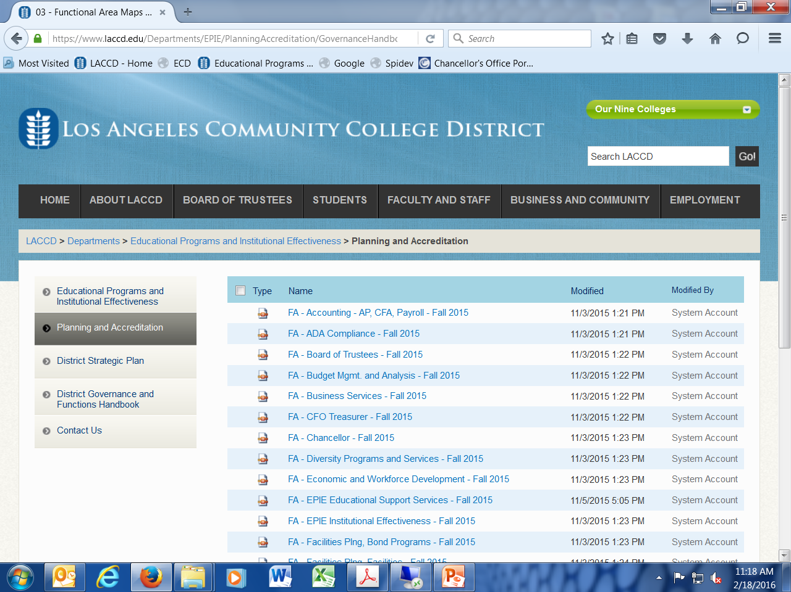

Slide 27
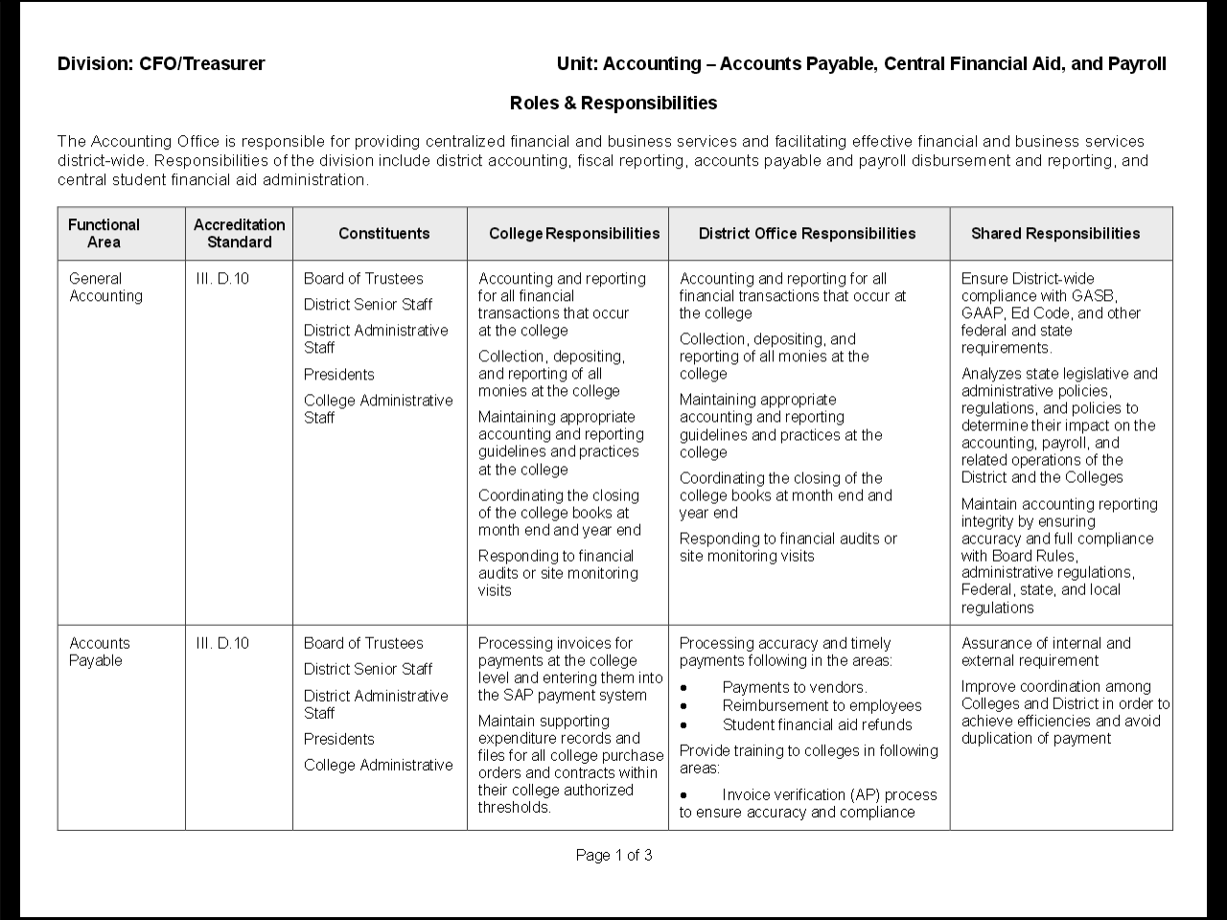

Slide 28
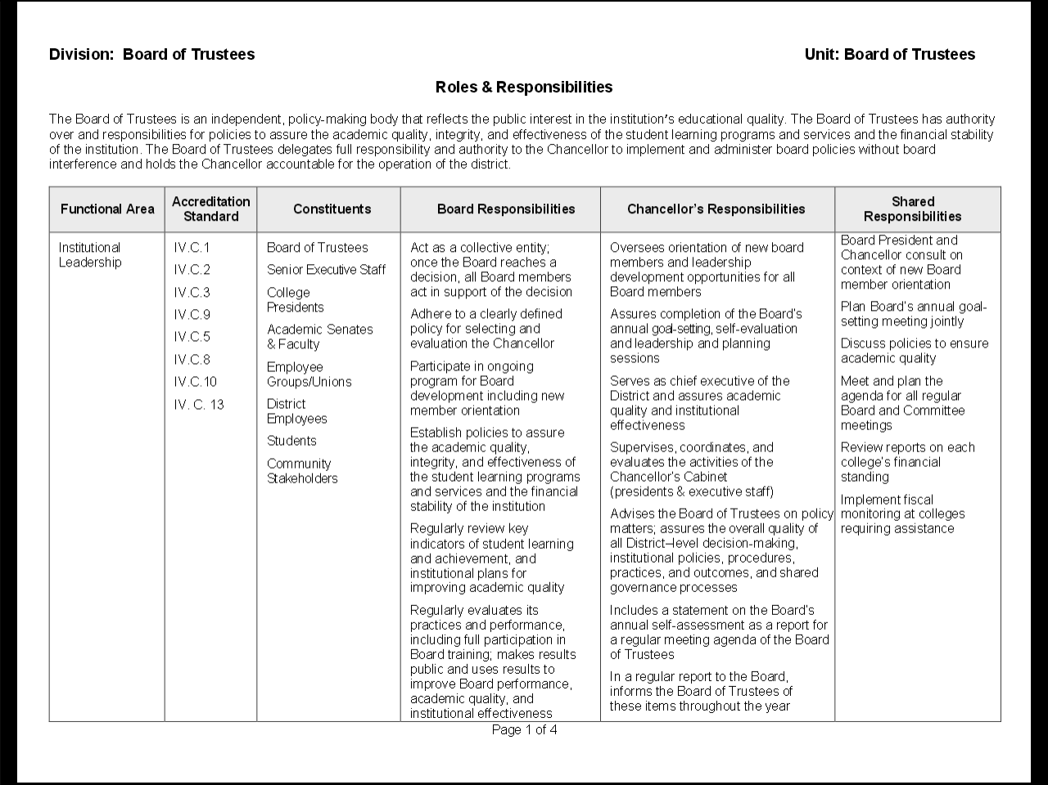

Slide 29
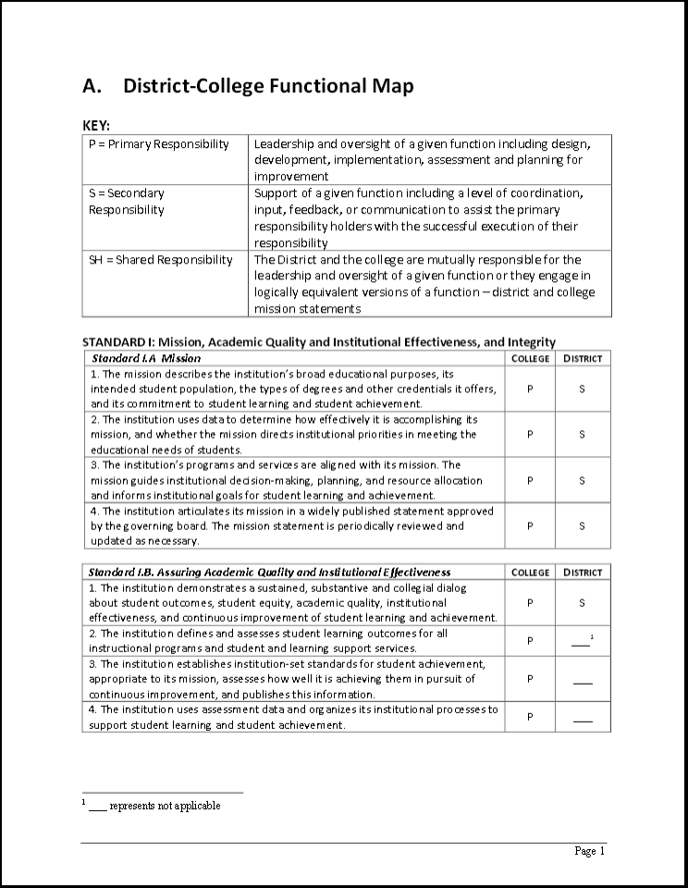

Slide 30
Standard IV.D – What We Found
Board engagement is critical – Institutional Effectiveness and Student Success Committee set an “accreditation-centric” agenda, visiting 5 colleges in 2014 and all 9 in 2015
Functional Area maps for Board and Chancellor to show clear delineation of responsibility
Instituted a regular newsletter – communication, direction, shared vision, educational excellence
Direct outreach to other governance committees – District Budget Committee, Technology Committee – to encourage alignment with District Strategic Plan and ACCJC standards; document points of mutual contact and decision making
Revised biennial student survey; created crosswalk w/ACCJC standards, SLO’s

Slide 31
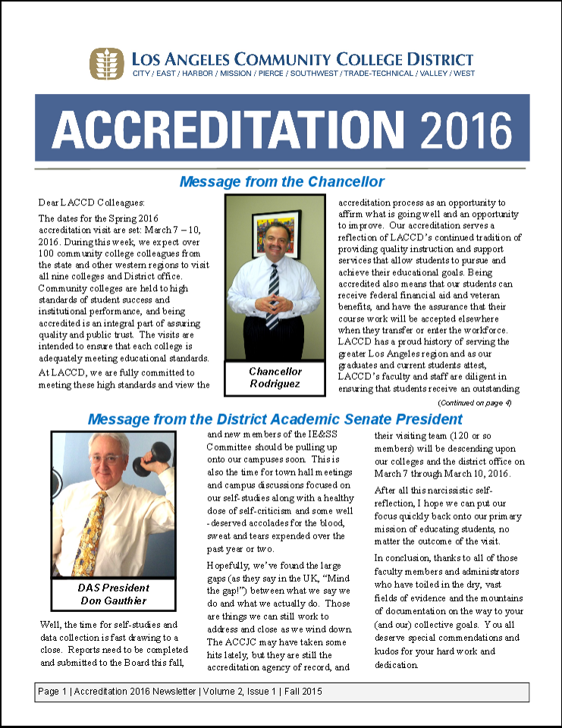

Slide 32
Survey Question | Accreditation Standard
I am familiar with the mission statement of this college | I.A Mission
I am aware of the intended learning outcomes of this college | I.B Academic Quality
I know where to find information on: Student success rates for this college and my program | I.B Institutional Effectiveness
The policies and penalties for cheating are clear and enforced | I.C Institutional Integrity
Course syllabi are followed | II.A Instructional Programs
Equipment and labs are adequate and up-to-date | II.B Library and Learning Support Services
Have you been able to follow the recommended list of courses in your Educational Plan? | II.C Student Support Services
I receive excellent instruction in most of my courses | III.A Human Resources
Campus buildings are clean and well maintained | III.B Physical Resources
I know who to contact if I have a problem with my LACCD email account | III.C Technology Resources
Student needs are taken into consideration by this college when making decisions | IV.A Decision-Making Roles and Processes
Survey Question

Slide 33
Resources
ACCJC Eligibility Requirements, Standards, Guides http://www.accjc.org
Examples of Integrated Planning and Governance Handbooks
  Los Angeles City College http://bit.ly/1Qeu0Fb
  Cuesta College http://bit.ly/1Qeu8om
  Rancho Santiago CCD http://bit.ly/1XqvkVa
  Santiago Canyon College http://bit.ly/1Wk4mgO
  Santa Ana College http://bit.ly/1PKagUi
LACC Committee Annual Assessment Template http://bit.ly/1TlIkvX
Supplementary materials for this presentation can be found at http://www.asccc.org/events/2016-02-19-160000-2016-02-20-200000/2016-accreditation-institute

Slide 34
Questions?
“
Our Contact Information:
Sunita Cooke – scooke@miracosta.edu
John Freitas – freitaje@lacitycollege.edu
Bobbi Kimble – kimbleb@email.laccd.edu
Craig Rutan – rutan_craig@sccollege.edu
THANK YOU!

