Slide 1
Welcome to the 2023 Accreditation Institute! We’ll begin shortly

Slide 2
Land Acknowledgement
We acknowledge that this important work is taking place throughout the unceded territory of California, home to nearly 200 tribal nations. We acknowledge and honor the original inhabitants of our various regions. A land acknowledgment is a critical step towards working with native communities to secure meaningful partnership and inclusion in the stewardship and protection of their cultural resources and homelands.
I acknowledge that I’m speaking to you on the land of the Kumeyaay people who have lived and continue to live here. I recognize the Kumeyaay people and their spiritual connection to the ocean and the land as the first stewards and the traditional caretakers of this area we now call San Diego. As we begin, I thank them for their strength, perseverance, and resistance and I invite you to take some time to recognize and honor the native communities in your area for their shared struggle to maintain their cultures, languages, worldview, and identities in our diverse landscape.

Slide 3
Cheryl Aschenbach ASCCC President
Welcome Statement

Slide 4
Institute Schedule
9:30 a.m. to 10:30 a.m. First General Session: Effective Strategies in Presenting Disaggregated Data to Tell the Story of Your Institution
10:30 a.m. to 11:00 a.m. Break
11:00 a.m. to 12:00 p.m. Second General Session: ACCJC Updates: The Newly Adopted 2024 Standards and the Comprehensive Review Process
12:00 p.m. to 1:00 p.m. Lunch
1:00 p.m. to 2:00 p.m. Third General Session: ACCJC’s Social Justice Policy and Enhancing Racial Equity in Accreditation
2:00 p.m. to 2:30 p.m. Break
2:30 p.m. to 3:30 p.m. Fourth General Session: Distance Education: Faculty, Students, and Accreditation
4:00 p.m. to 5:15 p.m. Fifth General Session: What Do I Do with All These Reports? Integrative Planning, Data-Informed Decision Making and Continuous Quality Improvement

Slide 5
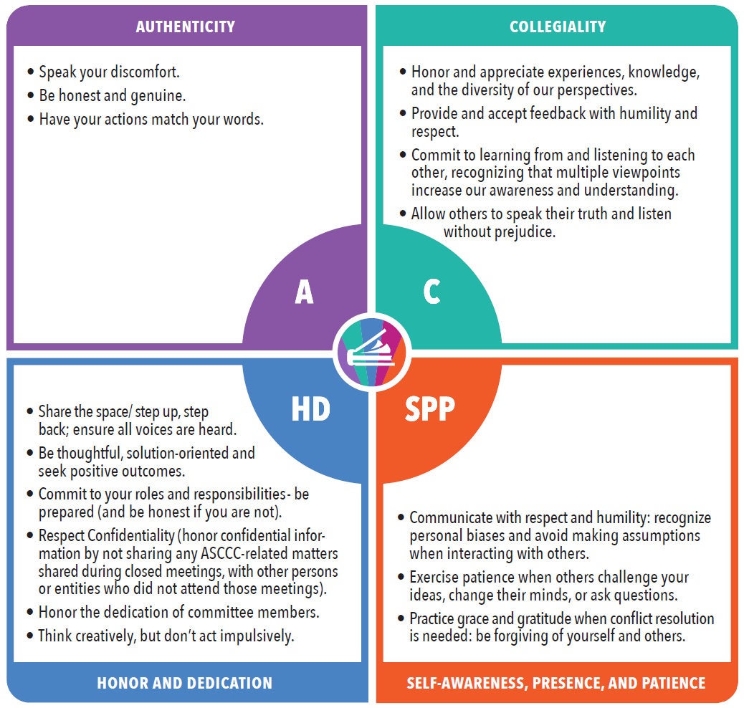
ASCCC Community Agreements

Slide 6
Thank You!
Events such as the Accreditation Institute require a great deal of work and support to be successful. We are sincerely grateful to the following groups and people for their support in making this Institute a success:
The 2023-’24 Accreditation Committee
The 2022-’23 Accreditation Committee (Co-chairs Dr. LaTonya Parker and Robert L. Stewart Jr.)
ASCCC President Cheryl Aschenbach and The ASCCC Executive Committee
Kevin Bontenbal and the ACCJC
Jeffrey Lamb and the CCCCIO
Tonya Davis, Patricia Carrillo, Austin Webster and the ASCCC Office Team
And to all of you for your participation and your leadership at your colleges!

