Slide 1
Pause, Reflect, Refine:
Mid-Semester Check-in
Using the CVC-OEI Rubric
Cheryl Chapman & Shawn Valcarcel
Instructional Designers (CVC)

Slide 2
Course Updates
Immediate fixes and updates
use announcements and the Canvas Inbox to clarify
Substantive Changes
use a Sandbox/Development Shell

Slide 3
Section A
Section B
Section C
Course Design Rubric

Slide 4
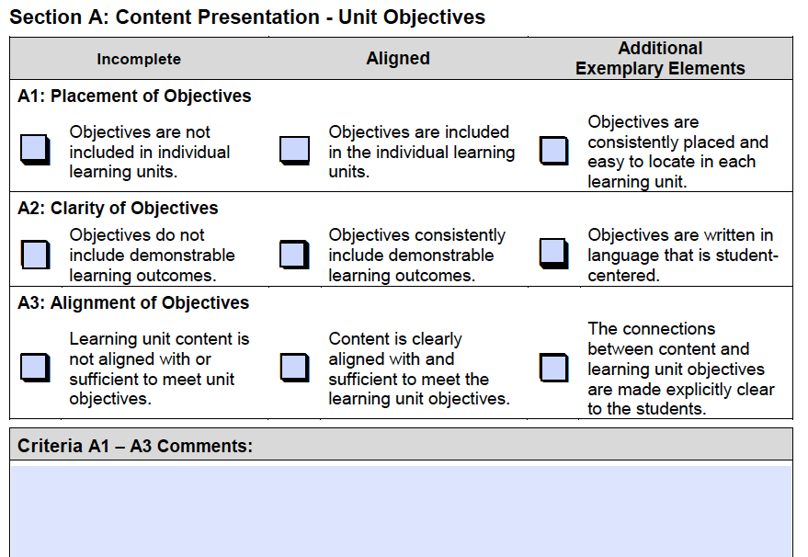
Use the Rubric as a...
Licensed under a Creative Commons Attribution 4.0 International license.
Instructors
Roadmap for building a new course
Tool to update/improve existing courses
Designers - Introduction to
Course elements
Course navigation
Student interactions

Slide 5
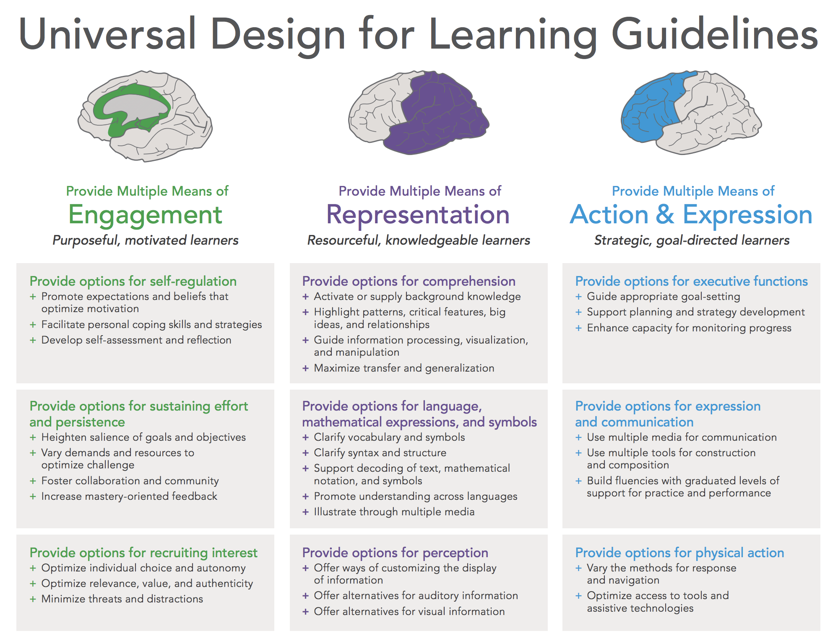
Accessibility First!
For All Students!
It’s the Law!
There are two major pieces of legislation that provide the foundation for our approach to accessibility in California:
Americans with Disabilities Act
Section 508 of the Rehabilitation Act of 1973
This legislation provides the underlying mandate for designing courses that are accessible to students with visual, auditory, and physical impairments, as well as students with information processing differences.
Universal Design for Learning

Slide 6
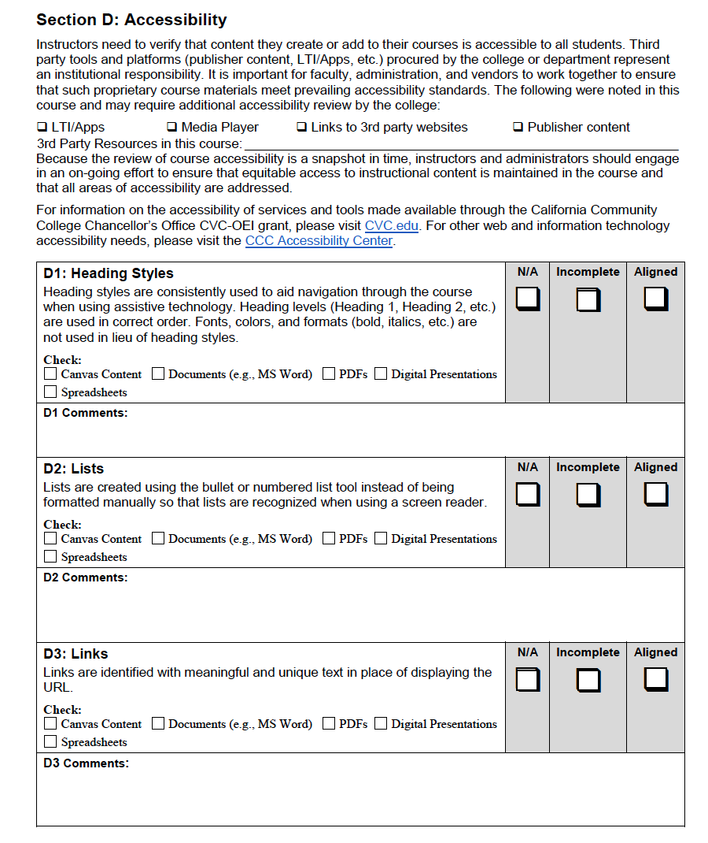
Section D: Accessibility
D1 Heading Styles
D2 Lists
D3 Links

Slide 7
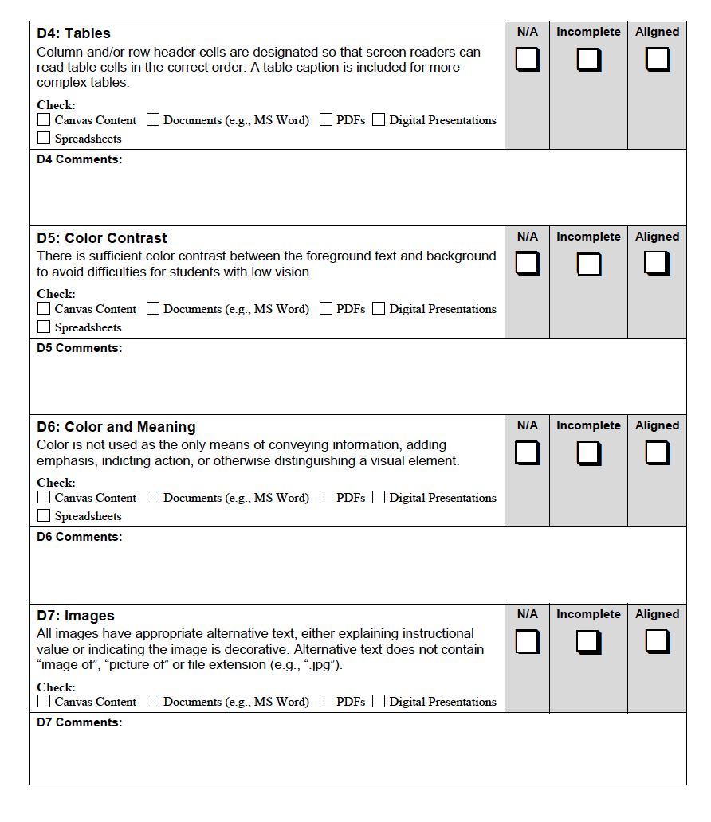
Section D: Accessibility
D4 Tables
D5 Color Contrast
D6 Color/Meaning
D7 Images

Slide 8
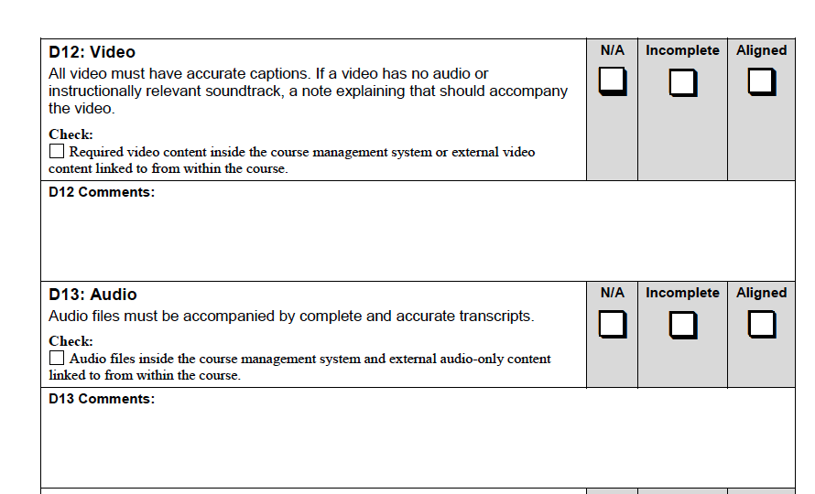
Section D: Accessibility
D12 Video
D13 Audio

Slide 9
Getting Started with a Sandbox
Fall 2020 ‘Live’ Course > Copy into a Sandbox/Dev Shell (name SP2021)
Make substantive changes for next semester in SP2021 Sandbox
Import Updated Content from SP2021 Sandbox into SP 2021 live course

Slide 10
Poll
Do you have an anonymous survey before the midterm? The final?
Do you use the results to make changes in your course for next term?

Slide 11
Possible Survey Questions
Example: We are just about at the halfway point in this course, so let's see how are we doing so far. Your responses are anonymous and are used only to improve your learning experience!
The design/structure/pacing/navigation of the course supports my understanding of the material. | Section A - Content Presentation/Unit Objectives A4 Course Navigation A5 Unit Chunking A6 Page Chunking
The objectives for each lesson are clear. | Section A Content Presentation/Unit Objectives A2 Clarity of Objectives
The instructions for each assignment are clear. | Section A Content Presentation/Unit Objectives A9 Instructions
I feel part of a learning community, connected to other students. | Section B Interaction/Instructor Contact B5 Regular Effective Contact Among Students
There has been helpful and timely feedback to me so far. | Section C Assessment/Effective Assessment C7 Feedback
I found opportunities so far to access my learning with instructor feedback. | Section C Assessment/Effective Assessment C8 Self-Assessment

Slide 12
Revision Process
Topic | Rubric Section | Rubric Item
Accessibility Check (pages first) | Section D | All pages
Mid-semester/final anonymous survey for continually course improvement | Section A | A11 Learner Feedback
Check Assessments are aligned with content (remove fluff or extra documents) | Section C | C2 Validity
Review Quizzes (reviewing results) | Section C | C1-4 Assessment/Effective Assessment
Adding images and new media in intervals | Section A | A8: Effective Use of Multimedia
Create new videos and add quizzes and conversations | Section A | A8: Effective Use of Multimedia

Slide 13
Resources
CVC Course Quality Rubric
(https://onlinenetworkofeducators.org/wp-content/uploads/2020/06/CVC_OEI_Course_Design_Rubric_rev_April_2020.pdf)
@ONE Course Listing
(https://onlinenetworkofeducators.org/course-cards/)
Aligning Section D in Canvas
(https://ccconlineed.instructure.com/courses/1455)
American Disabilities Act
(https://www.ada.gov/ada_intro.htm)
Section 508/Rehabilitation Act of 1973
(https://www.section508.gov/content/learn/laws-and-policies)
Universal Design for Learning
(https://ccconlineed.instructure.com/courses/4547/files/319783/download?wrap=1)

Slide 14
Questions?
cchapman@cvc.edu
svalcarcel@cvc.edu

