Slide 1
Dynamic Maps! Building Better Programs and Guided Pathways Maps with currIQūnet META
Nancy Howard, VP Product Delivery and Support
Ken Brown, VP Development and Technology
Mark Svorinic, CEO

Slide 2
Pathways As A Catalyst. . .
You Have All You Need – Use It!
Simple to Build
Easy to Maintain
Customize for added value
Good data leads to great maps!
Dynamic and in Real-Time
Create Once, Use Everywhere
Clear Pathways and Programs
Guided Exploration
Guided Progression
Academic & Student Support
Teaching
Learning

Slide 3
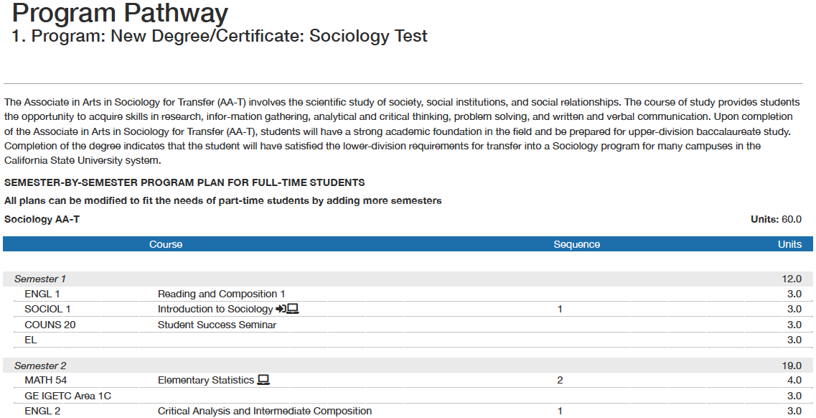
Associate in Arts in Sociology for Transfer (AA-T)
1
1
1
1
1 – Easily include known and approved curriculum data

Slide 4
Associate in Arts in Sociology for Transfer (AA-T)
2
2
2
2
2 – Simple semester by semester format with sequencing recommendations

Slide 5
Associate in Arts in Sociology for Transfer (AA-T)
3
3
3
3 – Dynamically include and calculate units or credits

Slide 6
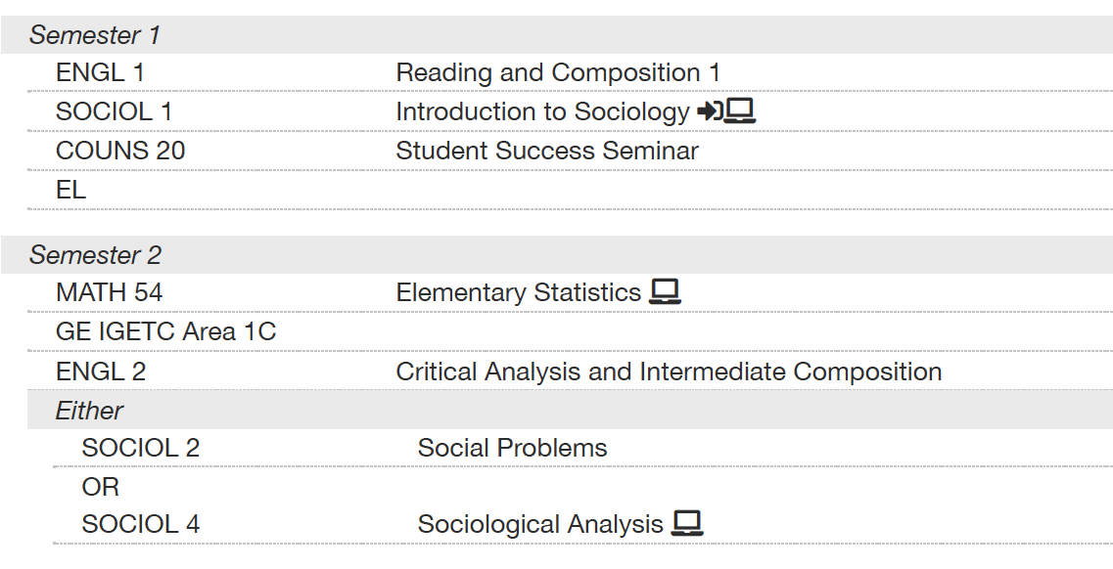
4
4
4
4 – Easily include informational icons for Online, Gateway, or Global Citizenship courses, etc.

Slide 7
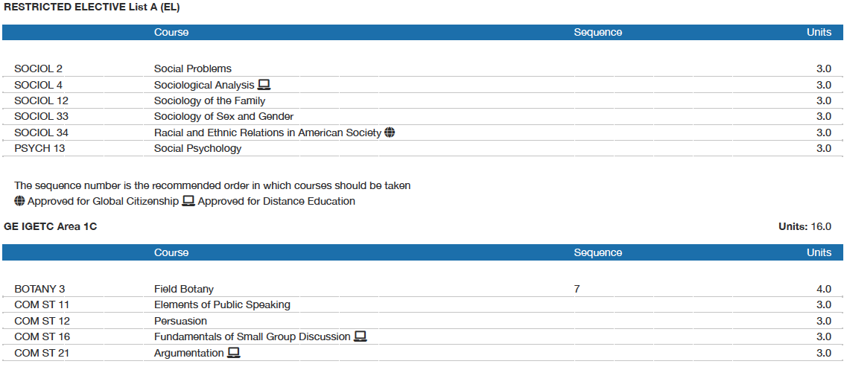
5
5 – Automatically include relevant legends to ease use

Slide 8
6
6
6 – Easily reference and include course block libraries

Slide 9
META Pathways and Programs
Maintain
Leverage
Impact
Share
Build

Slide 10
Let’s Build a Map!
1 – Semesters
Structure
2 – Courses
Content
3 – Sequences
Guidance
4 – References
Utility
5 – Output
Value

