Slide 1
California Community Colleges HBCU Connections: Transfer & Beyond

Slide 2
Historically Black College and Universities
Historically Black colleges and universities (HBCUs) are institutions that were established prior to 1964 with the principal mission of educating Black Americans. These institutions were founded and developed in an environment of legal segregation and, by providing access to higher education, they contributed substantially to the progress Black Americans made in improving their status.
Soruce: IES-National Center for Education Statistics

Slide 3
HBCU Background
Currently there are 101 Historically Black Colleges and Universities recognized by the US Dept. of Education located mainly in the South and on the East Coast. *2% of degree granting post-secondary institutions in the US. They include public, private, denominational, liberal arts, land-grant, independent university systems, single-gender serving, researched based, large and small with enrollment that range from less than 300 to over 11,000 students.
59% Award Bachelor’s Degrees only
41% Award Graduate/Masters/Professional Degrees
28% Award Doctoral Degrees

Slide 4
History & Background of HBCUs
Morrill Act of 1890
Notes:
The Morrill Acts
The First Morrill Act - the Morrill Land Grant College Act of 1862 set aside federal lands to create colleges to “benefit the agricultural and mechanical arts.”
The Second Morrill Act of 1890 The Second Morrill Act of 1890
prohibited the distribution of money to states that made distinctions of race in admissions unless at least one land-grant college for African Americans,
required the former Confederate states to establish sister universities for Blacks
creating the 1890 Historically Black Land-Grant Universities, which were some of the first Historically Black Colleges and Universities (HBCUs) in the nation. was established…establishing19 public black colleges

Slide 5
HBCU SUCCESS FACTS
How Many African Americans Are HBCU Graduates?
24% of Bachelors Degree Holders
40% of Members of Congress
12.5% of CEO’s
40% of Engineers
50% of Professors at Non-HBCU Institutions
50% of Lawyers
80% of Judges
(Diverse Issues in Higher Education, September 9th 2015/TMF Website)

Slide 6
The HBCU Educational Approach
A holistic intrusive advising approach is used to meet the needs of Black students, HBCUs have found the keys to unlocking the nation's student potential despite the challenges they face at Predominantly White Institutions (PWI) (Jones & Owens, 2018, para. 8).
Seymoure and Ray (2015) discovered that HBCU students report higher levels of satisfaction and more frequent and higher quality interaction with faculty and mentors than their counterparts at PWI’s.
Black students find validation, community, and student success with Black faculty due to common interests, beliefs, and cultural support (Bauer, 2014; Wood, 2014; Wood & Turner, 2011).

Slide 7
Helen P Young
Assistant Project Director

Slide 8
Began with nine HBCUs in 2015, now there are thirty-nine California Community College HBCU Partners!
Alabama State University, AL
Alcorn State University, MS
Arkansas Baptist College, AR
Benedict College, SC
Bethune- Cookman University, FL
Bennett College, NC
Bowie State University, MD
Claflin University, SC
Clark Atlanta University, GA
Central State, OH
Dillard University, LA
Edward Waters College, FL
Fisk University, TN
Florida Memorial University, FL
Fort Valley State University, GA
Grambling State University, LA
Hampton University, VA
Harris-Stowe State University, MO
Huston-Tillotson, TX
Kentucky State University, KY
Lane College, TN
Lincoln University, MO
Lincoln University, PA
Mississippi Valley State University, MS
North Carolina Central University, NC
Shaw University, NC
Philander Smith College, AR
Southern University and A&M College, LA
Southern University at New Orleans, LA
Stillman College, AL
Talladega College, AL
Tennessee State University, TN
Texas Southern University, TX
Tougaloo College, MS
Tuskegee University, AL
Virginia State University, VA
West Virginia State, WV
Wiley College, TX
Xavier University of Louisiana, LA

Slide 9
How Students Qualify for the Transfer Guarantee Agreement
(A) Obtain an Associate Degree for Transfer (ADT)*(60 units) with a 2.0 or higher GPA are guaranteed admission with junior standing to the 39 participating HBCUs.
*The Intersegmental General Education Transfer Curriculum (IGETC) or the California State University General Education Breadth pattern (CSU GE) must be followed when completing the ADT.
OR
(B) Transfer with 30 or more UC or CSU transferable units and a 2.0 or higher GPA. Units will be accepted for general education, pre major or elective units.
(Be advised that the minimum GPA requirement is higher for select partner HBCUs)

Slide 10
Partner HBCU Affordability
Fees & Tuition: the average cost to attend one of the HBCU partner institution is $13,500​
For our private partner HBCUs the cost is the same for all students no matter what state you originate from. ​​
For our public or state supported HBCU institutions Fees & Tuition increase for non-state residence. ​
HBCUs are offering in-state tuition & fees - the average cost to attend these partner schools is $7,800 (2019-20): ​
Lincoln University of PA​
Lincoln University of MO​
Grambling State University, LA*​
Alcorn State University, MS​
Harris-Stowe State University, MO​
Mississippi Valley State University ​
Southern University at New Orleans, LA *​
Southern University and A&M College, LA*​
West Virginia State University​
* certain requirements may apply

Slide 11
Program Benefits &Advantages
IN ADDITION TO THE ACCEPTANCE OF
TRANSFERABLE UNITS STUDENTS RECEIVE:
Fee waiver for the online Common Black College Application
Pre-transfer advisement from program and HBCU admission staff
Priority consideration for campus housing when deadlines met
Priority consideration for scholarship for students with a 3.2 GPA or higher based on available funding of HBCU

Slide 12
CCC to HBCU PROGRAM OUTCOMES
Over 400 CCC Students applied and transferred to one of the 39 HBCU partner schools
Average Persistence Rate 1 Year After Transfer: Approx. 359 (75%)
Average Persistence Rate for attending same institution: Approx. 238 (65%)
Average time to BA completion after transfer: 3 years
Number of students who have obtained a Baccalaureate Degree: 123
Number of students who attained a Graduate Degree: 1

Slide 13
Graduate & Career Path Profiles
Entrepreneurs
McDonald’s Corporation
Walmart Corporation
Google
Film/Production Companies
Education/Higher Ed
Accounting Firms
Athletic Coach
Social Work
Post-Bachelor Programs
Master’s Degree Programs
Law School

Slide 14
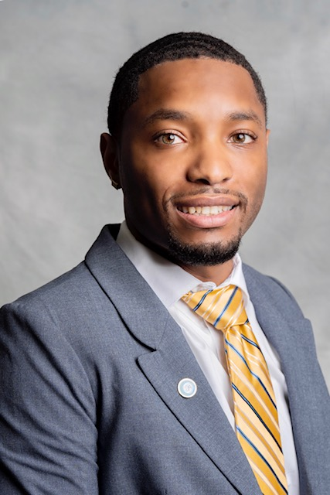
Mr. Ricker Carter Guest Panelist
LA Harbor College – Wilmington, CA
June 2019
AS – Fire Technology
AA Liberal Arts & Science: Arts and Humanities
AA Liberal Arts & Science: Social Behavioral Science
Southern University and A&M College – Baton Rouge, LA
May 2022
BS Agricultural Science w/concentration in Urban Forestry Natural Resources

Slide 15
BUILDING ON OUR HBCU SUCCESS Pipelines2Possibilities Developing Faculty Excellence in the CCC system!

Slide 16
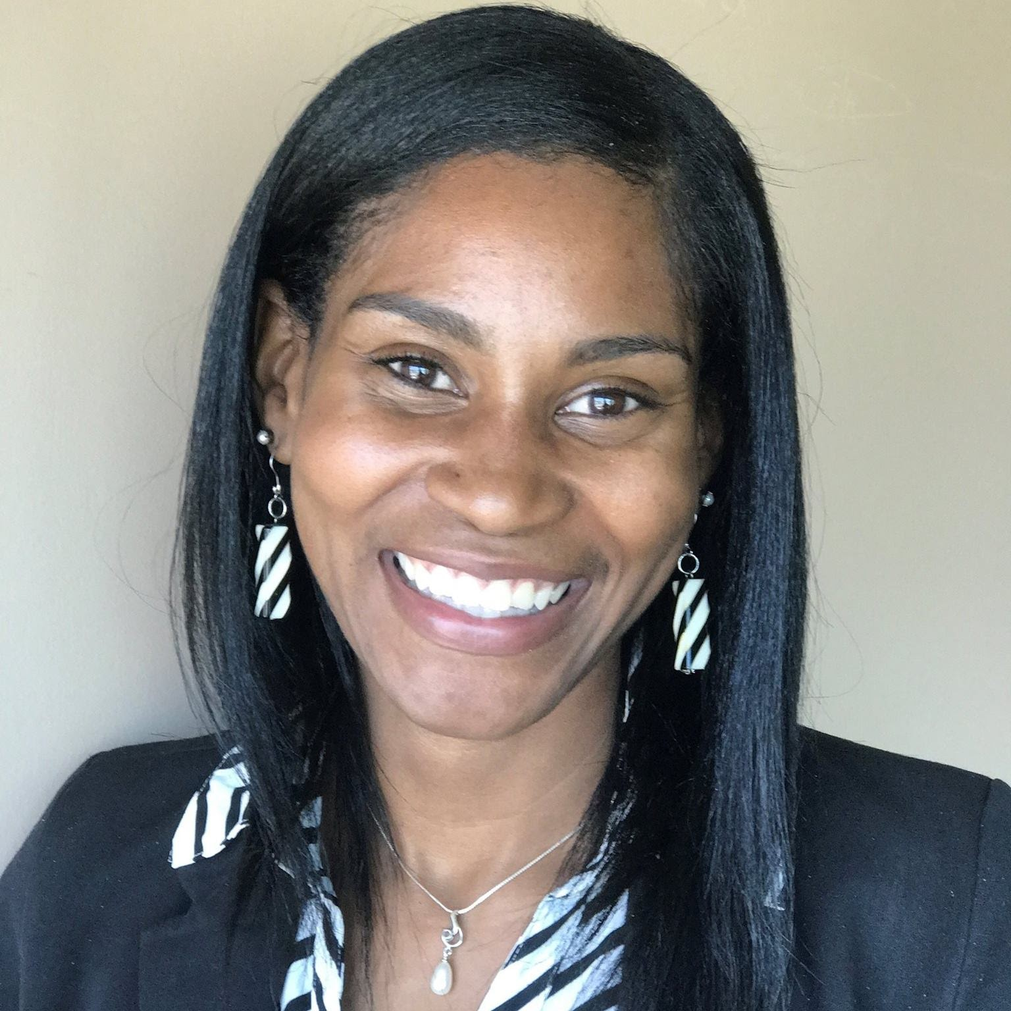
Ms. Sasha Knox
Founding P2P Team Member
12 years in Career Services and Student Advising
Job Placement Coordinator San Diego City College
Doctoral Student - San Diego State University’s EdD program concentration in Community College Leadership (CCLEAD) a Diversity Equity and Inclusion lens.
ADD PIC HERE

Slide 17
Vision for Success Alignment
VS Goal #5 Reduce equity gaps across all of the above measures through faster improvements among traditionally underrepresented student groups, with the goal of cutting achievement gaps by 40% within 5 years and fully closing those achievement gaps within 10 years
VS Goal #6 Reduce regional achievement gaps across all of the above measures through faster improvements among colleges located in regions with the lowest educational attainment of adults, with the ultimate goal of fully closing regional achievement gaps within 10 years

Slide 18
Diversity Equity and Inclusion Alignment
Institutional Diversity Strategies:
Vision for Success Commitment 2: Always design and decide with the student in mind
Strategy C: Develop culturally responsive faculty and staff (classified and administrators) recruitment strategies
Vision for Success Commitment 5: Take ownership of goals and performance
Strategy C: Implement innovative hiring and outreach practices focused on diversity such as advertising faculty openings in websites, publications, professional associations in specific disciplines, and other groups targeted towards underrepresented academic communities.
Vision for Success Commitment 6: Enable action and thoughtful innovation
Strategy A: Revise procedures that address diversity, equity, and inclusion to reduce bias in the hiring process. Ensure every step of the hiring process relates to Minimum Qualifications.
Individual Diversity Strategies:
Vision for Success Commitment 3: Pair high expectations with high support
Strategy A: Establish pipeline programs to diversify the faculty applicant pools.
Strategy B: Provide faculty and staff (classified and administrators) mentoring opportunities at colleges.

Slide 19
CCC Student Ethnic Demographic
Notes:
White students - 25%
Students of Color - 2.1 million students 75%
P2P seeks to diminish equity gaps as outlined in its Vision for Success, by improving proactive recruitment, hiring, and retention of diverse qualified tenured faculty within the CCC system, through the guaranteed placement of HBCU program participants to leverage the resources of the longstanding talent pipeline of faculty of color (The Foundation for California Community Colleges, n.d.).

Slide 20
CCC Faculty Demographic
Notes:
Black Faculty - 6%
White - 58%
75% of students of color

Slide 21
CCC Faculty Development Pipelines Across the State
Project Match (Los Angeles Community College District)
Faculty Diversity Internship (Peralta Community College District)
Faculty Diversity Internship (Los Rios Community College District)
Tech Exchange (“Howard West” Howard Univ. & Google, Inc.)
Preparing Future Professors (PFP Program) Stanford Univ.
Rise Program San Jose Unified School District & San Jose State University
2020-2021 California Community Colleges & HBCUs?

Slide 22
Pipelines2Possibilities Program
The Pipelines to Possibilities Program (P2P) offers a HBCU graduate internship program designed to develop an intentional faculty pipeline within the California Community College Districts. Through proactive recruitment, hiring, and retention of diverse tenured faculty aimed to diminish equity gaps, the P2P program meets the needs of diverse student populations to improve student success.

Slide 23
P2P Program Goals
1. Prioritize the value and contributions that faculty of color impart to all students and communities
Establish proactive recruitment of a pipeline of diverse tenured faculty of color.
3. Ensure guaranteed hiring of 15% tenured faculty of color within the CCC system.
4. Retain a pipeline of qualified faculty of color within the CCC system.
5. Prepare faculty of color with the knowledge, skills, and abilities to implement high-equity
driven pedagogy and leadership to foster student success.

Slide 24
Spring 2021 Pilot Program Success
Successfully paired nine HBCU graduate interns with nine CCC faculty. CCCs represented: San Diego City College, Los Angeles Pierce College, San Diego Mesa College, Southwestern College, Barstow Community College, Riverside City College, Moorpark College, and Diablo Valley College. HBCUs represented: Kentucky State University, Claflin University, Morgan State University and Grambling State University.
Training sessions were held over the 16 week term with the completion of thirty-six hours. Topics covered: Developing Black Spaces, Understanding the CCC Student and How to Serve, Creating, Developing and Validating Equity-Minded Classrooms, Conflict Management Resolution and Techniques, Cultural Proficiency and Curriculum Integration, Classroom Technology and Essentials of Distance Learning, Application, Hiring and Interview Strategies.
Session Presenters included: Dr. Edward Bush, Dr. Frank Harris III, Dr. Laura H. Manyweather, Dr. Siri Brown, Dr. Eric Bishop, Arnita Porter and Nzingha Dugas.

Slide 25
Spring 2022 Phase II Plans
Recruit 10 HBCU graduate interns to serve as mentees for participation.
Recruit 10 CCC Faculty to serve as mentors.
Provide support through training and professional development over 16 weeks for interns/mentees and mentors/.
Provide continued support to the spring 2021 P2P HBCU cohort through training and mentoring.

Slide 26
P2P Panelist Faculty Mentors & HBCU Fellows

Slide 27
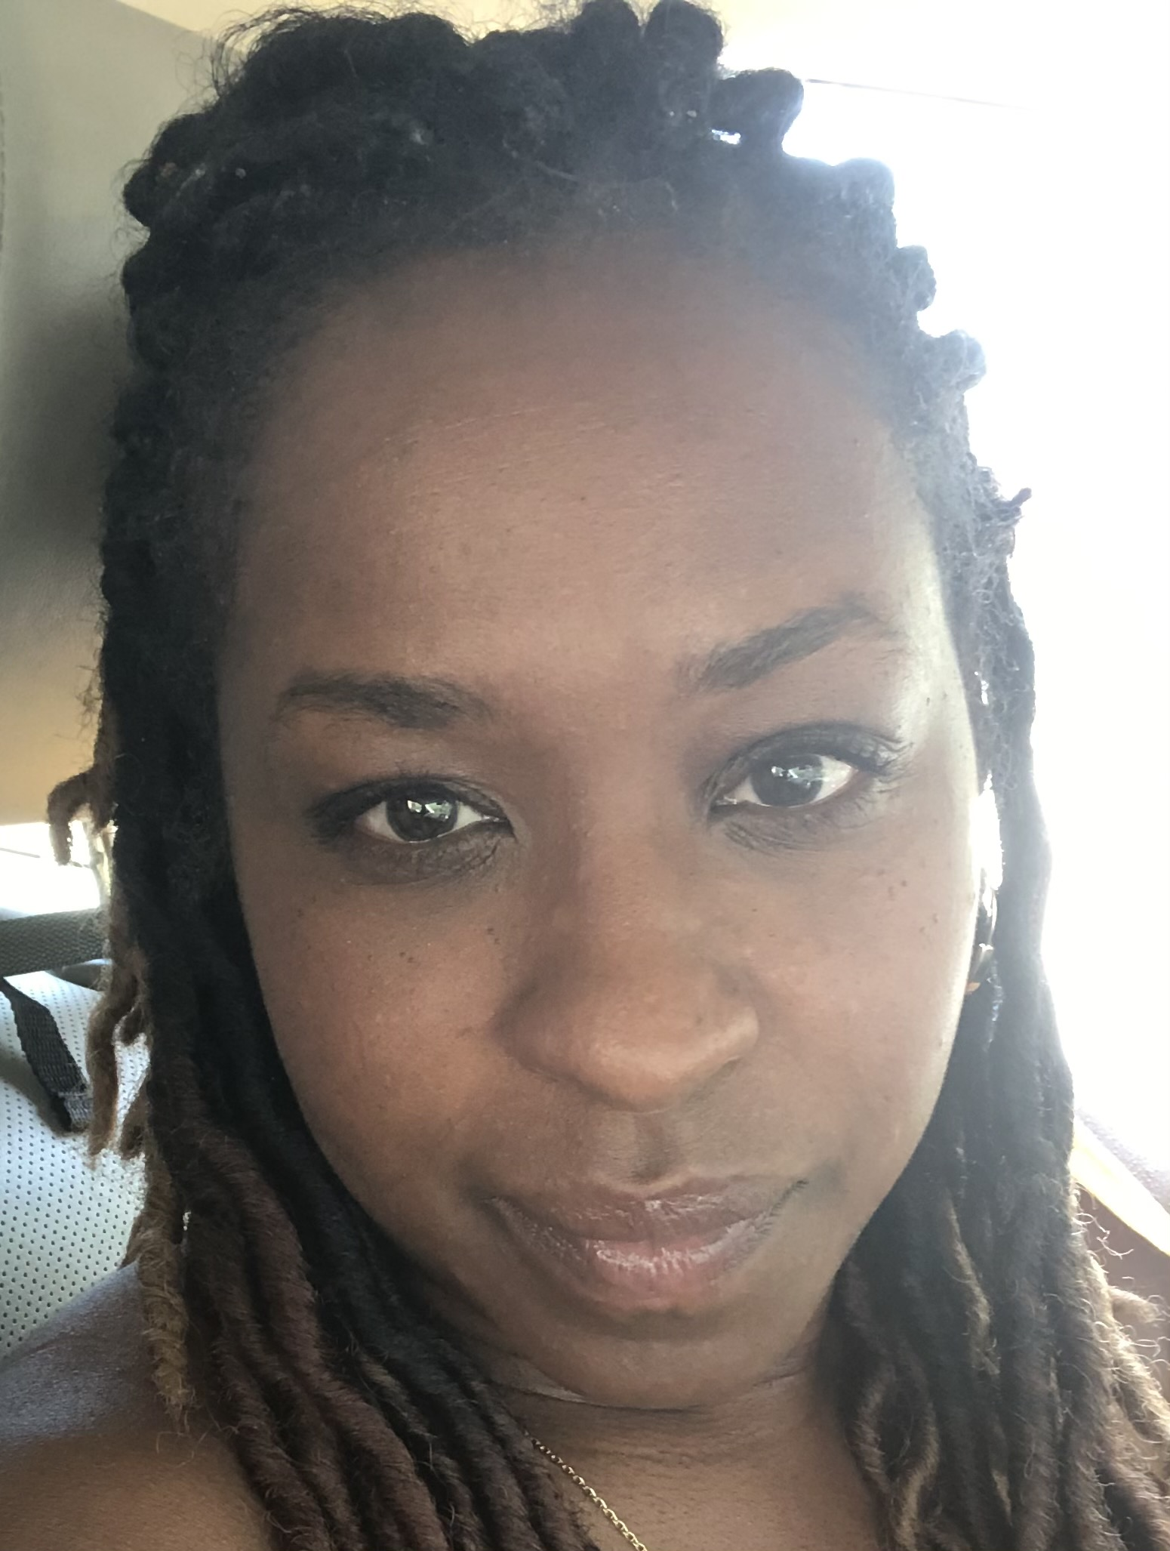
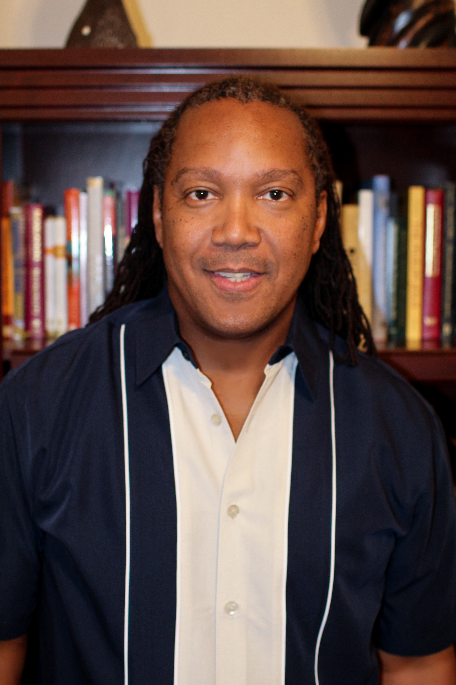
Ms. Ebony Tyree
Dr. Don “Ajene” Wilcoxson
Assistant Professor, English
San Diego City College (2017)
English Division (Reading, Writing, Composition & Literature)
Masters of Arts in English (Specialization in American Literature/Minority Literature/Feminist Literature)
San Diego State University, San Diego CA
Bachelor of Arts in English
University of San Diego, San Diego CA
Professor, Business & Entrepreneurship
Riverside City College (1998)
School of Business, Information Systems and Technology
Doctor of Ministry, Multi-Faith Theology
New York Theological Seminary, New York
Master of Business Administration, Entrepreneurship
California Baptist University, Riverside
Bachelor of Arts, Sociology
California State University, San Bernardino

Slide 28
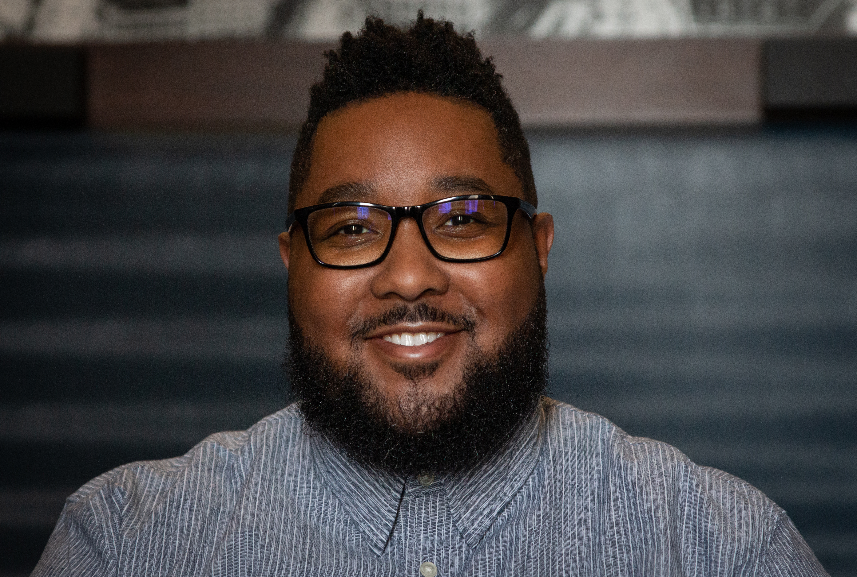
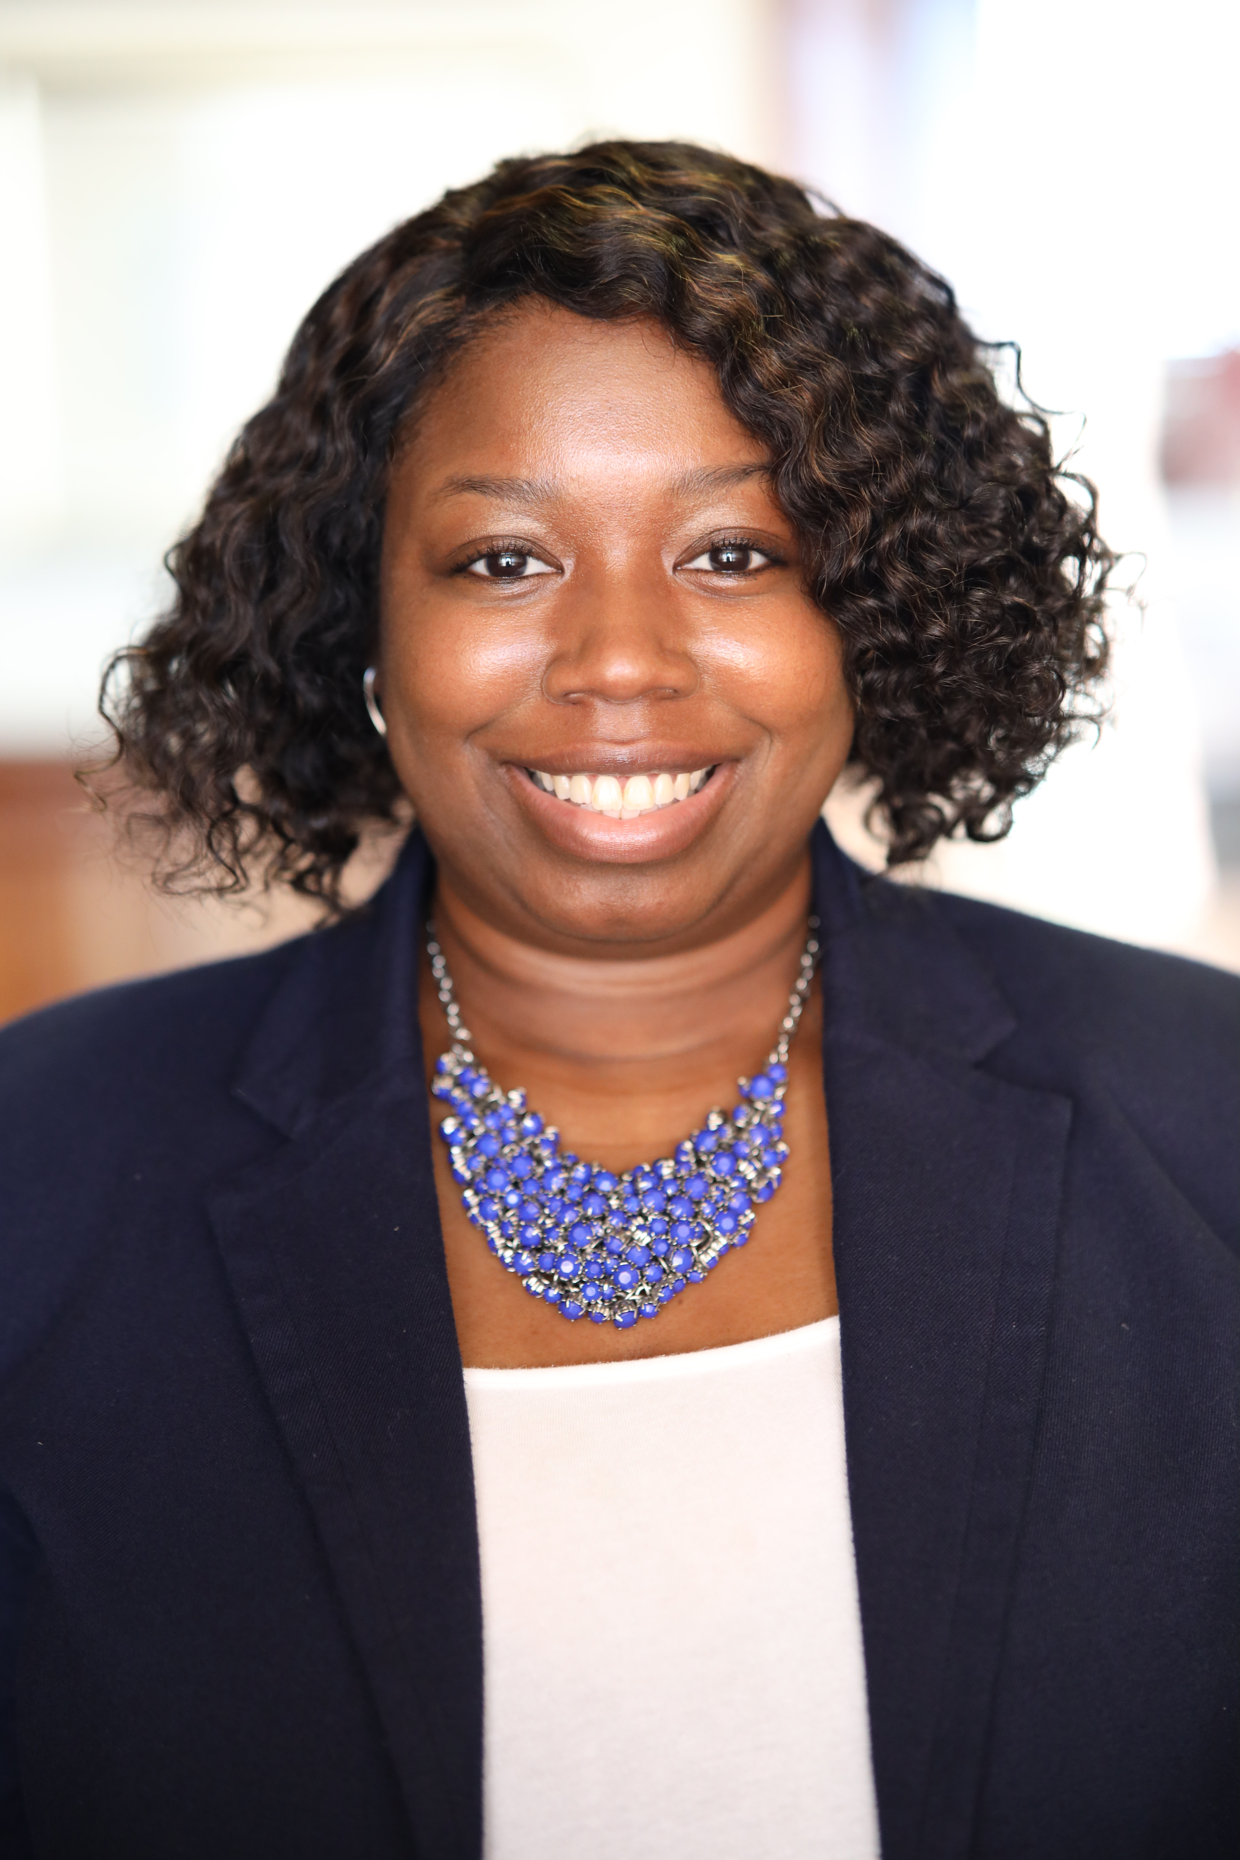
Dominique Turner
Brianna Kelly
Doctor of Philosophy, Higher Education Administration (2023)
Morgan State University, Baltimore, MD
Master of Public Administration; Management and Public Policy (2015)
Bowie State University, Bowie, MD
Bachelor of Science, Government/Political Science (2012)
Bowies State University, Bowie, MD
Director of Non-Tradition Programs
Adjunct Assistant Professor
University of Maryland Global Campus
Master of Education, Curriculum and Instruction (2023)
Claflin University, Orangeburg, SC
Bachelor of Arts, Psychology
Claflin University, Orangeburg, SC
Call Center Manager
Claflin University, Orangeburg, SC

Slide 29
Thank you! Q & A

