Slide 1
Humanizing Online Teaching & Learning: An Equity-Minded Approach
Kandace Knudson, Sacramento City College
Julie Oliver, ASCCC Area A Representative
Michelle Pacansky-Brock, CVC-OEI/@ONE
Robert L. Stewart, Jr., ASCCC Area C Representative
Transforming Organizational Cultures Through Anti-Racist Policies and Practice
Tiffany Lanoix, West Los Angeles College Sociology Faculty Julie Oliver, ASCCC Area A Representative Sharon Sampson, ASCCC Standards & Practices Committee Member Robert L. Stewart, Jr., ASCCC Area C Representative

Slide 3
Poll-Please answer in Pathable
What is your comfort level talking about racism?
Extremely comfortable
Moderately comfortable
Not at all comfortable

Slide 4
Overview of racism and antiracism
Ibram X. Kendi
How to be Antiracist (2019)
Racism
A marriage of racist policies and racist ideas that produces and normalizes racial inequities
Antiracism
A marriage of antiracist policies and antiracist ideas that lead to racial equity
There is no such thing as nonracist
Only racist and antiracist

Slide 5
Racism and Antiracism in Institutions
Racist policy
Any organizational practice that produces or systains racial inequality between racial groups
Antiracist policy
Any organizational practice that produces or sustains racial equity between groups
There is no such thing as a non-racist or race neutral policy
Very policy is producing/sustaining racial equity or inequity
Micro and macro levels
Personal and institutional
Most effective in combination with one another

Slide 6
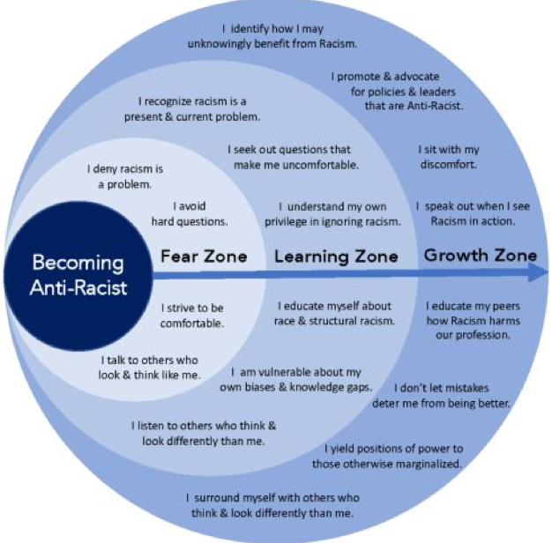
Becoming an Antiracist
Source: https://www.irondequoitlibrary.org/anti-racism-resource-page/

Slide 7
Becoming an Antiracist Institution
Fear Zone
Denying racism is a problem in our institution
Avoid hard questions
Strive to be comfortable
Learning Zone
Recognizing racism as a present & current problems in our institution
Sek out uncomfortable questions
Educate ourselves and race and structural racism
Recognize implicit biases & knowledge gaps

Slide 8
Becoming an Antiracist Institution
Growth Zone
Promote & enact policies & leaders that are explicitly antiracist
Sit with our discomfort
Speak out when we see racism in action
Educate our peers about how racism harms our profession, students and institution
Do not allow mistakes to deter us from bing and doing better
Yield positions of power to marginalized groups
Adopt an intersectional approach to address the complexity of students lived experiences

Slide 9
Poll-Please answer in Pathable
Becoming Anti-racist, where is your college/district?
Fear Zone
Learning Zone
Growth Zone

Slide 10
Despite attempts to attend to racial problems, United States higher education has not come very far in addressing systems of White dominance
(Alvarez McHatton, Keller, Shircliffe, & Zalaquett, 2009; Dodge & Jarratt, 2013; Stage & Hammrick, 1994).

Slide 11
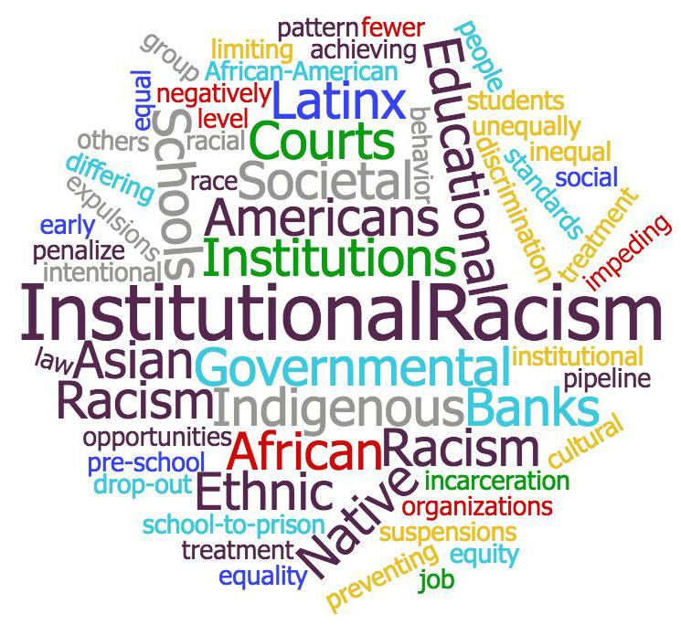
“Racism is a much more clandestine, much more hidden kind of phenomenon, but at the same time it's perhaps far more terrible than it's ever been.”
Angela Davis

Slide 12
Is "any institutional policy, practice, and structure in government agencies, businesses, unions, schools and universities, places of worship, courts, and law enforcement agencies that unfairly subordinate People of Color….." (Sue, 2006).
Institutional Racism

Slide 13
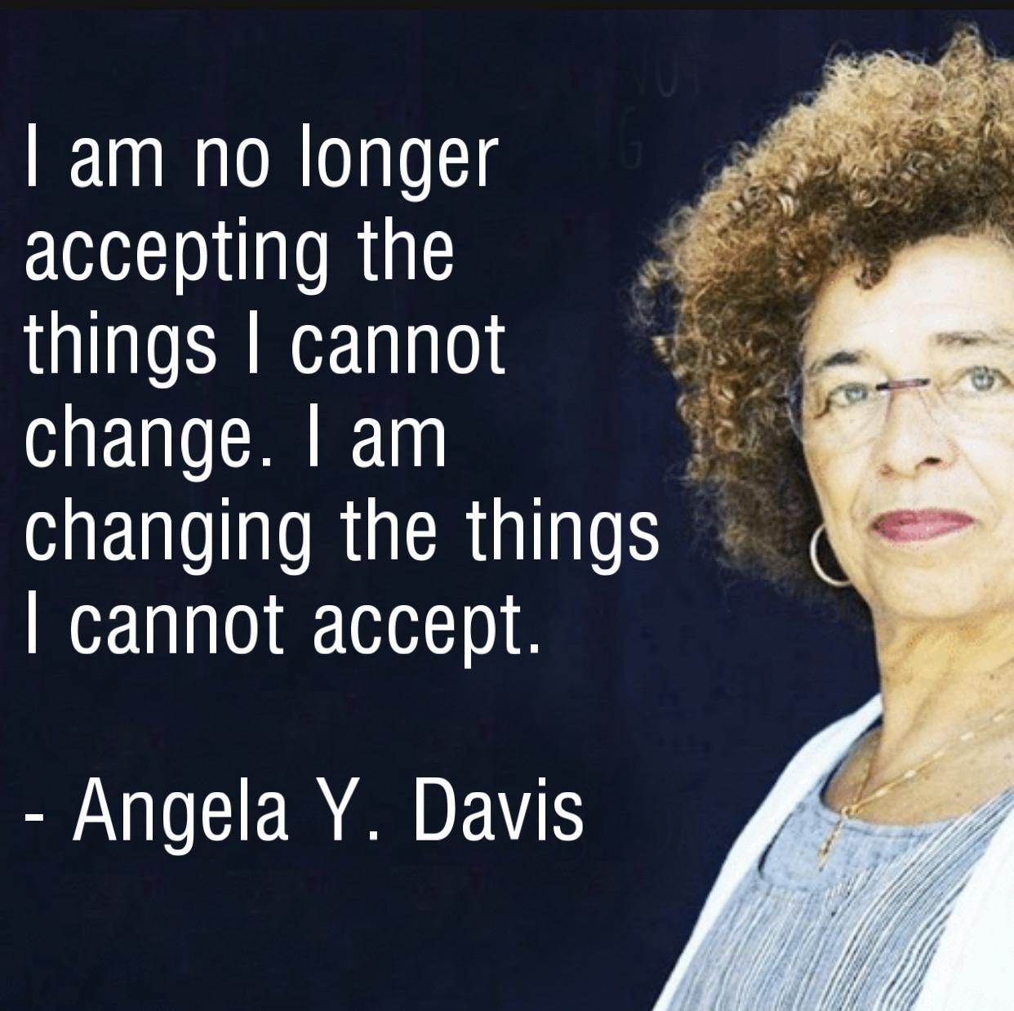
So, how can you as an individual contributor, actively engage in dismantling racism?
Freedom is a Constant Struggle: Ferguson, Palestine, and the Foundations of a Movement by Angela Y. Davis

Slide 14
Racism is systemic, yet we know the system includes individual people who perpetuate biases.
“Significant in the debate about racism and academic is that the issue of individual culpability is conflated with heady invocations of academic freedom, censorship and free speech.
So raising … issues of racism is immediately reduced to a stifling political correctness. … (and) the consequences of (racist) ideas being expressed are sidestepped.”
Les Back in Law et al (2004) “Ivory Towers? The Academy and Racism” p 3

Slide 15
Faculty
Staff
Challenging the System
Board of Governors
Administrators

Slide 16
Most forms of institutional racism are often disguised in standard operating procedures (SOPS) that are applied equally to everyone in institutional and organizational settings.
Michael D'Andrea and Judy Daniels

Slide 17
Leadership
Academic leadership “should incorporate into their annual work responsibilities the process of learning the racial history of whiteness.
Academic leadership should learn the way whiteness impacted the inception of their institutions, and personal work related to their own conscious and unconscious biases.
An assessment should be conducted of the present state of understanding and the growth for each leader to move closer to a conscious understanding of racial biases to change behaviors and the processes of making institutional decisions.
Race and Pedagogy Journal, vol. 4, no. 3 (2020)

Slide 18
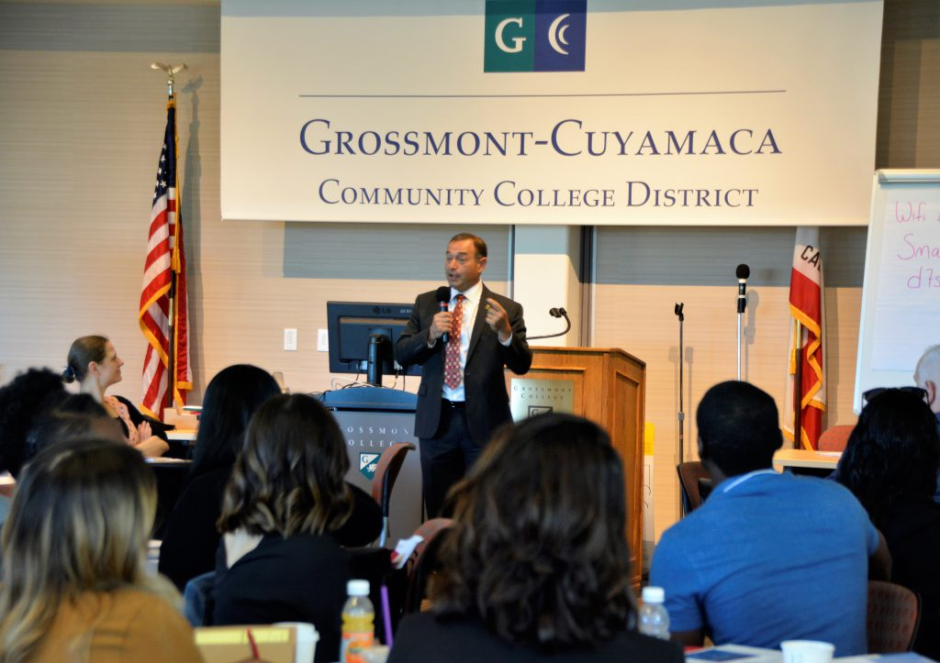
A Call to Action-Leadership
Grossmont~Anti-racism Task Force
Goals and objectives are to address the following:
Culture-Antiracism Campus Climate
Curriculum
Professional Development
Human Resources: Review Hiring Practices

Slide 19
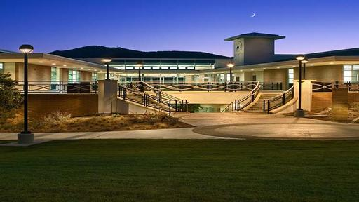
Behind the Institution

Slide 20
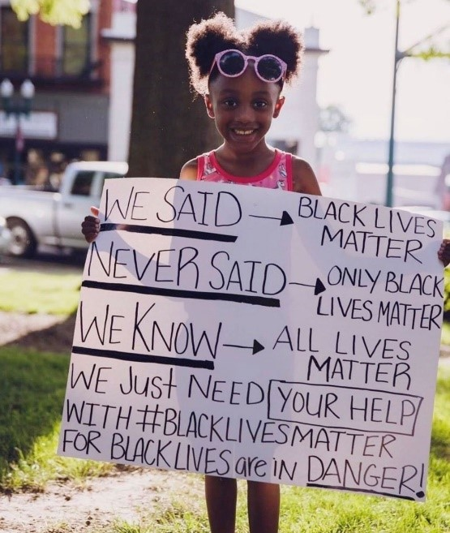
What legacy would you like to leave?

Slide 21
What should you review at your college/district?
Policy & Procedures
Regulations
Practices
Mission-Vision-Values
Committee Charges
Curriculum, Pedagogy/Andragogy

Slide 22
What are your thoughts now?
What’s Next?
Link to Journal
https://docs.google.com/document/d/1AkMtLIVZKMy9eGppR2mhhHsntdNNOtTAaU5uBTPzP3w/edit?usp=sharing

Slide 23
Thank you & Questions
info@asccc.org

Slide 24
Resources
D'Andrea, M., & Daniels, J. (2003, February). White supremacy, racism, and multicultural competence. Counseling Today, 45, 26/28.
Harper, Shaun R., Davis,Ryan J., & Hurtado, Sylvia (2010) Racial and Ethnic Diversity in Higher Education. Pearson Learning Solutions.
Jones, J. M., & Carter, R. T. (1996). Racism and White racial identity: Merging realities. In B. P. Bowser & R. G. Hunt (Eds.), Impacts of racism on White Americans (p. 1–23). Sage Publications, Inc.
Kendi, Ibram X. (2019) How to be an anti-racist. Penguin Random House.
Sue, D. W. (2006). The invisible Whiteness of being: Whiteness, White superiority, White privilege, and racism. In M. G. Constantine & D. W. Sue (Eds.), Addressing racism: Facilitating cultural competence in mental health and educational settings (pp. 15-32). Hoboken, NJ: John Wiley & Sons.

