Slide 1
The Community College Budget or Where Money Comes From
Ginni May, ASCCC Treasurer
Mario Rodriguez, Los Rios Community College District, AVC Finance
Faculty Leadership Institute, Sheraton Grand Sacramento
June 13, 2018, 2:30-3:30 pm

Slide 2
Description
The Student Centered Funding Formula (SCFF) has been front and center in conversations about the California Community College budget. What is the SCFF, how is the money allocated, and is the allocation changing? In order to better understand some of the debate around the SCFF, and to ensure budgetary decisions are made to best serve students, faculty leaders should understand how the budget works at the state and college/district levels. During this session, the presenters will talk about where money comes from, where money goes, and what faculty leaders should watch for.

Slide 3
Overview
Where does the money come from?
Community College Budget: State level
Where does the money go?
Community College Budget: District level
The Student Centered Funding Formula
What do academic senate leaders need to watch for?
Questions and Comments

Slide 4
California Community College Budget
January 10 Governor’s Budget Proposal
May Revise
Assembly, Senate consider → Conference Committee resolves differences
Simple majority vote in each house to pass, June 15 is deadline
To Governor to sign (or veto)
Notes:
Prop 25 of 2010 permitted the simple majority

Slide 5
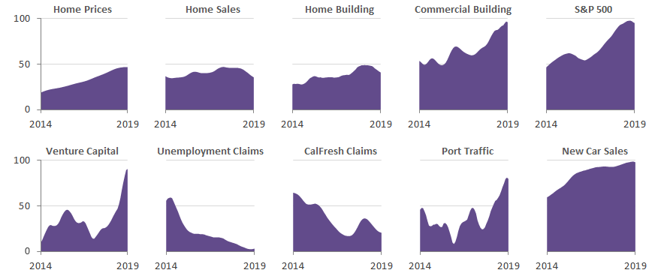
State Economic Indicators

Slide 6
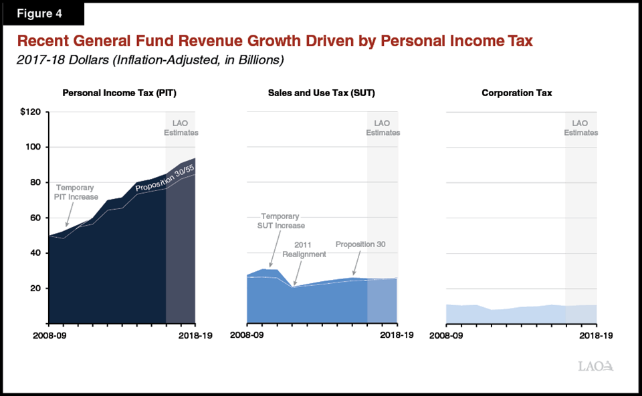
State Revenues

Slide 7
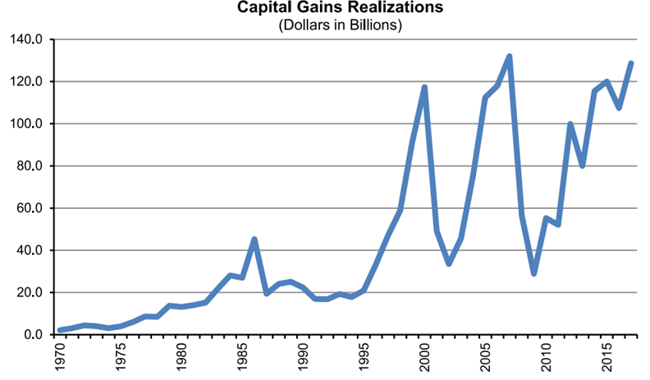
Capital Gains Revenue

Slide 8
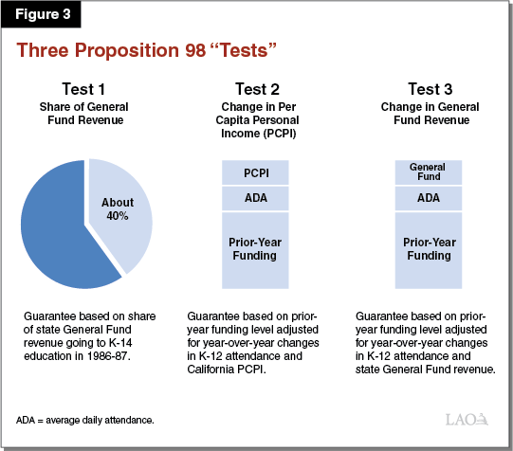
Proposition 98 - “Tests”

Slide 9
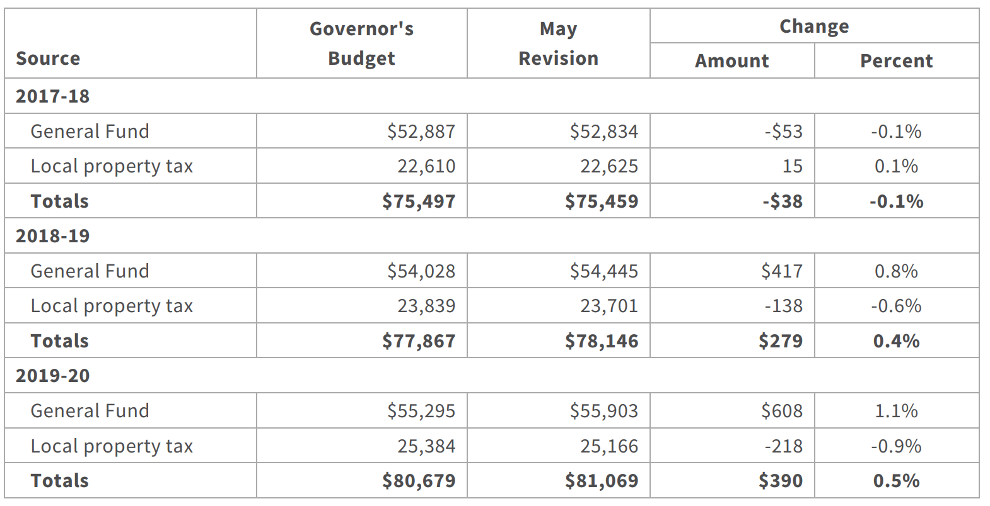
Proposition 98 - May Revision

Slide 10
State Budget Process

Slide 11
2019-20 May Revision Adjustments

Slide 12
Student Centered Funding Formula
Three Components
Base Allocation – promote broad access
Supplemental Allocation – address barriers to access and success for low-income students
Student Success (Performance) Allocation – encourage progress on outcomes linked to goals in the Vision for Success
Allocation
Year | 2018-19 | 2019-20 | 2020-21 | 2021-22
Base | 70% | 70% | 60% | 60%
Supplemental | 20% | 20% | 20% | 20%
Student Success/Performance | 10% | 10% | 20% | 20%
Notes:
Allocations are changing to allow colleges to adjust

Slide 13
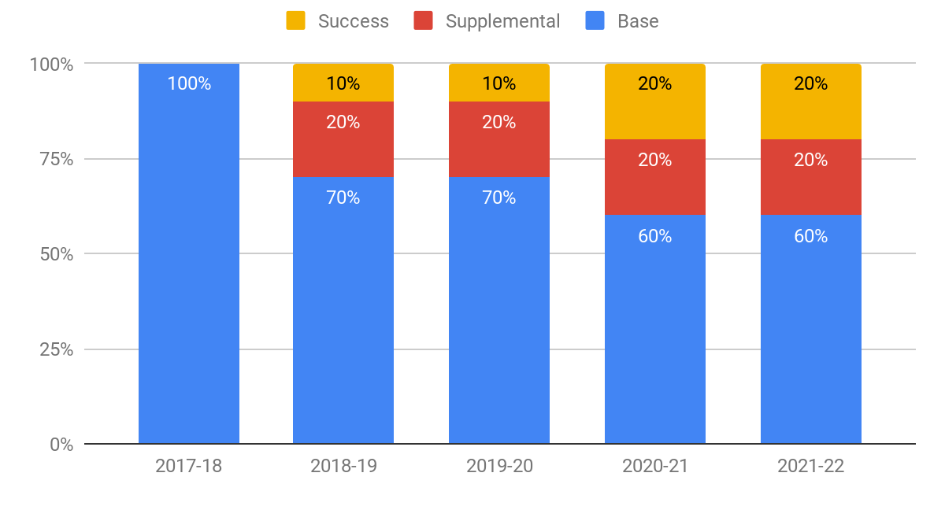
SCFF Calculation - Phased In

Slide 14
SCFF – Performance Metrics
The Point System
 | Outcome | Points
1 | Associate Degree for Transfer | 4 (per degree)
2 | Local Associate Degree | 3 (per degree)
3 | Baccalaureate Degree | 3 (per degree)
4 | Credit Certificate (16 or more semester units, 24 or more quarter units) | 2 (per certificate)
5 | Completion of transfer-level math and English during student’s first academic year | 2 (per student)
6 | Successful transfer to a 4-year institution | 1.5 (per student)
7 | Completion of 9 or more CTE units | 1 (per student)
8 | Attainment of a Regional Living Wage | 1 (per student)

Slide 15
2018-19 SCFF Funding

Slide 16
SCFF Calculation - Entitlement and Revenue

Slide 17
Excess Tax School Entity (Basic Aid)
Higher offsetting revenues (local property tax and student enrollment fees) than apportionment entitlement (SCFF calculation).
Only 6 CCDs in the state (Marin, South Orange, Mira Costa, West Valley-Mission, San Jose-Evergreen, San Mateo).
They get to keep all of the property tax, which means they have a higher per student funding level.
They may be less likely to have a bond program (conservative voters).
They may have formulas that tie property tax changes to compensation changes.

Slide 18
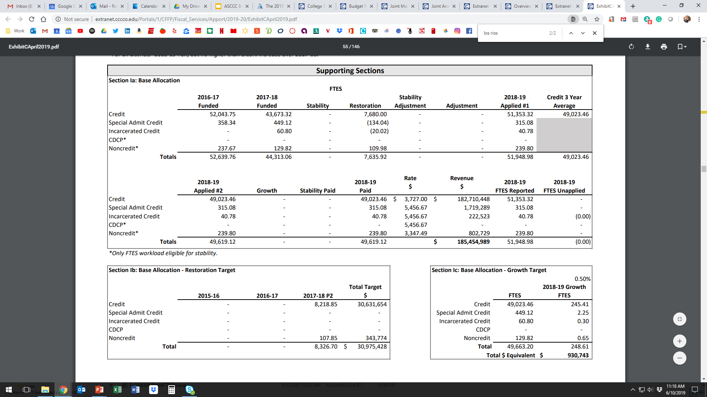
SCFF Calculation - FTES

Slide 19
SCFF Calculation - Basic and Supplemental

Slide 20
SCFF Calculation - Student Success

Slide 21
ASCCC Recommendations on SCFF
If the state of California must keep the performance metric*…
Letter to legislature on “Revisiting the Student Centered Funding Formula to Incentive Student Focused Outcomes”
Level the point system for associate degree awards so that all educational goals and achievements of comparable unit values are counted equally.
Award colleges only once per year per student for the highest award achieved as a means of prioritizing per-student success, as opposed to incentivizing maximizing awards more generally.
Keep the performance metric portion set at 10% of the total allocation to ensure funding stability and to support college exploration of how best to serve students.
*The ASCCC has long standing positions in opposition to performance-based funding…

Slide 22
Current Expense of Education (50% Law)
Education Code § 84362
Only the Unrestricted General Fund
Numerator
Full-time and part-time instructors salaries and benefits
Instructional aides salaries and benefits
Denominator
Non-instructional salaries and benefits
Supplies and materials
Other operating expenses
Exclusions
Instructional staff-retirees’ benefits and retirement incentives; Student health services above amount collected; Student transportation; Non-instructional staff-retirees’ benefits and retirement incentives; Rents and leases; Lottery expenditures; Capital expenditures

Slide 23
Full-time Equivalent Students - Timeline

Slide 24
Full-time Equivalent Students - Terminology
Stability: “Guaranteed” funding for 1 year. By end of the subsequent year, college must achieve original FTES goal or lose funding.
Restoration: Entitled to restore base funded FTES during three years following year of initial decrease.
Summer shift: For summer intersession daily census courses that cross fiscal years, associated FTES are to be reported in the fiscal year in which the census date falls or when the course ends.
Term length multiplier: Number of weeks in primary term with at least three days of instruction and/or examination.
Census day: The day of the class meeting that is nearest 20% of the number of days the course is scheduled to meet.

Slide 25
Full-time Equivalent Students - Calculation
Multiply Census Week WSCH by the TLM and divide by 525
FTES = (CWSCH x TLM) / 525
Example:
Class meets 3 hours/week
24 students enrolled on Census Day
TLM = 17.5
FTES = (3 x 24 x 17.5) / 525 = 2.40

Slide 26
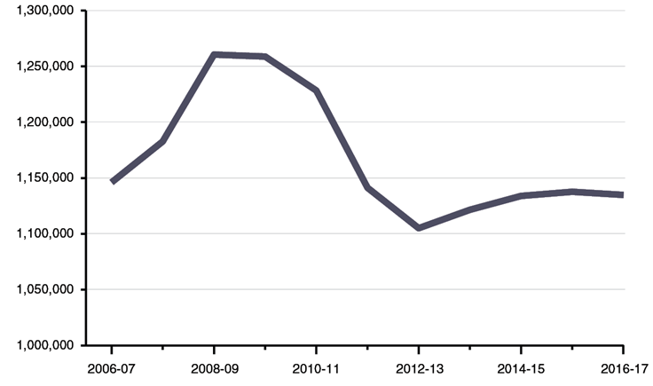
Full-time Equivalent Students - Trends

Slide 27
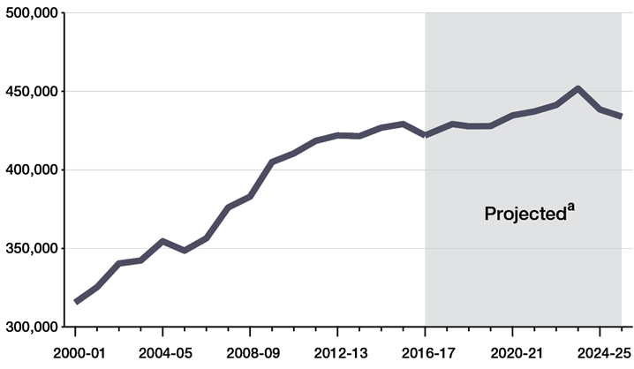
Full-time Equivalent Students - HS Graduates

Slide 28
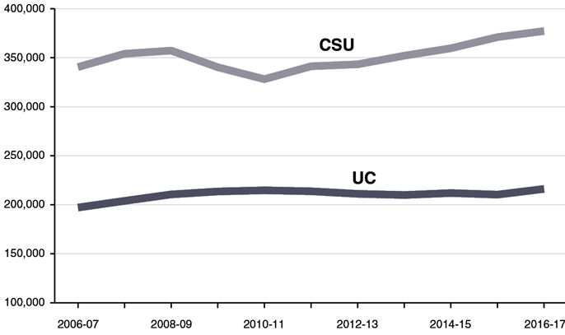
Full-time Equivalent Students - UC/CSU Enrollments

Slide 29
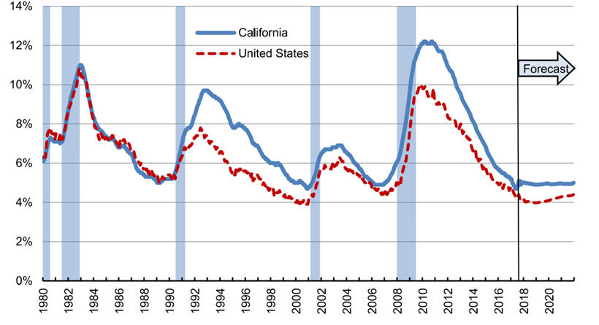
Full-time Equivalent Students - Unemployment %

Slide 30
Faculty Obligation Number (FON)
Title 5 §§ 51025 and 53311
AB1725 (passed in 1988) established a goal to reach 75% of instructional hours to be taught by full-time faculty
Includes all tenured and tenure track positions (instructional and non-instructional)
Does not matter the funding source (unrestricted general fund, restricted funds, etc.)
Compliance based on each CCDs FON in 1988-1989
Increased proportionally with funded credit FTES
Compliance FON is the lower of Advance FON or P2 FON

Slide 31
Title 5 §53200 or The “10+1”
(c) “Academic and professional matters” means the following policy development and implementation matters:
(1) thru (9)
(10) processes for institutional planning and budget development; and
(11)
(d) “Consult collegially” means that the district governing board shall develop policies on academic and professional matters through either or both of the following methods, according to its own discretion:
(1) relying primarily upon the advice and judgment of the academic senate; or
(2) agreeing that the district governing board, or such representatives as it may designate, and the representatives of the academic senate shall have the obligation to reach mutual agreement by written resolution, regulation, or policy of the governing board effectuating such recommendations.

Slide 32
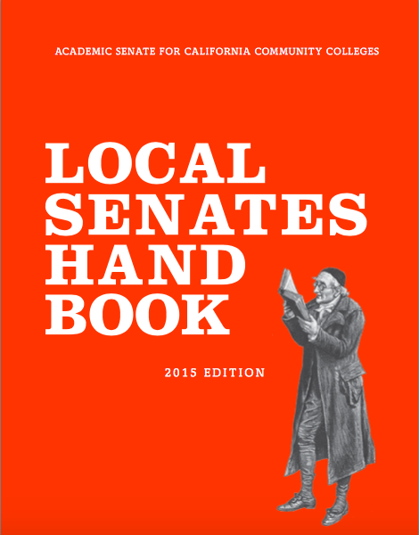
From Local Senates Handbook
Secure Resources to Ensure Senate Success
Work with the local administration to identify the types of budget resources, such as reassigned time or travel, available to the senate.
Notes:
There may be other budget items that senates are responsible for such as clerical staff, equipment and supplies – not all colleges have this.

Slide 33
From Local Senates Handbook
Secure Resources to Ensure Senate Success
Work with the administration to put in writing any budget agreements to fund the senate. Informal agreements have a habit of disappearing with rapidly shifting administration members.
Notes:
And academic senate leaders – documenting agreements is crucial

Slide 34
From Local Senates Handbook
Secure Resources to Ensure Senate Success
Justify to the college administration why inadequate resources may harm students, accreditation, campus climate, and effective participatory governance in order to convince the college to increase resources.
Notes:
Reassigned time, travel funds, professional development funds, supplies, funds to host events, and such

Slide 35
ASCCC Resolutions
Resolution 5.02 Spring 2019 – Guided Pathways Budget Development
Resolution 5.03 Spring 2018 – Develop Resources with Guidance Relevant to the Student Centered Funding Formula
Resolution 17.01 Spring 2017 – Academic Senate Involvement in and Sign-off on Grants and Initiative Plans
Resolution 6.05 Fall 2016 – Direct Strong Workforce Funding to Districts (not through regional consortium)
Resolution 11.02 Spring 1999 – Use of Technology Money (sign-off by the local academic senate president)
Resolution 12.04 Spring 1996 – Staff Diversity Funds (local senate president sign off on reports to CCCCO)
More…
Notes:
5.02 S19 - Resolved, That the Academic Senate for California Community Colleges urge local academic senates to ensure proper collegial consultation and transparency in developing guided pathways budget processes, including supporting comparability between collegesin multi-college districts;
5.03 S18 - Resolved, That the Academic Senate for California Community Colleges develop resources with guidance regarding assessing and monitoring sources of information relevant to the Student Centered Funding Formula and ensuring local budgeting processes respect academic integrity and academic expertise; and
Resolved, That the Academic Senate for California Community Colleges update the paper Budget Considerations – A Primer for Senate Leaders (2009) with guidance regarding assessing and monitoring sources of information relevant to the Student Centered Funding Formula, including best practices for local budgeting processes, and bring the updated paper to the Spring 2020 Plenary Session for adoption.
17.01 S17 - Resolved, That the Academic Senate for California Community Colleges urge local senates to remain vigilant in their contributions to and review of grants, programs, and initiatives that fall under the purview of academic and professional matters; and
Resolved, That the Academic Senate for California Community Colleges urge the Chancellor’s Office to include mechanisms, including a local academic senate signoff, that ensure local senate involvement in and approval of all state grants, programs, and initiatives that fall under the purview of academic and professional matters.

Slide 36
Student Success (Performance) Metrics
Student Success or Performance Metric – 8 Outcomes
associate degrees for transfer (ADT) granted,
associate degrees granted (excluding ADTs),
baccalaureate degrees granted,
credit certificates (16 units or more) granted,
completion of transfer-level mathematics and English courses in first year of enrollment*,
successful transfer to a four-year university*,
completion of nine or more CTE units*, and
attainment of a regional living wage*
*How are these interpreted?
Notes:
Stay up-to-date on how these are interepreted

Slide 37
The FON, 50% Law, and 75:25
FON (1989) – Fulltime Faculty Obligation Number
Ed Code §87482.6 and CCR Title 5 §51025 requires districts to increase the number of full time faculty over the prior year in proportion to the amount of growth in funded credit FTES.
Based on credit funded FTES
Baseline Compliance established based on local FON in 1988-89
50% Law (1961) – Ed Code §84362(d) requires that 50% of district’s current expense of education be for salaries of classroom instructors
75:25 – AB 1725 (Vasconcellos,1988) Established a goal that 75% of instructional hours be taught by full time faculty.

Slide 38
Faculty Roles in Budget Processes…
College and district budget committees
Academic Senate President Signature on statewide grants and initiatives:
Guided Pathways
Student Equity and Achievement (SEA) Program
Others
Curriculum Implications
Student Centered Funding Formula—Performance-based Funding:
New degrees and certificates must meet needs of students and community
AB 705 Implementation:
Watch enrollment trends,
Monitor student success and persistence
Notes:
Guided Pathways Scale of Adoption

Slide 39
Questions and Comments

